Slide 1
SALES DATA ANALYSIS USING
PYTHON
Personal Project Presentation
Submitted by
SOWMIYA M
BCA – Data Science
SRM Institute of Science and Technology
Academic Year: 2024–2027

Slide 2
PROJECT OBJECTIVE
The main objective of this project is to analyze sales data using Python and understand sales performance.
Objectives:
To analyze sales data.
To find total sales and average sales.
To identify top-selling products.
To create charts for easy understanding.
To find useful insights from the data.
Tools Used: Python, Pandas, Matplotlib, Google Colab

Slide 3
DATASET SUMMARY
Dataset Details:
Total Records: 200
Total Orders: 200
Total Quantity Sold: 1,053
Total Sales: ₹23,969,616
Average Sales: ₹119,848.08
Dataset Columns:
Order ID
Product Name
Quantity
Price
Sales
Tools: Python, Pandas, Google Colab

Slide 4
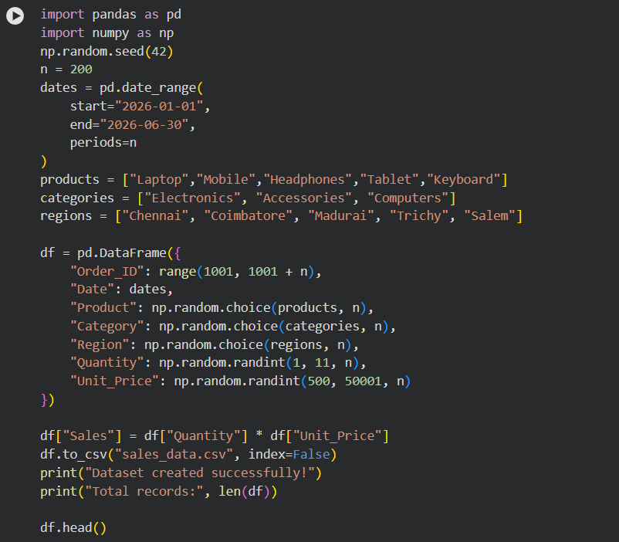
Python Code and Outpu

Slide 5
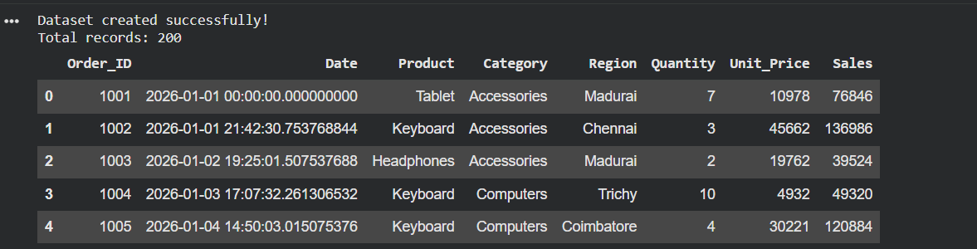
OUTPUT:

Slide 6
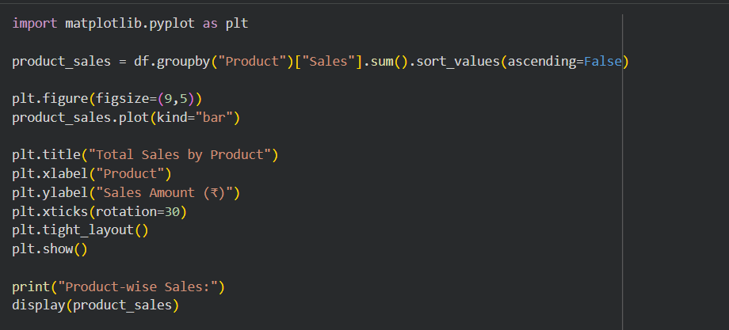
Total Sales by Product code
Total Sales by Product:

Slide 7
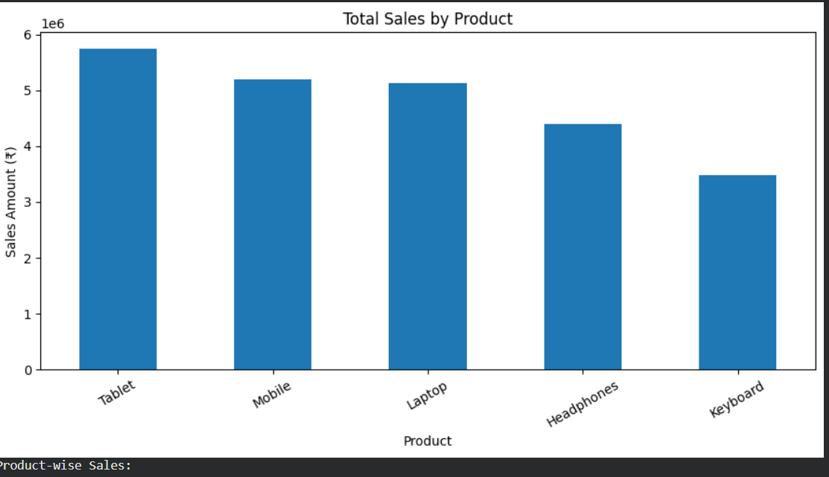
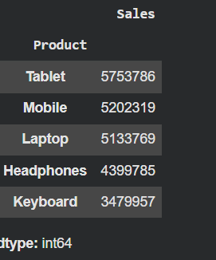
Output:

Slide 8
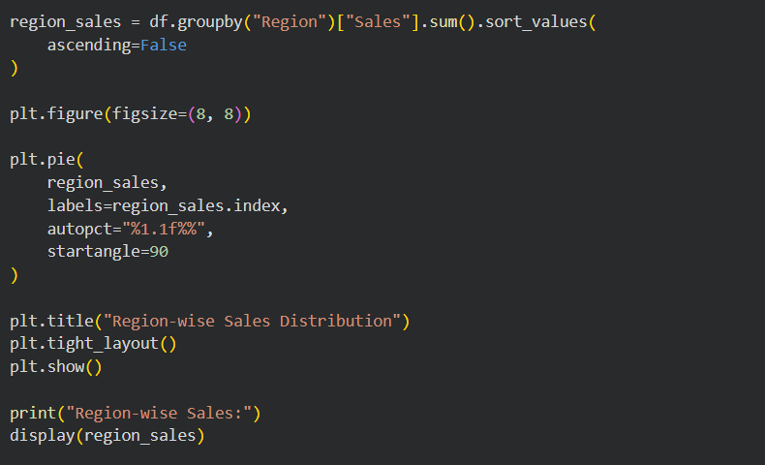
Region-wise Sales Distribution

Slide 9
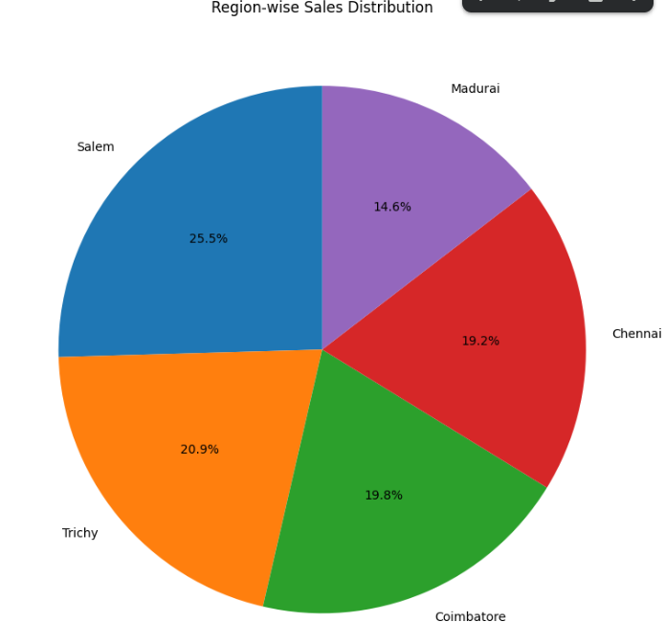
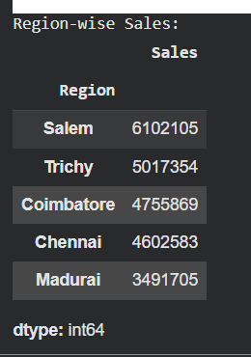
Output:

Slide 10
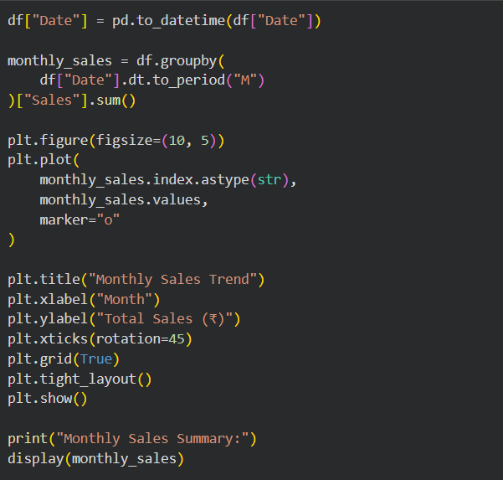
SALES DATA VISUALIZATION

Slide 11
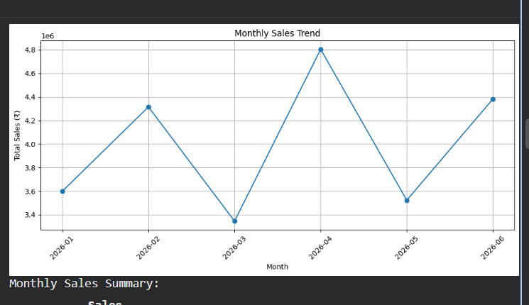
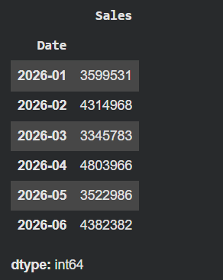
Output:

Slide 12
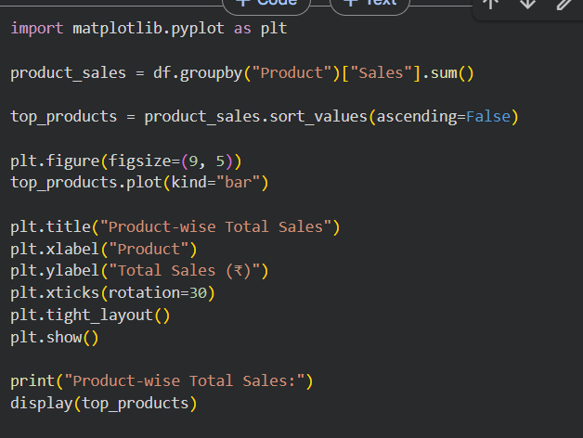
Product-wise Total Sales:

Slide 13
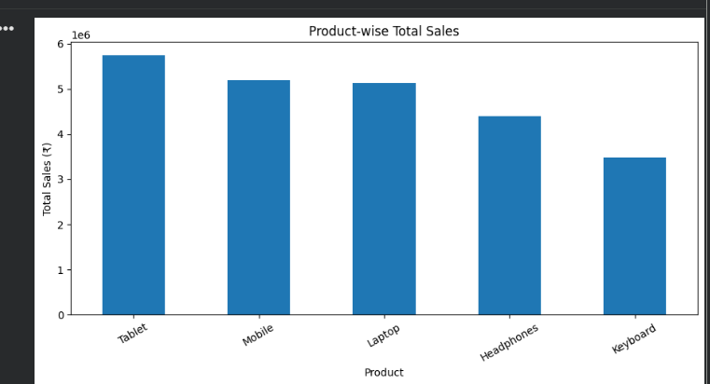
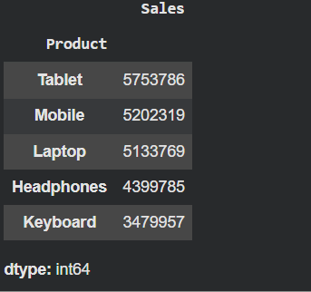
Output:

Slide 14
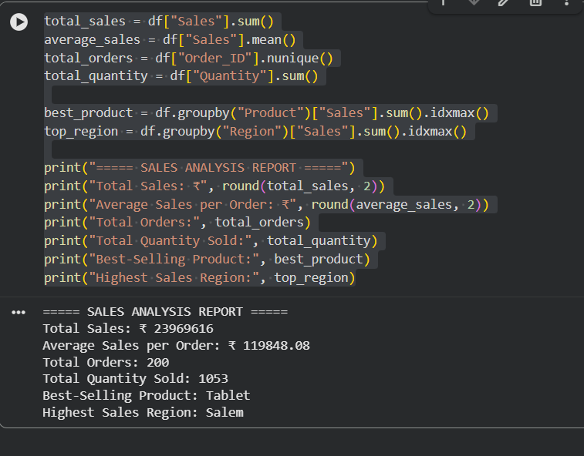
Sales Analysis Report:

Slide 15
CONCLUSION:
This project helped me understand sales data using Python.
Analyzed sales data using Pandas.
Calculated total sales and average sales.
Identified the best-selling product and highest sales region.
Created charts to understand sales trends.
Learned how to analyze data and present results visually.
THANK YOU
Presented by Sowmiya M

