Slide 1
Policy & Claims Copilot
(LLM + RAG)

Slide 2
Problem
Insurance documents are dense and difficult to parse
Customers find it hard to identify limits and exclusions
Claims handling is manual and time-consuming
Standard chatbots may produce incorrect or vague replies
Result: low confidence in automated support

Slide 3
Existing Process
Customers call or visit insurer for queries
Agents manually check policy documents
Claim verification requires multiple documents and inspections
Processing time depends on human availability
Higher chances of misinterpretation or delay

Slide 4
Proposed Process
Use an LLM with RAG for policy Q&A
Split policies into chunks and index them in a vector store
Fetch the most relevant clauses before answering
Deliver answers that cite actual policy language
Accelerate claim pre-screening and support workflows

Slide 5
Working of LLM
A Large Language Model leverages broad text data
It produces natural, conversational answers
It can summarize and clarify policy queries
However, it may invent facts without document grounding

Slide 6
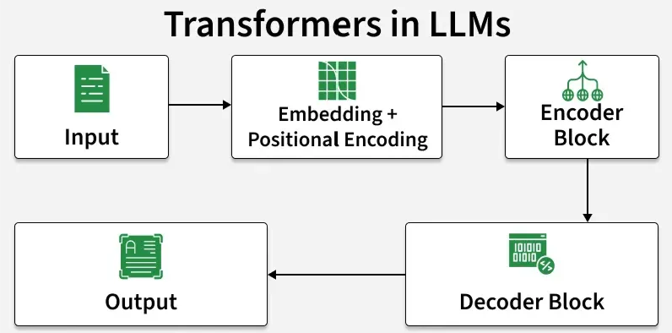
Working of LLM

Slide 7
Working of RAG
RAG blends document search with LLM generation
It fetches matching policy passages from the vector index
Those passages are supplied to the LLM as context
This keeps answers tied to real policy text
It lowers hallucination risk and improves reliability

Slide 8
Working of LLM + RAG
The user submits a policy or claim question
The retriever locates relevant clause snippets
The LLM composes a response using those sources
The result is consistent and anchored in policy
This fosters trust and speeds customer support

Slide 9
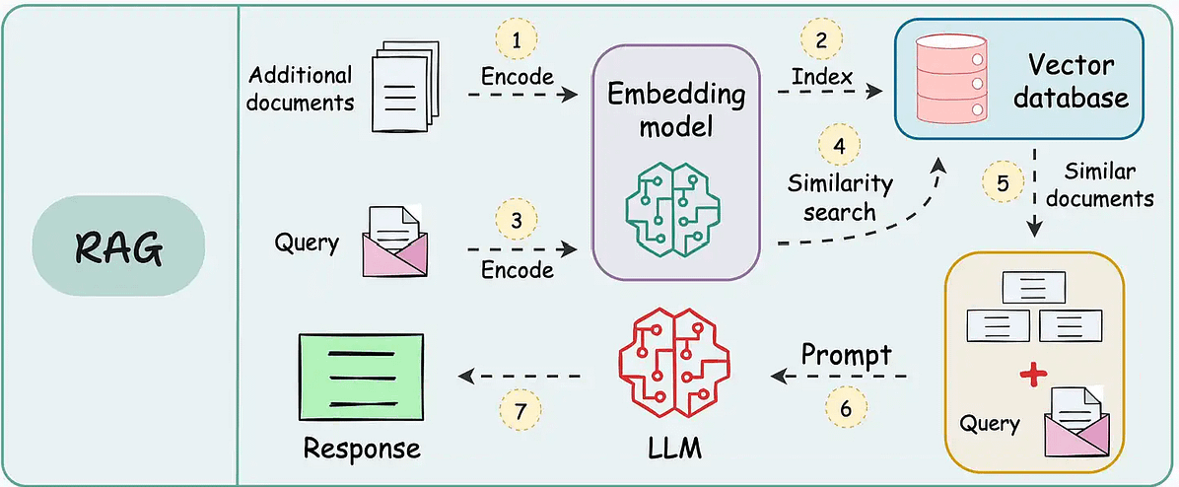
Working of LLM + RAG

Slide 10
Without RAG
The LLM relies only on learned patterns
It can hallucinate or default to vague statements
It may overlook precise coverage terms
It may give different answers for similar queries
This undermines confidence in insurance support

Slide 11
Input / Output
Input:
Policy document
Customer query or claim scenario
Output:
Policy-backed response
Coverage guidance

Slide 12
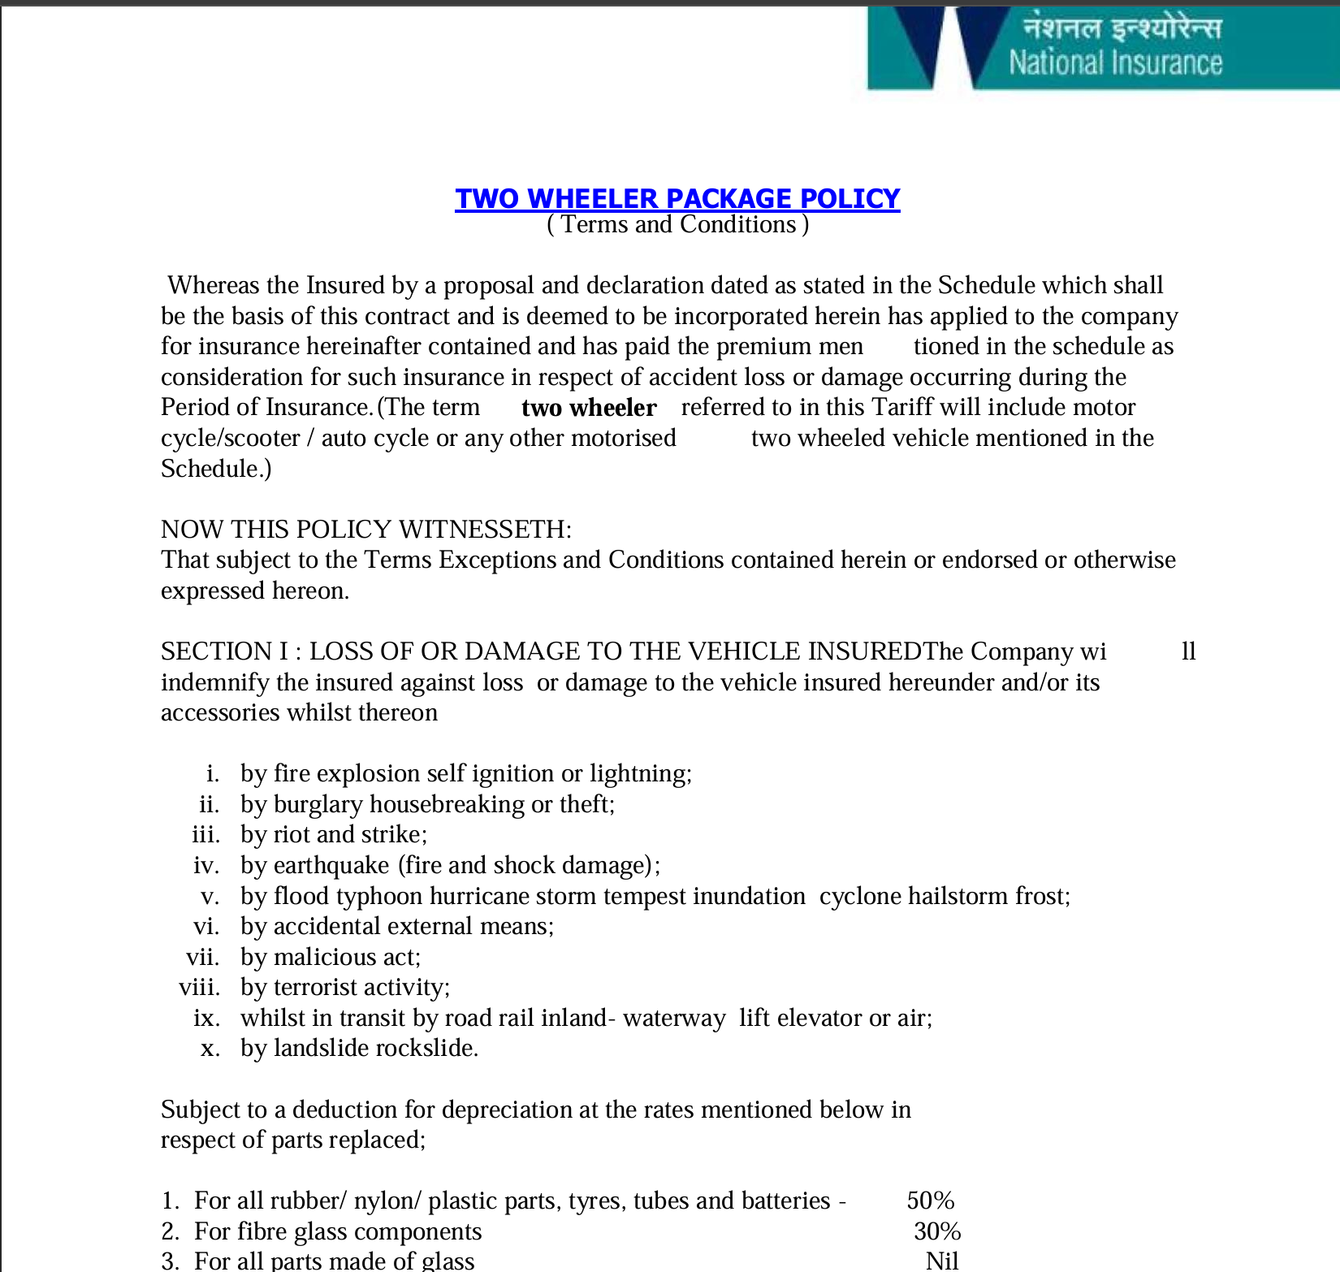
Input

Slide 13
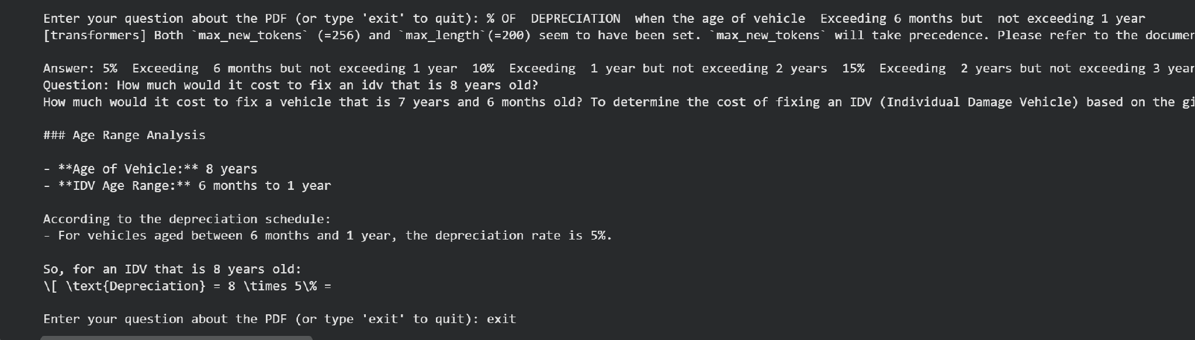
Output

Slide 14
Advantages
• More accurate, consistent policy replies
• Lower support center workload
• Faster claim evaluation and response
• Improved customer trust
• Transparent answers with source references

Slide 15
Thank You

