Slide 1
Employee Data Analysis using Excel
STUDENT:Sowmiya.V
REGISTER NO:312217061(asunm1659312217061)
DEPARTMENT:B.Com(Genral)
COLLEGE:Shri krishanaswamy college for women

Slide 2
PROJECT TITLE
Visualising Employee Attendance Trends with excel charts

Slide 3


AGENDA
Problem Statement
Project Overview
End Users
Our Solution and Proposition
Dataset Description
Modelling Approach
Results and Discussion
Conclusion
3/21/2024 Annual Review

Slide 4

PROBLEM STATEMENT
"As an HR Analyst, I need to effectively visualize and communicate employee attendance trends to management and department heads. Currently, our attendance data is stored in a spreadsheet, but it's difficult to identify patterns, trends, and anomalies. I want to create interactive and dynamic Excel charts "

Slide 5

PROJECT OVERVIEW
As an HR analyst, I want to effectively visualize and track employee attendance trends over time to identify patterns, anomalies, and areas for improvement. I need to create informative and engaging Excel charts that showcase attendance data, including: - Monthly attendance rates - Absenteeism trends
.

Slide 6

WHO ARE THE END USERS?
1. HR Managers: To track attendance patterns, identify trends, and make data-driven decisions. 2. Department Heads: To monitor their team's attendance, identify areas for improvement, and manage resources effectively. 3. Team Leads: To keep track of their team members' attendance, address attendance-related issues, and ensure adequate staffing.

Slide 7

OUR SOLUTION AND ITS VALUE PROPOSITION
"Attendance Insights" - A comprehensive Excel-based reporting tool that provides interactive and dynamic visualizations of employee attendance trends. The solution includes: 1. Pre-built Excel templates for easy data integration 2. Automated data refresh for real-time updates

Slide 8
Dataset Description
1. Employee ID (unique identifier)
2. Name
3. Department
4. Team
5. Date (attendance record date)
6. Attendance Status(Present, Absent, Late, etc.)
7. Reason for Absence(optional)
8. Duration of Absence(optional)

Slide 9

THE "WOW" IN OUR SOLUTION
"Wow" Factor:"Instant Insights" - AI-powered Attendance Analytics With "Attendance Insights", you don't just get static reports. Our AI-powered engine analyzes your attendance data in real-time, providing: 1. Predictive Attendance Forecasts: Anticipate attendance trends and patterns, enabling proactive decision-making.
3/21/2024 Annual Review
9

Slide 10
MODELLING
1.Data Preparation: - Clean and preprocess attendance data - Convert data into a suitable format for analysis 2. Exploratory Data Analysis (EDA): - Analyze attendance patterns and trends - Identify correlations and relationships between variables 3. Feature Engineering: - Create new features to capture attendance trends and patterns
10

Slide 11
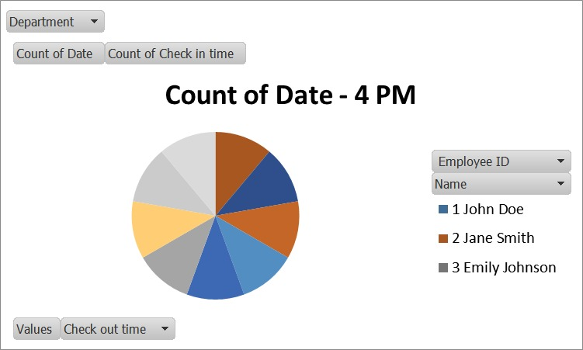
RESULTS
11

Slide 12
conclusion
Visualizing employee attendance trends with Excel charts provides a powerful tool for organizations to: - Identify patterns and anomalies in attendance data - Understand the impact of attendance on productivity and performance

