Slide 1

Basic Details of the Team and Problem Statement
Ministry/Organization Name/Student Innovation:
NSTL, DRDO, Ministry of Defence
PS Code: SIH 1416
Problem Statement Title:
AI based automatic alarm generation and dropping of payload at a particular object through a drone.
Team Name: AeroLogix Ensemble
Team Leader Name: S. Rishabh
Institute Code (AISHE): U-1153
Institute Name: Shiv Nadar University Chennai
Theme Name:
Dronetic Choreography: Precision in Aid Delivery.

Slide 2
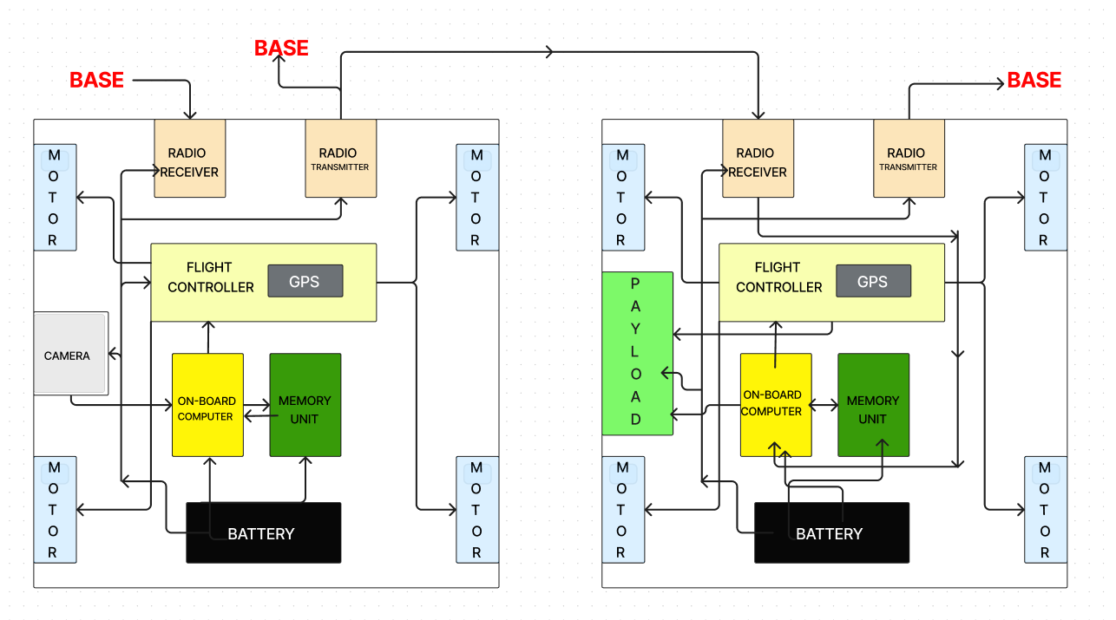
Idea/Approach Details
Flow Chart:
IDEA/SOLUTION:
Develop A Drone-based Disaster Relief System For Efficient Area Exploration And Aid Delivery, Optimizing Resource Allocation And Minimizing Response Time.
INITIAL SCOUTING DRONE:
Purpose: Rapidly scout the area for people.
Speed Advantage: Significantly faster to cover ground swiftly.
Method: Utilizes an exhaustive search algorithm.
Technology: Employs open-camera vision software to identify and geotag individuals.
Data Sharing: Transmits location data to another drone for supply delivery.
PAYLOAD DELIVERY DRONE:
Purpose: Deliver supplies to identified locations.
Data Utilization: Utilizes the geotagged location data for route planning.
Efficiency Focus: Implements a shortest path algorithm to optimize delivery routes.
Payload Deployment: Delivers supplies to each geotagged location efficiently.
Scouting Drone
Payload Drone
TECHNOLOGY STACK:
Python Programming Language
Open CV (SSD- Single Shot Detection)
PyCharm
Heridal Dataset & Aerial Dataset
Concorde TSP Solver (Travelling Salesman Problem Solver)
Traversal Using Boundary Condition
GIS – Geographical Information System

Slide 3
Scouting Drone
Payload Drone

Slide 4
Idea/Approach Details
DEPENDENCIES / SHOW STOPPER:
USE CASES:
Image Resolution and Detection Precision:: Higher image resolution improves accuracy but increases computational demands for detection.
Optimizing 3D Graph Construction:: Efficiency in constructing 3D graphs is crucial for optimizing shortest path generation.
Versatility: Highly versatile algorithm adaptable to various land and air transportation scenarios.
System Scalability: increasing system capacity is easily achieved by adding more scout or supply drones in response to growing demand
Parallel Processing: The scout drone monitors and detects objects in real-time, while the supply drone prepares for faster payload delivery, minimizing response time.
Reliability: Highly reliable with zero dependency on the internet and meticulous consideration of external factors.
Supplying Resources to Remote Locations: Rapid deployment of food, medical aid and other essentials to isolated locations in disaster ridden zones by detecting where people are trapped.
Search And Rescue Operations: Assists with reconnaissance, navigation of rescue operations by on-ground rescue teams via the data and paths provided by the drones’ algorithm for efficient rescue missions.
Wildfire Detection and extinguishing
Landmine Detection and Diffusal: By 2 Separate Rovers on Land.
Satellite Supply Drops in Extraterrestrial Bases.
BUSINESS POTENTIAL:
Market Expansion: The algorithm, designed for fast scouting and geotagging alongside supply drones using the shortest path algorithm, can be marketed and sold to a diverse range of organizations seeking efficient solutions.
Cost Efficiency: Implementing this drone system offers substantial cost savings compared to using military-grade helicopters and human resources, making it an attractive option for various potential customers.

Slide 5
Team Member Details
Team Leader Name: S.RISHABH
Branch : B.Tech Stream : CSE Year : II
Team Member 1 Name: SHWETHA.M
Branch : B.Tech Stream : CSE Year : II
Team Member 2 Name: T.SOWMMYASHRI
Branch : B.Tech Stream : CSE Year : II
Team Member 3 Name: S.ARJUN
Branch : B.Tech Stream : CSE Year : II
Team Member 4 Name: S.VIGNESHRAM
Branch : B.Tech Stream : CSE Year : II
Team Member 5 Name: T.YOHAN SUBBARAJ
Branch : B.Tech Stream : CSE Year : II
Team Mentor 1 Name: Type Your Name Here
Category (Academic/Industry): Expertise (AI/ML/Blockchain etc): Domain Experience (in years):
Team Mentor 2 Name: Type Your Name Here
Category (Academic/Industry): Expertise (AI/ML/Blockchain etc): Domain Experience (in years):

