Slide 1


H.E.R
H.E.R
Smart Safety Solution for Women
Problem Statement ID : SIH1594
Problem Statement Title: Student Innovation
(H.E.R: Smart Women's Safety App with Automated Route Deviation Alerts and SOS Features)
Theme: Transportation and Logistics
PS Category: Software
Team Name: H.E.R (Helpful and Engaging Response )
Helpful and Engaging Response
ONE STEP FORWARD IN THE RIGHT DIRECTION

Slide 2
IDEA
H.E.R (Helpful and Engaging Response) is a smart safety solution for women, integrated directly into WhatsApp as an API and background service. It provides real-time response and critical safety tools along with Automated Route Deviation Alerts and SOS Features within a familiar platform while offering offline fallback options to ensure support even without an internet connection.
Key Features:
1
Online Features (via WhatsApp):
SOS Alerts: Send distress signals to emergency contacts instantly through WhatsApp.
Route Deviation Detection: Notify contacts if the user strays from their expected route.
Video & Voice Recording: Capture evidence in real-time for emergencies (requires user agreement to terms and conditions to enable audio/video).
Merchandise Purchase: Easily buy women’s safety gear directly through the WhatsApp contact.
2
Offline Fallback Features (via SMS/Calls):
SOS Alerts via SMS/Call: When offline, users can send emergency alerts to pre-set contacts through SMS or make emergency calls.
Voice-Activated Alerts: Use voice commands to trigger SOS alerts if unable to manually access the phone.
3
Advantages of Using WhatsApp Business API
Wide User Base and Ease of Use: WhatsApp is widely used for daily communication, so no need to convince users to install another app.
Lower Development Costs: Avoid the time and resources to develop, test, and maintain a full-fledged mobile app.
Instant Communication: WhatsApp offers instant messaging, voice, and video calling, which aligns well with features like SOS alerts and emergency contact notifications.

Slide 3
TECHNICAL APPROACH
Front-End:
WhatsApp messaging integration: WhatsApp Business API
SMS messaging: Twilio SMS API
Voice to text conversion: Google Cloud Speech-to-Text API
Back-End:
Server-side framework: Node.js (Express.js)
NoSQL database: MongoDB
SQL database: PostgreSQL/MySQL
Real-Time Features:
Location services: Google Maps API
Real-time communication: WebRTC
Cloud file storage: Google Cloud Storage
Emergency Alerts & Communication:
Push notifications: Firebase Cloud Messaging (FCM)
Voice call integration: Twilio Voice API
Security:
Data encryption: AES
Secure data transmission: SSL/TLS
Cloud Infrastructure:
Serverless computing: AWS Lambda
Monitoring and Analytics:
Monitoring and performance metrics: Datadog / Prometheus
Data visualization: Google Data Studio
Testing & Deployment:
Continuous integration and deployment (CI/CD): GitHub Actions
Containerization: Docker

Slide 4
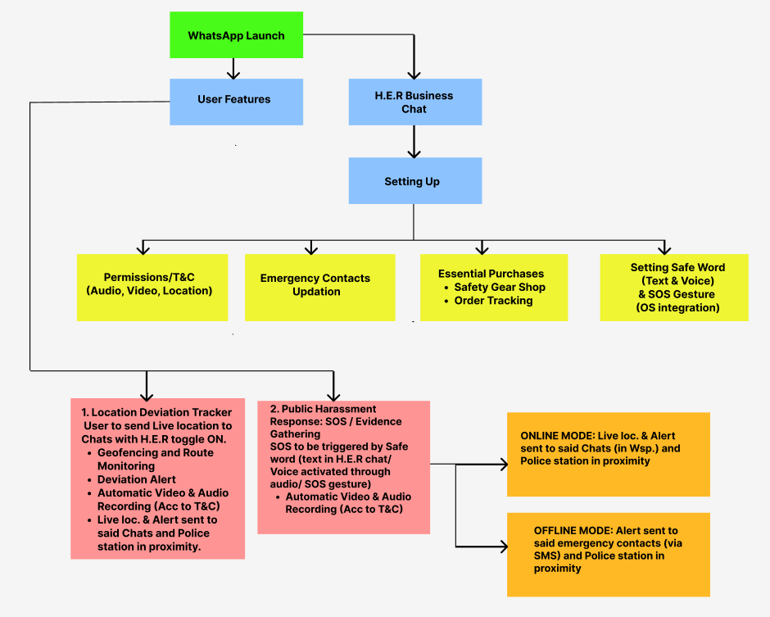
FLOW DIAGRAM

Slide 5

FEASIBILITY AND VIABILITY
Feasibility:
Technical Feasibility:
Technology Availability: Technologies like GPS and mobile frameworks are readily available and mature for implementation.
Development Complexity: Advanced features like route deviation can be challenging but manageable with the right skills.
Operational Feasibility:
User Accessibility: This must work on various devices, including low-end smartphones, which requires performance optimization.
Testing and Deployment: Safety-critical features like SOS alerts and route deviation require rigorous testing, which must be planned well to fit the timeline.
Viability:
Market Viability:
User Demand: There is strong demand for women's safety apps, and the combination of features integrated with the already existing and widely used WhatsApp offers a competitive edge.
Competitive Landscape: While there are similar apps, our integrated solution provides a more comprehensive feature set that can stand out in market.
Financial Viability:
Monetization Strategy: This can offer premium features and partnerships to generate revenue.
Development Costs: Avoid the time and resources to develop, test, and maintain a full-fledged mobile app.
Sustainability: Consider ongoing costs like server maintenance, and explore funding options such as grants or sponsorships.
Social and Ethical Viability:
Social Impact: This contributes positively by enhancing women's safety and could lead to broad adoption and societal benefits.
Ethical Considerations: Ensuring privacy, data security, and transparency are crucial for user trust and compliance with regulations.

Slide 6
IMPACT AND BENEFITS
Impact on the Target Audience:
Enhanced Personal Safety
Increased Confidence and Independence Support for Victims of Abuse
Empowerment through Self-Defense and Safety Education
Benefits of the Solution
Social Benefits
Provides end to end encryption Reduction in Gender-Based Violence Empowerment and Equality
Economic Benefits
Lesser storage space required since it is integrated with WhatsApp and not a separate app Increased Workforce Participation
Cost Savings on Emergency Response

Slide 7
RESEARCH AND REFERENCES
https://ieeexplore.ieee.org/document/7443652
https://ieeexplore.ieee.org/document/9936427
https://link.springer.com/article/10.3758/s13428-023-02213-2
https://lastinvention.co.za/ussd2chatapp/
https://www.ijarnd.com/manuscripts/v3i4/V3I4-1196.pdf
https://bmcpublichealth.biomedcentral.com/articles/10.1186/s12889-021-12292-5

