Slide 1
Amazon Sales Data Analysis using Excel
Data Cleaning | Dashboard | Insights
Sowmya Jaganathan
LinkedIn: sowmya-jaganathan
GitHub: Sowmya-Jaganathan

Slide 2
Project Overview
This Excel-based project focuses on analyzing Amazon sales data. It includes:
- Cleaning raw sales data
- Identifying trends and insights
- Building a dashboard using only Microsoft Excel

Slide 3
Tools Used
- Microsoft Excel
- Data Cleaning (removing duplicates, fixing formats)
- Pivot Tables and Charts
- Dashboard Design using slicers, filters, and formatting

Slide 4
Raw Data Challenges
- Missing or blank values
- Inconsistent data formats
- Duplicates and irrelevant columns
- Need for derived columns

Slide 5
Data Cleaning Process
- Removed blank rows and duplicates
- Standardized date and currency formats
- Created helper columns using Excel formulas
- Structured data into tables

Slide 6
Dashboard Preview
Interactive Excel dashboard built using:
- Pivot Tables and Pivot Charts
- Slicers for filtering
- Conditional Formatting for highlights

Slide 7
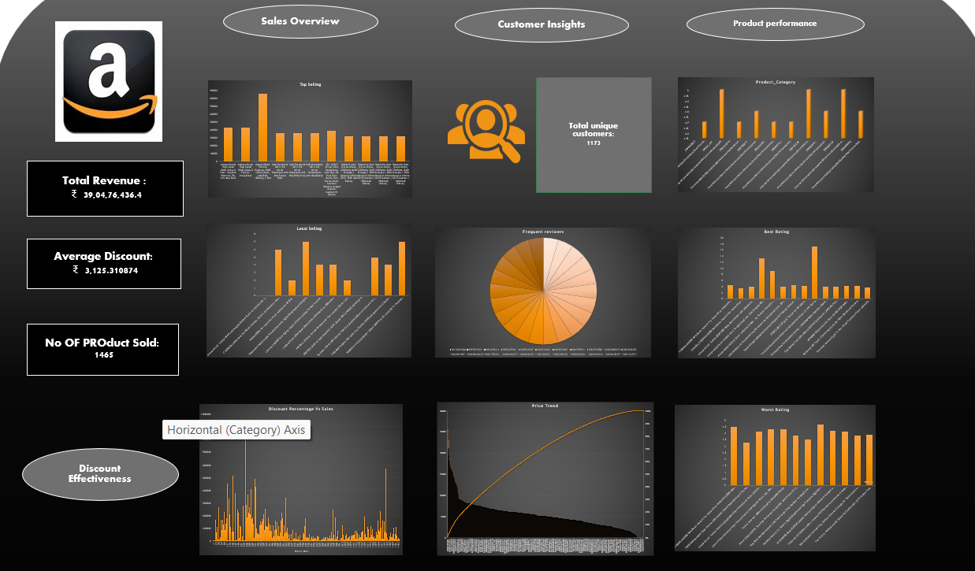
Dashboard

Slide 8
Key Insights
- Best-selling products and categories
- Monthly sales trends
- Preferred payment methods
- Regional performance

Slide 9
Conclusion
Through this project, I learned how to:
- Clean and transform data efficiently in Excel
- Build a professional dashboard
- Derive actionable business insights
GitHub: https://github.com/Sowmya-Jaganathan
LinkedIn: www.linkedin.com/in/sowmya-jaganathan

