Slide 1
Nmap(Network Mapper)
By
- Sowmya Yelmati
- Sadanand Kallakuri

Slide 2
History
Developed by Gordon Lyon
It is a open source utility tool.
Runs on Linux, Windows, Mac OS X
GUI options
- Zenmap
- XNMap
- NmapFE

Slide 3
Why Nmap is used?
Nmap can quickly scan broad ranges of devices and provides valuable information about devices on your network
It can be used for IT auditing and asset discovery as well as for security profiling of the network
Can be used for hacking – to discover vulnerable ports
Unauthorized use of Nmap on a system could be illegal.

Slide 4
Features:
Host Discovery
Port Scanning
Version Detecting
OS detection
Scriptable interaction with the target

Slide 5
How it works?
It uses raw IP packets. To determine:
What hosts are available on network?
Services that are enabled?
Operating system?
Version of the host?
What sort of firewall?
And many more..

Slide 6
Some of the scans:
Connect | SYN Stealth
FIN, XMAS, Null | Ping
UDP Scan | IP Protocol scan
ACK Scan | Window Scan
RPC Scan | List scan
FTP Bounce

Slide 7
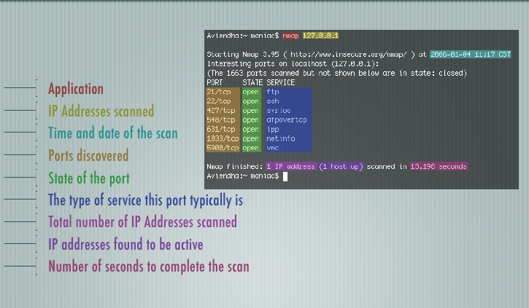
Nmap Basic Scan

Slide 8
Commands Format
When using the command line , commands should be given in the following format
nmap [<scan type>…] [<options>] {<target specification>}

Slide 9
Questions??

Slide 10
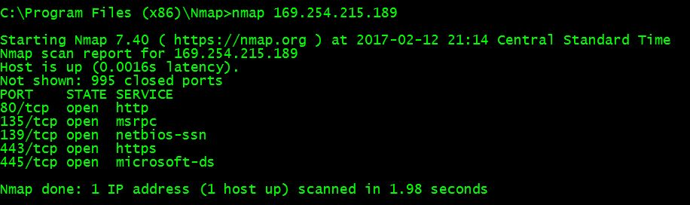
Demo Output Screenshots:
Nmap Basic commands:

Slide 11
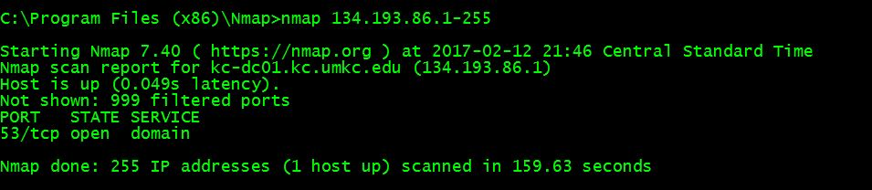
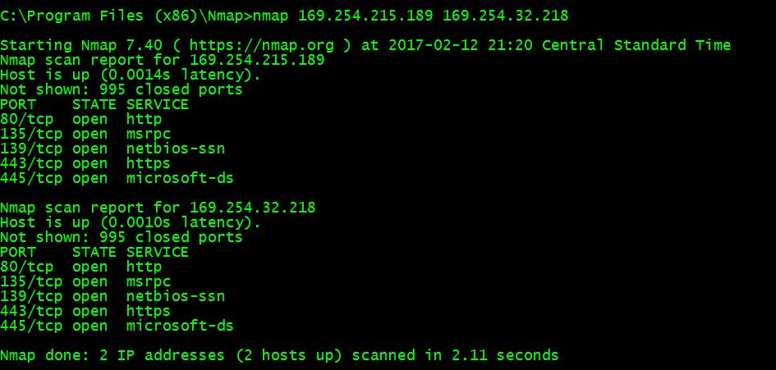
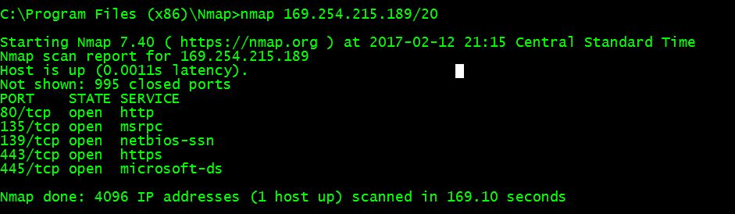
Multiple ways to scan IP ranges

Slide 12
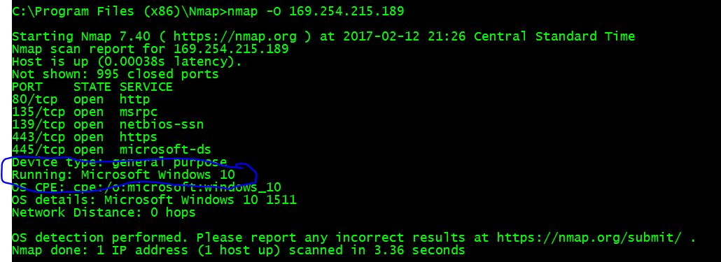
OS Detection(-O)

Slide 13
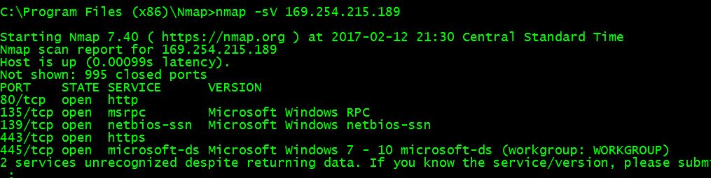
Version Detection(-sV)

Slide 14
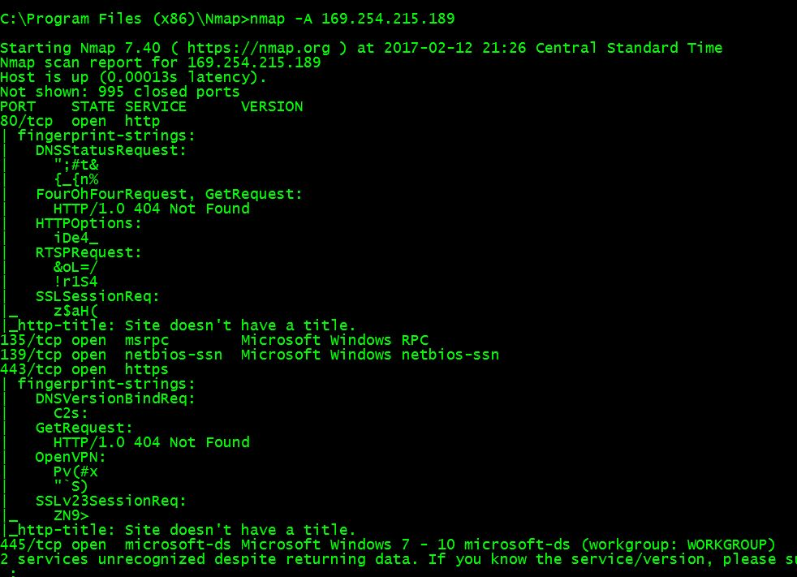
Aggressive Scan(-A)(Get both OS and Version with one command)

Slide 15
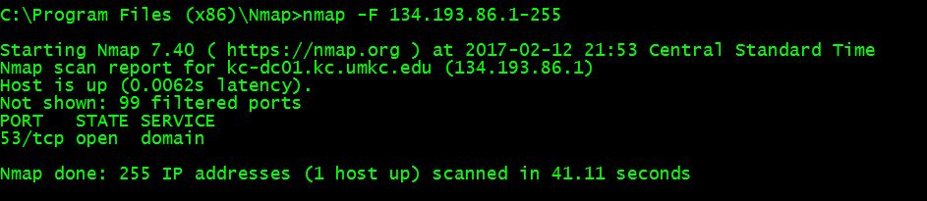
Fast command(-F)
Scan thousands of IP’s in very less time(compare time in both outputs)

Slide 16
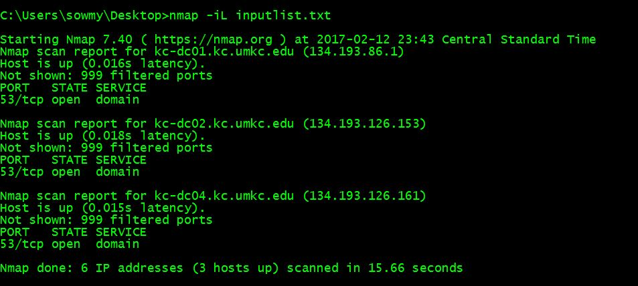
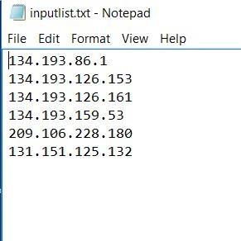
Input List(-iL) Scan different IP’s from the text file

Slide 17
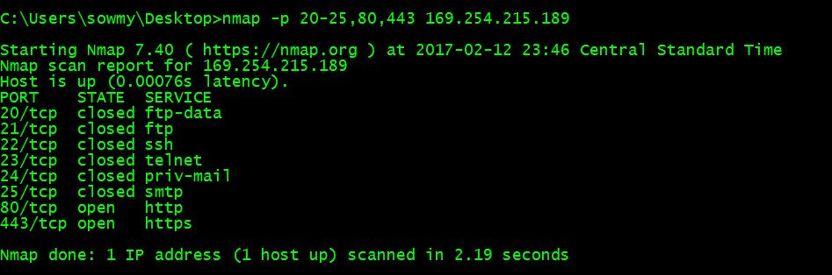
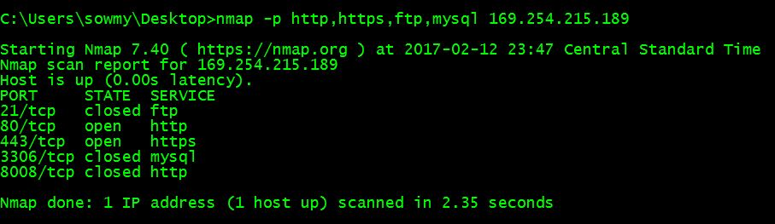
Scan the selected ports

Slide 18
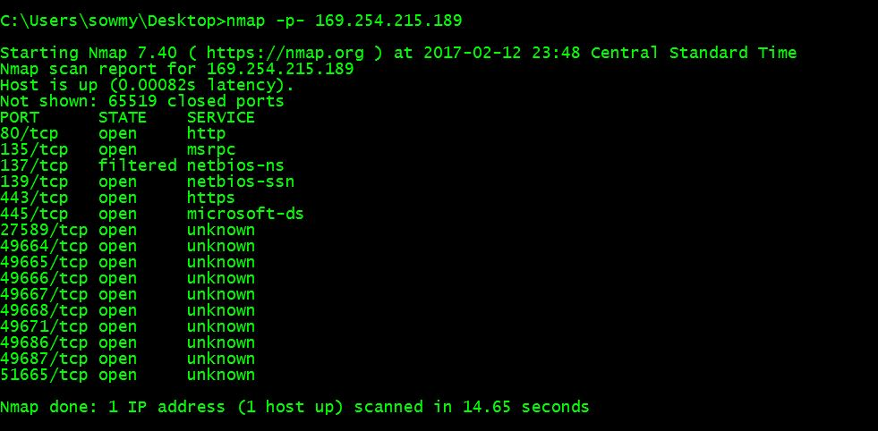
Scan all the ports available on target

Slide 19
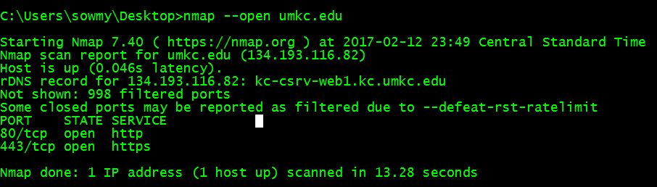
Scan the open ports(only)

Slide 20
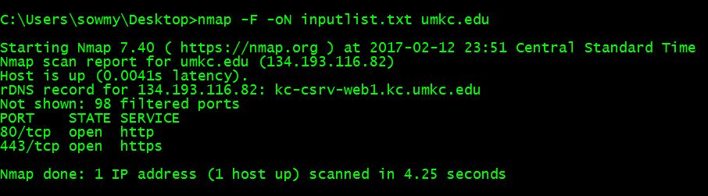
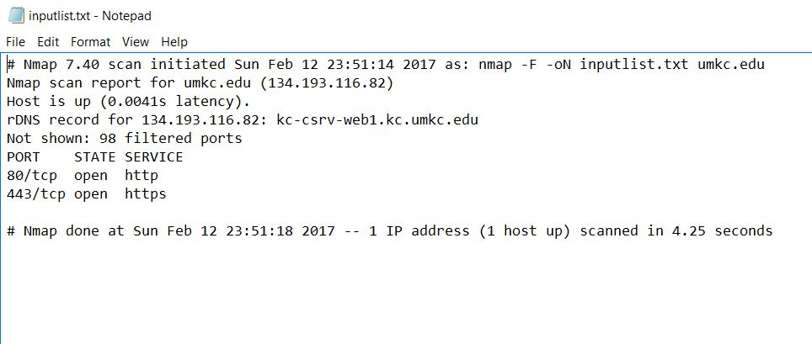
Print the output to a text(-oN) or XML(-oX) file

Slide 21
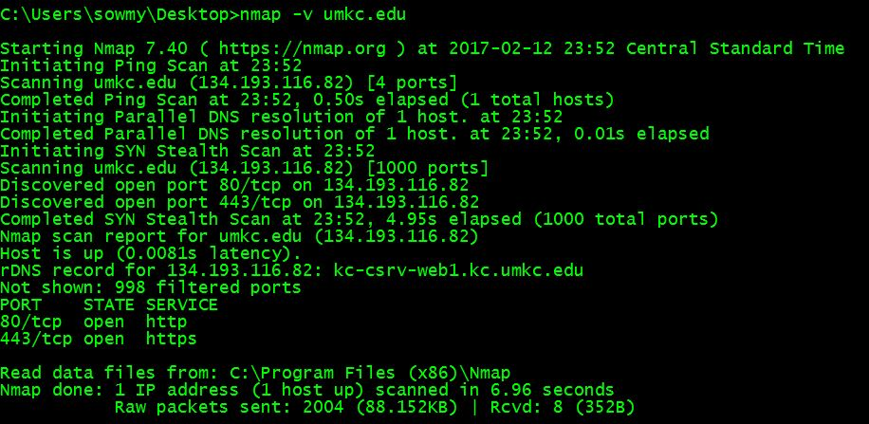
Output in verbose form

Slide 22
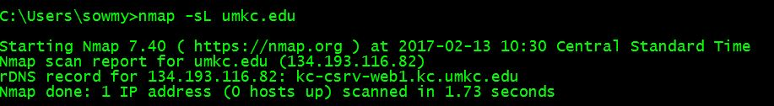
Host Discovery
Multiple ways to do Host discovery-
List Scan (-sL) :
it just shows the list of IP addresses on the network
Does not send any packets to the target.
Less Intrusive.
Good to check your IP addresses before scanning the network.

Slide 23
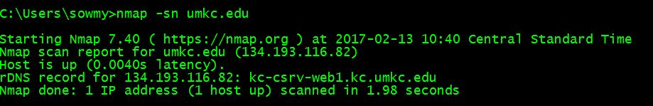
No Port Scan (-sn)
Nmap usually do the port scanning after the host discovery.
This option tells Nmap not to do port scan after host discovery.
This is little more intrusive than List scan.
Knowing how many hosts are up on the network is more valuable information for attackers than all the IP addresses on the network.

Slide 24
No Ping Scan (-Pn)
Nmap only performs the port scanning functions such as OS detection, version detection on the hosts that are up.
By using this command, Nmap skips the discovery stage all together and it will attempt to perform the requested scanning functions against every IP address on the network.
Ex: nmap –Pn –O –sV umkc.edu

Slide 25
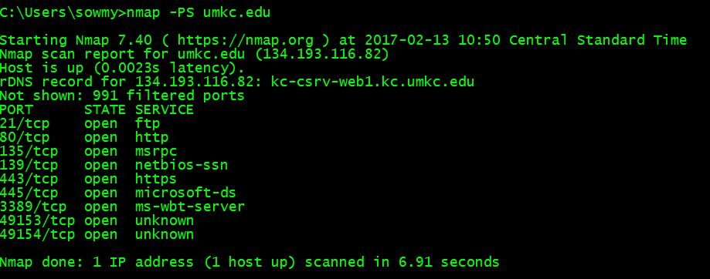
TCP SYN,TCP ACK,UDP Pings
TCP SYN Ping(-PS)
Command: nmap –PS20-25,80,443 umkc.edu

Slide 26
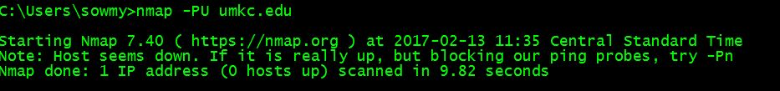
Continued..
TCP ACK Ping(-PA)
Command: nmap –PA20-25,80,443 umkc.edu
UPD Ping (-PU)
Command: nmap –PU20-25,80,443 umkc.edu

Slide 27
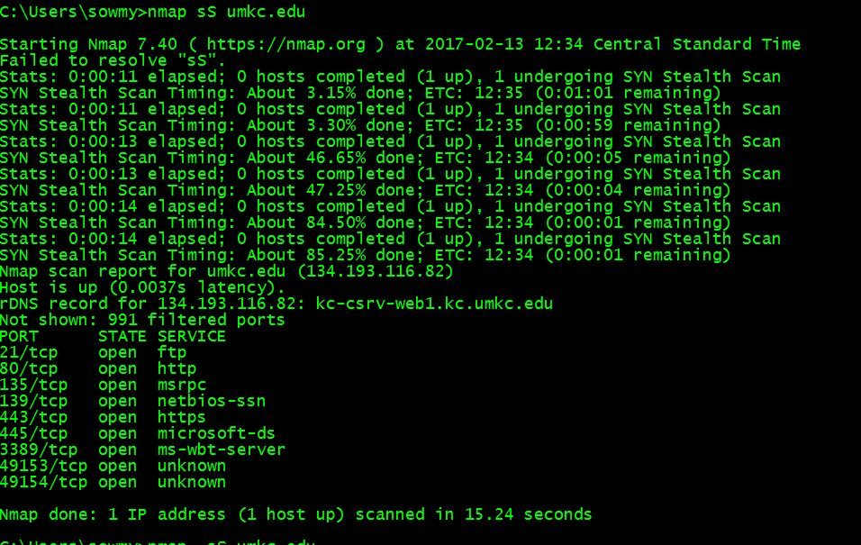
Port Scanning techniques:
TCP SYN Port Scan(-sS):

Slide 28
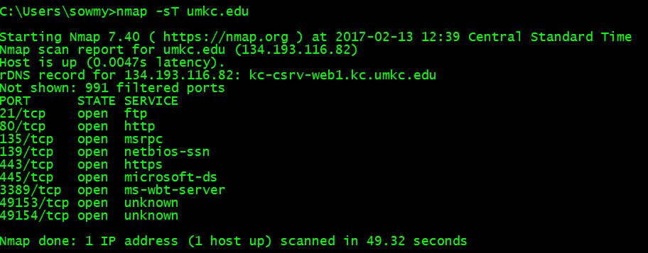
Continued..
TCP Connect Scan(-sT):

Slide 29
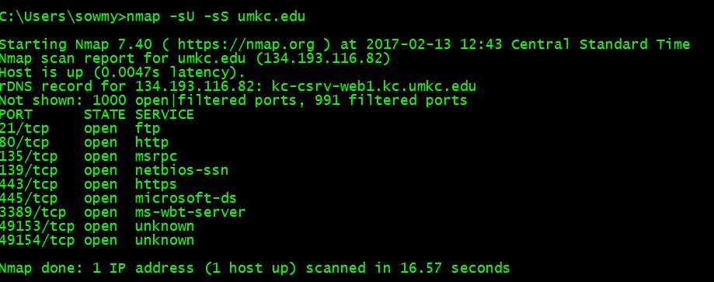
Continued..
UDP Scan(-sU)

Slide 30
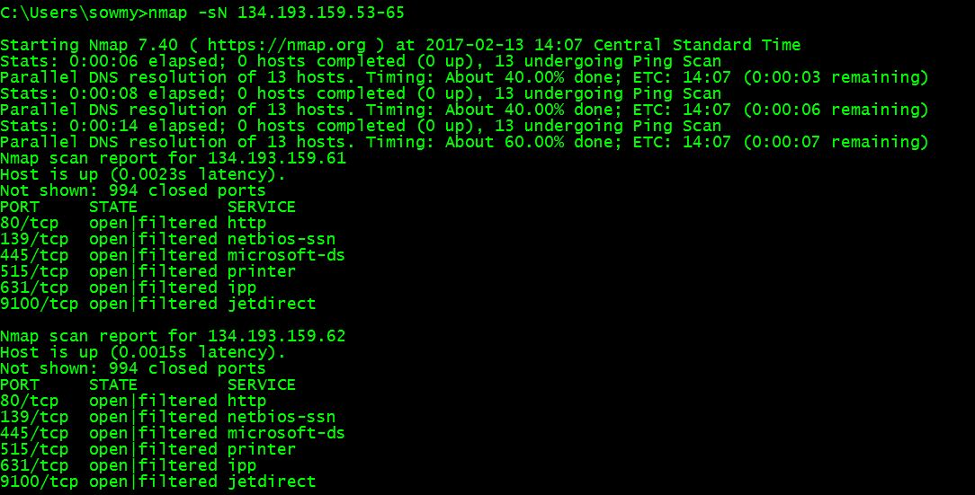
Continued..
Null Scan (-sN)

Slide 31
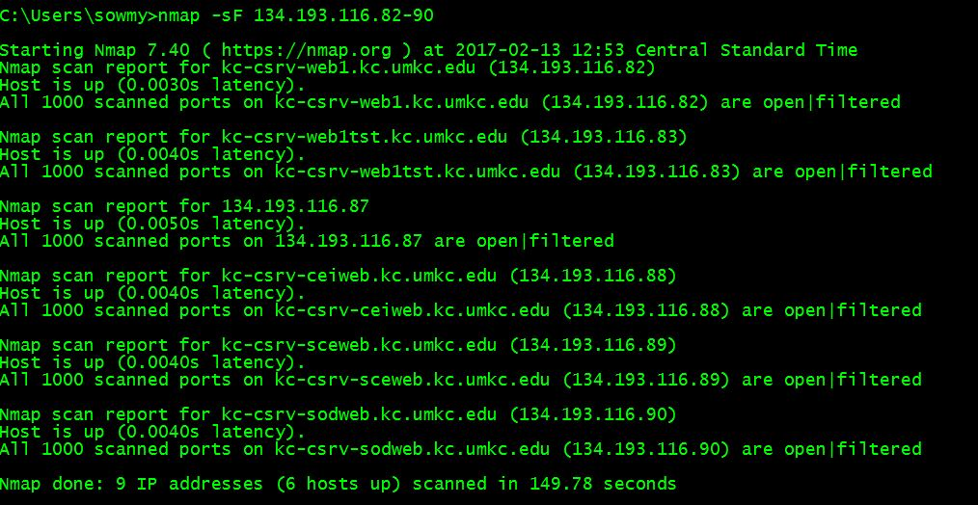
Continued..
FIN Scan(-sF):

Slide 32
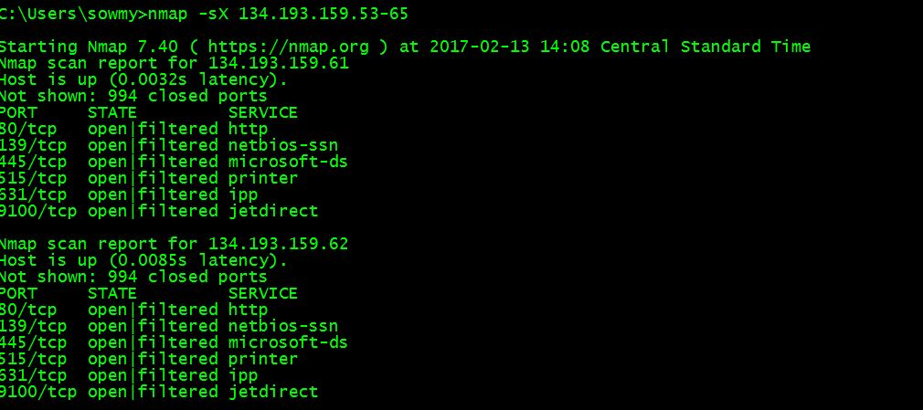
Continued..
XMAS Scan(-sX):

Slide 33
References:
http://www.slideshare.net/amiable_indian/nmap-basics
https://www.iup.edu/WorkArea/DownloadAsset.aspx?id=116848
https://nmap.org/book/man.html
Install nmap on windows: https://nmap.org/book/inst-windows.html#inst-win-exec
Reference guide: https://nmap.org/book/man.html

