Slide 1
Netcare
Members
ARCHA MANOHAR V
RAHANA A
SOWMYA SILVY

Slide 2
INTRODUCTION
Security of networks.
It is a well-secured network.
It is a Java project.
It is about scanning the live systems and their ports on a network so that we can identify vulnerabilities on a network.
The system will also find any intruders that are in the network.

Slide 3
GOAL OF THE PROJECT
NETCARE is very fast.
Easy to use IP scanner.
Port scanner tool.
It can scan IP addresses and ports in any specified IP address range.

Slide 4
EXISTING SYSTEM
The existing system is the network mapper (NMAP).
Nmap (network mapper) is a security scanner.
Drawbacks of Existing System
It takes more time to scan
More complex
Need to learn all the codes for scanning
Cannot identify vulnerability

Slide 5
PROPOSED SYSTEM
NETCARE.
Scanning live systems and their ports on a network.
Find any intruders that are in the network.

Slide 6
FEATURES OF PROPOSED SYSTEM
UI designs
More simple than the other tools
Can find vulnerability
Less time for scanning compared to existing system

Slide 7
REQUIREMENTS SPECIFICATION
Faster Response Time
Efficient Processing
Maintains Authentication And Authorization
User Friendly

Slide 8
HARDWARE REQUIREMENTS
SYSTEM : PENTIUM IV 2.4 GHZ
HARD DISK : 250 GB
MONITOR : 15 VGA COLOUR
MOUSE : LOGITECH.
KEYBOARD : 110 KEYS ENHANCED
RAM : 1 GB
Operating System : Windows 95/98/2000/NT4.0.

Slide 9
SOFTWARE REQUIREMENTS
SOFTWARE : JAVA
Operating System : Windows 95/98/2000/NT4.0.
Application Server : Apache Tomcat
Language : Java.
Database : MySQL.
Database Connectivity: PhpMyAdmin

Slide 10
TOOLS AND PLATFORMS
Java
Java is one of the world's most important and widely used computer languages.
MySQL
Mysql is the world's second most widely used open-source relational database management system (RDBMS).

Slide 11
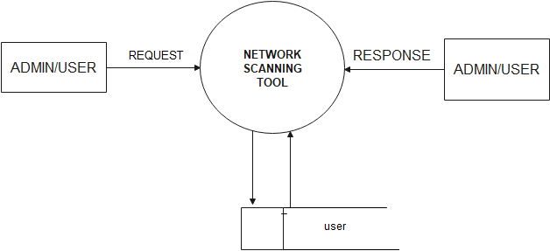
DATA FLOW DIAGRAM LEvel 0 dfd

Slide 12
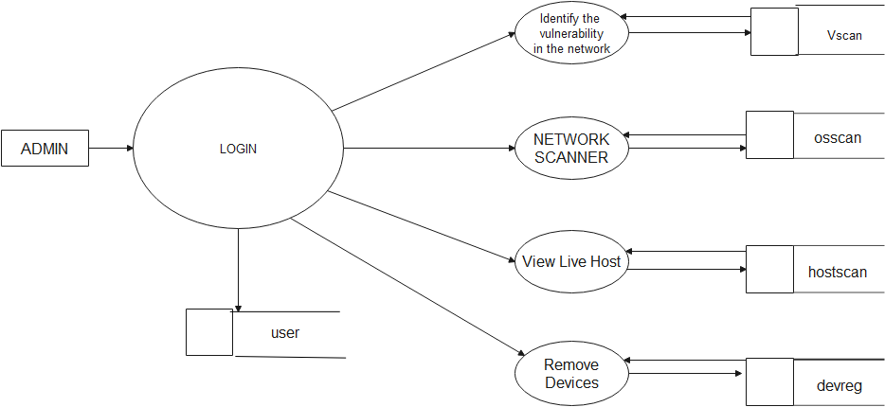
Level 1 dfd

Slide 13
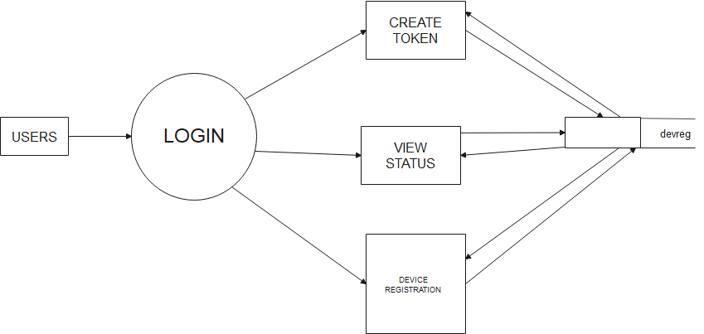
Level 1.1 dfd

Slide 14
TABLE DESIGN Signin
Sl No. | Field Name | Data Type | Size | Constraint | Description
1 | id | Int | 11 | PRIMARY KEY | Id number auto increment
2 | Name | Varchar | 20 | NOT NULL | Name of the user/admin
3 | Email | Varchar | 30 | NOT NULL | Email of the user/admin
4 | Contact | Bigint | 10 | NOT NULL | Contact number of the user
5 | Username | Varchar | 50 | NOT NULL | Username of user /admin
6 | Password | Varchar | 20 | NOT NULL | Password of user/admin
7 | Designation | Varchar | 10 | NOT NULL | Designation of user
8 | Department | Varchar | 10 | NOT NULL | Department of the user
9 | Acctype | varchar | 10 | NOT NULL | Specifies the type of the user

Slide 15
Devreg
Sl No | Field name | Data Type | Size | Constraint | Description
1 | Id | Int | 11 | PRIMARYKEY | Id number auto increment
2 | Name | Varchar | 20 | NOT NULL | Name of user/admin
3 | Email | Varchar | 30 | NOT NULL | Email of user/admin
4 | Contact | Bigint | 10 | NOT NULL | Contact number of user
5 | Username | Varchar | 50 | NOT NULL | Username of user/admin
6 | Designation | Varchar | 20 | NOT NULL | Designation of user
7 | Department | Varchar | 10 | NOT NULL | Department of user
8 | Devicename | Varchar | 10 | NOT NULL | Specifies the name of the device
9 | Devicetype | Varchar | 50 | NOT NULL | Specifies the type of the device
10 | Ipadd | Varchar | 30 | NOT NULL | Specifies the ip address of the device
11 | Macadd | Varchar | 30 | NOT NULL | Specifies the Mac address of the device
12 | Status | Int | 3 | NOT NULL | Specifies the status of the device

Slide 16
Scaninfo
Sl No | Field Name | Data Type | Size | Constraint | Description
1 | Id | Int | 10 | PRIMARYKEY | Id number auto increment
2 | Date | Date |  | NOT NULL | Date of scanning
3 | Scan Type | Varchar | 30 | NOT NULL | Type of scanning

Slide 17
Hostscan
Sl No | Field Name | Data Type | Size | Constraint | Description
1 | Id | int | 10 | PRIMARY KEY | Id number auto increment
2 | Scanid | Int | 10 | NOT NULL | Scan id from the scaninfo
3 | Ip address | Varchar | 30 | NOT NULL | Ip address of scanning report
4 | Result | Varchar | 10 | NOT NULL | Status of the scanning

