Slide 1

Analysis of the Stack Overflow Survey Data
By Sowmya
Created on 05-05-2025

Slide 2



OUTLINE
Executive Summary
Introduction
Methodology
Results
Visualization – Charts
Dashboard
Discussion
Findings & Implications
Conclusion
Appendix

Slide 3

EXECUTIVE SUMMARY
This presentation analyzes developer survey data to understand current trends and future preferences.
The objective is to extract meaningful insights from responses regarding programming languages, tools, databases, platforms, and work conditions.
A dashboard was built using IBM Cognos Analytics to visualize key findings such as top languages developers use or desire to work with, and factors influencing technology choices.
Key insights support better decision-making in hiring, learning paths, and tech stack choices.

Slide 4

INTRODUCTION
The tech industry evolves rapidly; staying current with developer trends is essential.
This study explores what languages developers use today and what they aspire to work with next year.
Understanding these preferences helps organizations align with talent expectations and market demands.

Slide 5

METHODOLOGY
We used a cleaned and structured dataset derived from a large-scale developer survey.
The data was loaded into IBM Cognos Analytics for visualization and analysis. The following steps were taken:
Data Cleaning: Removed nulls, irrelevant columns, duplicate values, and correcting inconsistencies.
Data Transformation: Used Cognos features like custom calculations and filters.
Visualization: Created bar charts and dashboards to display top 10 technologies and demographic trends.
Filtering & Aggregation: Applied filters to focus on key trends (e.g., top 10 values) and grouped responses for better clarity.

Slide 6
RESULTS
Visualization – Charts
Programming Languages:
Current Year: Most developers have experience with languages like JavaScript, TypeScript, HTML/CSS, and SQL.
Next Year: Developers express interest in working more with TypeScript, Python, and modern web languages.
Clear shift toward modern, high-demand languages for future work.
Databases:
Current Usage: SQL-based databases (e.g., MySQL, PostgreSQL, SQL Server) dominate current use.
Future Preferences: There's growing interest in NoSQL and newer database technologies (e.g., MongoDB, Firebase).
Indicates a trend toward scalability and cloud-native database solutions.

Slide 7
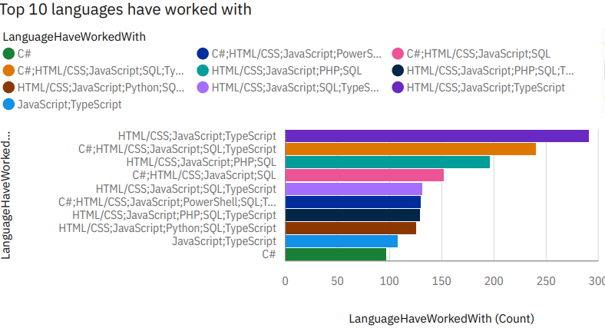
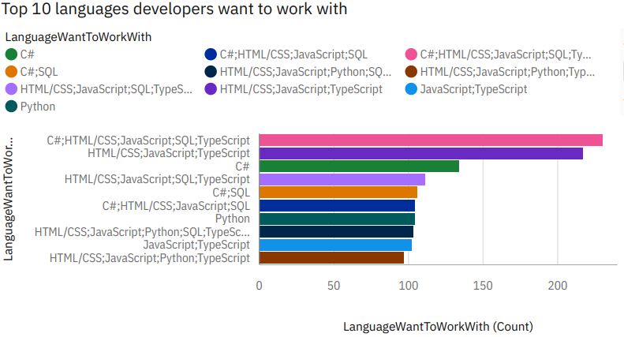
PROGRAMMING LANGUAGE TRENDS
Current Year
Next Year

Slide 8
PROGRAMMING LANGUAGE TRENDS - FINDINGS & IMPLICATIONS
Findings
Core stack (HTML/CSS, JavaScript, SQL) remains dominant.
Interest in C# and Python rises significantly.
Python is highly desired but less used currently.
Developers commonly work with multiple languages.
TypeScript continues to gain traction.
Implications
Hire for full-stack skillsets, not single languages.
Focus learning resources on Python and TypeScript.
Offer upskilling to retain developers.
Modernize tech stacks to attract top talent.

Slide 9
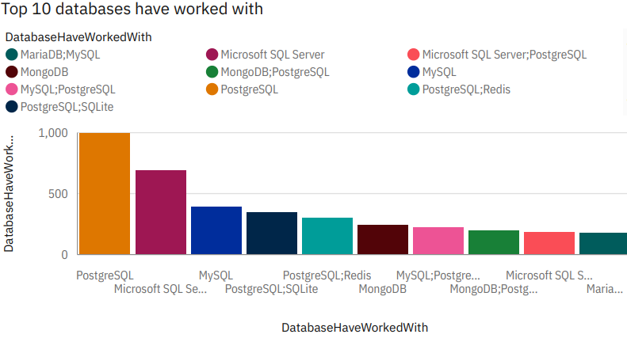
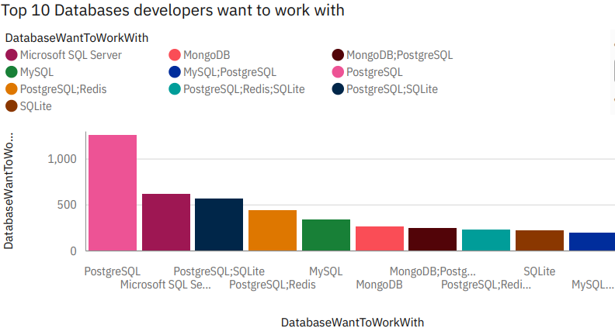
DATABASE TRENDS
Current Year
Next Year

Slide 10
DATABASE TRENDS - FINDINGS & IMPLICATIONS
Findings
PostgreSQL is the most popular and most desired database.
MySQL and Microsoft SQL Server still see strong usage and interest.
MongoDB and Redis are gaining popularity — especially in combinations with SQL databases.
Developers commonly work with multiple database types, not just one.
Implications
PostgreSQL remains a solid choice for new projects and long-term use.
Growing interest in NoSQL (e.g., MongoDB, Redis) signals a need for broader database training.
Teams should prepare for hybrid database setups (SQL + NoSQL).
Education and skilling efforts should cover a range of database technologies, not just relational systems.

Slide 11

DISCUSSION
Shifting Technology Preferences
Developers show a gap between current and desired tech stacks.
Indicates evolving interests and future-focused career paths.
Key Trends
Python & TypeScript gaining popularity for their use in data science and scalable web apps.
NoSQL databases like MongoDB rising, reflecting a shift to cloud-native solutions.

Slide 12
DASHBOARDS LINKS
The GitHub link of the Cognos Analytics Dashboards:
Dashboards links

Slide 13
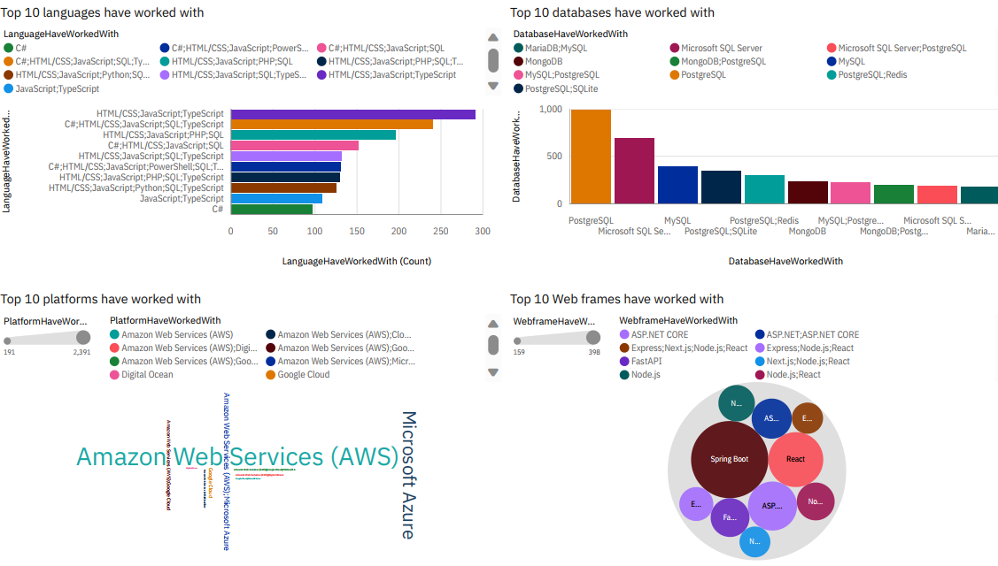
DASHBOARD 1 – CURRENT TECHNOLOGY USAGE

Slide 14
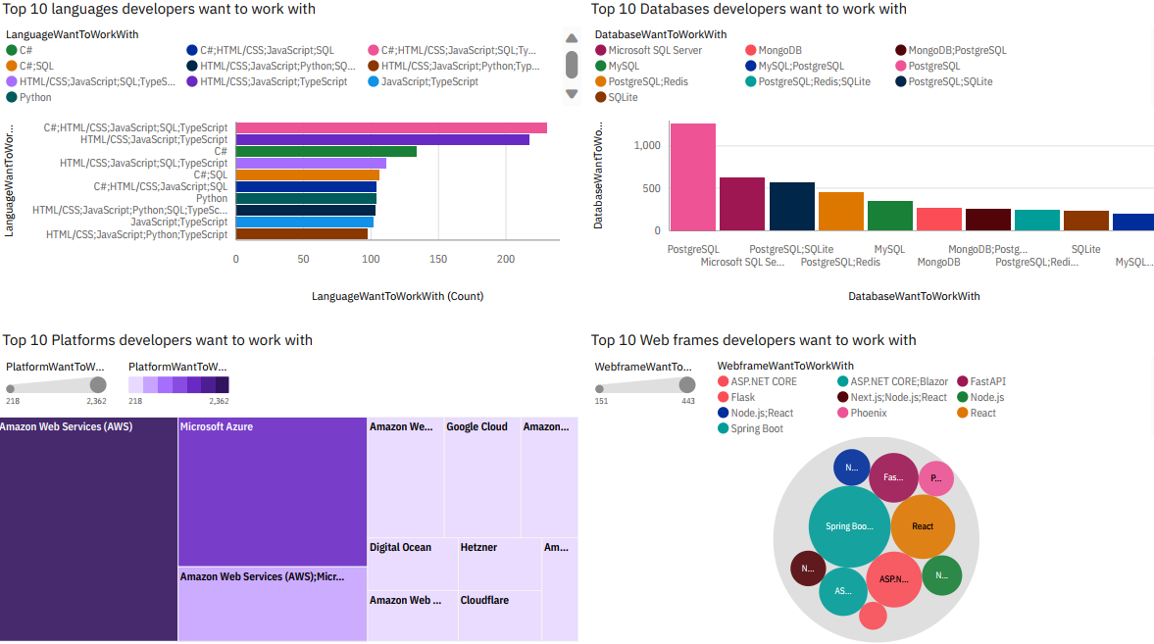
DASHBOARD 2 – FUTURE TECHNOLOGY TREND

Slide 15
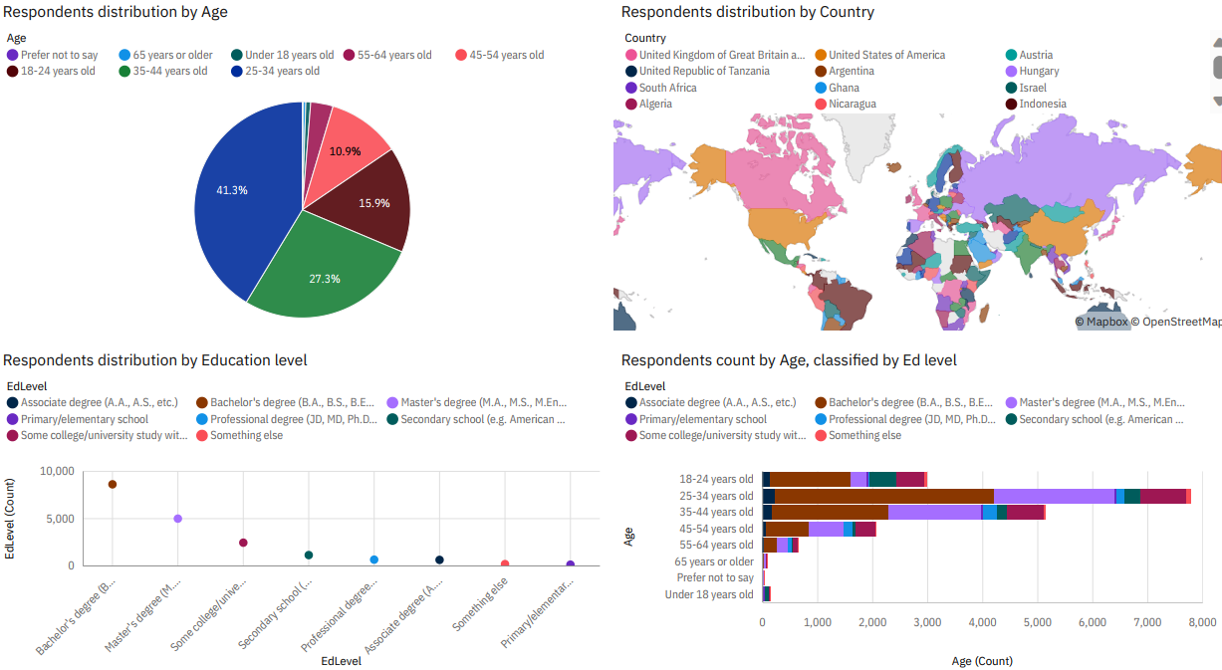
DASHBOARD 3 - DEMOGRAPHICS

Slide 16
DATABASES - FINDINGS & IMPLICATIONS
Findings
PostgreSQL is the most used and most wanted database.
Developers are combining PostgreSQL with Redis and SQLite more frequently.
Microsoft SQL Server and MySQL are still widely used but less in demand for future use.
MongoDB's popularity is growing — especially in "want to work with" responses.
Implications
Companies should prioritize PostgreSQL and modern NoSQL databases (e.g., MongoDB, Redis).
Developers can increase their market value by learning PostgreSQL and NoSQL combinations.
Educators should teach hybrid data architecture concepts and modern database tools.

Slide 17
PROGRAMMING LANGUAGES - FINDINGS & IMPLICATIONS
Findings
HTML/CSS, JavaScript, and SQL remain the most widely used.
TypeScript and Python are highly desired by developers moving forward.
C# remains relevant but is not as in-demand as newer languages.
Full-stack development skills (frontend + backend) are very common.
Implications
Employers should adopt modern stacks using TypeScript and Python to stay attractive.
Developers should focus on TypeScript (for frontend) and Python (for backend/data).
Learning platforms should update offerings to emphasize modern, in-demand languages.

Slide 18
DEMOGRAPHICS - FINDINGS & IMPLICATIONS
Findings
Majority of respondents are aged 25–34, followed by 18–24 — workforce is largely young.
Most hold a Bachelor’s or Master’s degree.
Global participation spans North America, Europe, Asia, and Africa.
Implications
Employers must adapt hiring, onboarding, and training for a younger, diverse audience.
Learning resources should be globally accessible and culturally adaptable.

Slide 19
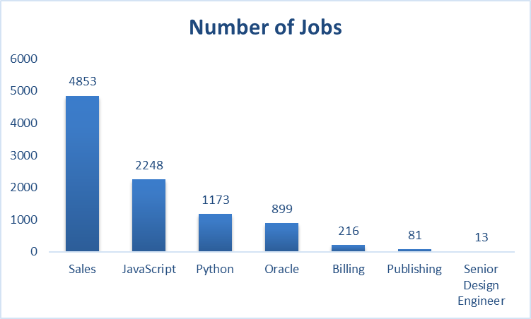
JOB MARKET - NUMBER OF JOBS BY ROLE
Sales dominates the job market with 4,853 openings.
JavaScript and Python are the top tech-related roles, with 2,248 and 1,173 jobs respectively.
Niche roles like Senior Design Engineer have significantly fewer listings (only 13).

Slide 20
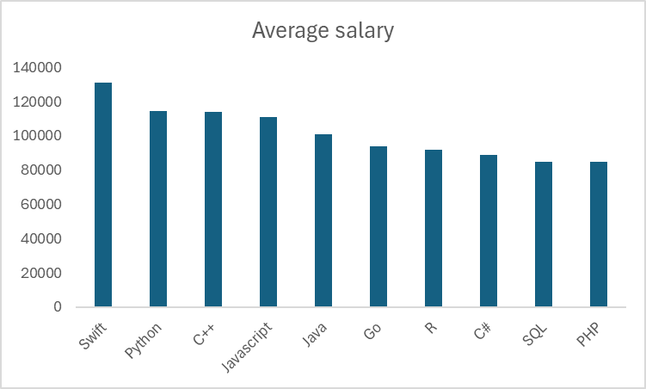
AVERAGE SALARIES FOR POPULAR PROGRAMMING LANGUAGES
Swift developers earn the highest average salary (~$135,000).
Python and C++ follow closely with salaries above $115,000.
PHP and SQL are on the lower end, with averages below $90,000.

Slide 21

CONCLUSION
Developer preferences are evolving, with a clear trend toward modern, versatile technologies like Python, TypeScript, and PostgreSQL.
Cloud platforms (especially AWS and Azure) dominate both current usage and future interest, highlighting the importance of cloud-native skills.
There's a strong interest in full-stack capabilities, as seen in multi-language and multi-framework usage patterns.
Employers and educators should align with these trends by updating tech stacks, offering training in in-demand tools, and supporting developer growth.

Slide 22
Thank You!
Questions & Discussions Welcome

