Slide 1
Performance Test Summary
View: Login, Registration & File Upload

Slide 2
Summary
Login & Registration scale reliably up to 1000 concurrent users
File Upload is the primary bottleneck impacting user experience
High failure rate and tail latency pose product risk
Optimization required before scaling usage further
User Load | Run 1 (Evening 17th Jan 26) | Run 2 (Morning 19th Jan 26) | Run 3 (Morning 21st Jan 26)
50 | No Errors | No Errors | No Errors
100 | No Errors | No Errors | No Errors
500 | No Errors | Error 500 (161 uploads) | Error 500 (The script stops at 496), had to stop the execution
1000 | No Errors | Error 500 (367 uploads) | Error 500 (The script stops at 996), had to stop the execution

Slide 3
Test Scope & Setup
Load levels: 5, 50, 100, 500, 1000 concurrent users
Test windows: Weekdays and Weekends
Focus journeys: Login, Registration, Resume Upload

Slide 4
Issues Identified
File Upload bottleneck under high load
Error 500 observed for 500+ users - file uploads began failing intermittently once the system crossed ~200 uploads. The failures were not continuous but appeared sporadically, returning HTTP 500 errors.
The error message indicates a Neo4j memory pool exhaustionException Occurred while generating API Response:{code: Neo.TransientError.General.MemoryPoolOutOfMemoryError}{message: The allocation of an extra 2.0 MiB would exceed the limit of 250.0 MiB. Currently using 250.0 MiB. dbms.memory.transaction.total.max threshold reached}The same behavior was observed during the 1000-user test, where uploads started failing around the 200-user mark with identical error.
Tail latency affects user experience
Upload script halted at 496 and 996 uploads (500 and 1000-user test) - Test is not reaching full concurrency because a small number of threads are failing or exiting prematurely.

Slide 5
Error Rate by Feature (%)

Slide 6
99th Percentile Response Time (sec)

Slide 7
Throughput (Transactions / sec)

Slide 8
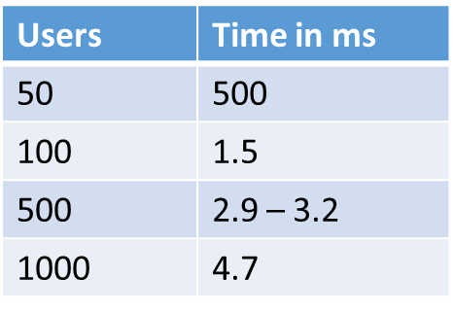
Infrastructure Health
CPU usage remained below 70% (peak ~40%)
Memory usage stable below 200 MB
No memory leaks or crashes observed
Indicates backend capacity exists — issue is functional, not infra
App Response Time Trends:

Slide 9
Product Impact Assessment
Most users complete uploads successfully
However, ~1 in 3 upload attempts fail at peak load
Slow tail experiences risk user frustration & abandonment
Resume upload is a critical funnel step — high business impact

Slide 10
Recommended Next Actions
Investigate upload failures (Error 500) at 500–1000 users
Optimize upload pipeline (async processing, chunking, retries)
Define acceptable SLA for upload latency & throughput
Re-test post-fix before user scale-up

