Slide 1

BACHELOR OF TECHNOLOGY
IN
Artificial Intelligence and Machine Learning
Project Title : Urban Harvesting
Batch Number:10
Project Guide : M Ashok
ok
Department of AIML, School of Engineering
Malla Reddy University
Section : Beta
Roll Numbers :
2411CS020107 Ch Sai Sudeep
2411CS020123 C Ananya Reddy
2411CS020163 D Sowmya Sravani
2411CS020169 E Siddhartha
2411CS020171 E Sunny Reddy

Slide 2
Abstract
The direct sale from farmers to consumers is a digital initiative aimed at eliminating intermediaries in the agricultural supply chain. Farmers often receive minimal returns for their produce due to multiple layers of middlemen, while urban consumers pay higher prices for food that is not always fresh. By creating a digital marketplace, farmers can directly connect with consumers in urban areas, ensuring fair pricing, improved profits, and access to fresh, locally grown produce. The platform leverages technology to provide real-time updates on available produce, transparent pricing, secure payments, and efficient delivery or pickup mechanisms. This system not only empowers farmers economically but also promotes sustainable urban food systems by reducing food miles, supporting local agriculture, and ensuring traceability and trust between producers and consumers.

Slide 3
Problem Statement
The current agricultural marketing system is dominated by intermediaries, resulting in farmers earning significantly less than the market price for their produce. At the same time, urban consumers face inflated costs, limited transparency, and reduced freshness of food products. This gap between producers and consumers creates economic inequality, reduces farmer motivation, and contributes to food wastage. There is an urgent need for a platform that enables farmers to directly reach consumers, ensuring fair trade, transparent pricing, and sustainable supply chains that benefit both parties.

Slide 4
Literature Survey
Survey – I
Title: Enabling Farmer Producer Companies’ Success in Marketing
Authors: IDinsight
Year: 2021
Summary:
This policy brief studies how Farmer Producer Companies (FPOs) help smallholders overcome scale barriers in marketing—by aggregating produce, improving access to inputs, facilitating infrastructure/technology, and building market linkages. Evidence indicates FPOs can raise farmers’ bargaining power and prices received, provided they get support for management capacity, working capital, and market connections—making them an effective vehicle for direct or near-direct farmer-to-consumer models.

Slide 5
Survey – II
Title: Web-Enabled Direct Marketing of Agricultural Produce
Authors: IJSAT Journal
Year: 2025
Summary:
Reports on a pilot digital platform where farmers list produce and transact directly with buyers. The study examines usability, adoption, and user feedback from both farmers and consumers, finding improved price transparency, faster payments, and reduced spoilage when orders are pre-aggregated. It also flags challenges: last-mile logistics, trust/quality verification, and onboarding/training needs—key design inputs for farmer-to-consumer app development.

Slide 6
Survey – III
Title: AI-Integrated Urban Harvesting and Smart Agriculture Platform
Authors: International Journal of Emerging Technologies in Computer Science (IJETCS)
Year: 2025
Summary:
This study presents an AI-driven platform designed to enhance urban agriculture through real-time weather prediction, crop recommendations, and direct farmer-to-consumer interactions. The system integrates IoT sensors, machine learning models, and mobile interfaces to support urban farmers in decision-making and marketing. Results show improved crop yield forecasting accuracy, reduced wastage, and greater consumer accessibility to fresh produce. Key challenges include data integration across diverse sources, ensuring offline accessibility, and addressing user training needs for sustainable adoption.

Slide 7
Survey – IV
Title: AI-Integrated Urban Harvesting and Smart Agriculture Platform
Authors: International Journal of Emerging Technologies in Computer Science (IJETCS)
Year: 2025
Summary:
This study presents an AI-driven platform designed to enhance urban agriculture through real-time weather prediction, crop recommendations, and direct farmer-to-consumer interactions. The system integrates IoT sensors, machine learning models, and mobile interfaces to support urban farmers in decision-making and marketing. Results show improved crop yield forecasting accuracy, reduced wastage, and greater consumer accessibility to fresh produce. Key challenges include data integration across diverse sources, ensuring offline accessibility, and addressing user training needs for sustainable adoption.

Slide 8
Survey – V
Title: IoT-Based Precision Farming for Urban Agriculture
Authors: International Research Journal of Engineering and Technology (IRJET)
Year: 2024
Summary:
This paper explores the use of IoT devices for real-time monitoring of soil moisture, temperature, and humidity in rooftop and urban farms. The research demonstrates that automated irrigation and environmental tracking improve productivity and resource efficiency by over 30%. However, it highlights technical challenges such as high setup costs, sensor calibration, and limited scalability in dense urban environments.

Slide 9
Survey – VI
Title: Mobile Application for Sustainable Crop Recommendation Systems
Authors: International Journal of Computer Applications (IJCA)
Year: 2023
Summary:
This research focuses on a mobile-based crop advisory system using machine learning algorithms like K-Nearest Neighbors (KNN) and Decision Trees. The app assists farmers by suggesting optimal crops based on soil and weather conditions. The study reports enhanced farmer decision-making and yield prediction but notes a need f

Slide 10
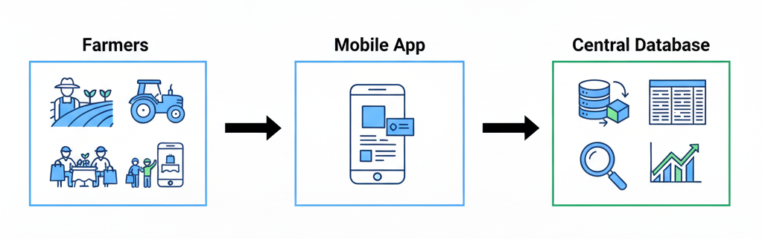
Data Collection
Sources of Data:
Farmer inputs: crop type, quantity,
and availability schedule
Consumer data: demand patterns,
location, and order frequency
Market data: current prices, seasonal trends
Logistics: delivery partner details and route data
Data Collection Methods:
Mobile app input forms for farmers and consumers
GPS integration for location tracking
APIs for real-time market prices
Cloud storage for centralized data access

Slide 11
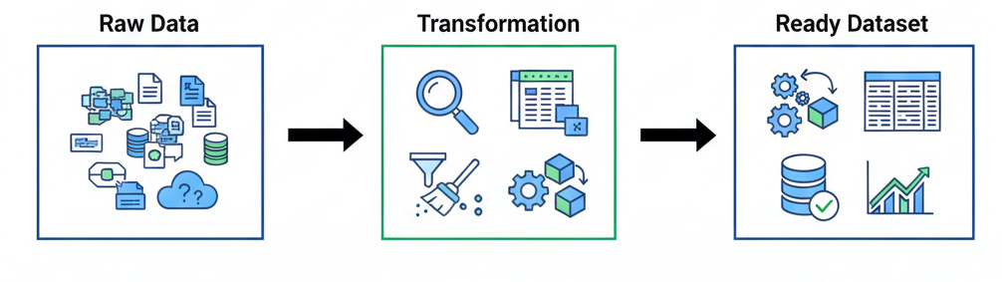
Preprocessing
Cleaning:
Removing duplicates and inconsistent entries
Handling missing or incomplete data
Transformation:
Normalizing price units (₹/kg, ₹/dozen, etc.)
Converting text inputs into structured formats
Feature Extraction:
Farmer reliability, product freshness, and delivery speed
Consumer buying patterns
Data Storage:
Preprocessed data stored in a secure cloud database
Ready for use in recommendation and pricing algorithms

Slide 12
Component | Model Selection Type | Rationale
Core Platform | Software Architecture (MVC/Microservices) | Manages the dynamic interactions between Farmers (suppliers), Consumers (buyers), and the Database (product, order, and user data).
Product Discovery | Recommendation System | To achieve the objective of promoting local/seasonal produce and improving sales, an ML model can recommend products to consumers based on:<ul><li>Collaborative Filtering: Based on what similar users bought.</li><li>Content-Based Filtering: Based on the features of the produce (seasonal, local, type).
Image Verification | Convolutional Neural Network (CNN) | To build trust and traceability (Objective 5), a CNN model could be used for basic Quality Check/Produce Verification by analyzing images uploaded by farmers to ensure the listed product visually matches the description (e.g., classifying a tomato vs. a potato).
Demand Forecasting | Time Series Model (e.g., ARIMA, Prophet) | To help farmers plan their harvest and manage inventory efficiently (addressing reduced wastage), a model can predict consumer demand for specific produce based on historical sales data, seasonality, and urban area demand.

Slide 13
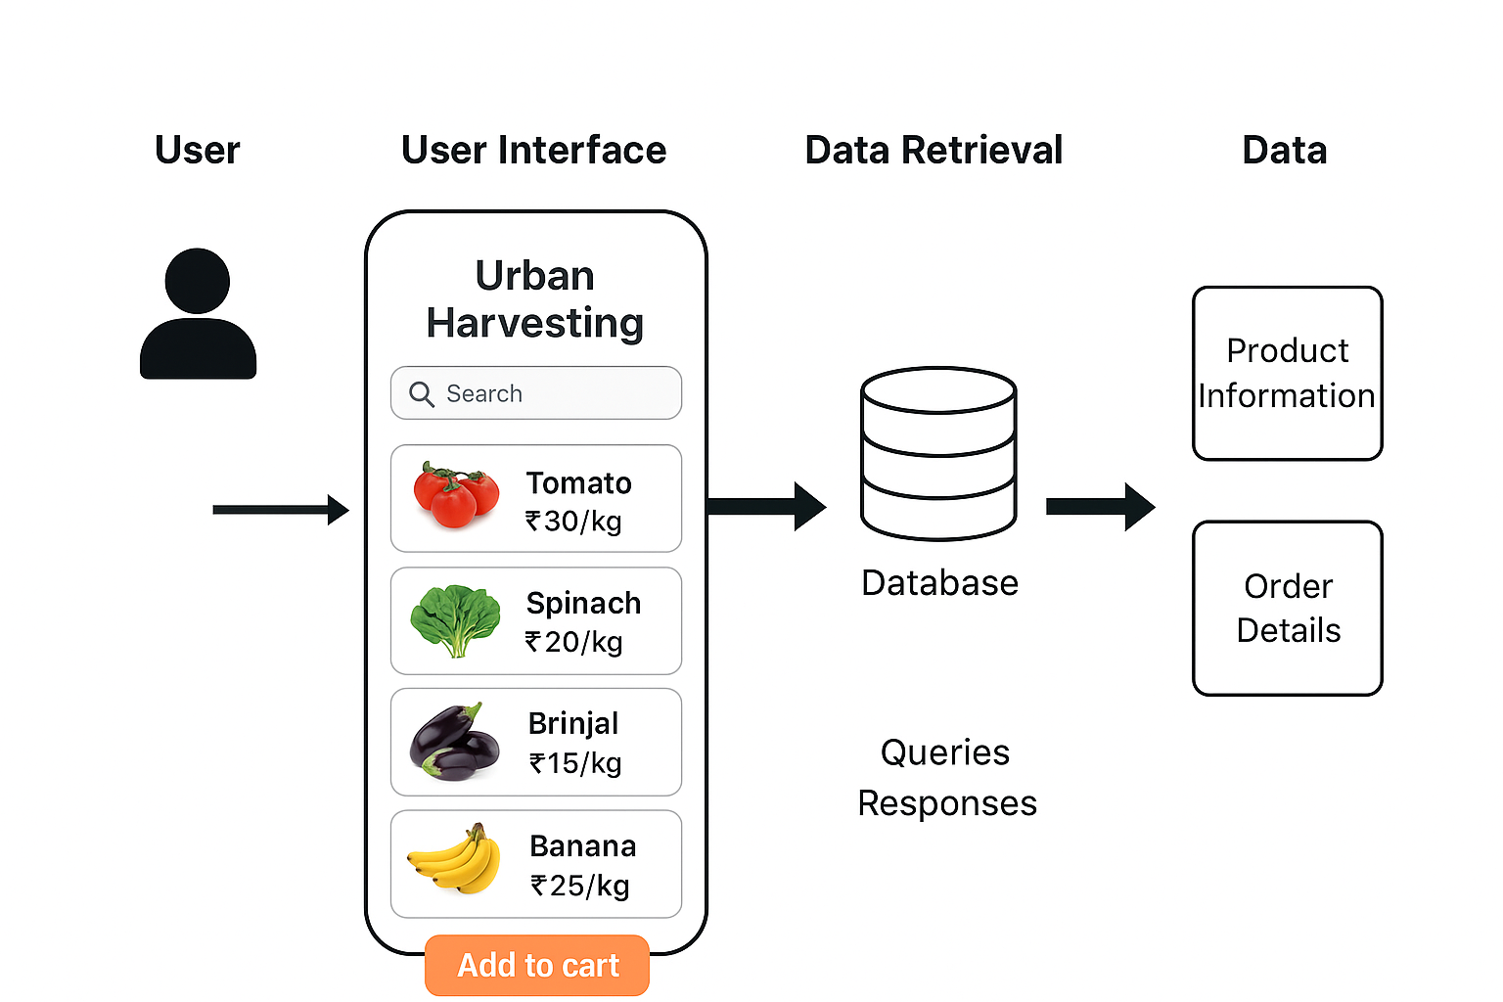
Architecture

Slide 14
Hardware Requirements
Component | Specification
Processor | Intel Core i3 / AMD Ryzen 3 or higher
RAM | Minimum 4 GB (8 GB recommended)
Hard Disk | At least 100 GB free space
Display | 1024 × 768 resolution or higher
Network | Stable internet connection for cloud access
Other Peripherals | Keyboard, Mouse, Smartphone (for mobile user

Slide 15
Software Requirements
Category | Specification
Operating System | Windows 10 / 11, Linux, or macOS
Programming Languages | JavaScript, HTML, CSS
Frameworks | Node.js with Express.js (Backend), React.js (Frontend – optional)
Database | MongoDB Atlas (Cloud Database)
Server Environment | Node.js Runtime Environment
Web Browser | Google Chrome / Microsoft Edge / Firefox
Code Editor | Visual Studio Code
APIs / Tools | Weather API, GPS API, RESTful API Integration
Hosting Platform | AWS / Render / Vercel (for deployment)

Slide 16
SYSTEM MODULES
Weather & Forecasting Module
Provides real-time weather updates to assist in farming and planning.
Crop & Marketplace Module
Suggests suitable crops using AI and enables direct farmer-to-consumer sales.
Health & Safety Module
Sends health risk alerts related to weather conditions.
Order & Payment Module
Allows consumers to add products to cart, place orders, and manage transactions.
Emergency Assistance Module
Supports offline SOS alerts via GPS and SMS for urgent situations.
Admin & Analytics Module
Monitors user activity, transactions, and generates useful data insights.

Slide 17
Technologies used:
1. Front-End (User Interface)
Used by farmers and consumers.
HTML – for structure of web pages
CSS – for styling (colors, layout, fonts)
JavaScript – for basic interactivity (buttons, forms, etc.)
2. Back-End (Server Side)
Handles login, data storage, and communication.
Node.js (Express) – simple backend frameworks to create APIs
3. Database
Stores all data — farmers, products, orders, consumers.
MySQL – simple and widely used database

Slide 18
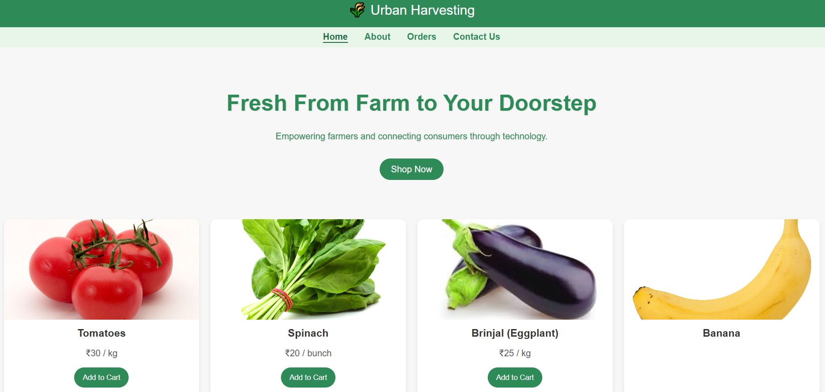
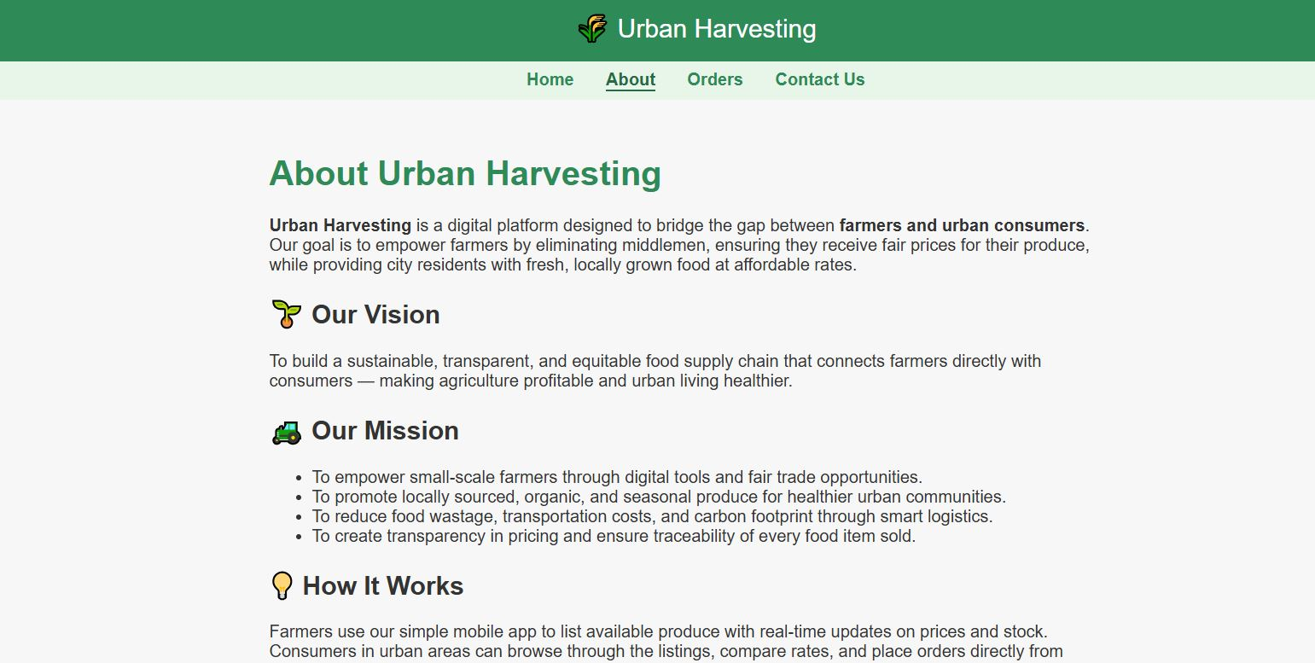
Index.html
About.html

Slide 19
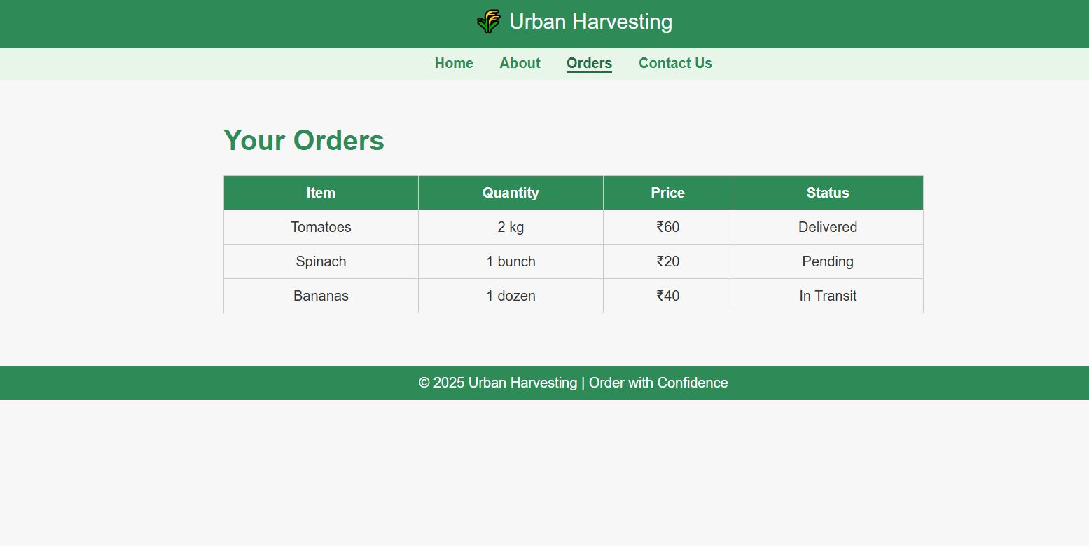
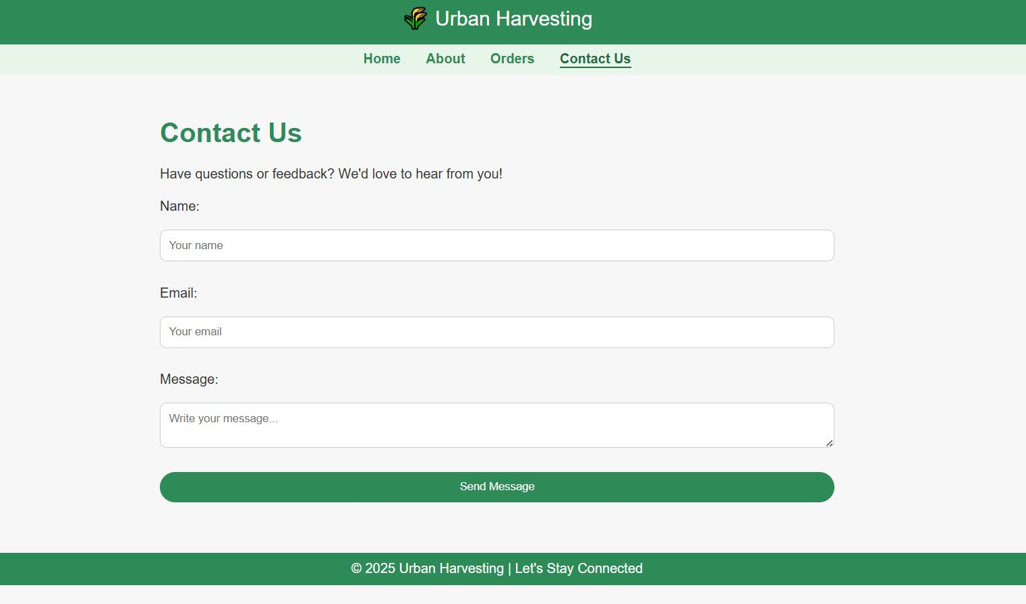
Orders.html
Contact.html

Slide 20
5. FUTURE SCOPE
AI & Automation:
Integrate AI for crop price prediction, smart farming, and automated decision-making.
IoT & Blockchain:
Use IoT sensors for real-time soil and weather monitoring, and blockchain for transparent transactions.
User Experience:
Add voice and regional language support, and personalized recommendations for farmers and consumers.
Collaboration & Sustainability:
Partner with logistics networks for efficient delivery and promote eco-friendly urban farming practices.
Government Integration:
Link with agricultural departments for subsidies, crop insurance, and real-time weather alerts.

Slide 21
Conclusion
Our app is designed to directly address the drawbacks of existing platforms. By removing middlemen and keeping commissions low, farmers receive a fair share of profit while consumers get affordable prices. The app supports better logistics through local delivery partners and collection points to maintain freshness and reduce waste. Unlike other platforms, it gives equal visibility to small farmers, ensuring they are not overshadowed by larger suppliers.
It also focuses on trust and transparency by offering instant payments to farmers and verified product details for consumers. With a simple interface, local language support, and even voice features, the app becomes truly farmer-friendly. Farmers can also see consumer prices, ensuring fairness in trade. In this way, our app becomes more than a marketplace—it becomes a transparent and supportive bridge between farmers and consumers.

Slide 22
THANK YOU

