Slide 1


WOMEN HEALTH
Sowmya Thipparthi

Slide 2
Project Flow
Data
Topic-Introduction
Attributes
Tests
Conclusion

Slide 3
Introduction
Environmental
Occupational
Metabolic
Behavioral

Slide 4


Slide 5
Data
Our World in Data World Women Health

Slide 6
Attributes
Underweight
Healthy
Overweight
Total Fertility
Brest Cancer
Cervical Cancer
Pollution
Prevalence of Alcohol Disorder
Anemia
Vitamin A Deficiency
Women Deaths during childbirth
HIV

Slide 7
Attributes
Prevalence of Low Nutrition
Mental Disorder
Drug use Disorder
Mean BMI-Urban
Mean BMI-Rural
Mean BMI
Non communicable diseases
Daily calorie intake
Daily Protein Intake

Slide 8
Analytical Tests Performed
Paired Sample Test
Correlation Analysis
Multiple Regression
Logistic Regression
Test For Independence
Moderation Analysis

Slide 9
Paired Sample Test
Mean BMI(Urban Vs Rural)
Hypothesis:
H0 : µd = 0
H1 : µd ≠ 0
t=8.268
Two Tailed test

Slide 10
Inference
P(Area) = [1-T.Dist(t, n-1, TRUE)]*2=3.59E-13
P< Alpha (Reject the null)
There is significant difference

Slide 11



Correlation Analysis
Correlation between Fertility and Obesity

Slide 12
Correlation Analysis
Hypothesis
H0 : ρ = 0
H1 : ρ ≠ 0
t = -2.2996
Two Tailed Test

Slide 13

Inference
P = 0.0233
P<Alpha (Reject the Null)
Correlation

Slide 14
Multiple Regression
Smoking, Obesity and prevalence of alcohol predict non communicable diseases

Slide 15
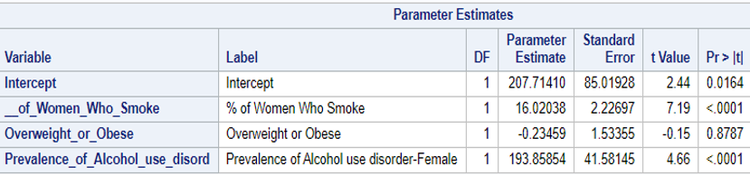
Multiple Regression -1st Run
1st Run
P-Value | <0.0001
Adj.R square | 0.4613
0.8787

Slide 16
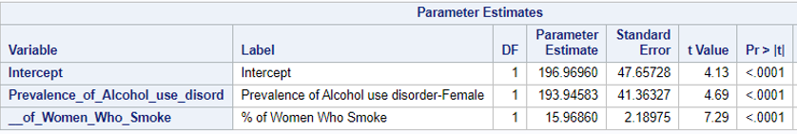
Multiple Regression-2nd Run
Exclude Obesity
Adj R-Square = 0.48

Slide 17
Multiple Regression
Hypothesis for Intercept: H0: β0=0
H1: β0≠0
P < α, we reject the null → intercept β0≠0 and has a value
Hypothesis for Slope: H0: βn=0
H0: βn≠0

Slide 18
Inference
N-C D = 196.97 + 193.94 (Prevalence of Alcohol Use) + 15.96 (Smoking Disorder)

Slide 19
Logistic Regression
Anemia, Pollution and Prevalence of low nutrition predicts low life expectancy(G,L)

Slide 20
Logistic Regression
Hypothesis:
H0=Do not predict Low Life Exp
H1=Predicts Low Life Exp
Life_Exp | Freq
Good | 87
Low | 11
R-Square
R-Square | 0.2188
Max Rescaled R-Square | 0.4333

Slide 21
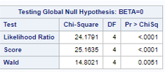
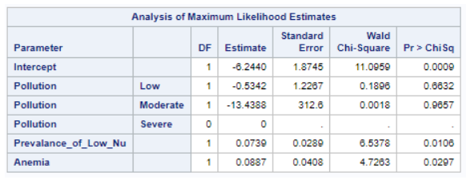
Logistic Regression-1st Run
P-value of χ2 statistic is P < α
0.6632
0.9657

Slide 22
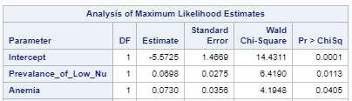

Logistic Regression-2nd Run
Exclude Pollution
0.1765
0.3499
1.079
1.069
C=0.875

Slide 23
Inference
Prevalence of low nutrition and Anemia predicts low life expectancy.

Slide 24



Test of Independence
Pollution and Women death during childbirth

Slide 25
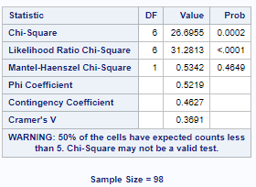
Test of Independence
Hypothesis
H0=The variables are independent
H1=The variables are dependent
P < α for χ2 statistic

Slide 26
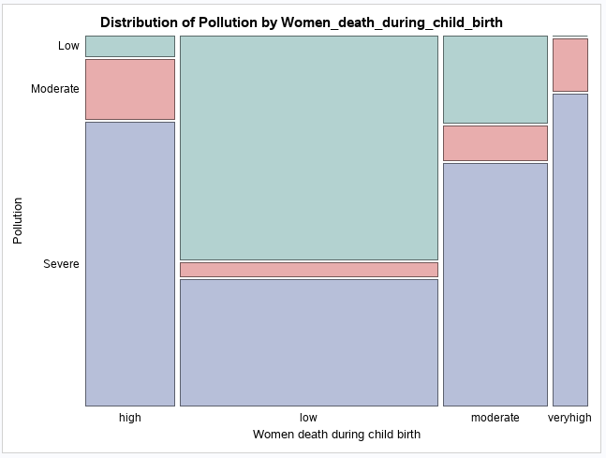
Inference

Slide 27
Moderation Analysis
Alcohol Disorder
Depression
Life Expectancy

Slide 28
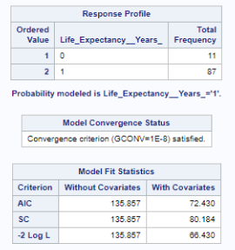
Moderation Analysis
Hypothesis
H0: No Interaction
H1: Interaction effect
135.857
66.430

Slide 29
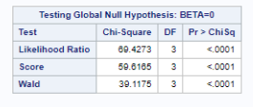
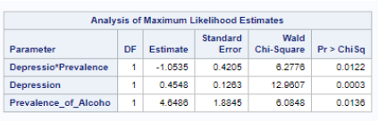
Moderation Analysis
C=0.655

Slide 30
Conclusion
AL the factors considered are helping us in contributing towards working on overall health and prosperity of Women.

Slide 31
Questions?

Slide 32
Thank You!

