Slide 1
AZ-305 Prep

Slide 2
Governance Case Study
Apparel
Sporting Goods
Prod-Dev
Marketing
Sales
Prod-Dev
Marketing
Sales
Development Project
DevTest Labs
Tags
Policies
https://microsoftlearning.github.io/AZ-305-DesigningMicrosoftAzureInfrastructureSolutions/Instructions/CaseStudy/01-Governance.html

Slide 3
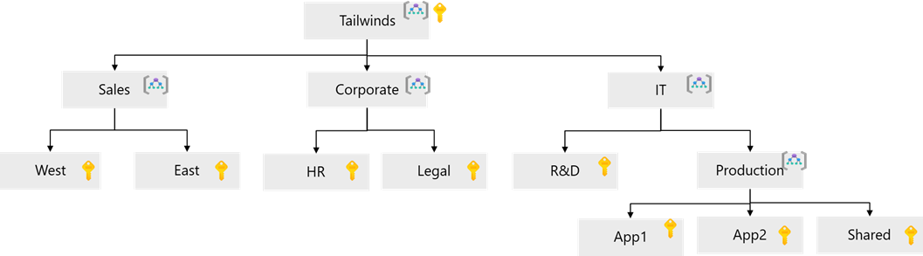

Slide 4
Governance Notes
Root Management Group.
Management group by Division.
Subscriptions at each sub-unit?
Tags based cost across multiple units/sub-units.

