Slide 1
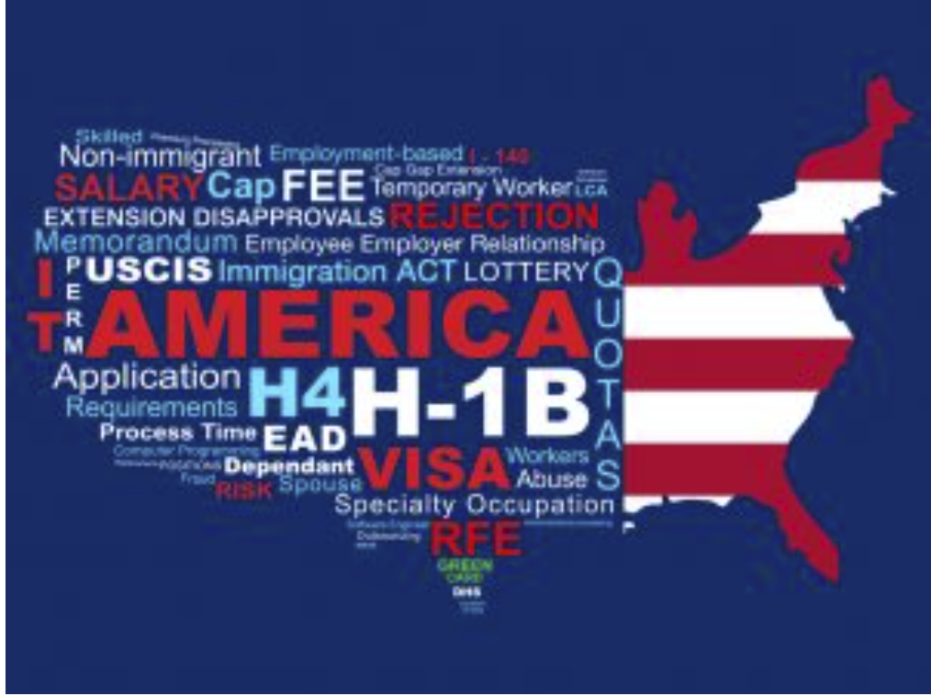
Analysis of H-1B Visa Applications from 2011-2016
By
Sowmya Ravichandran
015337400

Slide 2
Project Background
The H-1B visa is a non-immigrant visa that allows US firms to hire foreign employees for specialized positions that are difficult to fill.
It has benefitted the tech industry greatly, and it has also been utilized to cover worker shortfalls in other industries like as health care, research, and finance.
This is the most prevalent visa status for overseas students who have completed their college or higher education and have started working full-time.

Slide 3
Who gets H1B
Employers petition the government for H-1B visas connected to specific positions, which are awarded through an employer-driven system.
There were 200,000 requests for 85,000 visas when the US Citizen and Immigration Services (USCIS) held a lottery to choose H-1B visas.
The president signed the "Buy American and Hire American" petition to promote American products and safeguard American workers.

Slide 4
Motivation
To see how many application are filed by each state
The approval and denial rates
List of Employers filing for different roles and sectors
Average Salary for employees
Demand for Data Analysts
Ratio of the total population and H-1B visa holders

Slide 5


Dataset Collection
H1-B visa petitions 2011-2016 dataset is taken from Kaggle
Population for the entire US state wise is collected from the United States Census Bureau
Population of H1-B holders is collected from United States Census Bureau

Slide 6
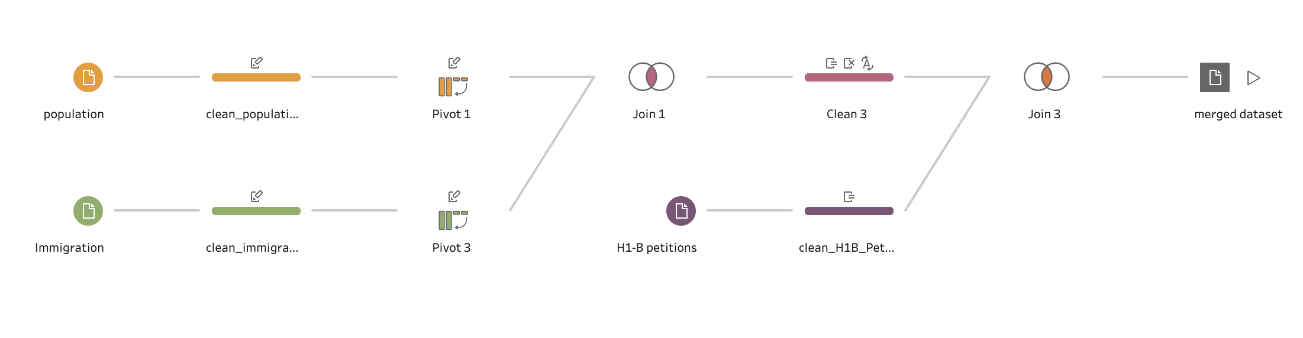
Data Flow

Slide 7
Data Processing
H1-B petitions from 2011-2016 Dataset:
Removing nulls, duplicates and redundant attributes.
Data formatting, removing unnecessary columns, splitting state and city, renaming field.
Population and Population of Nonimmigrants Dataset:
The dataset was pivoted and state, city column were split and renamed.
The datasets were merged using Tableau Prep Builder.

Slide 8
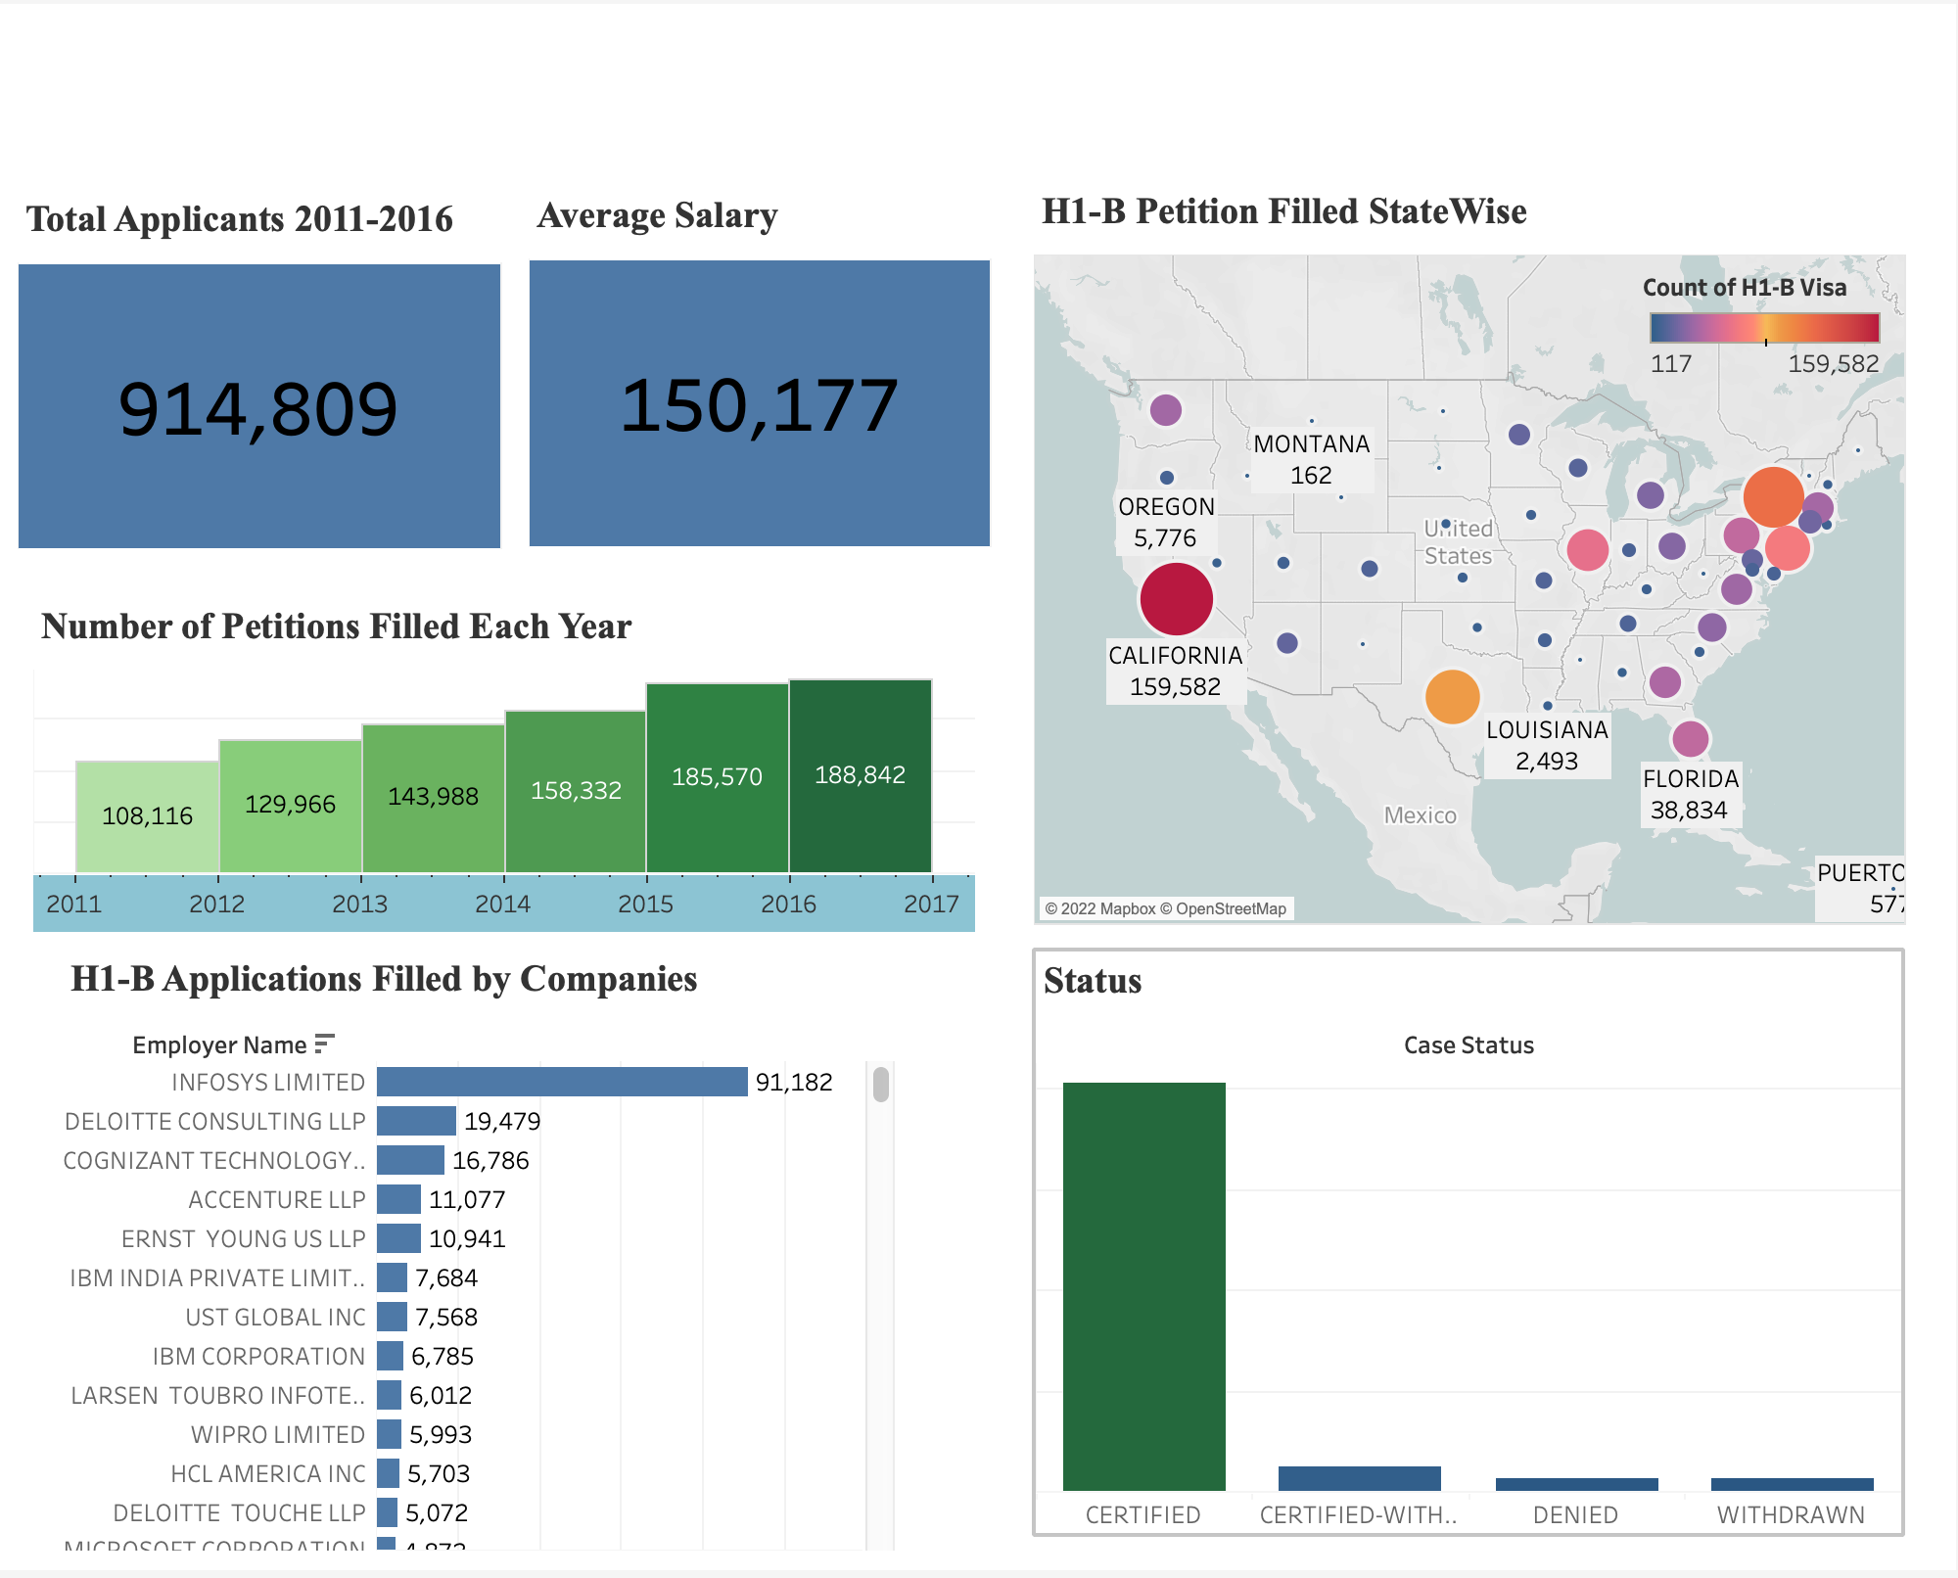
Visualization

Slide 9
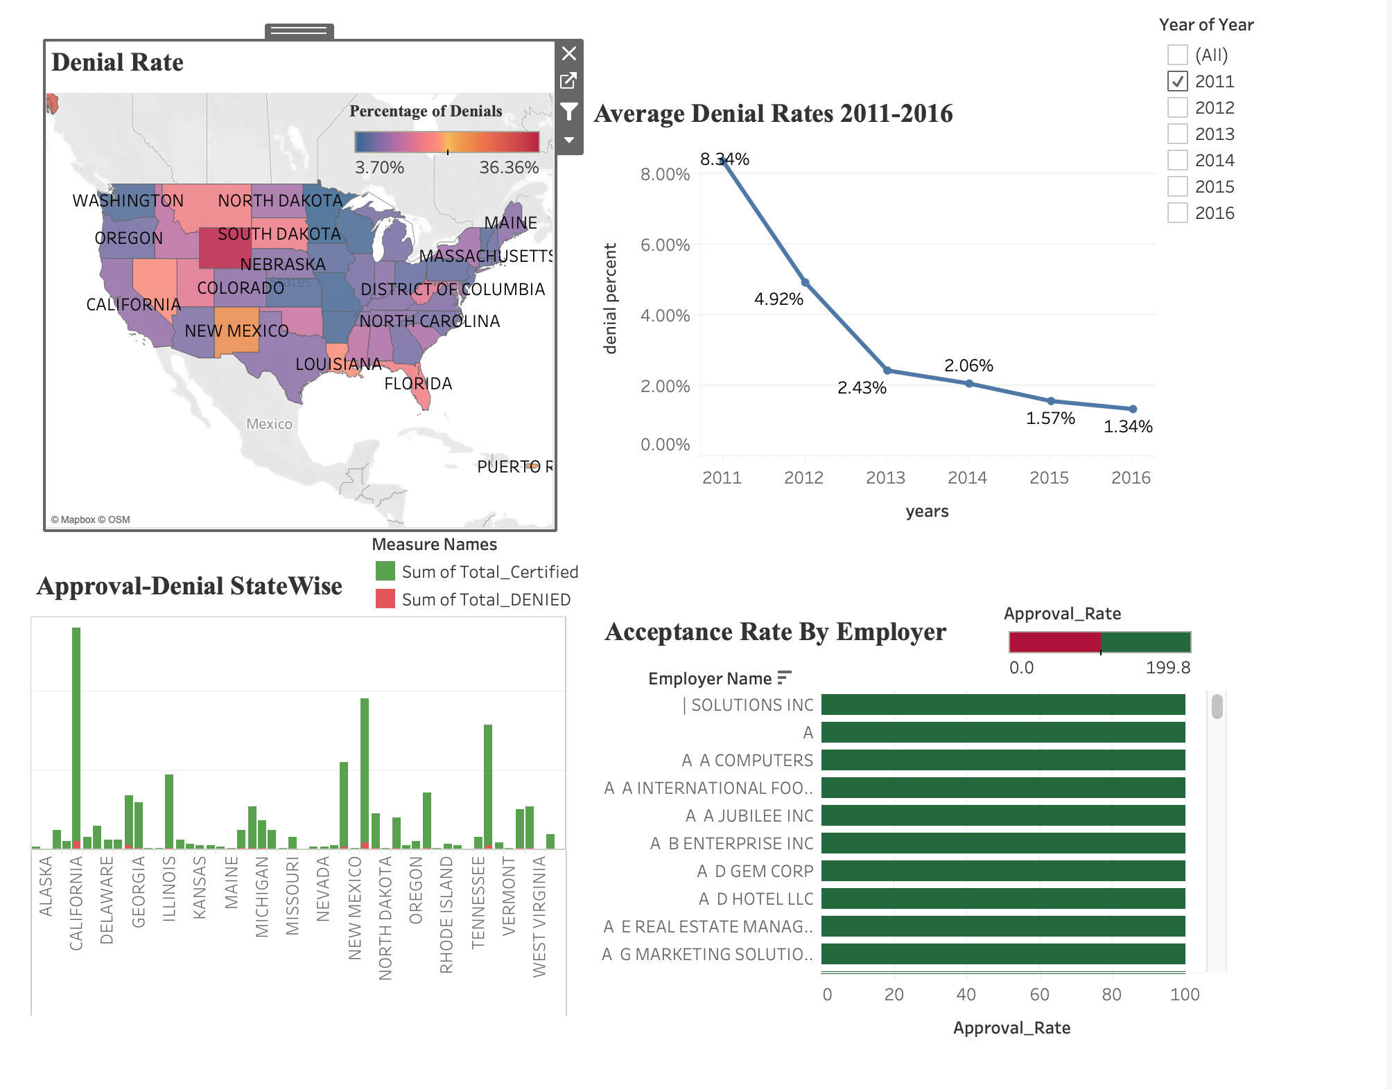
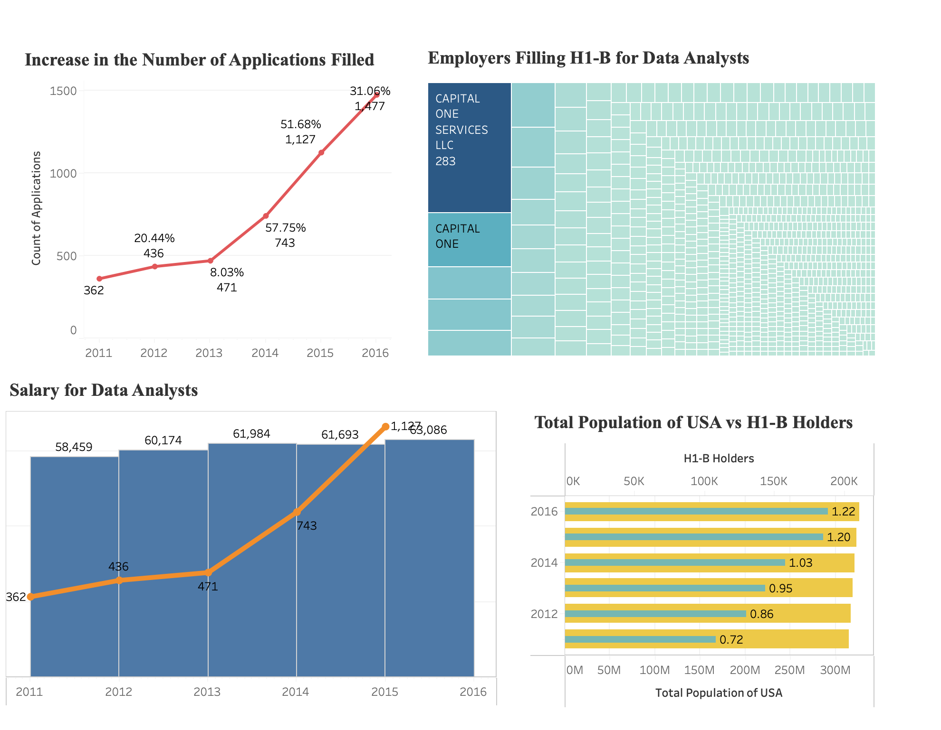
Visualization

Slide 10
Future Work
This study will be expanded for the following years to look at what happened after the president signed the "Buy American, Hire American" Petition. The income and demand for other jobs will also be examined since we have only focused on Data Analysts in this depiction. In addition, the number of H-1B candidates who file for PERM and citizenship will be examined.

Slide 11
Conclusion
The patterns depicted in this project offer a clear list of organizations who sponsor H-1B visas in the United States for various professions.
California, Massachusetts, New York, and Washington are the most popular states for filing H-1B visas.
The average pay of the data analyst is presented, indicating that this position is in high demand, with the compensation likely to rise with time
Furthermore, the number of applications has above the government's normal quota, demonstrating the need for the "Buy American Hire American" petition.
The visualization also clearly indicates which companies file the most H-1B visas, allowing applicants to target such companies when applying for job in the United States.

Slide 12
Thank You

