Slide 1


PROJECT PRESENTATION
BIG DATA HADOOP
G SOWMYA LAKSHMI | H1-B US VISA CASE STUDY
S170030600329| NIIT LIMITED

Slide 2
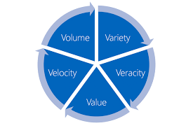
What is Big Data?
Big data is a collection of large datasets that cannot be processed using traditional computing techniques.
Big Data includes 5 V’s.

Slide 3

APACHE HADOOP
Hadoop is an open-source software framework for storing data and running applications on clusters of commodity hardware
Flexibility, Fault tolerance, reliability and scalability are some main features of hadoop
Hadoop tools include – Mapreduce Framework, Hive, Pig, Hbase, Sqoop, Flume, oozie etc.

Slide 4

H1-B US VISA
The H1-B is an employment based, non- immigrant visa category for temporary foreign workers in the United States.
Eligibility for appling H1- B is as follows:
Have a minimum entry requirement of a Bachelor's or higher degree or its equivalent
Hold an unrestricted state license, registration, or certification which authorizes you to fully practice the specialty occupation.

Slide 5
ABOUT THE PROJECT
Input data of H1-B US VISA DATA(CSV format)
Conversion of double quotes into tab seperated format using Hive and merging map outputs into a single text format using Pig.
Analysis - Eligible non-Immigrants to work in US.
Tools used - Mapreduce Framework, HiveQL, PIG, SQOOP
and MSExcel for data visualization.
Purpose - Analysis helps the government to find the eligible non-Immigrants to work in US.

Slide 6
Input Data includes
Case Status
Employer name
SOC name
Job Title
Full time position
Prevailing wage
Year
Worksite
Longitude
Latitude

Slide 7

HIVE ANALYSIS
Find the percentage and the count of each case status on total applications for each year.
Tool: Hive
Prerequsite: Input Data should be loaded in Hive table
Database- H1b Table- h1b_pro
Load the data in hive table using the following query:
LOAD DATA LOCAL INPATH ‘/home/sowmya/h1b.csv’
overwrite into table h1b_pro;

Slide 8
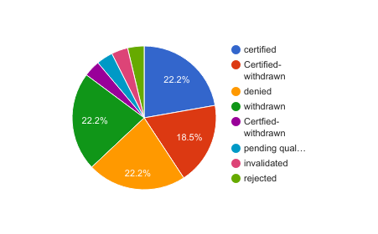
HIVE QUERY AND GRAPHICAL VIEW
hive(H1b)> select count(s_no) as count,round(((count(s_no)/t.tot)*100),2) as ctn,year,case_status from h1b_pro,(select count(s_no) as tot from h1b_pro)t where year!='NULL' or year!='NA' group by case_status,year,t.tot order by ctn desc;

Slide 9

Is number of petitions of Data Engineer increasing over the time?
Tool used : Pig
Pig operates in two modes- Local and mapreduce mode
Go to grunt shell by: pig -x local
Data set is loaded in a bag in Pig grunt shell or by using
the .pig script file.
The required tuples for Data Enginner is obtained using filter operator.
Count the Engineers and store the results.

Slide 10
PIG LATIN- SCRIPT
h1b= LOAD '/home/sowmya/Desktop/mapreduce' using PigStorage('\t') AS (s_no:int,case_status:chararray,employer_name:chararray,soc_name:chararray,job_title:chararray,full_time_position:chararray,prevailing_wage,year, worksite1:chararray,longitute, latitute);
filter_bag= filter h1b by job_title== 'DATA ENGINEER';
group_all= group filter_bag by year;
count_all= foreach group_all generate $0, COUNT(filter_bag) as headcount;

Slide 11
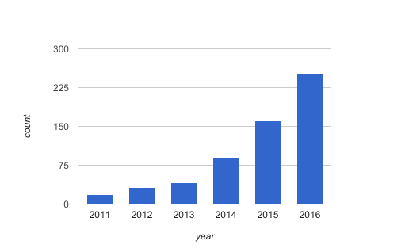
PREVIEW
Year | Count
2011 | 18
2012 | 32
2013 | 41
2014 | 89
2015 | 160
2016 | 251

Slide 12

MAPREDUCE FRAMEWORK
Input data should be put in HDFS(Hadoop Distrbuted File System)
Methodology:
Top 5 employers who file the most petition each year
Tree map is used in the program which sorts the values in ascending order
Cleanup( ) function is called at the end of the task.

Slide 13
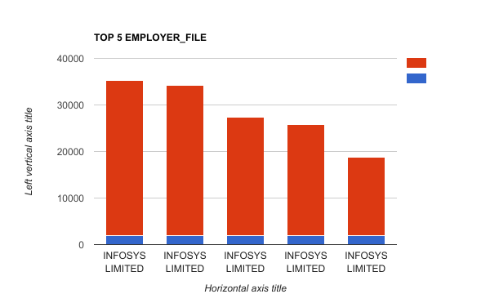
GRAPH

Slide 14
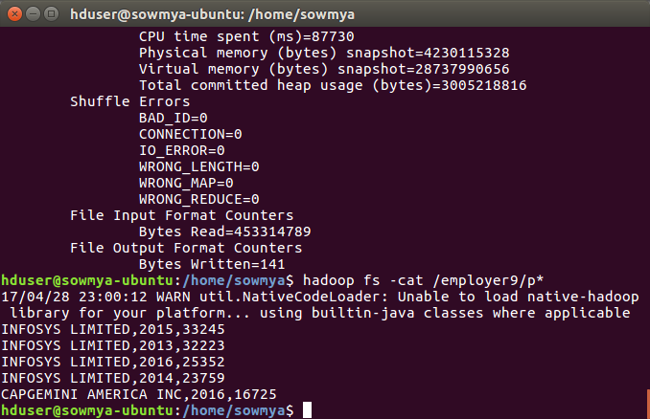
OUTPUT SAMPLE

Slide 15



SQOOP
Sqoop is used to import and export data from or to Relational Databases
It is provided by the Apache Software Foundation.

Slide 16
SQOOP IMPORT FROM HDFS TO MYSQL
Make an input file for the query and put it in HDFS by using the query:
hduser@sowmya-ubuntu:~$hadoop fs -put /home/sowmya/visa.txt /niit
Enter the mysql server: mysql -u root -p
Create a table in Mysql of database app:
create table h1b_app(
success_rate FLOAT NOT NULL,
position VARCHAR(40) NOT NULL,
status VARCHAR(40) NOT NULL,
PRIMARY KEY(success_rate));

Slide 17
SQOOP QUERY
sqoop export --connect jdbc:mysql://localhost/app --username root -P --table h1b_app --update-mode allowinsert --update-key success_rate --export-dir /niit/visa.txt --input-fields-terminated-by ',';
In Mysql :
mysql>select position,success_rate from h1b_app where position = ‘TECHNOLOGY ANALYST’;
Output:
POSITION | SUCCESS_RATE
TECHNOLOGY ANALYST | 0.87
r

Slide 18
ANALYSIS
Analysis of H1-B US-Visa is as follows:
The number of applications submitted for H1-B Visas are increasing repidly every year. So the government needs to select the top candidates
The top job positions who get certified are Programmer Analyst, Software Enginner and Computer Programmer
The top companies who get certified are Infosys Ltd, TCS Ltd and Wipro Ltd

Slide 19
Thank You

