Slide 1

Tweet Classifier Using Random Forest
Shiva sai Konda
Sowmya Varanganti
Siri Chandana Bomma
Sowmya Katla

Slide 2
Checkpoint 1
By tweet classifier using Random Forest algorithm we aim to classify customer tweets as favorable, negative, or neutral. The tweet classifier handles sentiment analysis, social media marketing, consumer feedback analysis, brand monitoring, and market research. Kaggle provided 1.6 million tweets. TF-IDF converts numbers and GPT models contextualize embeddings for feature extraction. Data collection, pre-processing, feature extraction, Random Forest classifier implementation, and outcome evaluation follow a flowchart. The project seeks to improve understanding of Twitter sentiment analysis, real-world data handling, Random Forest implementation, performance evaluation, and relevant insights.
The Random Forest twitter classifier project analyzes customer sentiment in tweets to deliver insights for numerous applications. It implements and evaluates sentiment analysis and machine learning methods to improve knowledge.

Slide 3
Checkpoint 2
The checkpoint 2 is explained with dataset description i.e., dataset has six fields: Target (polarity), Ids (ID), Date (date), Flag (query), User (author), and Text (content). GPT preprocessing removes special characters, URLs, mentions, and hashtags from tweets. Tokenization processes words. Pretrained GPT models incorporate tweets and extract features. The Random Forest classifier has training and testing sets. For classification and regression, the Random Forest approach is popular. Ensemble learning improves predictions. Tweets are preprocessed for special characters, hashtags, mentions, and URLs. TF-IDF matrices represent dataset features. Categories label tweets. The Random Forest classifier training and testing sets are then created.
The tweet classifier project preprocesses and extracts features using GPT and TF-IDF. The Random Forest algorithm is trained and tested to identify tweets by sentiment and polarity.

Slide 4
Checkpoint 3
Imported libraries manipulate and visualize data. Target value conversion and word count analysis preprocess the dataset. Lowercasing, deleting URLs, usernames, and punctuation, tokenization, and lemmatization preprocess text. Training and testing data are separated.
Pre-processed data trains Random Forest Classifier and Linear SVC models. Training and testing data accuracy is evaluated. Both models generate classification reports and confusion matrices.
It is also added with a screenshot of the results including technologies Used such as Python and Machine Learning Library i.e., sci-kit learn.
Finally, Random Forest and Linear SVC machine learning algorithms are used to classify tweet sentiment. Preprocessing and model evaluation reveal classification performance. This analysis uses Python with sci-kit learn.

Slide 5
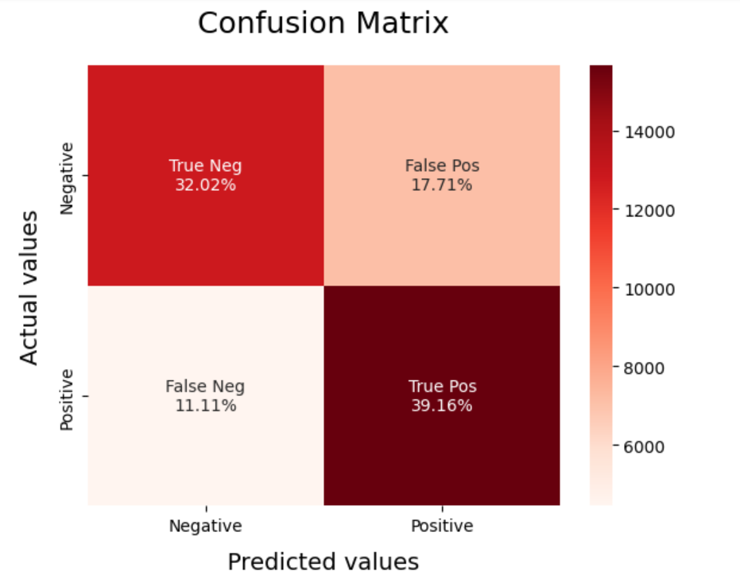
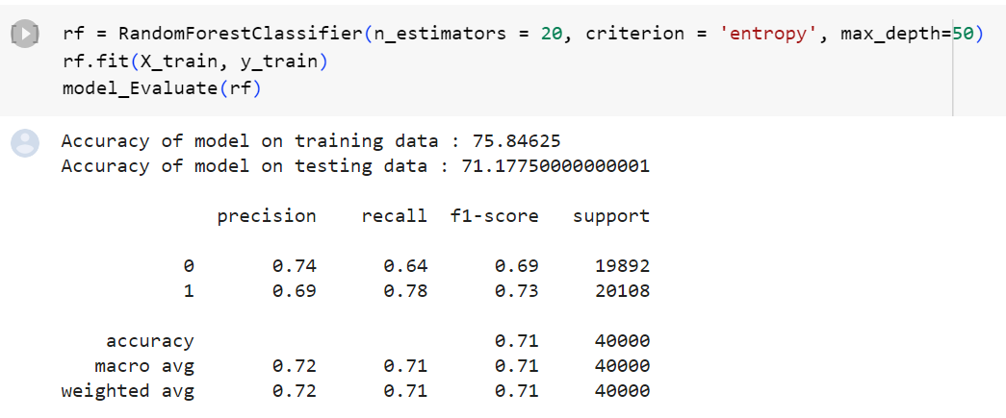
Check point 4

Slide 6
Thank You

