Slide 1

Ready, Steady…. Go – The Programming Language http://golang.org
May 19, 2021
By,
Sowndariya M

Slide 2
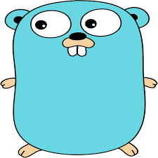
What will we see in Go?
What is Go?
Why a New Language?
Variables
Who were the creators?
History of Go
Control flow statements: Defer, Panic and Recover
Primitives
Constants
Arrays and Slices
Maps and Structs
Conditional Statements: If , Switch, Looping
Interface
Goroutines
Channels
Packages
Pointers
Functions
Errors
Concurrency

Slide 3

What will we not see in Go?
Exception Handling
Generics
Assert
Inheritance
Method Overload
Have not been implemented in favour of efficiency

Slide 4


What is Go?
Go is a compiled, concurrent, garbage-collected, statically typed language developed at Google.

Slide 5

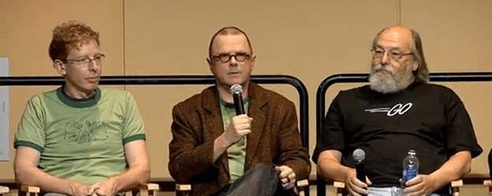
Who were the Creators?

Slide 6
History Of Go
In 2007, Founders of Golang started and built as a part-time project.
In 2008, A lot of others people help to bring go from prototype to reality.
In 2009, Go became a public Open Source project.
In 2010, Starts to have adoption by other programmers.

Slide 7
Why a New Language?
Python is easy to use, but SLOW
Java is increasing complex type system
Complex type system slow compile times

Slide 8
Why Go? Cont…
It was designed by and for the people who read, write, debug and maintain large software systems. It’s purpose is to make its designer’s programming lives better.
Ease of use.
Edit/refresh cycle relative fast.
Best for cloud compatibility.
Eliminate clumsiness.
Improve productive.
Eliminate Slowness.

Slide 9

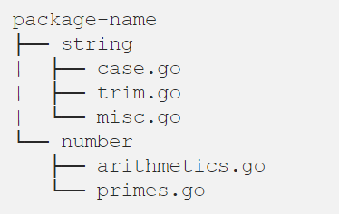
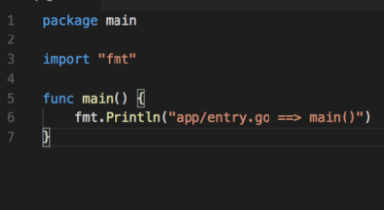
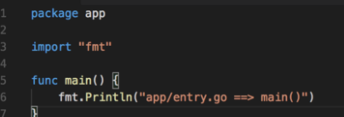
Packages
Ref: https://medium.com/rungo/everything-you-need-to-know-about-packages-in-go-b8bac62b74cc

Slide 10

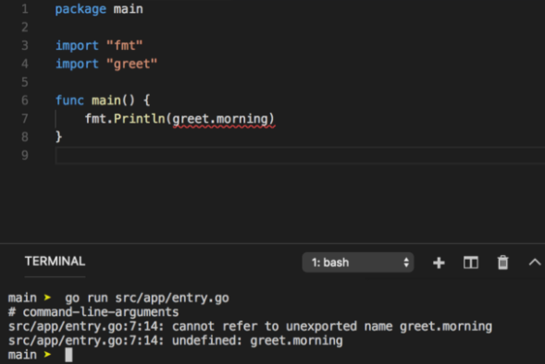
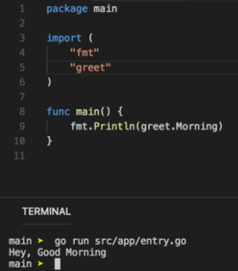
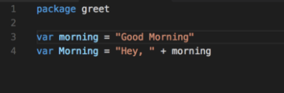
Packages - Example

Slide 11

Variables
All variables must be used.
Can’t redeclare variables, but can shadow them.
var a int
Var a int = 100
a:=100
Variable Declaration

Slide 12
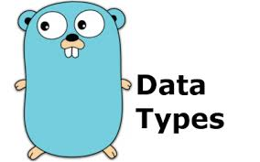
Primitives
package main
import (
"fmt"
)
var (
a_bool bool
b_int int
c_float float64
d_string string
e_rune rune
f_byte byte
g_complex complex64
)
func main() {
fmt.Printf("Type: %T Value: %v\n", a_bool, a_bool)
fmt.Printf("Type: %T Value: %v\n", b_int, b_int)
fmt.Printf("Type: %T Value: %v\n", c_float, c_float)
fmt.Printf("Type: %T Value: %v\n", d_string, d_string)
fmt.Printf("Type: %T Value: %v\n", e_rune, e_rune)
fmt.Printf("Type: %T Value: %v\n", f_byte, f_byte)
fmt.Printf("Type: %T Value: %v\n", g_complex, g_complex)
}
Output:
Type: bool Value: false
Type: int Value: 0
Type: float64 Value: 0
Type: string Value:
Type: int32 Value: 0
Type: uint8 Value: 0
Type: complex64 Value: (0+0i)
Program exited.

Slide 13
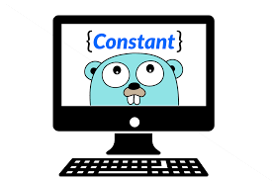
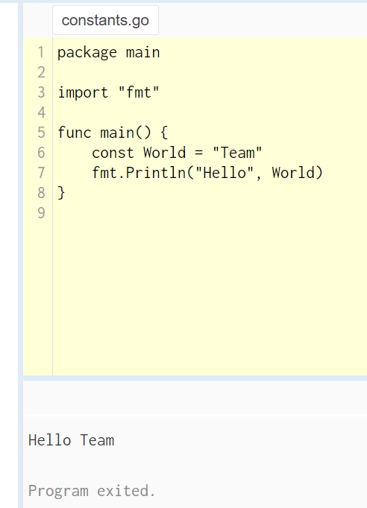
Constants
Constants are declared like variables, but with the const keyword.
It can be character, string, Boolean, or numeric values.
It cannot be declared using the := syntax.

Slide 14
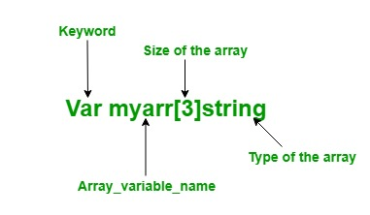
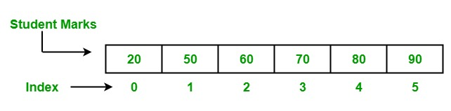
Arrays and Slices
Array Declaration Styles:
1. Using Shorthand declaration:
2. Using Var Keyword:
arr:= [6]int{20,50,60,70,80,90}
Array Types:
One Dimensional Array
Two Dimensional Array

Slide 15
Arrays and Slices Cont..
Slice Declaration Styles:
1. New slice — not sliced out of anything.
2. From an existing array.
a := make([]int, 10)
Creating Slice with capacity and length == 10.
a := make([]int, 10,100)
Slice with length == 10 and capacity == 100.
myArray := [10]int{0,1,2,3,4,5,6,7,8,9) mySlice1 := myArray[1:5]
firstly we need an array
slice from 1st up to 5th element, so [1 2 3 4]

Slide 16
Arrays and Slices Cont..
Appending and copying:
Append
It appends new elements at the end of slice, and grows the slice if greater capacity is needed.
Copy
Example: s s:= []int{1,2,3} // creates slice s == [1 2 3] t := make([]int, len(s), cap(s)*2) // creates new slice t, filled with zero- values (0s for int), of specified length and capacity copy(t, s) s = t // cap(s) == 3 // cap(t) == 6
Syntax: append(slice []Type, elements...Type) []Type
Example:
a := []string{"a", "b", "c"} b := []string{"x", "y", "z"} a = append(a,b) // equivalent to "append(a, b[0], b[1], b[2])"
fmt.Printf("%d %v", cap(a), a) // 6 [a b c x y z]
Syntax: copy(destination, source []T) int

Slide 17
Arrays and Slices Cont..
Arrays Vs Slices - when to use which?
Arrays
use them with super caution
Arrays are useful when planning the detailed layout of memory and sometimes can help avoid allocation, but primarily they are a building block for slices.
Slices
use them almost all the time
slices hold references to an underlying array(=it doesn’t store any data), and if you assign one slice to another, both refer to the same array
changing the elements of a slice modifies the corresponding elements of its underlying array and we modify elements of slice, it modifies corresponding array, and all other slices that refers to it;

Slide 18
Maps and Structs
Collection of value types that are accessed via keys.
Created via literals or via make function.
Members accessed via [key] syntax.
Syntax: myMap[“Key”] = “value”
Check for presence with “value,ok” form of result
Maps

Slide 19
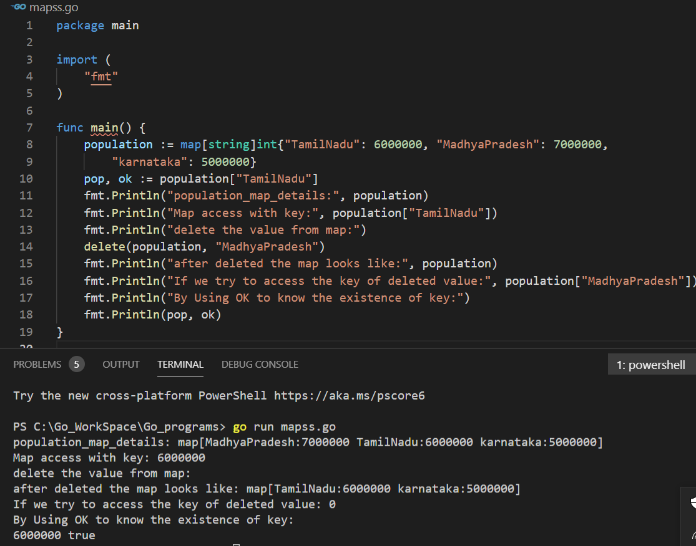
Maps and Structs Cont….
Example - Maps

Slide 20
Maps and Structs Cont….
Collections of disparate data types that describe a single concept.
Tags can be added to struct fields to describe field.
Keyed by named fields.
Normally created as types, but anonymous structs are allowed.
Structs are value types.
No inheritance but we can use composition via embedding.
Structs

Slide 21
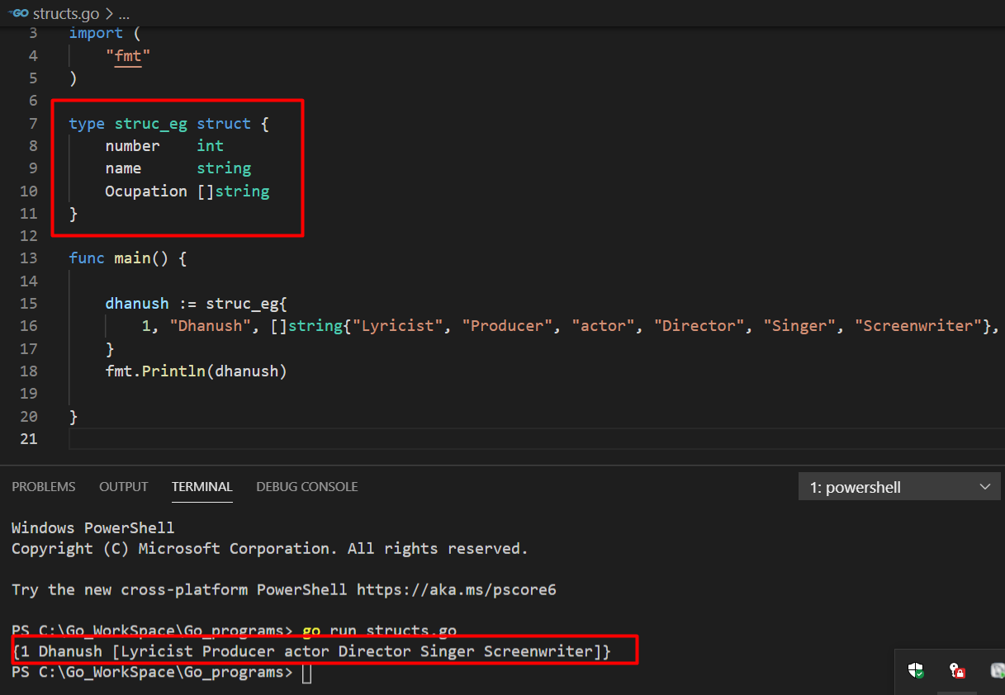
Maps and Structs Cont….
Example - Structs

Slide 22
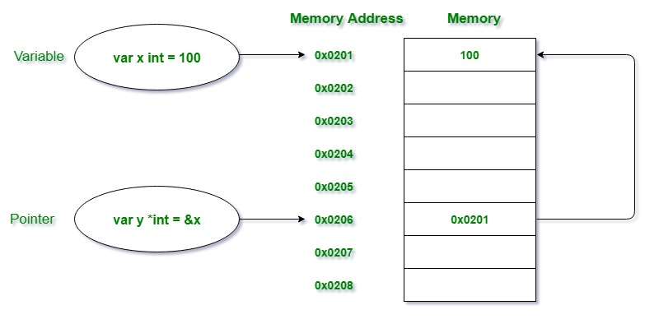
Pointers
Pointers is a variable which is used to store the memory address of another variable. Pointers in Golang is also termed as the special variables. The variables are used to store some data at a particular memory address in the system.

Slide 23
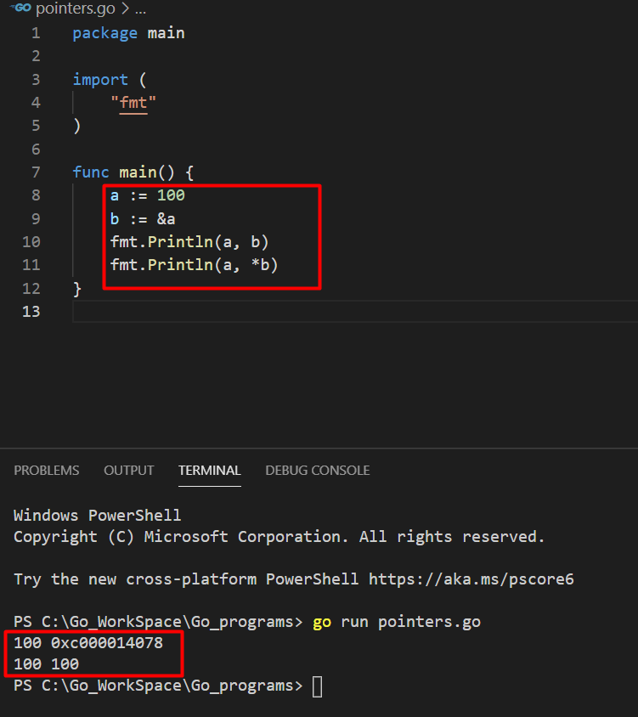
Pointers Cont….
Example

Slide 24
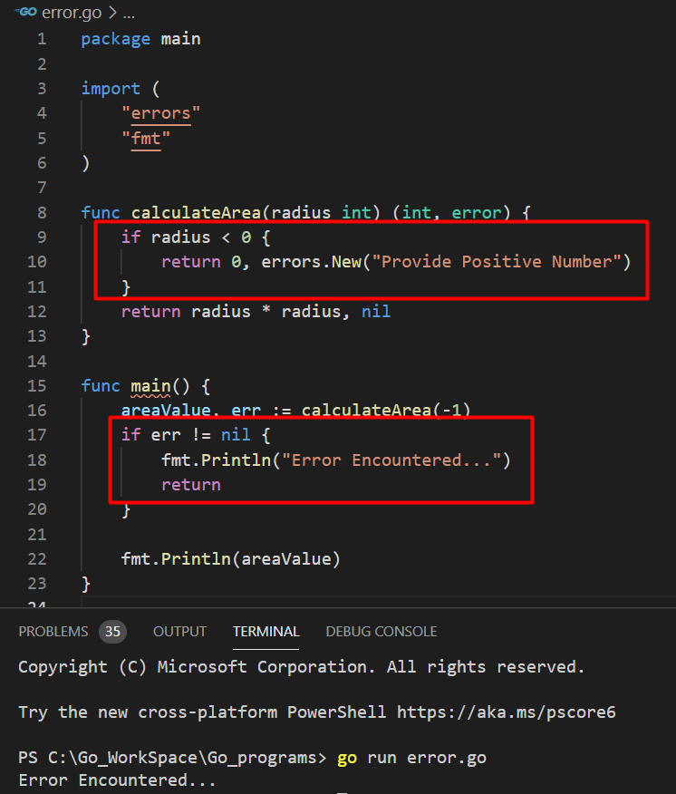
Errors
Errors package is used to implement the functions to manipulate the errors.
errors.New() function returns an error that formats like given text.

Slide 25
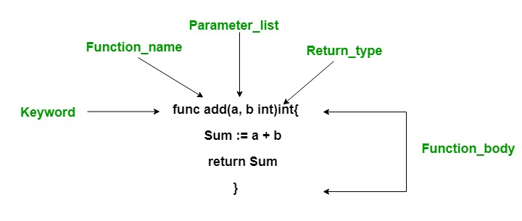
Functions
Functions are generally the block of codes or statements in a program that gives the user the ability to reuse the same code which ultimately saves the excessive use of memory, acts as a time saver and more importantly, provides better readability of the code.
It is a collection of statements that perform some specific task and return the result to the caller.

Slide 26
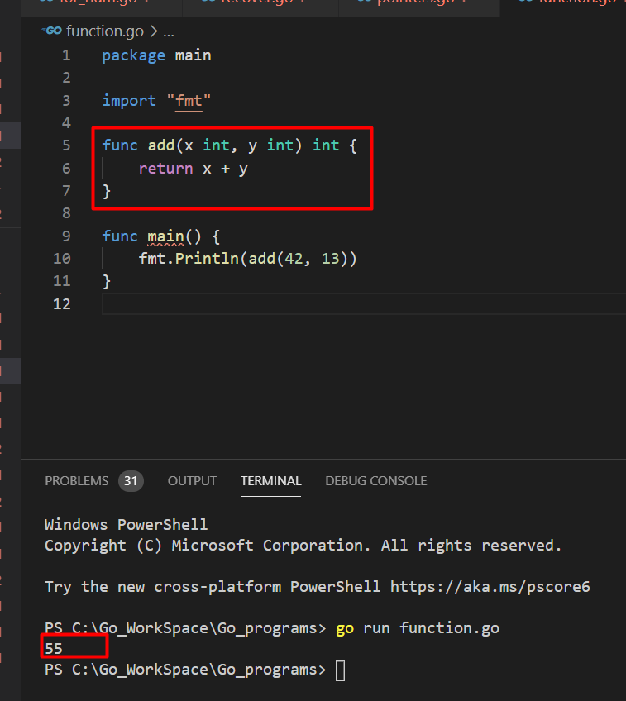
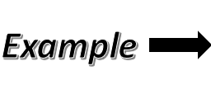
Functions Cont….

Slide 27
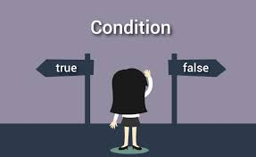
Conditional Statements:
If
This is used to execute a block of code only ifthe specified condition evaluates to true.
This statement allows you to execute one block of code if the specified condition is evaluates to true and another block of code if it is evaluates to false.
The if...else if...else statement allows to combine multiple if...else statements.
if...else if...else
If else
If Statement:

Slide 28
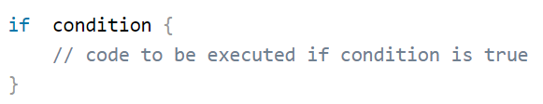
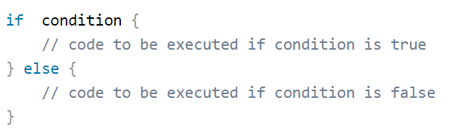
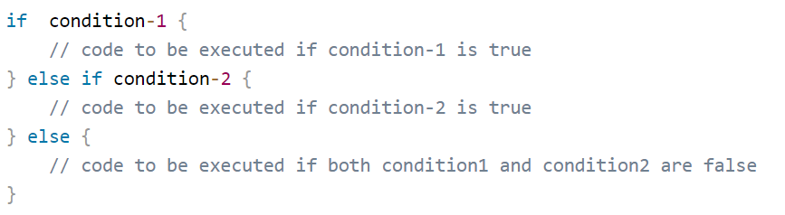
Conditional Statements Cont….
If Statement – Syntaxes:
If
If-else
If...else if...else

Slide 29
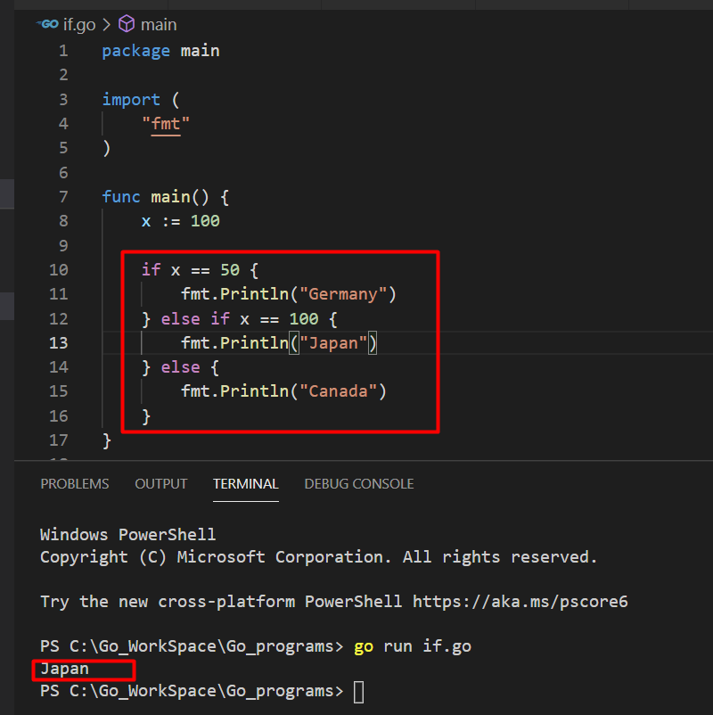
Conditional Statements Cont….
Example - If

Slide 30
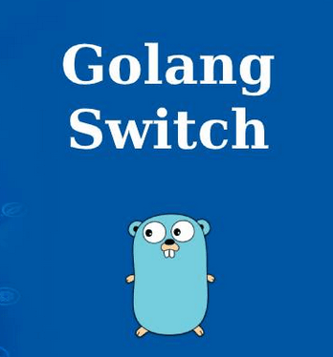
Conditional Statements Cont….
Switch Statement:
Switch case is used to execute a particular code block when we have multiple code blocks based on condition. It is an alternative syntax for writing if-else block. ... Type Switch -Switch expressions types are compared with case expressions.
Switch fallthrough case Statement:
The fallthrough keyword used to force the execution flow to fall through the successive case block.
Ref: https://www.golangprograms.com

Slide 31
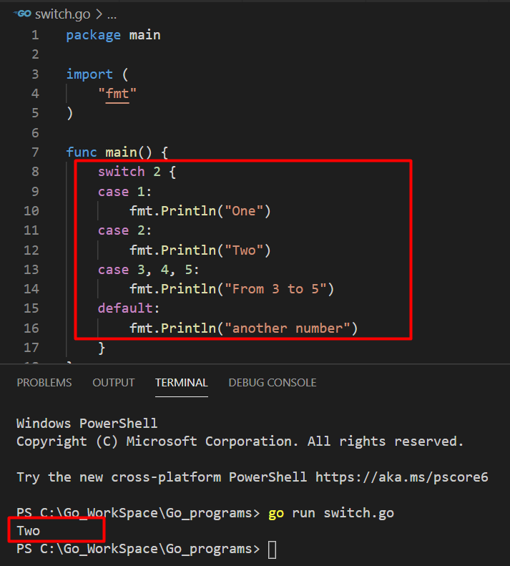
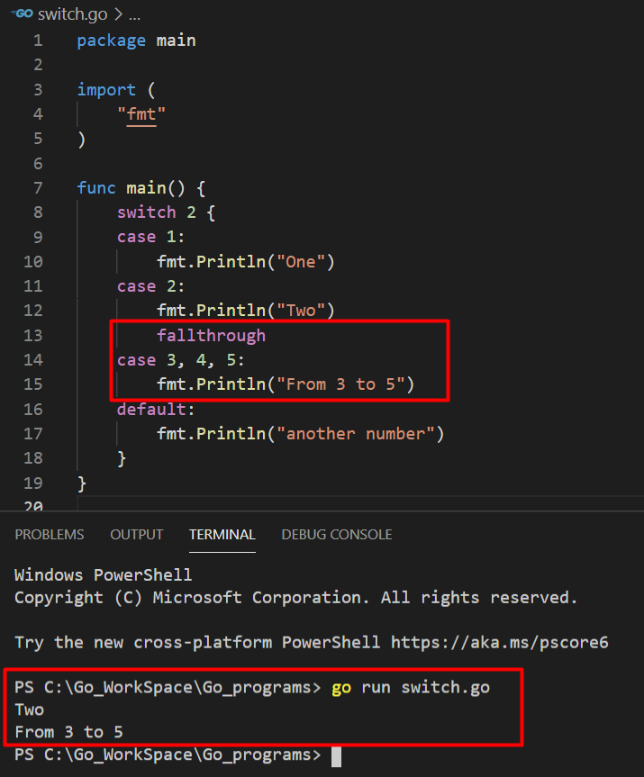
Conditional Statements Cont….

Slide 32
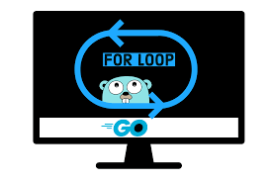
Conditional Statements Cont….
Loop:
As a language related to the C-family, Golang also supports for loop style control structures.
Golang has no while loop because the for loop serves the same purpose when used with a single condition.
1. for range Statement:
The for statement supports one additional form that uses the keyword range to iterate over an expression that evaluates to an array, slice, map, string, or channel.
2. range loop over string:
The for loop iterate over each character of string.
3. Infinite Loop:
The for loop runs infinite times unless until we can't break.

Slide 33
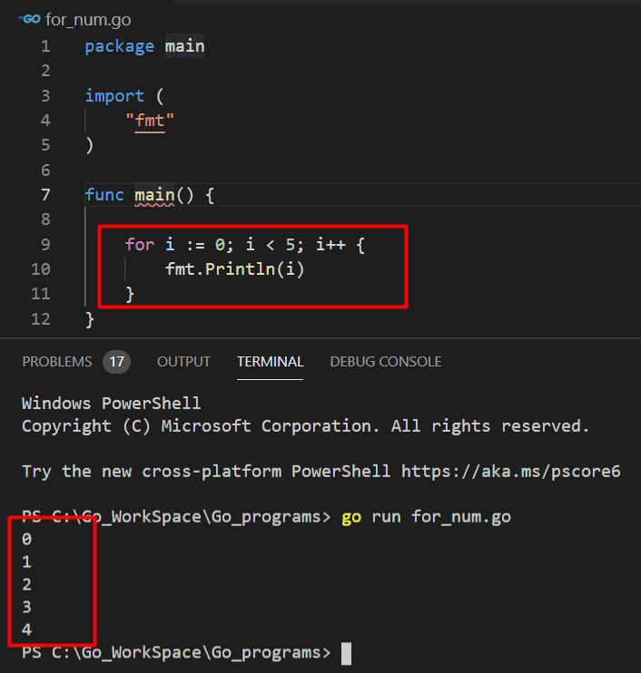
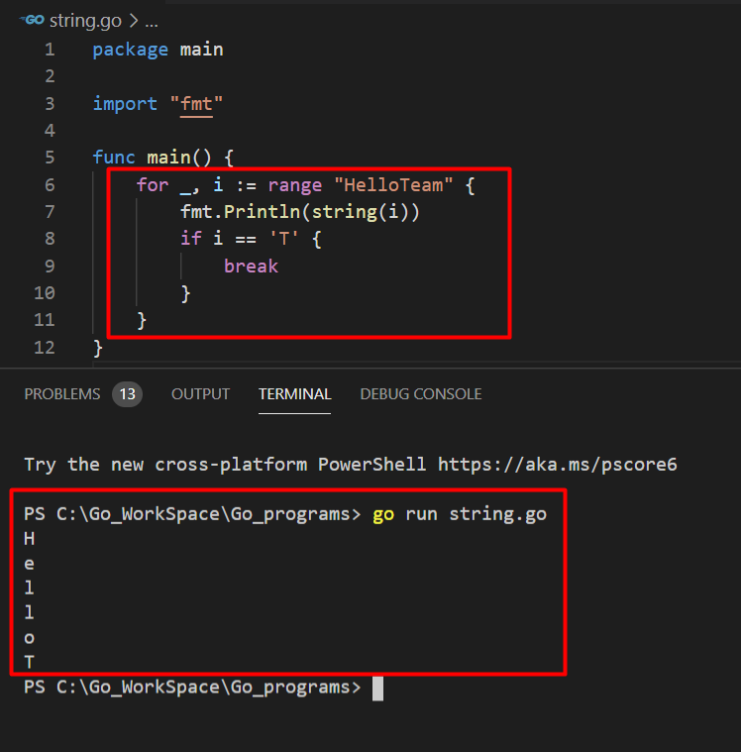
Conditional Statements Cont…. - LOOP

Slide 34
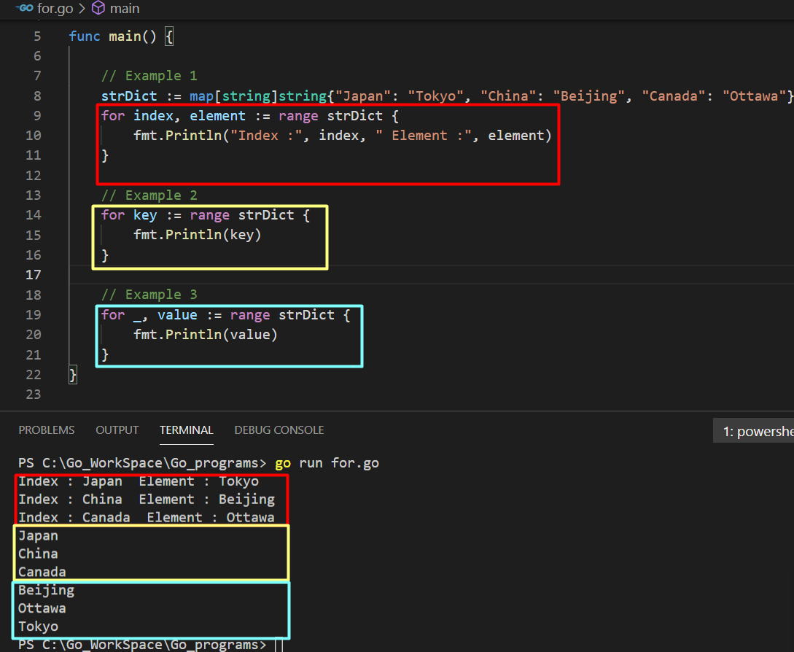
Conditional Statements Cont…. - LOOP

Slide 35
Control flow Statements: Defer, Panic, Recover
Defer
It schedules a function call to run immediately before the function returns
Panic
Occur when program cannot continue at all.
Function will stop executing.
Recover
Used to recover from panics.
Deferred functions will still fire.
If nothing handles panic, program will exit.
Only useful in deferred functions.
Current function will not attempt to continue, but higher functions in call stack will.
It can be placed at any point in the code
Functions marked with “defer” execute even if the error is encountered
Ref: https://medium.com/technofunnel/error-handling-in-golang-with-panic-defer-and-recover-d77db7ae3875

Slide 36
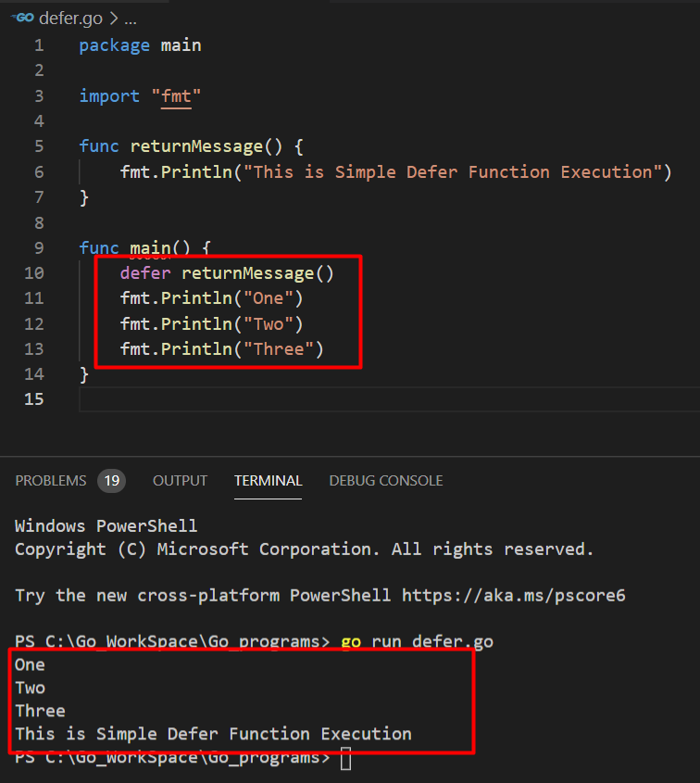
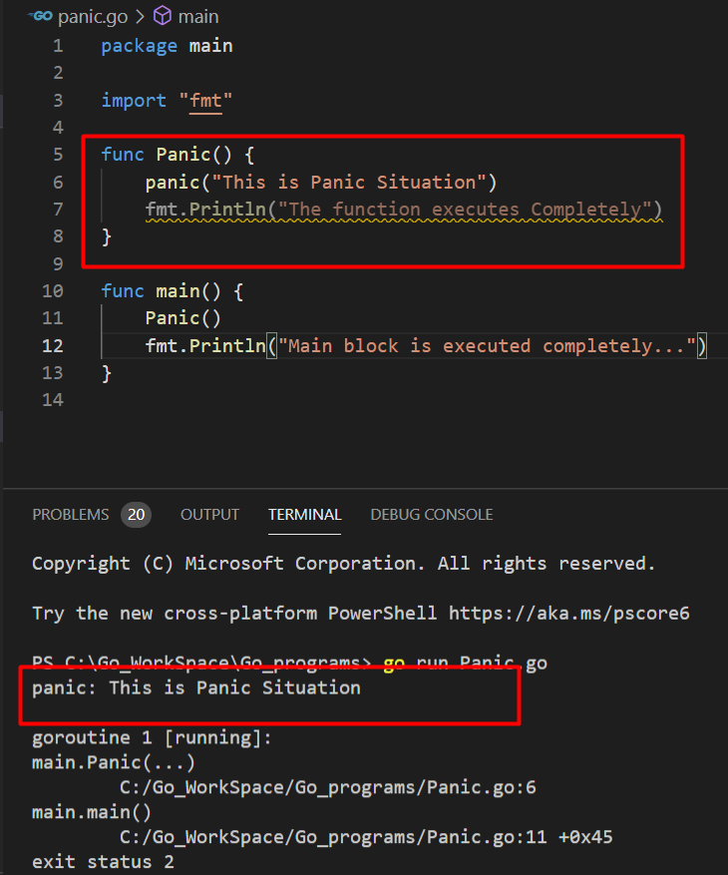
Control flow Statements Cont….

Slide 37
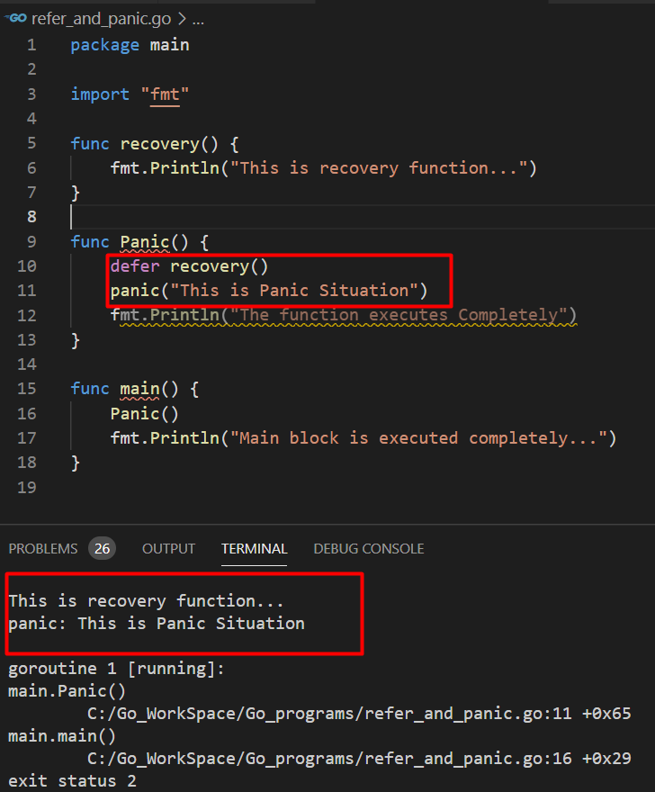
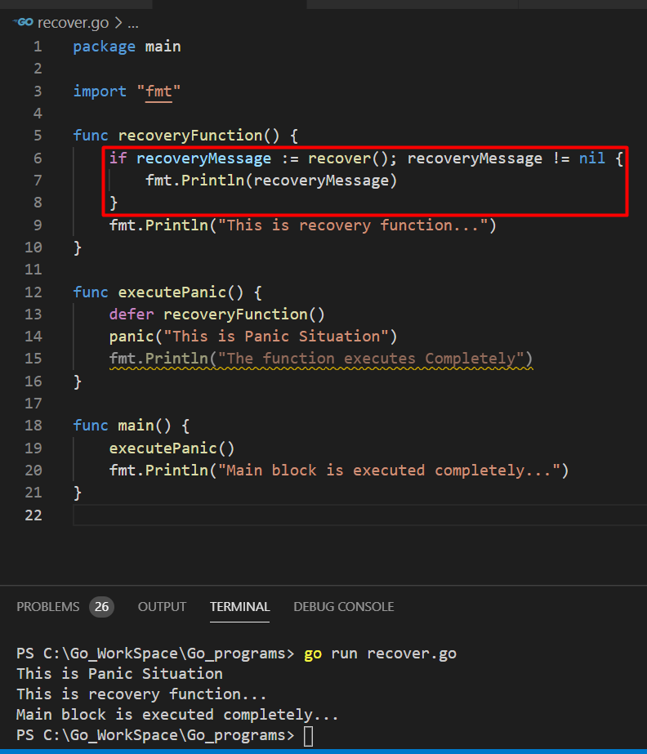
Control flow Statements Cont….

Slide 38

Interface
The interface is a custom type that is used to specify a set of one or more method signatures.
Syntax:
type interface_name interface {
// Method signatures
}
Ref: https://www.geeksforgeeks.org/interfaces-in-golang/

Slide 39
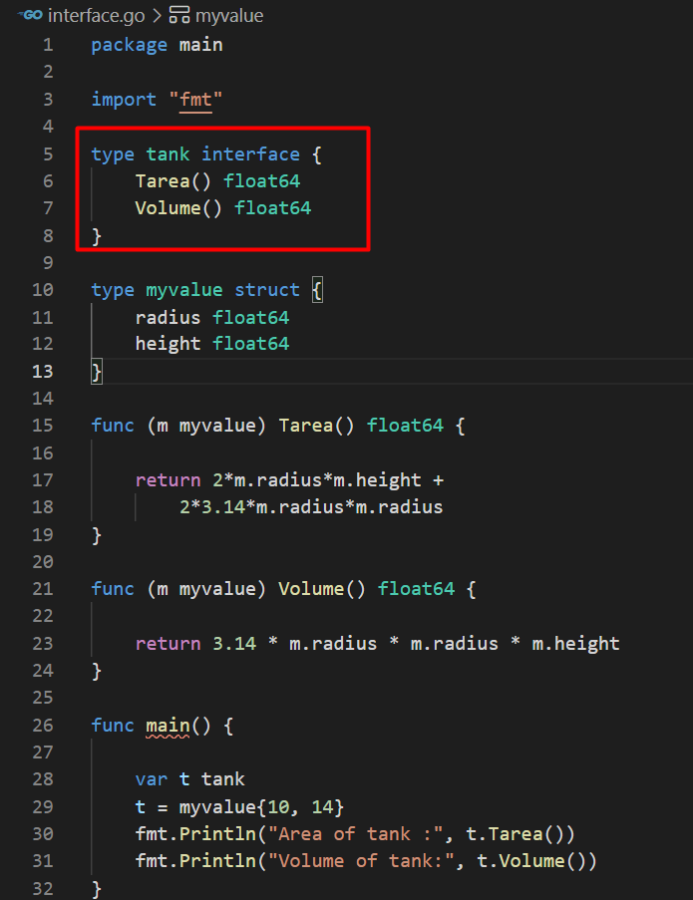

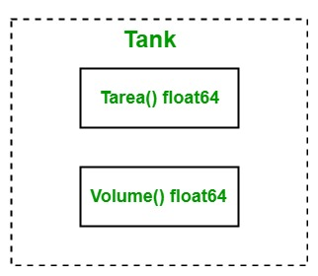
OUTPUT :

Slide 40

Concurrency
We could run our tasks sequentially in a single thread. But it does not fit for our problems.
So , we use more than one thread to run our task asynchronously.
Concurrency is not the same with running tasks at the same time.
Running tasks as parallel is a mix of hardware and software requirements. But concurrency is about our code design.
concurrency is the ability of different parts or units of a program, algorithm, or problem to be executed out-of-order or in partial order, without affecting the final outcome.

Slide 41
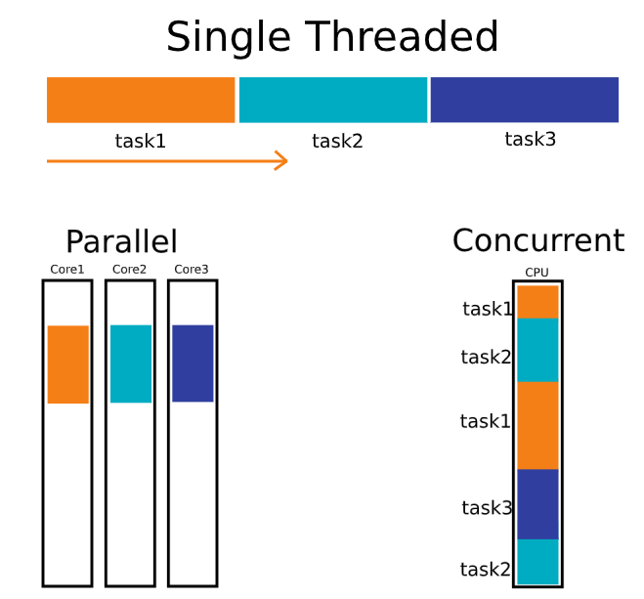
Parallel Vs Concurrent

Slide 42

Problems in Concurrency
Shared resource is one of them. Shared resources can be accessed by several threads concurrently. So, the sequence of access to that resource is important.
When a thread tries to read a shared variable, another thread may change the value of the shared variable. That may cause inconsistency.

Slide 43

Concurrency solution in Go
We may solve concurrency problems using Wait group, Mutexes etc. when one thread tries to access the shared resource, it locks the critical section, in this way other threads can not access the shared resource until the section is unlocked.
Go solves those problems in another way. It uses goroutines instead of threads and uses channels instead of accessing to a shared state.

Slide 44
Wait group, Mutexes:
Waitgroup:
It is used to sync multiple goroutines together, it will sync main function with synonyms goroutine.
It is globally access our application, by that share the object concurrently.
Mutexes :
A Mutex is used to provide a locking mechanism to ensure that only one Goroutine is running the critical section of code at any point in time.
Mutex is available in the sync package.
There are two methods defined on Mutex namely Lock and Unlock.
Any code that is present between a call to Lock and Unlock will be executed by only one Goroutine.

Slide 45
Why Go routines?
Threads in a traditional Java application map directly to OS threads by JVM. Go uses goroutines rather than threads.
Goroutines are divided onto small numbers of OS threads. They exist only in the virtual space of go runtime. Go has a segmented stack that grows when needed. That means it is controlled by Go runtime, not OS.
Goroutines have other advantages like startup time. Goroutines are started faster than threads.
Goroutines are created with only 2 KB stack size. A Java thread takes about 1 MB stack size.

Slide 46
How Go routines are communicating?
Goroutines are good and easy to use. But how they communicate? We have learned a term called “shared resource” .
Do the goroutines access to a shared resource? The answer is NO.
It is not preferred to use a shared resource in Go. Instead use channels to communicate goroutines. Go’s concurrency model relies on CSP (Communicating Sequential Processes, 1978).
This approach ensures that only one goroutine access to the data at a given time.

Slide 47



Ref.Program for Goroutines :
( find the following programs in the footer github link)
goroutine.go
arg_race_goroutine.go
sync_wait.go
sync_wait_issue.go
sync_Mutex.go
runtimegomax.go

Slide 48

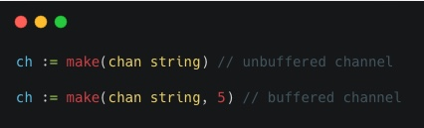
Go Channels
Go channels are like pipes. One goroutine sends data, other goroutines receive that data from the other side.
There are 2 types of channels called buffered and unbuffered.

Slide 49
Go Channels types
Buffered channel
There is a given capacity to hold data in the buffered channel.
Channels block sender side till receiver is available and block receiver side till message is available.
A buffered channel is asynchronous; It can decouple sender and receiver with buffered channels.
We should use buffered channel when send and receiver have asymmetric loading.
Unbuffered channel
It does not have the capacity to hold more than one data. That means, only one piece of data fits through the unbuffered channel at a time.

Slide 50
Go Channels - elements
For range loops with channels
Use to monitor channel and process messages as they arrive.
Loop exits if channel is closed.
Channel Direction – to restrict the data flow
We can specify a direction on a channel type thus restricting it to either sending or receiving.
Send - Only : func pinger(c chan<- string)
Receive - Only: func printer(c <-chan string)
Select
Go has a special statement called select which works like a switch but for channels.
Allows goroutine to monitor several channels at once.
If multiple channels receive value simultaneously, behaviour is undefined.
Default
The default case happens immediately if none of the channels are ready..

Slide 51
Ref.Program – Goroutine channels:
( find the following programs in the footer github link)
channel.go
channel_unbuffered_for_loop.go
channel_unbuffer_issue.go
channel_send_receive.go
buffered_channel.go
buffered_ok.go
Select_default.go

Slide 52







Top Seven Companies using Golang

Slide 53

Golang – The future of Programming?
The Go language seems to be more relevant to the present day than most of the commonly used languages. Thanks to the simplicity and the principle of “one problem – one solution”, it allows the companies using Golang to work on large projects.

Slide 54


Thank You

Slide 55
REFERENCES:
http://golang.org/doc
https://medium.com/rungo/everything-you-need-to-know-about-packages-in-go-b8bac62b74cc
https://www.golangprograms.com
https://www.geeksforgeeks.org/interfaces-in-golang/
https://medium.com/technofunnel/error-handling-in-golang-with-panic-defer-and-recover-d77db7ae3875
https://www.geeksforgeeks.org/interfaces-in-golang/
https://golangbot.com/mutex/
https://brainhub.eu/library/companies-using-golang/
https://youtu.be/YS4e4q9oBaU
Online IDE for golang: https://play.golang.org
To install go : https://golang.org/doc/install
To access all programs : https://github.com/SowndaRiya-M/golang_programs

