Slide 1


Bharathi Education Trust(R) G MADEGOWDA INSTITUTE OF TECHNOLOGY (AFFILIATED TO VTU, APPROVED BY AICTE) DEPARTMENT OF COMPUTER SCIENCE & ENGINEERING
FINAL PROJECT PRESENTATION
ONLINE EXAMINATION PORTAL
Presented by
Lavanya S 4MG17CS011
Niranjanprasad M 4MG17CS018
Ruchitha C N 4MG17CS024
Sowndarya K P 4MG17CS031
Under the Guidance of
Mr. PRADEEP B M
Assistant Professor
Dept. of CSE, GMIT

Slide 2
CONTENTS
Abstract
Introduction
Problem Statement
Existing system
Proposed system
Hardware & Software Requirements
Data Flow Diagram
Advantages and Limitations
Conclusion
References

Slide 3
ABSTRACT
Online Examination Portal is a software solution, which allows a College or institute to arrange, conduct and manage examinations via an online environment. This can be done through the Internet, Intranet and/or Local Area Network environments.
The main goal of this online examination system is to effectively evaluate the student thoroughly through a totally automated system that not only reduce the required time but also obtain fast and accurate results.
It provides an easy to use environment for both Faculties and Students appearing for Examination. It fulfills the requirements of the institutes to conduct the exams online. The purpose of the site is to provide a system that saves the efforts and time of Faculty.

Slide 4
INTRODUCTION
Online Examination portal is a project which is developed or implemented in Java domain.
The purpose of online examination portal is to automate the existing manual system by the help of computerized equipment's, so that their data can be stored for a longer period with easy accessing and manipulation of the same.
We are developing this system which is very useful for all students to take exams from their place itself.
In current generation lots of the examinations like GATE, JEE, and NEE Etc. are conducted through online.
Already many Competitive exams and Entrance exams are conducting in online mode.

Slide 5
This website is simple and easy to use. It is implemented based on 4 login modules and an admin login.
Principal module
HOD module
Faculty module
Student module
During this pandemic situation students can’t take offline exams in college. So that they can easily attend Exams through this website.
Faculties can also easily monitor each and every student and can do digital evaluation securely.
Principal and HOD’s can also monitor all the actions done by their next lower level users.

Slide 6
PROBLEM STATEMENT
This project aims at developing a Website which provides a platform to attend the exams by Students, to submit their assignments and to access their results in a single website.

Slide 7
EXISTING SYSTEM
The whole process of assigning test and evaluating their scores after the test was done manually till date.
The current system is very time consuming.
More invigilators are required.
The chances of paper leakages are more.
Result processing takes more time as it is done manually.
The answer sheets and other important paper works are storing for a long duration, so that it will get tared, erase or it may cause any damages in future.

Slide 8
PROPOSED SYSTEM
In comparison to the present system the proposed system will be less time consuming and is more efficient.
This system is very secure as no chances of leakage of questions paper as it is dependent on the administrator only.
Results will be very accurate and will be declared in very short span of time.
The logs of appeared candidates and their marks are stored and can be backup for the future use.
Here students can take exams, can submit assignments, also they can view their results from this single website.
The application is reduced as much as possible to avoid errors while entering the data. It also provides error messages while entering invalid data.

Slide 9
HARDWARE & SOFTWARE REQUIREMENTS
HARDWARE :
Processor : Intel's Core i5
RAM: 4GB
Hard disk : 1TB
SOFTWARE :
Operating System : Windows 7 and above.
Front end : JSP, HTML , CSS, Bootstrap
Back end: Java, Ajax , JQuery.
Tools : MySQL , JDK, NETBEANS.

Slide 10
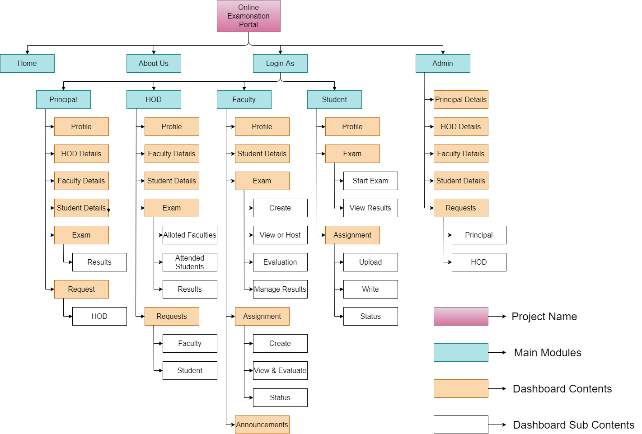
DATA FLOW DIAGRAM
OVERALL SITE MAP

Slide 11
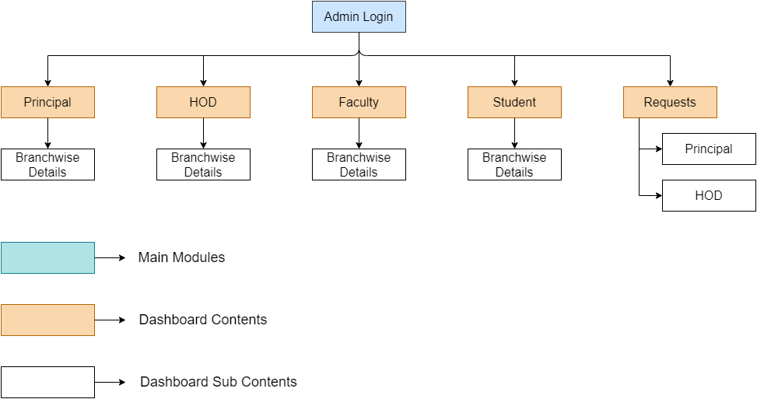
ADMIN

Slide 12
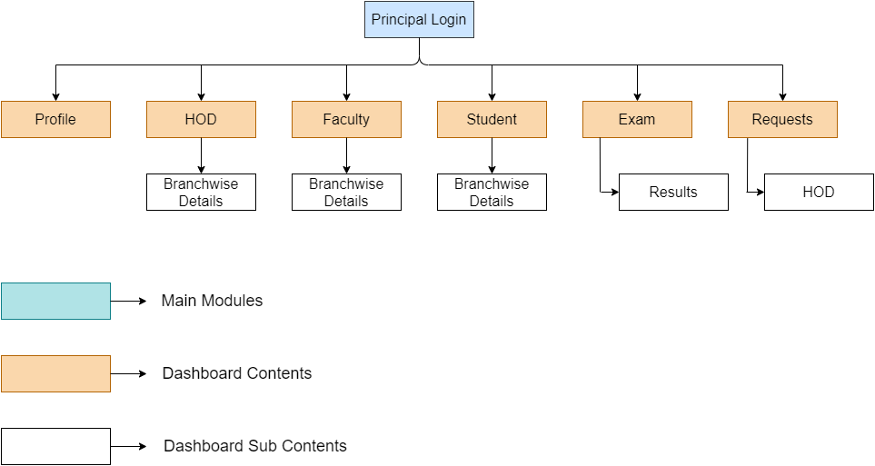
PRINCIPAL

Slide 13
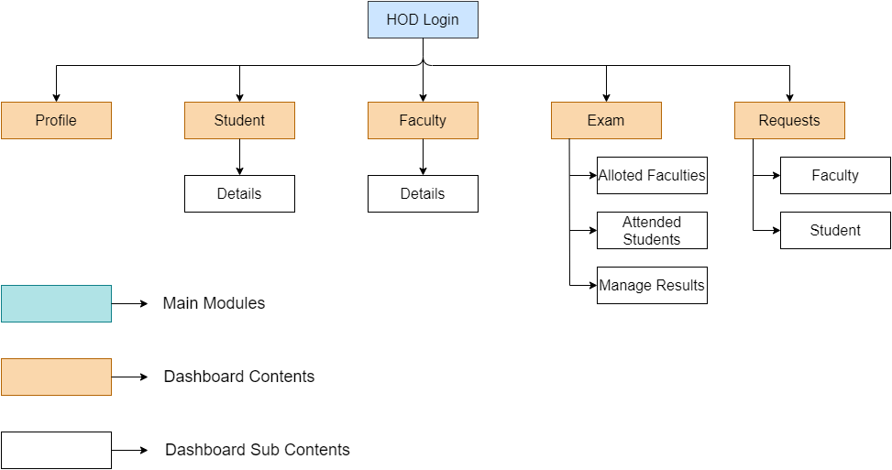
HOD

Slide 14
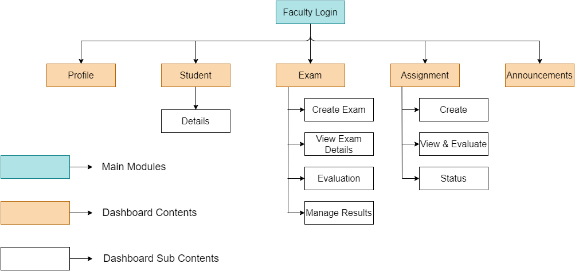
FACULTY

Slide 15
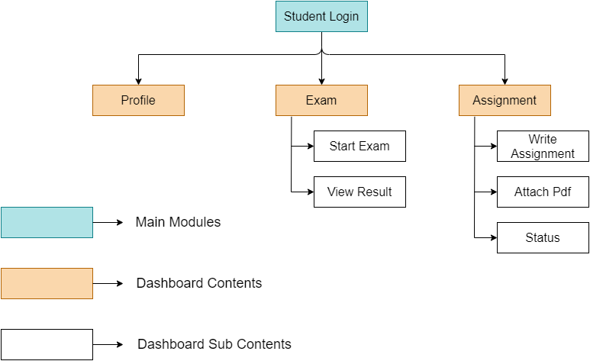
STUDENT

Slide 16
ADVANTAGES
The required software and hardware are easily available and easy to work with.
The user-Interface of this website is user friendly and easy to access.
Very Accurate in checking the answers(MCQ) and calculating results.
Secure because of authentication and also Increased Security and Privacy during the exam conduction.
It’s More Environmentally Friendly because we are minimizing the usage of paper.
Students can take exam, submit assignments and also they can access there results in a single website.
Flexibility to Take Exams Anywhere.
Reduced Administrative Burden.
Eliminates Labour Cost.
Most Of Time-saving.

Slide 17
LIMITATIONS
Internet connection: It Is Crucial To Have An stable internet connection while conducting exams.
Typing speed: For some students it is difficulty to type the answers in given time.
Every student needs a system to attend the exams.

Slide 18
CONCLUSION
Online examination portal is a web application. The key concept is to minimize the amount of paper and convert all forms of documentation to digital form. Also during worst situations like covid pandemic time in such cases this is very useful. Students can easily take exams in their places. Also After working with this project, I get to understand more about the technologies with real time examples and also get the knowledge of FULL STACK development.

Slide 19
REFERENCES
[1] www.Sookshmas.com
[2] www.exam.net
[3] www.w3schools.com
[4] www.getbootstrap.com
[5] www.github.com

Slide 20
Thank you

