Slide 1
DATA ANALYTICS PROJECT
SOCIAL MEDIA
ENGAGEMENT ANALYSIS
Turning social media data into actionable insights
INSTAGRAM
YOUTUBE
FACEBOOK
Power BI Dashboard • Engagement • Reach • Content • Regions

Slide 2
01 | PROJECT
02
The business problem
Why social media performance needs analytics
FROM NUMBERS → DECISIONS
TRACK
Social platforms create huge volumes of audience interaction data.
ANALYZE
• Which platform creates the strongest engagement?
• Which content formats attract more interactions?
• When are audiences most responsive?
• Which regions generate stronger reach and conversions?
GROW

Slide 3
02 | OVERVIEW
03
Project overview
A complete workflow from social media data to interactive insight
10K
999M
120M
15M
25M
Total Posts
Total Reach
Total Likes
Total Shares
Total Comments
ANALYTICS WORKFLOW
01
02
03
04
DATA
ANALYZE
VISUALIZE
INSIGHT
Prepare & clean
Compare metrics
Power BI dashboard
Business actions

Slide 4
03 | OBJECTIVES
04
What this project aims to answer
01
PLATFORM
02
CONTENT
03
TREND
Compare Instagram, YouTube and Facebook
Identify high-performing content formats
Study engagement by date and posting day
04
REGION
05
DECISION
06
DASHBOARD
Compare reach, engagement and conversions
Turn findings into practical recommendations
Create an interactive Power BI experience

Slide 5
04 | DATA
05
Dataset & analytical dimensions
The dashboard combines interaction, exposure and outcome measures
PLATFORM
CONTENT
INTERACTION
TIME
OUTCOME
Instagram
YouTube
Facebook
Image • Reel • Video
Carousel • Story • Live
Likes • Comments
Shares • Engagement
Published Date
Posting Day
Reach
Conversions
Core dashboard filters
Platform
Content_Type
Category

Slide 6
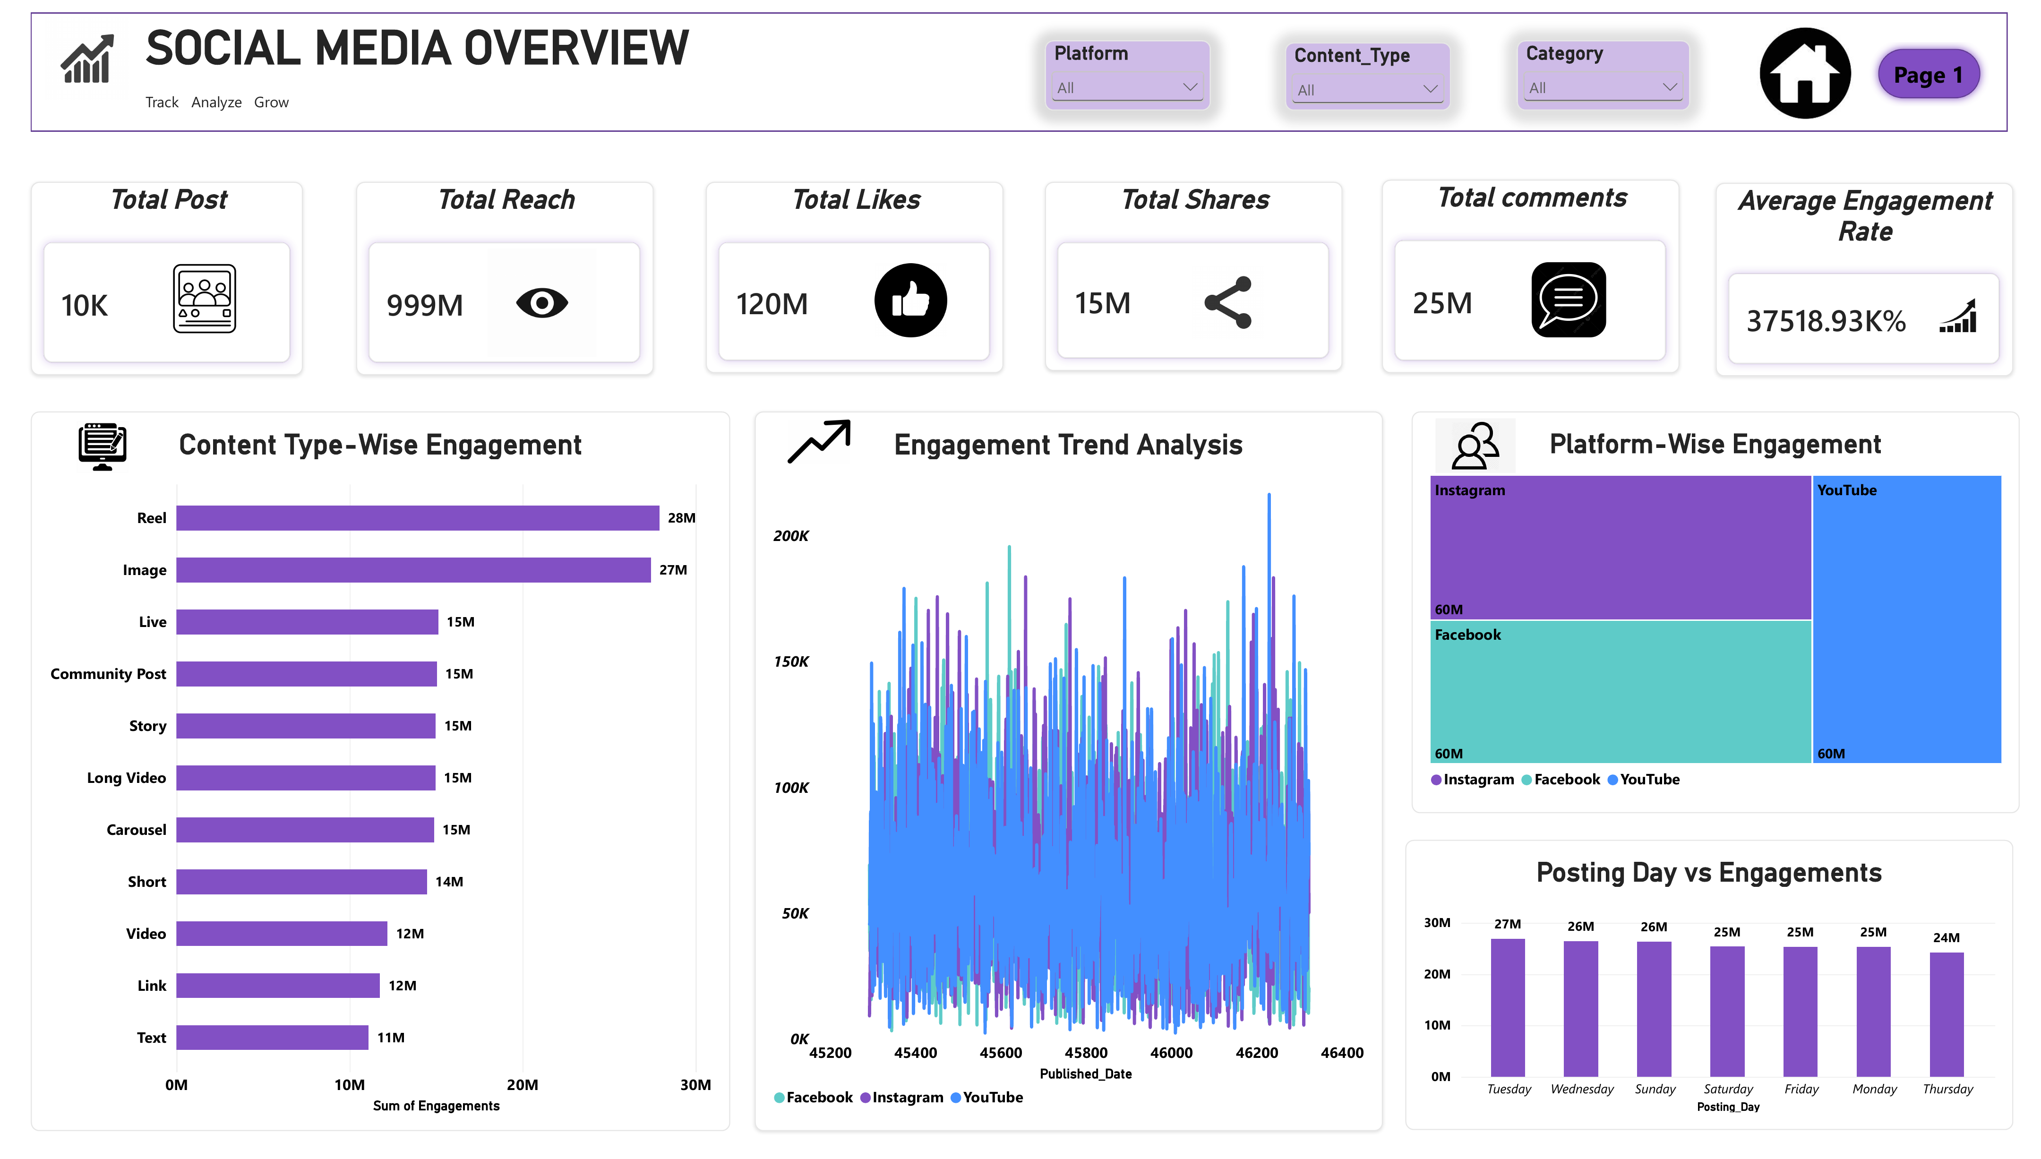
05 | DASHBOARD 01
06
Social Media Overview
Executive view of reach, engagement, content and posting patterns
Executive dashboard

Slide 7
06 | INSIGHTS
07
Content performance
Reels and Images lead the engagement mix
KEY TAKEAWAY
28M
Reel engagement
Images follow at 27M.
The strongest formats should guide future content testing.

Slide 8
07 | INSIGHTS
08
Platform performance
Engagement is split evenly across platforms, about 60M each
60M
60M
60M
Instagram engagements
Facebook engagements
YouTube engagements
INSTAGRAM
FACEBOOK
YOUTUBE
40M likes
80M likes
40M likes
25M comments
8M comments
8M comments
5M shares
10M shares
5M shares

Slide 9
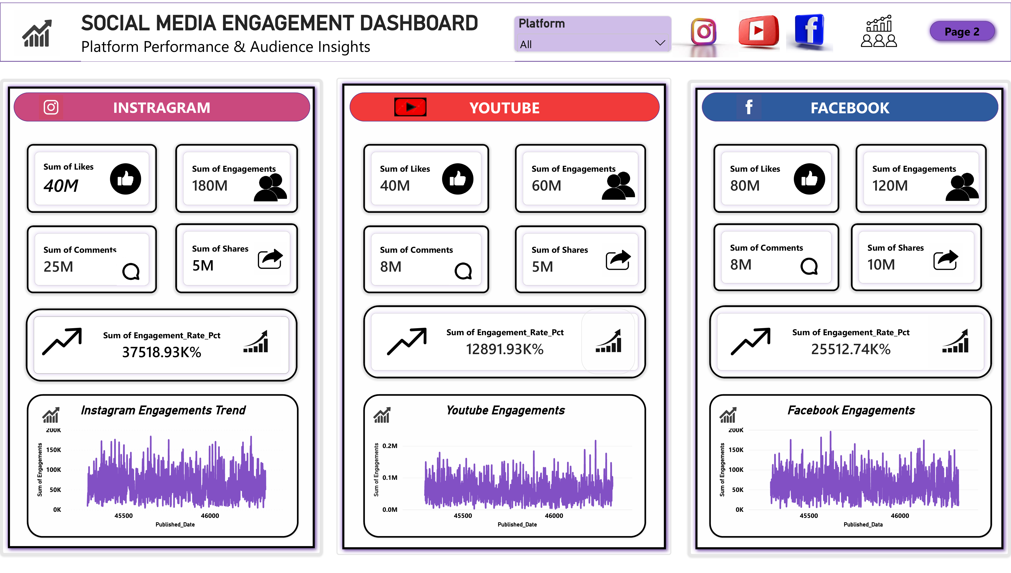
08 | DASHBOARD 02
09
Platform & audience insights
Three platform-level trend views make comparison easier

Slide 10
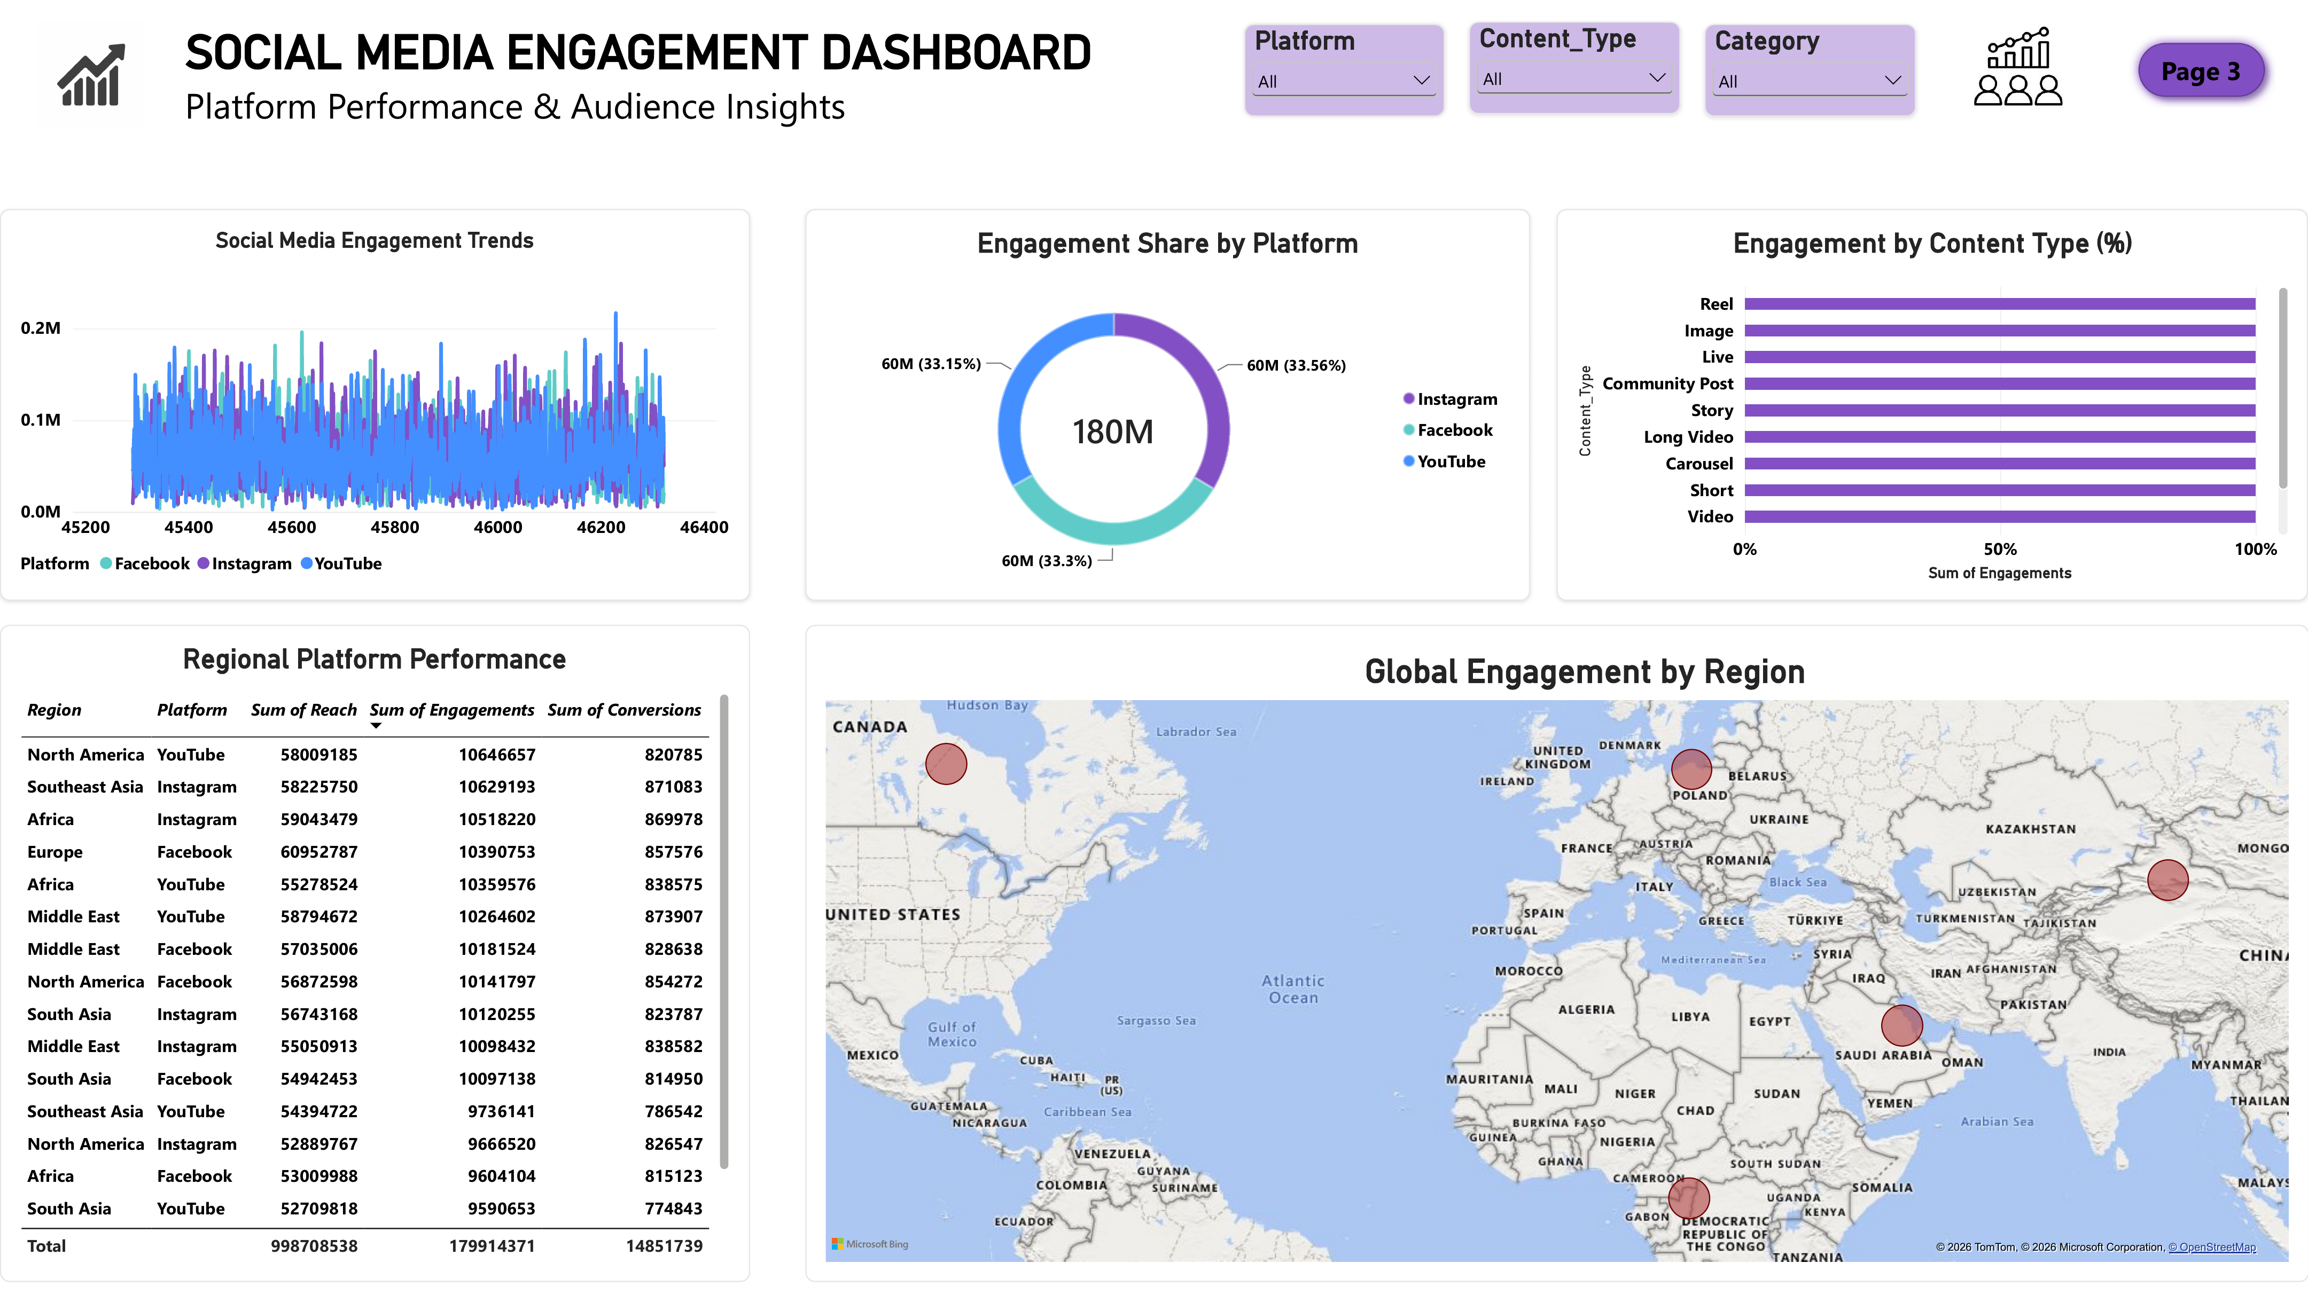
08 | DASHBOARD 03
10
Global & Regional Engagement
Regional platform performance, engagement share and global audience distribution

Slide 11
09 | REGIONAL
10
Regional platform performance
Reach, engagement and conversions vary by market
998.71M
179.91M
14.85M
Total Reach
Total Engagements
Total Conversions
REGIONS COVERED
Africa
Middle East
South Asia
North America
Southeast Asia
Europe

Slide 12
10 | FINDINGS
11
Four findings to remember
01
EVEN PLATFORM SPLIT
02
REELS LEAD
60M engagements each, about 33% share per platform.
28M engagement, followed by Images at 27M.
03
FACEBOOK IS STRONG
04
REGION MATTERS
80M likes and 10M shares, the highest of any platform.
Platform performance changes across geographic markets.

Slide 13
11 | ACTION
12
Recommendations
How the analysis can support better social media decisions
01
Prioritize winners
Use high-performing formats as the starting point for content planning.
02
Think platform-first
Adapt content strategy to each platform rather than copying the same approach.
03
Optimize timing
Use posting-day and trend analysis to test stronger publishing windows.
04
Localize
Use regional reach and conversion patterns to tailor campaigns.
05
Measure outcomes
Track reach + engagement + conversions together.

Slide 14
12 | NEXT STEPS
13
Limitations & future scope
CURRENT LIMITS
FUTURE SCOPE
• Insights depend on the available dataset.
• Engagement does not capture sentiment or content quality by itself.
• Historical depth can be expanded for stronger time-based analysis.
• Add follower growth and audience demographics.
• Perform sentiment analysis on comments.
• Build predictive models for engagement and conversions.
• Extend the study to campaign-level comparisons.

Slide 15
CONCLUSION
From social media data
to smarter decisions.
The dashboard brings platform, content, trend and regional metrics into one interactive view.
TRACK
ANALYZE
GROW
THANK YOU

