Slide 1


THE REALITY OF PCOD AND PCOS

Slide 2


PROBLEM DEFINITION
Now a days a lot of women face problems like PCOD, PCOS with respect to periods. What they get is that assistance about that and What can be done to cure it, they also get insight about are exercises to do. And What about behind the scenes???
The stress, the drama , the anxiety and the mood swings , the weight gain and what not.
The issues they face are know by only them
and they lag in being understood too

Slide 3

INTRODUCTION
Considering the problem we are trying to provide comfort trough the website () .
The website contains blog area where users can share their experiences about their journey about what they have gone trough and going trough in the form of blogs.
So that the other user who are going trough similar situation
can get to know that they are not alone, and can get a help trough.

Slide 4

OUR APPROACH
The current existing blogs gives you assistances about how you can overcome what can you eat the exercises you can do.
Many young women often feel shy to share their condition and to openly speak about it. They will be going trough a lot of mental, physical changes rapidly, for example there are instances of gaining a 5kg of weight over a span of month.
Our approach to all these above problems is that, Women here they can share their own life stories of how they have overcome the problems like PCOD and PCOS.
.

Slide 5
The final idea of the project:
A real life stories blog
user can share the stories trough blog
A private chat between the users
A period calendar

Slide 6

Glimpse of our vision

Slide 7
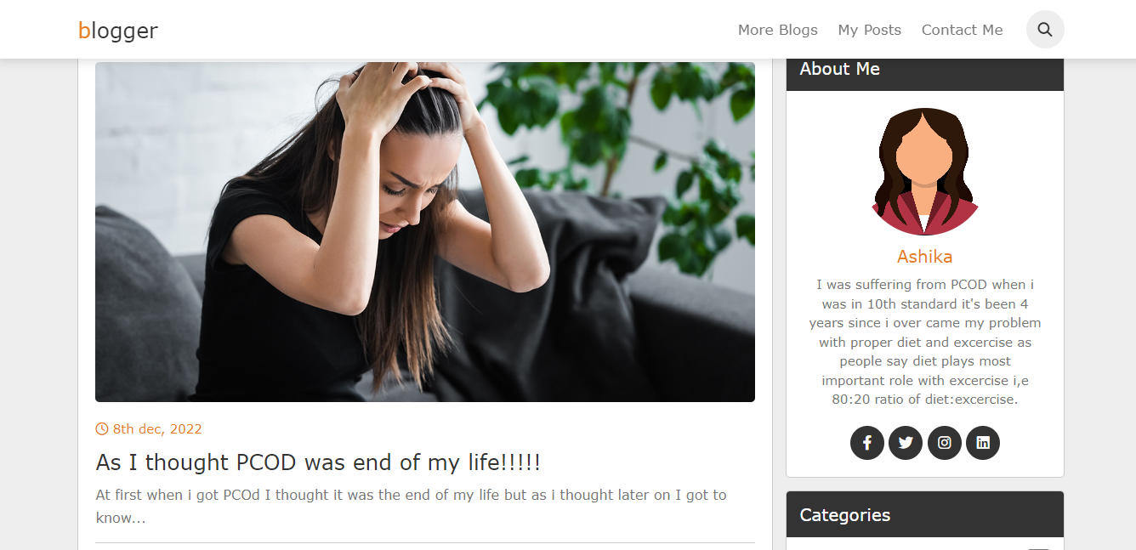

Slide 8

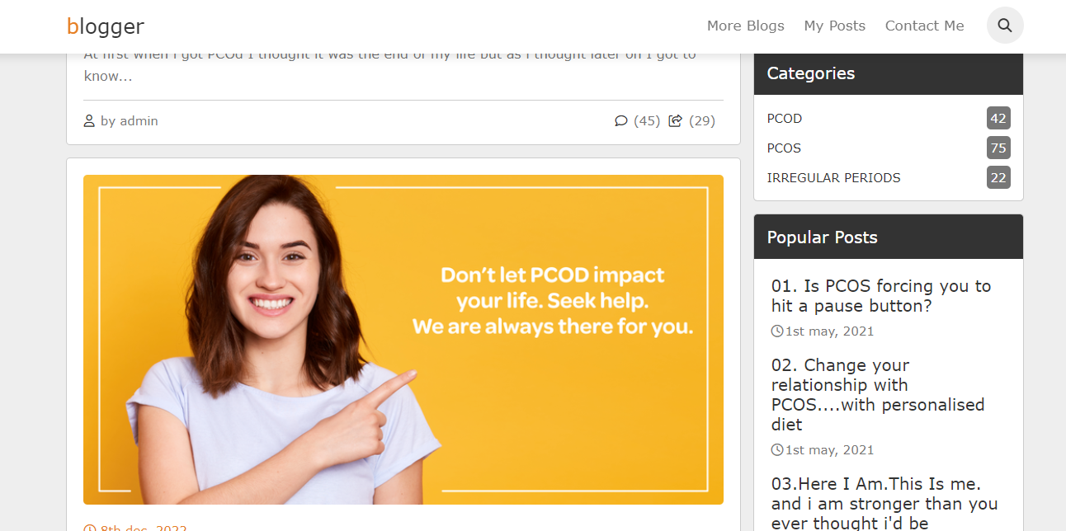

Slide 9



