Slide 1

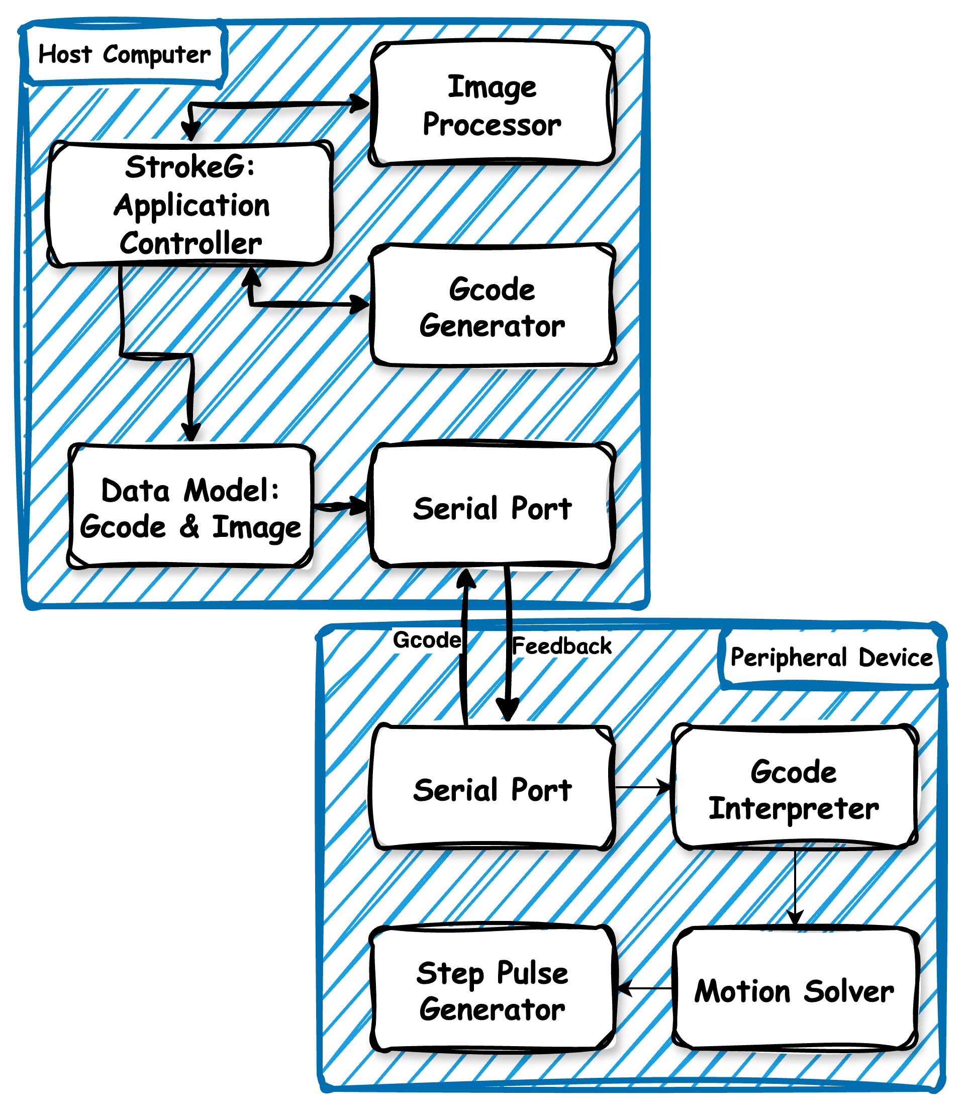
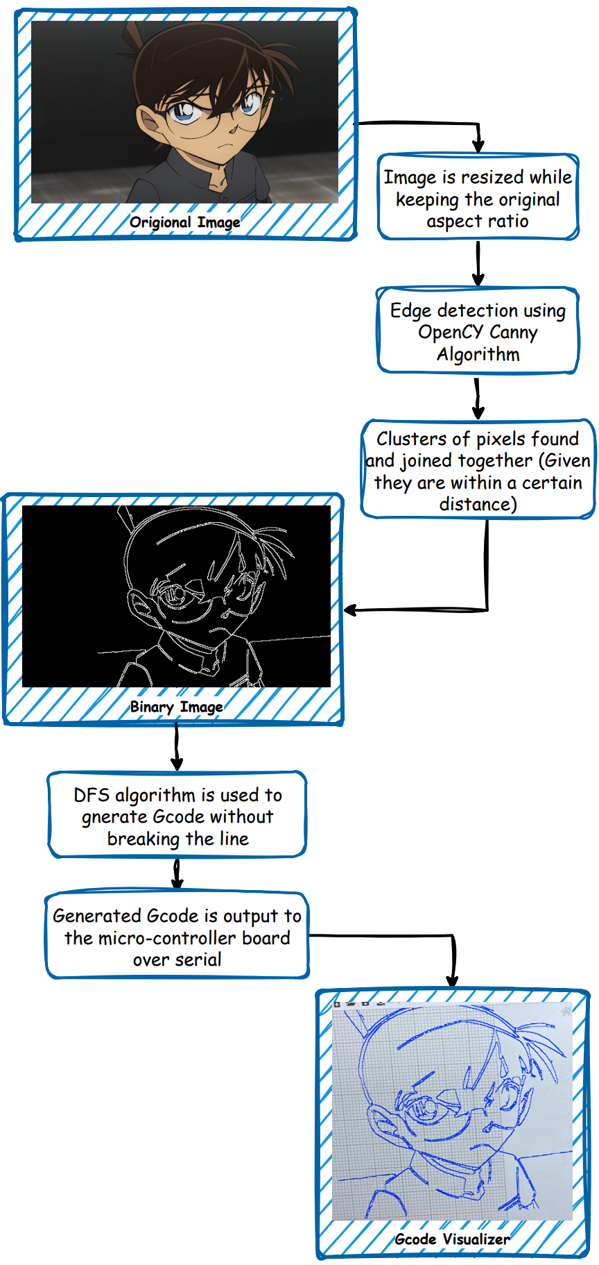

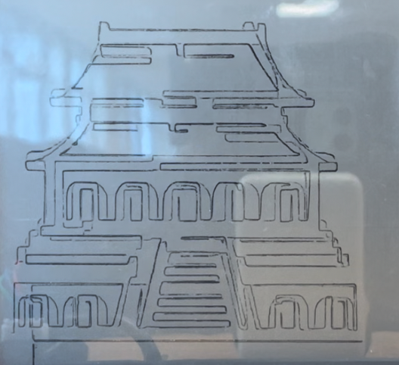
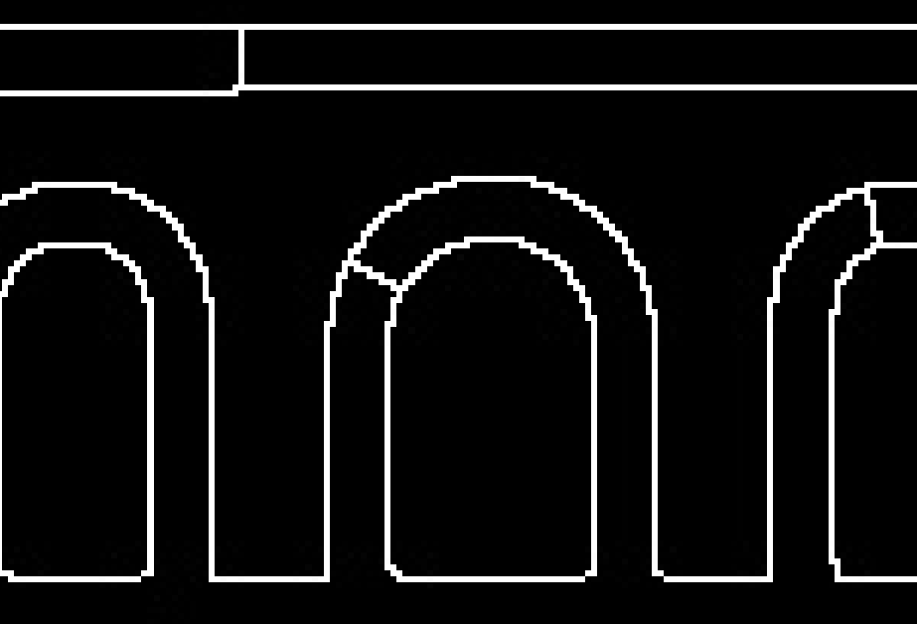
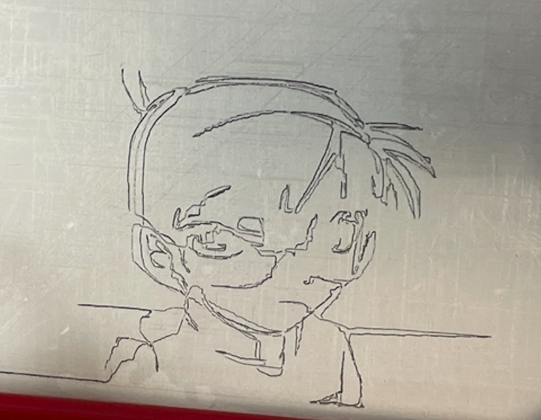
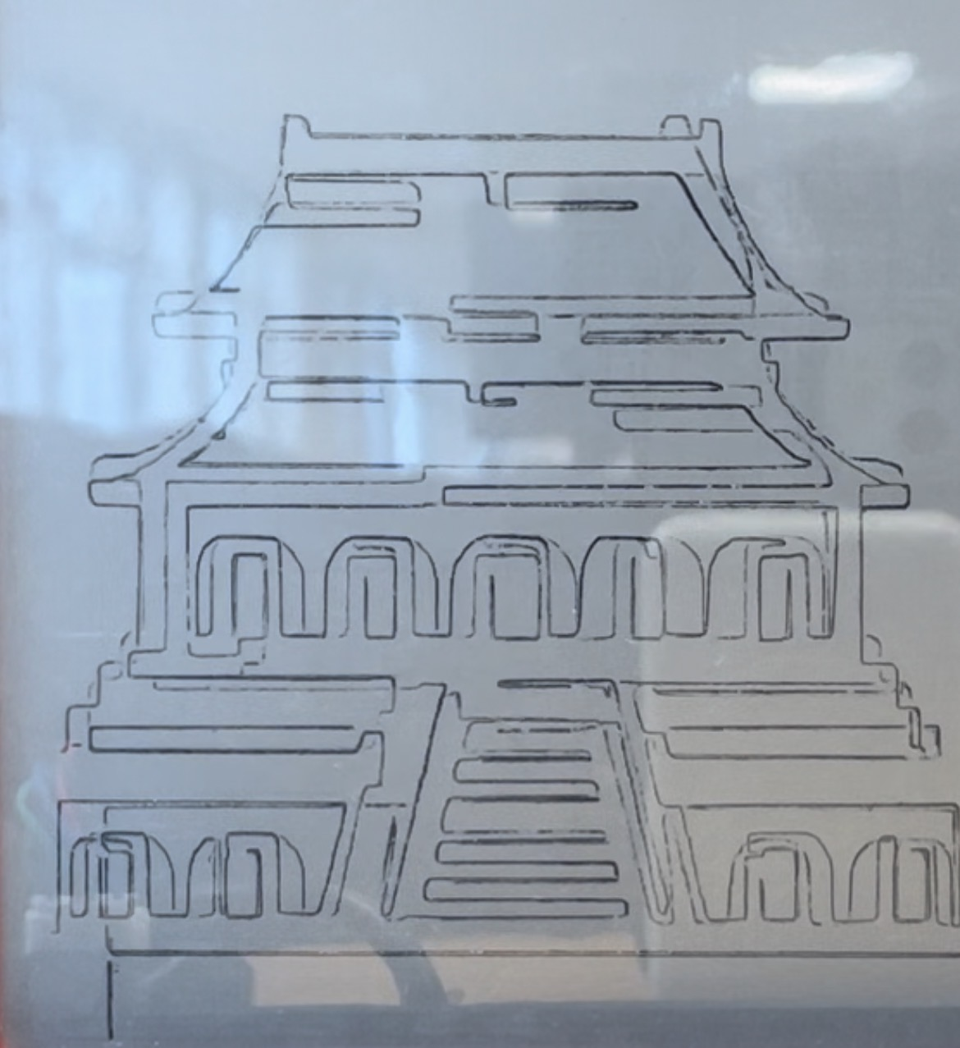

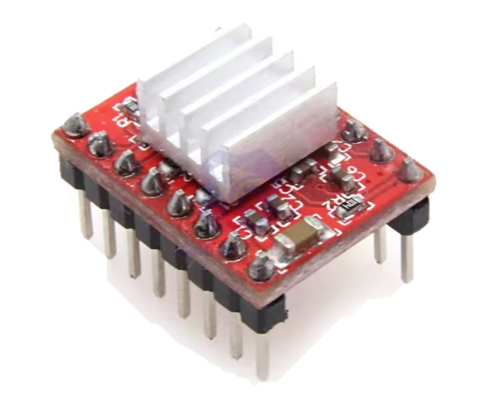


Etch A Sketch Robot
Academic Supervisor: Shanpu Shen
Project Member: Mingjie Zhu 201850714, Zhexi Zhang 201850703, Matteo Venuti 201735577,
Yuxuan Zhuang 201850716, Monong Yang 201850688
Introduction
Software
Inspired by CNC machining, this project creates an automated drawing machine using an Etch A Sketch board^{[1]}.
It first introduces a software pipeline that transforms digital images into continuous-line drawings. By employing edge detection techniques and a specialized depth-first search (DFS) algorithm, our system generates optimized G-code instructions tailored for our custom-built drawing machine.
The hardware system interprets these instructions and uses two stepper motors to precisely control the Etch A Sketch knobs, allowing the machine to replicate digital images as physical sketches.
The host computer runs a fully automated pipeline to transform digital images into precise, single-line sketches.
Image Processing & Path Generation
The input image is processed using OpenCV’s edge detection to extract key contours.
A depth-first search (DFS) algorithm reconstructs the path into a continuous single-line drawing, ensuring smooth and natural sketching.
G-code Generation
The optimized drawing path is converted into G-code instructions (coordinates), acting as a precise movement script for the hardware.^{[3]}
Motor Control & Execution
The G-code is sent to the Arduino via serial communication. A self-developed script is used for messaging and receiving feedback.
The driver program on peripheral device achieves features including
Asynchronous, non-blocking motor motion, ensuring independent movement.
Asynchronous communication with the host computer, allowing continuous execution without delays.
Methodology
System Design:
Implemented an MVC structure, separating the controller from the data model to ensure modularity.
Designed a host-peripheral computing setup for future hardware upgrades and scalability.
Hardware Development:
Used an Arduino Uno to control two stepper motors via A4988 drivers.
Designed a custom 3D-printed frame for precise Etch A Sketch knob rotation.
Software Development:
Python-based image processing generates a plotting scheme, using OpenCV for edge detection. The processed image is converted into G-code instructions^{[2]}.
Programmed the Arduino to interpret G-code and send step pulses to A4988 motor drivers via serial communication.
Figure 3. System Design Diagram
Result
Image processing and generative algorithm:
Software successfully demonstrated image vectorization and path optimization.
Software demonstrated the ability to join clusters of pixels to form an image out of a single line.
Motion control and execution
Successful control of stepper motors and independent motion of motors using an Arduino microcontroller.
Drawbacks:
The system is open loop and the etch a sketch is not perfect, therefore feedback control is not achieved, resulting in a drifting in the physical sketched image.
Figure 4. Cluster Linking Result
Figure 5. The Forbidden City
Hardware
Components:
Microcontroller: Arduino Uno – controls the motor system and executes G-code instructions.
Motor Drivers: A4988 stepper motor drivers – regulate motor speed and direction.Stepper
Motors: Two stepper motors – precisely control the Etch A Sketch knobs for drawing.
Power Supply: 12V, 5A – provides stable power for motor operation.
Frame & Mounts: A custom 3D-printed frame ensures stability and precise motor alignment
Working Principles:
The Arduino Uno receives G-code commands via serial communication.
The commands are processed, and step signals are sent to the A4988 drivers.
The A4988 drivers convert signals into precise step movements for the stepper motors.
The motors turn the Etch A Sketch knobs, translating digital paths into physical drawings.
Figure 2. Software Pipeline Diagram
Figure 6. Image Drifting
Conclusions
In conclusion, our project successfully met the predetermined requirements, demonstrating the integration of edge detection and path optimization to generate a given image for a CNC-based plotter.
However, some challenges remain. Specifically, since the system operates in an open-loop configuration without feedback, it cannot track the exact position of the pins during the drawing process. As a result, there is a potential risk of double images appearing in the physical output.
Figure 1. A4988 Driver
References
[1]Every Flavor of Robot, " This Etch-A-Sketch Animates VIDEOS," YouTube, Dec. 20, 2024. [Online]. Available: https://www.youtube.com/watch?v=p4cUWCG7fM4&t=1316s.
[2] A. Hodel, G-code Optimizer, GitHub repository. Available: https://github.com/andrewhodel/gcode-optimizer. [Accessed: 21-Feb-2025].
[3] "Writing your own G-code interpreter," Arduino Forum, Aug. 19, 2014. Available: https://forum.arduino.cc/t/writing-your-own-g-code-interpreter/258828. [Accessed: Feb. 21, 2025].
Figure 1. Label in 24pt Calibri.
Figure 2. Label in 24pt Calibri.

