Slide 1
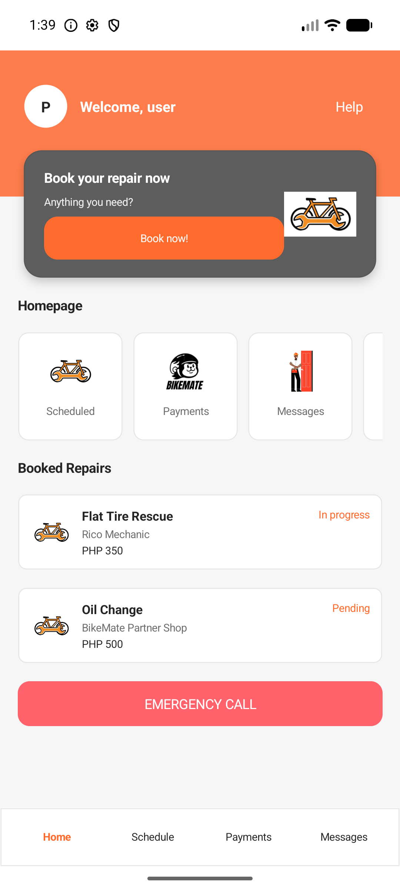
BikeMate
Motorcycle Service Assistance System
Formal Project Presentation
Prepared by: Group 10
Members: [Member 1], [Member 2], [Member 3], [Member 4]
BikeMate Motorcycle Service Assistance System
01

Slide 2
BIKEMATE PROJECT PRESENTATION
The presentation follows the project from problem to validated system.
01
Context
Why motorcycle service support needs a digital workflow
02
Objectives
What the system is designed to accomplish
03
Scope
Which users, modules, and features are included
04
Demonstration
How the mobile, API, database, and web admin parts work
05
Verification
What was tested and what remains for production deployment
BikeMate Motorcycle Service Assistance System
02

Slide 3
BIKEMATE PROJECT PRESENTATION
BikeMate responds to a practical gap in motorcycle repair access.
Background
Motorcycle riders often need repair help quickly, but available shops, trusted mechanics, price expectations, status updates, and emergency support are usually fragmented across calls, referrals, and manual searching.
Customers need faster discovery and clearer repair tracking.
Mechanics need organized job assignment and status tools.
Shops need a way to manage services, bookings, products, and reputation.
Administrators need verification and monitoring controls.
BikeMate Motorcycle Service Assistance System
03

Slide 4
BIKEMATE PROJECT PRESENTATION
The project objective is to connect riders, shops, mechanics, and administrators.
Specific Objectives
General Objective
Enable customers to register, book repairs, track requests, and pay.
Develop a motorcycle service assistance platform that supports service booking, emergency repair requests, real-time communication, payment tracking, and platform administration.
Enable mechanics to accept jobs and update service progress.
Enable shops to manage services, products, bookings, and staff.
Enable system admins to verify users and monitor operations.
Store platform data in a normalized SQL Server database.
BikeMate Motorcycle Service Assistance System
04

Slide 5
BIKEMATE PROJECT PRESENTATION
The scope covers the full local prototype for a service marketplace.
Mobile users
Shop operations
Customer, mechanic, system-admin mobile shells and role routing.
Separate MAUI shop-admin app for onboarding and management.
Backend services
Data layer
ASP.NET Core API for auth, service requests, payments, chat, emergency, reports, and files.
SQL Server schema, EF Core migrations, seed data, and trigger scripts.
Web administration
Blazor dashboard for approvals, users, shops, mechanics, payments, requests, and emergencies.
BikeMate Motorcycle Service Assistance System
05

Slide 6
BIKEMATE PROJECT PRESENTATION
The architecture separates user apps, API logic, shared contracts, and persistence.
BikeMate.Mobile
BikeMate.Core
Customer, mechanic, and system-admin mobile screens
DTOs, constants, and entity contracts shared by projects
BikeMate.Api
Authentication, requests, messaging, payments, emergency, reports
BIKEMATES_ADMIN
BikeMate.Infrastructure
Shop owner onboarding and shop management app
EF Core DbContext, SQL Server migrations, and scripts
BikeMate Motorcycle Service Assistance System
06

Slide 7
BIKEMATE PROJECT PRESENTATION
The technology stack is built around .NET with SQL Server persistence.
Mobile
.NET MAUI, C#, XAML, Android target
Backend
ASP.NET Core Web API, JWT bearer authentication, SignalR
Data
SQL Server, Entity Framework Core, migrations, SQL scripts
Web Admin
Blazor, Razor components, Bootstrap styling
Testing
xUnit tests for services, constants, middleware, and helpers
Prepared Integrations
PayMongo, Google OAuth, email/OTP, Firebase, file storage
BikeMate Motorcycle Service Assistance System
07

Slide 8
BIKEMATE PROJECT PRESENTATION
Four roles define the system behavior and access boundaries.
Customer
Mechanic / Rider
Books repair services, tracks jobs, chats, pays, reviews, and requests emergency support.
Receives assigned work, accepts or rejects jobs, updates progress, shares location, and views ratings.
Shop Admin
System Admin
Submits shop application, manages profile, services, products, bookings, mechanics, messages, and reports.
Approves accounts, monitors requests, manages users, shops, mechanics, payments, and emergency queues.
BikeMate Motorcycle Service Assistance System
08

Slide 9


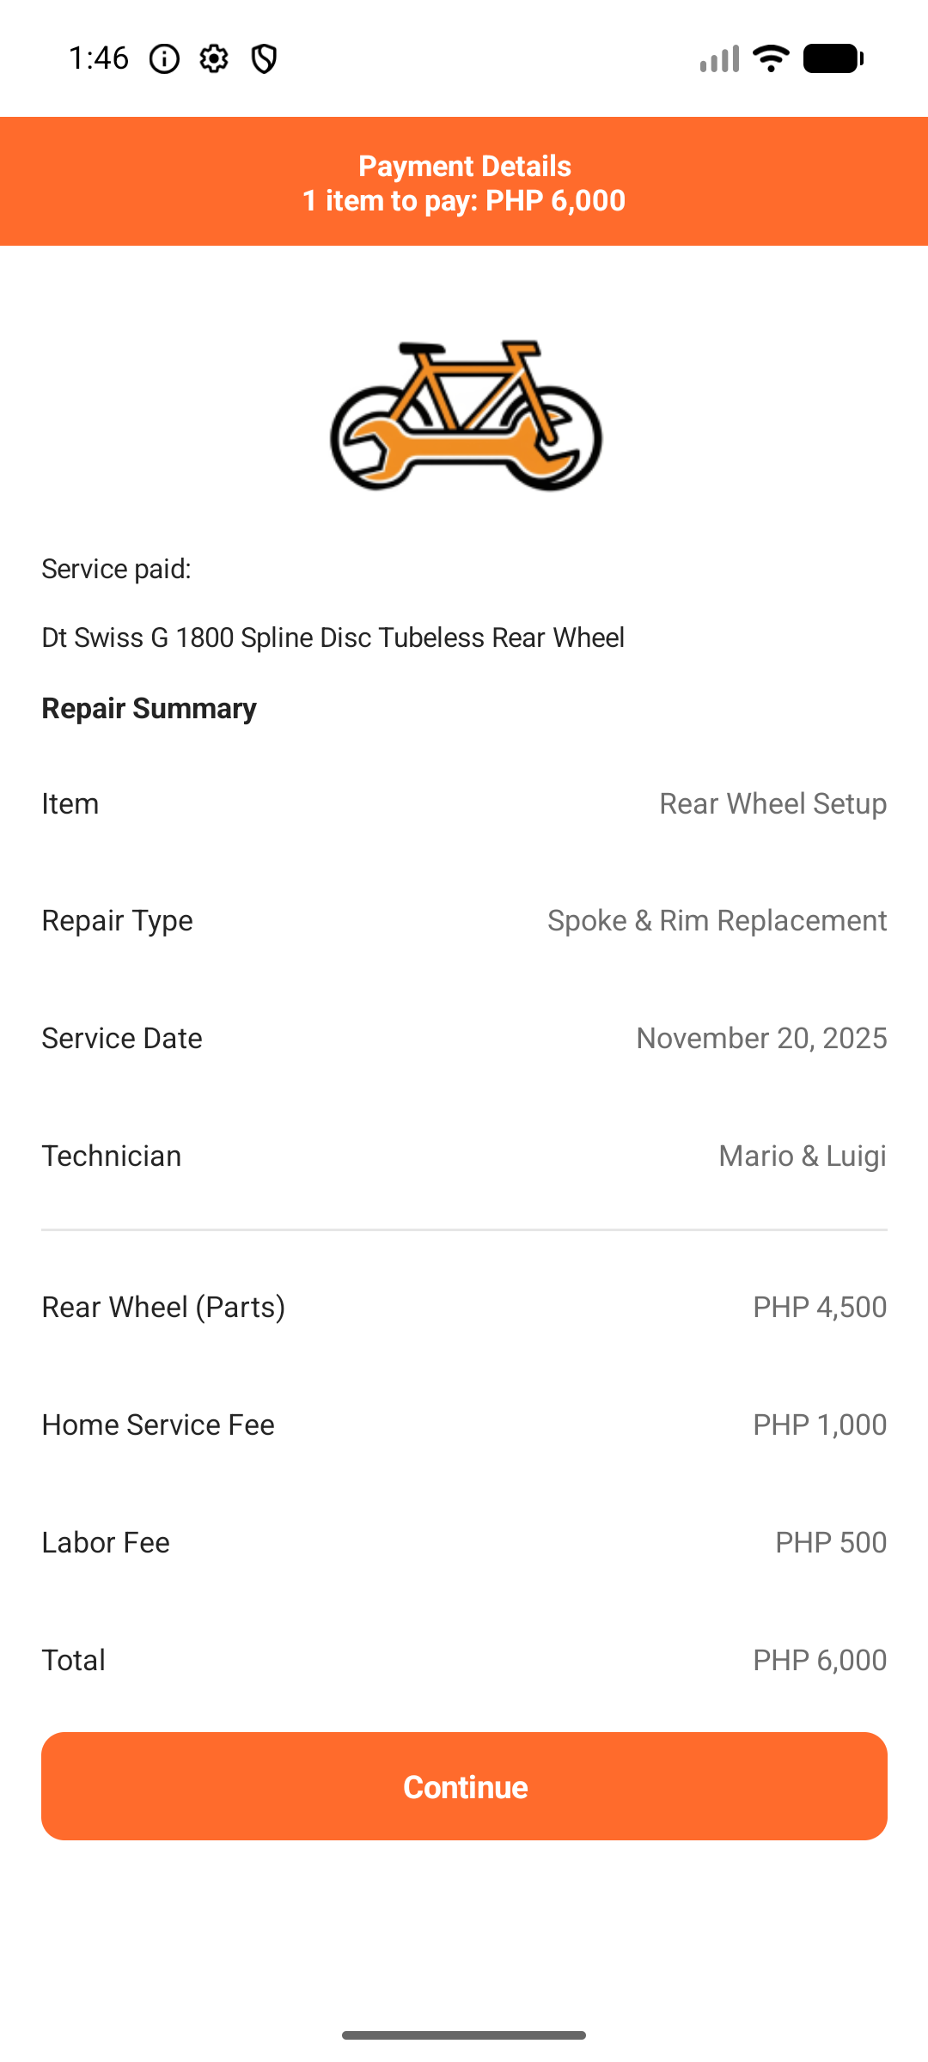
BIKEMATE PROJECT PRESENTATION
The customer flow moves from discovery to booking, tracking, and payment.
Users can view services, create a repair request, schedule work, track status, and manage payment records.
Home
Booking
Payment
BikeMate Motorcycle Service Assistance System
09

Slide 10
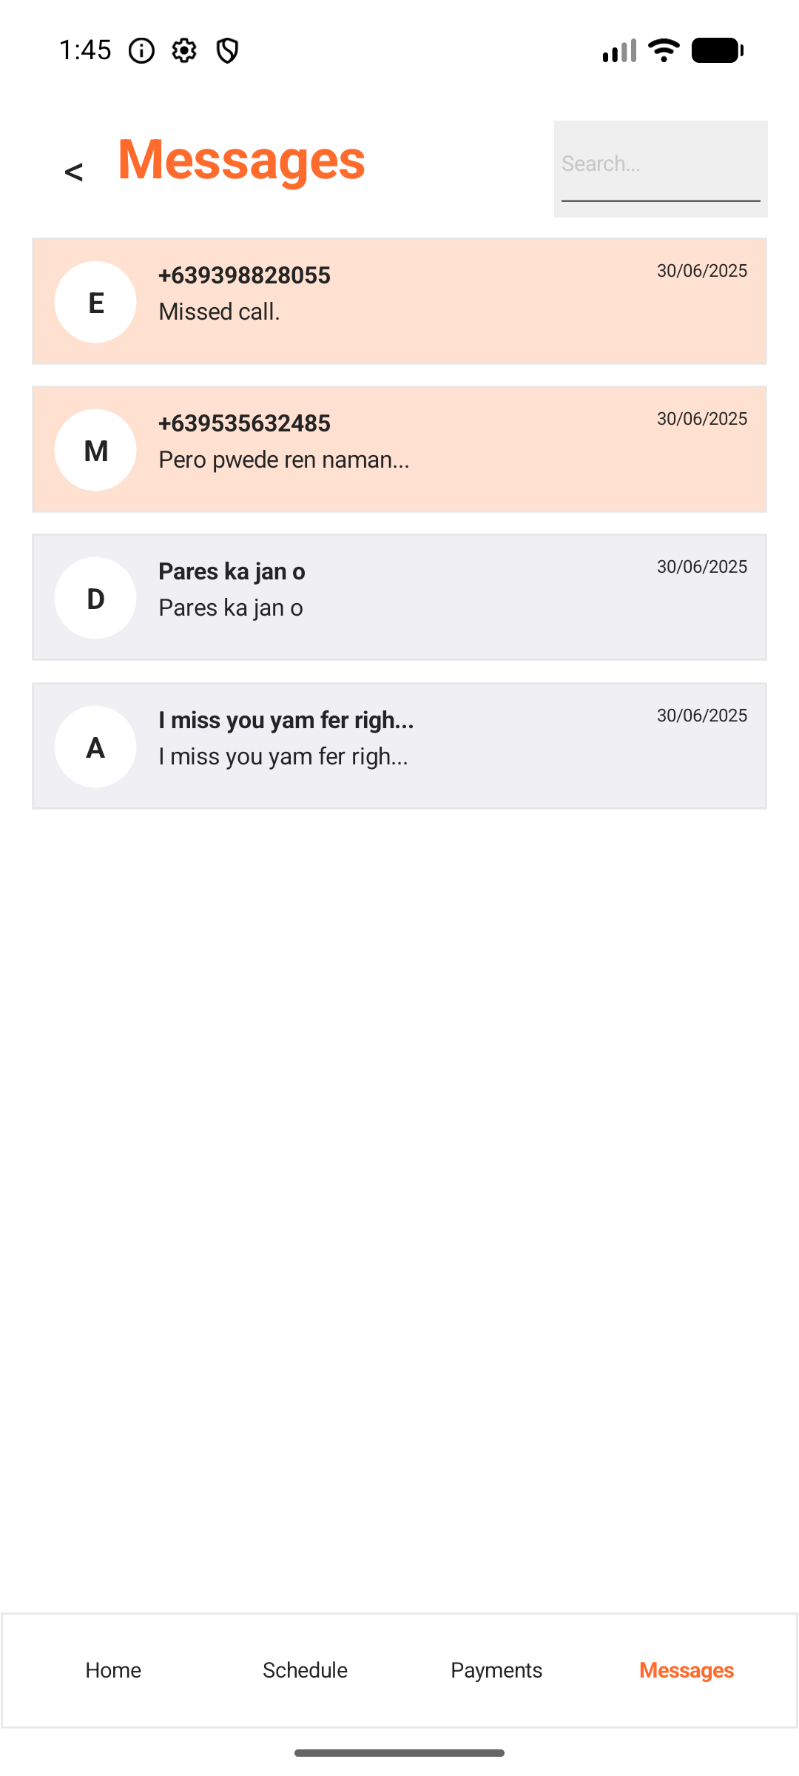
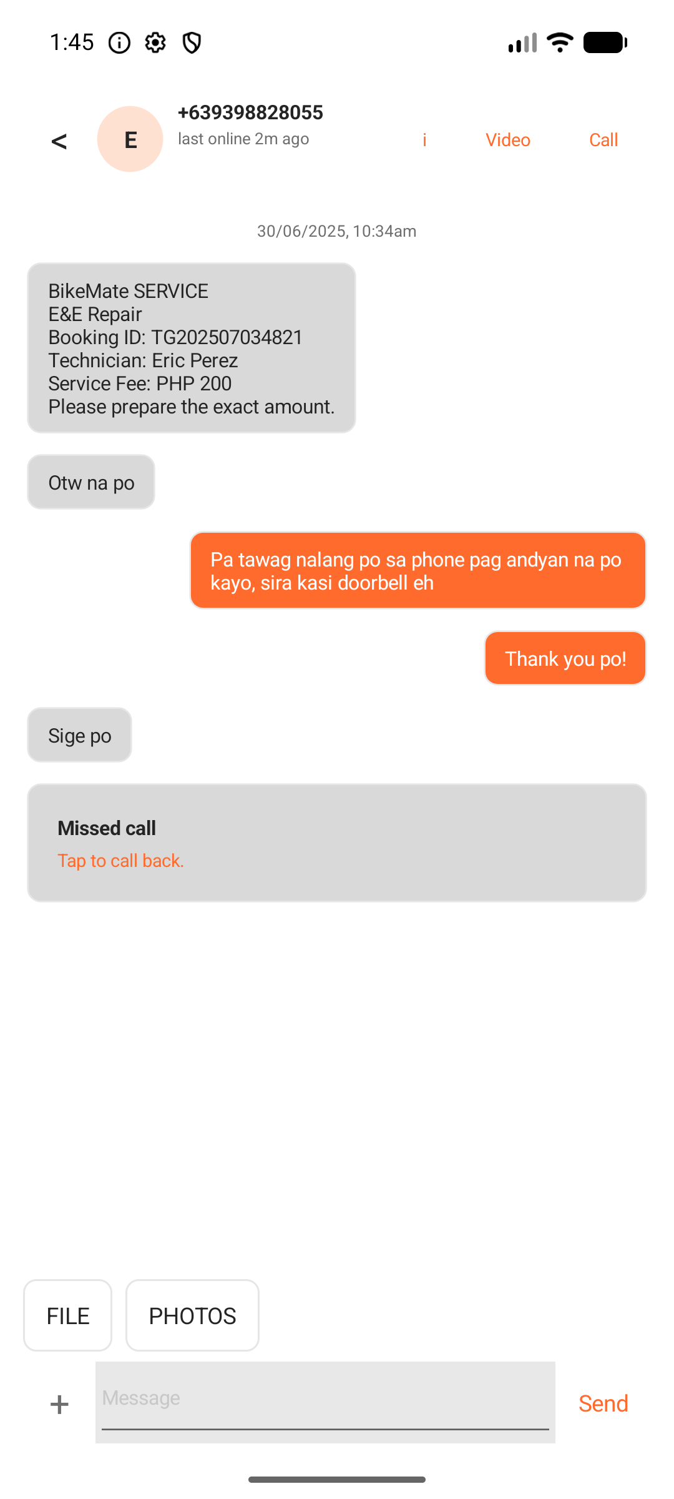
BIKEMATE PROJECT PRESENTATION
Communication and emergency support make the service workflow responsive.
Emergency workflow
Customer sends location and emergency details.
Nearby responders are identified by the backend.
Mechanic or admin can monitor and accept the case.
SignalR supports emergency, location, and notification updates.
BikeMate Motorcycle Service Assistance System
10

Slide 11
BIKEMATE PROJECT PRESENTATION
Shop and system administrators keep the platform trustworthy.
Shop Admin App
System Admin Web
Shop application and OTP verification
Dashboard for platform monitoring
Owner, shop, permit, and valid ID details
User, shop, mechanic, and customer approvals
Services, products, bookings, mechanics, messages, reports
Requests, emergency queue, payments, and admin accounts
BikeMate Motorcycle Service Assistance System
11

Slide 12
BIKEMATE PROJECT PRESENTATION
The database records both operations and accountability.
Identity
Users, roles, OTP, reset tokens, auth providers, device tokens
Service network
Clients, motorcycles, mechanics, shops, hours, services, products
Transactions
Service requests, status history, media, payments, payment events
Engagement
Conversations, messages, reviews, notifications, live locations
Governance
Audit logs, verification status, account status, shop status
BikeMate Motorcycle Service Assistance System
12

Slide 13
BIKEMATE PROJECT PRESENTATION
The API exposes the main business workflows through role-aware endpoints.
Core APIs
Operations
Administration
Auth
Customers
Mechanics
Shops
Services
Products
Service Requests
Emergency
Payments
Messages
Location
Notifications
Admin Dashboard
Approvals
Reports
Users
Files
Devices
Real-time hubs: booking, chat, emergency, location, notification
BikeMate Motorcycle Service Assistance System
13

Slide 14
BIKEMATE PROJECT PRESENTATION
Testing confirms the system is ready for local demonstration.
4
36
5
6
Verified roles
Database tables
SignalR hubs
Main projects
API build, health endpoint, login, authorization, and role data passed.
Customer, mechanic, shop admin, and system admin workflows were smoke-tested.
Android build and emulator launch were verified for the mobile app.
Production payment, OAuth, email, notification, and storage keys remain external requirements.
BikeMate Motorcycle Service Assistance System
14

Slide 15
BIKEMATE PROJECT PRESENTATION
BikeMate demonstrates a complete foundation for motorcycle service assistance.
The project delivers a working full-stack prototype with mobile apps, web administration, backend APIs, real-time hubs, database schema, tests, and demo assets. Its value is the organized connection between customers who need help, mechanics who provide service, shops that manage operations, and administrators who maintain trust.
Conclusion
BikeMate is ready for formal presentation and local project demonstration.
BikeMate Motorcycle Service Assistance System
15

