Slide 1
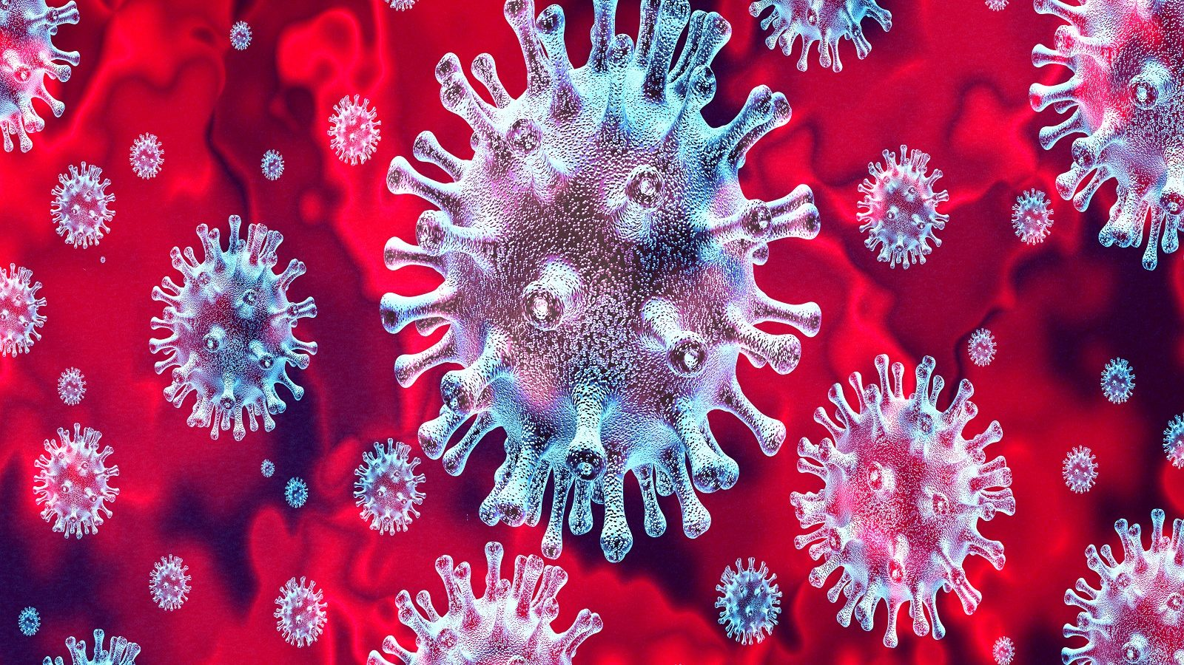


Slide 2

Corona virus is a very dangrous virus.
It attact almost all living being .
Especially it attact old man or women .
It is so dengerious that it can kill people .
Expert are trying to find the vaccain of it .

Slide 3

Corona virus is transmitted in many ways .
It transmitted through sneezing .
It transmitted through sitting with the people who has been infected from the corona virus.
It can also transmitted through toughting to infected Person.
It can also be transmitted through hugging to infected .

Slide 4

The symtoms of corona virus is sneezing to much .
High fever
Falling blood from nose .

Slide 5

We should wear mask every time .
We should wash our hand with water and soap.
We can use senetizer too.
We should make distance from people around us.

Slide 6

As per the analysis by the Asia Development Bank, the outbreak of this deadly disease will hit almost every sector of the Nepali economy,shaving up to 0.13 per off the gross domestic product and rendering up to 15,880 people jobless.

