Slide 1

Project Presentation On Hall Management System
Shameema Afreen Senjuty
Roll: 1909010
Dept: Electronics And Communication Engineering

Slide 2
My Project ,hall management system is a user-friendly database project in an easy and efficient manner. This project is designed to keep the record of the students living in hostel, allocation of rooms, their monthly or semester wise dues and many more things
Key features of the Hall Management System include:
Detailed information of Hall
Important Record of Student
Payment Record of Each Student
Total Number of Room
RoomAllotment Management
Furniture distribution
Track the Visitors
Administrator of the Hall

Slide 3
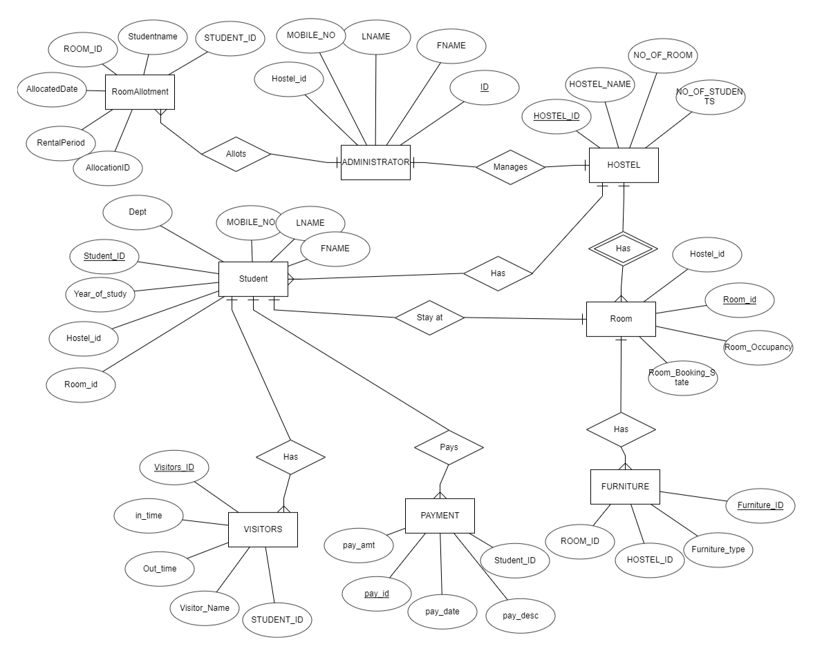

Slide 4
Student Table
STUDENT_ID | FNAME | LNAME | MOBILE_NO | Dept | Year_of_study | Hostel_id | Room_id
1905 | Shameema | Afreen | 016784289 | ECE | Third | 01 | 1016
1911 | Arifin | Nir | 0169084289 | ME | Third | 01 | 2012
2199 | Ayesha | Katun | 0197842890 | EEE | First | 01 | 215
2052 | Mushrat | Jahan | 0167846795 | BME | Second | 01 | 108

Slide 5
ADMINISTRATOR TABLE
ID | FNAME | LNAME | MOBILE_NO | Hostel_id
001 | Shuheli | Sayla | 0167842898 | 01
002 | Nourin | Mohsin | 0169084289 | 01
003 | Farjana | Afroj | 0197842890 | 01
004 | Abdul | Hafiz | 0167846795 | 02

Slide 6
HOSTEL TABLE
HOSTEL_ID | HOSTEL_ NAME | NO_OF_ ROOM | NO_OF_STUDENTS
01 | Rokeya Hall | 120 | 1000
02 | Amar Ekushey hall | 150 | 2000
03 | Mujibur Rahman Hall | 180 | 1300
04 | Rashid Hall | 110 | 1700

Slide 7
Room Table
Hostel_ID | Room_id | Room_ Occupancy | Room_Booking_State
01 | 1016 | 4 | Yes
02 | 108 | 2 | No
05 | 115 | 3 | No
06 | 8 | 2 | Yes

Slide 8
FURNITURE TABLE
Furniture_ID | Furniture_ type | HOSTEL_ID | ROOM_ID
41 | Bed | 01 | 1016
31 | Bed | 02 | 2012
61 | Chair | 02 | 2012
43 | Table | 06 | 108

Slide 9
Visitors Table
Visitors_ID | In_time | Out_time | Visitor_Name | STUDENT_ID
010 | 2023-11-11, 12:34:56 | 2023-11-12 12:34:56 | Nitu | 1905
011 | 2022-11-11 12:34:56 | 2022-11-12 12:34:56 | Mahi | 1911
012 | 2023-01-14 13:34:51 | 2023-01-12 21:34:56 | Neru | 2199
013 | 2023-12-11 14:23:56 | 2023-12-12 23:34:56 | Milu | 2024

Slide 10
PAYMENT TABLE
Pay_id | pay_date | Pay_amt | Pay_desc | Student_ID
1 | 2023-11-11 | 500 | Tuition | 1937
2 | 2023-11-12 | 200 | Books | 2111
3 | 2023-11-13 | 300 | Fees | 2024
4 | 2023-11-14 | 150 | Meal Fees | 1937

Slide 11
RoomAllotment Table
STUDENT_ID | Studentname | ROOM_ID | AllocatedDate | RentalPeriod | AllocationID
1989 | John Doe | 1016 | 2023-11-11 | 1 YEAR | 12
1803 | Jane Smith | 2012 | 2023-11-12 | 6 MONTH | 23
2278 | Alice Johnson | 108 | 2023-11-1 | 2 YEAR | 35
2012 | Bob Williams | 108 | 2023-11-3 | 3 MONTH | 49

Slide 12
Thank You

