Slide 1
Disk and New Storage Devices
毛 波
厦门大学 信息学院

Slide 2
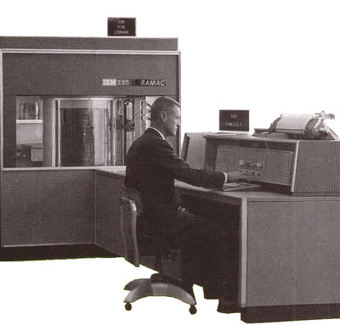
The first HDD (1956)
IBM 305 RAMAC
4 MB
50x24” disks
1200 rpm
100 ms access
35k$/y rent
Included computer & accounting software
(tubes not transistors)

Slide 3
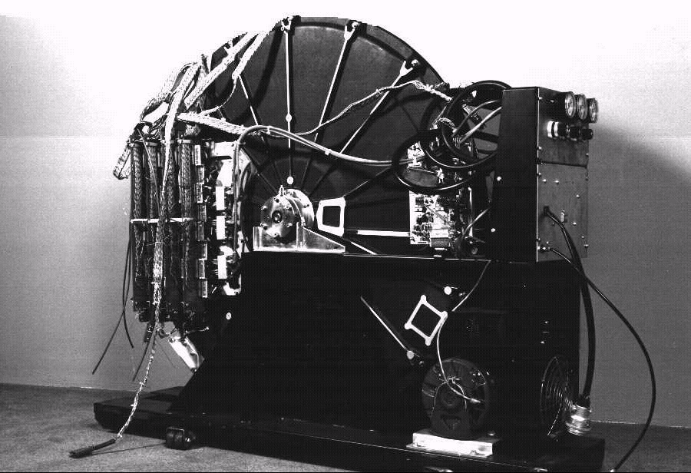
10 years later
1.6 meters

Slide 4
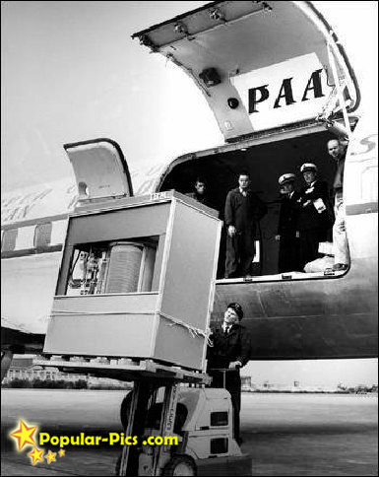
Transportation of HDD

Slide 5

1 inch disk drive!
2000 IBM MicroDrive:
  1.7” x 1.4” x 0.2”
  1 GB, 3600 RPM,
  5 MB/s, 15 ms seek
  Digital camera, PalmPC?
2006 MicroDrive
  8 GB, 50 MB/s!

Slide 6
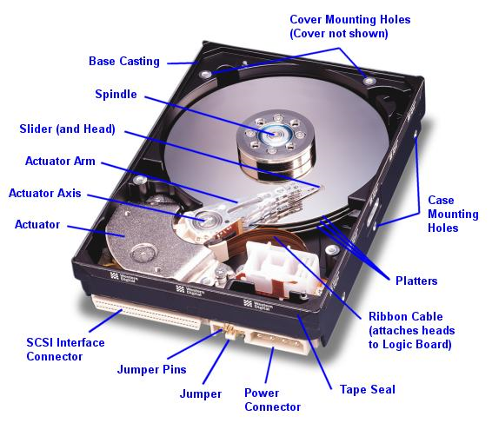
The internal look of HDD (now)

Slide 7
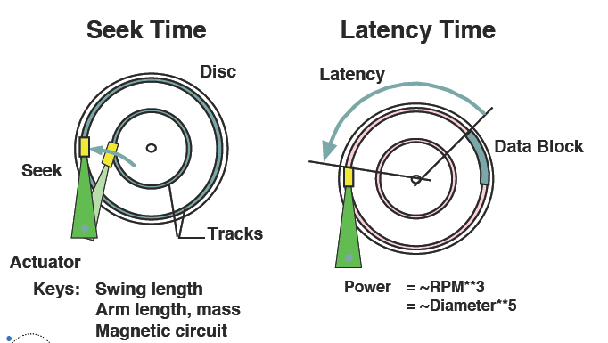
Data access of HDD
  Access Time = Seek Time + Rotational Delay + Transfer Time

Slide 8
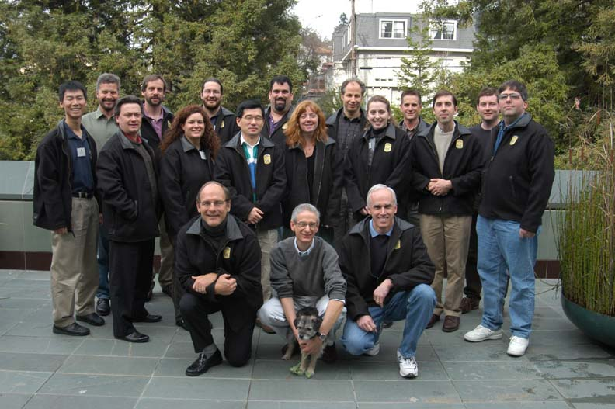
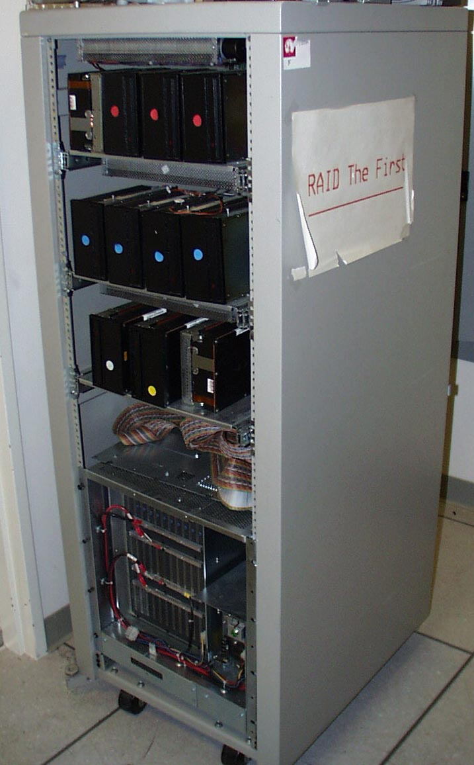
Redundant Array of Inexpensive Disks (RAID):
1987-1993
Randy Katz and David Patterson:
“Use many PC disks to build better storage?”
RAID I built on 1st SPARC, 28 disks
RAID II custom HW, 144 disks
Today, RAID ~$25B industry
RAID students join industry and academia, started own companies (VMware, Panassas)

Slide 9
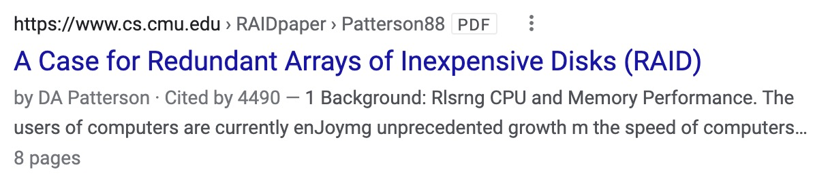
The RAID paper
D. A. Patterson, G. Gibson, and R. H. Katz, "A case for redundant arrays of inexpensive disks (RAID)," in SIGMOD'88 Proceedings of the 1988 ACM SIGMOD International Conference on Management of Data, 1988, vol. 17, no. 3, pp. 109-116.
One of the important publications in computer science. http://en.wikipedia.org/wiki/List_of_important_publications_in_computer_science
EMC, HP, IBM, NetApp… have produced so many RAID-related storage products.

Slide 10
Better Storage?
Capacity?
Performance?
Availability?
……

Slide 11
RAID Levels
RAID | Min Disks | Storage Efficiency % | Cost | Read Performance | Write Performance
0 | 2 | 100 | Low | Very good | Very good
1 | 2 | 50 | High | Better than a single disk | Slower than a single disk
4 | 3 | (n-1)*100/n | Moderate | Good for reads | Poor for small random writes
5 | 3 | (n-1)*100/n | Moderate | Good for reads | Poor for small random writes
6 | 4 | (n-2)*100/n | Moderate | Good for reads | Poor for small random writes

Slide 12
课堂练习（姓名+学号）
假设每个磁盘的容量为10GB，根据RAID技术的相关知识填表：
级别 | 盘个数 | 容量（GB） | 存储效率
RAID0 |  | 60 | 100%
RAID1 | 8 |  | 50%
RAID5 | 8 | 70
RAID6 | 6 |  | 66.7%

Slide 13
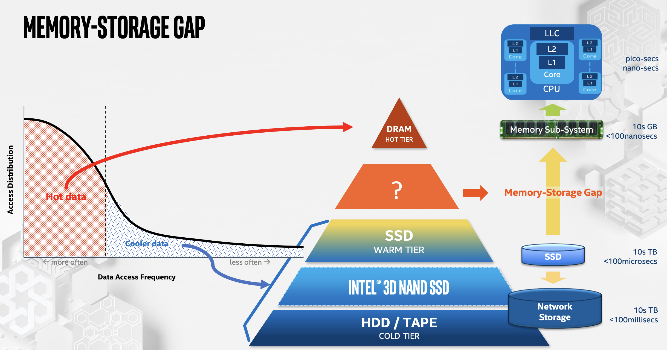
Storage Hierarchy

Slide 14
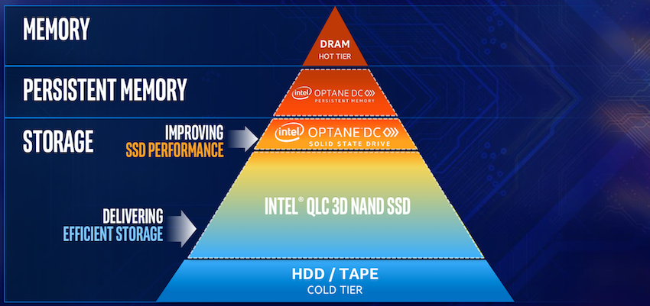
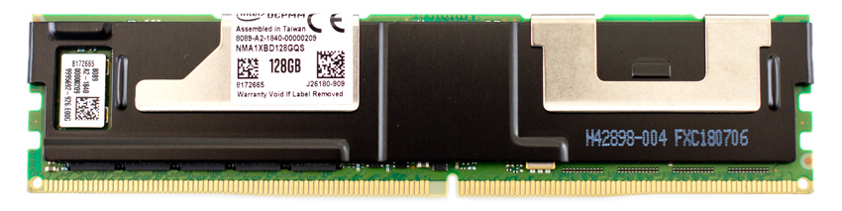
Storage Hierarchy

Slide 15
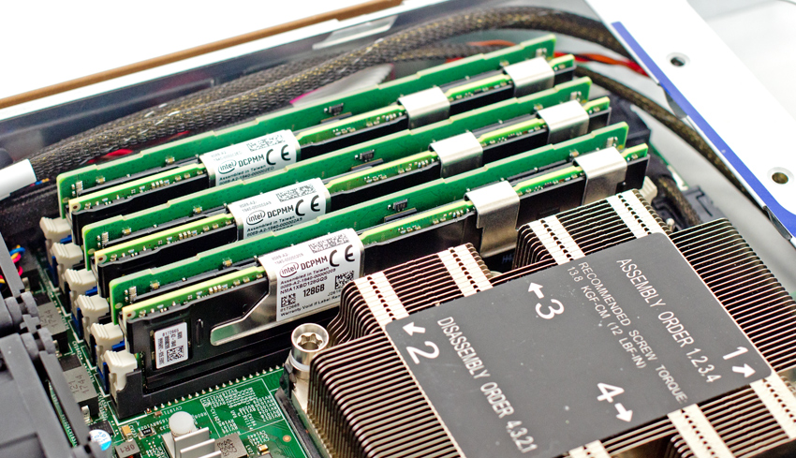
Intel Optane PM

Slide 16
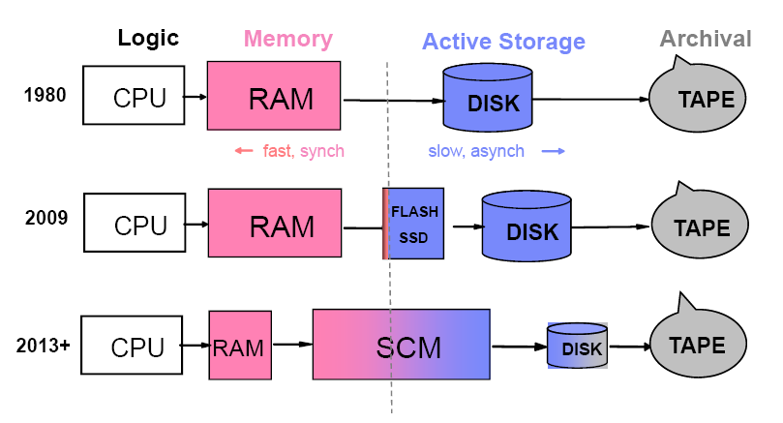
New Storage Devices

Slide 17
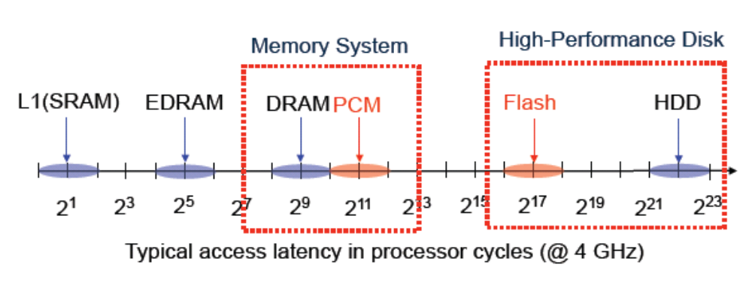
New Storage Devices

Slide 18
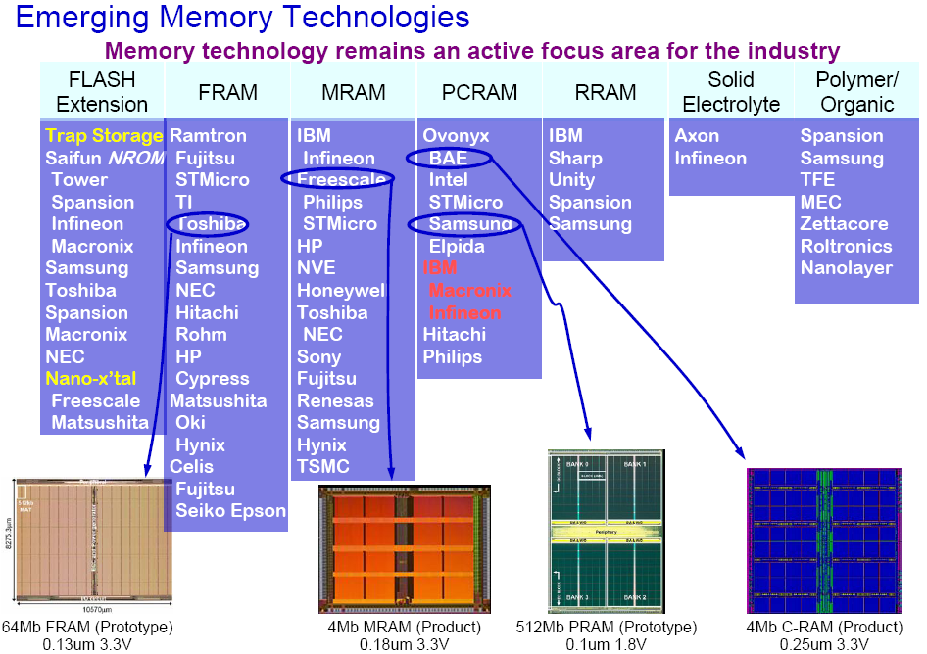
Backup

Slide 19
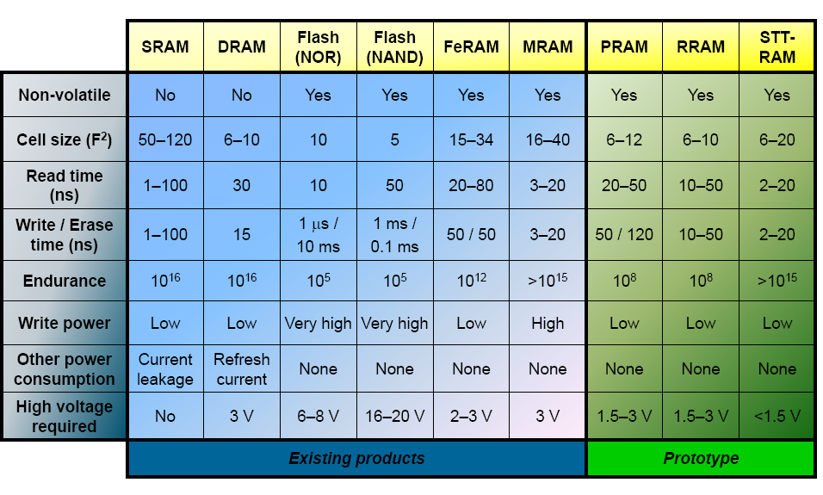
New Storage Devices

Slide 20
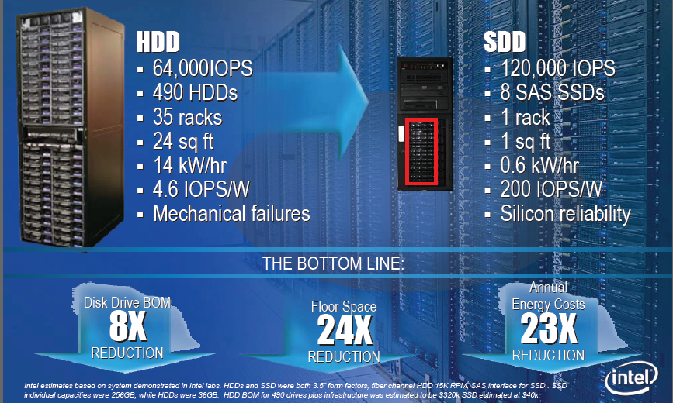
New Storage Devices

Slide 21
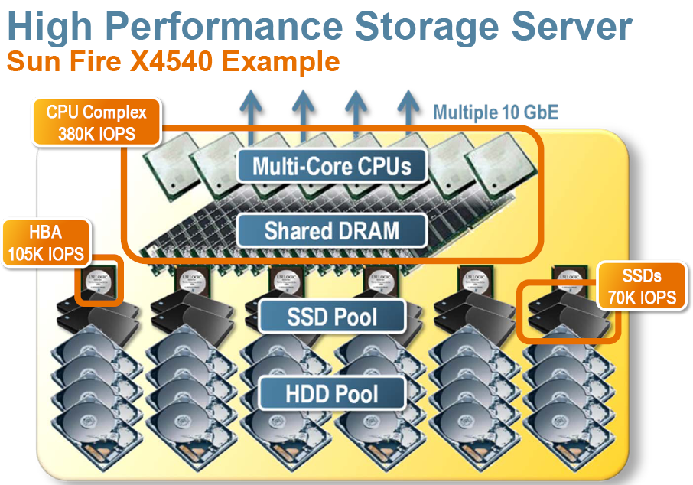
New Storage Devices

Slide 22
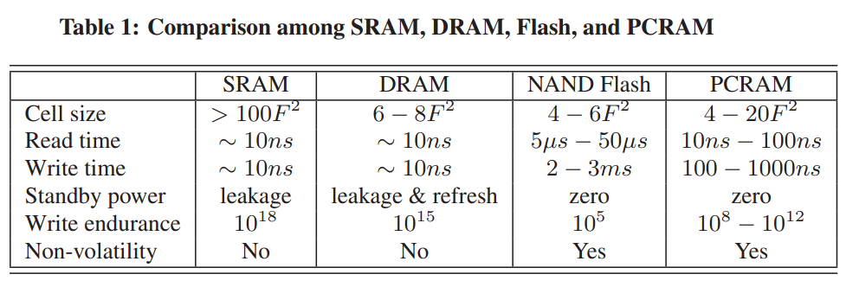
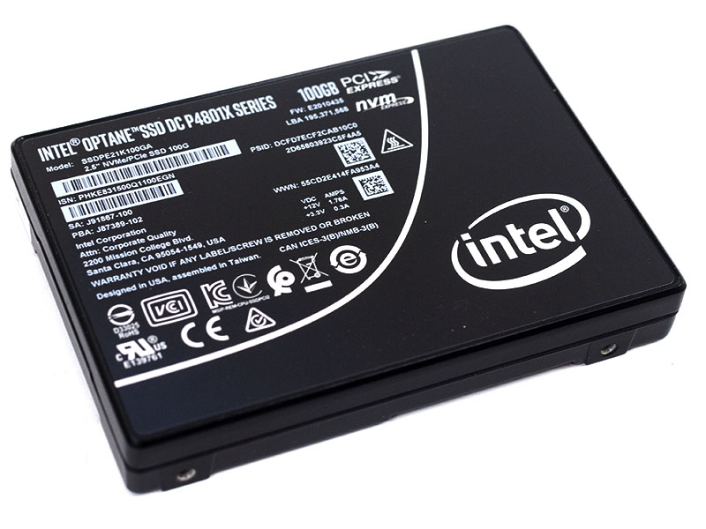
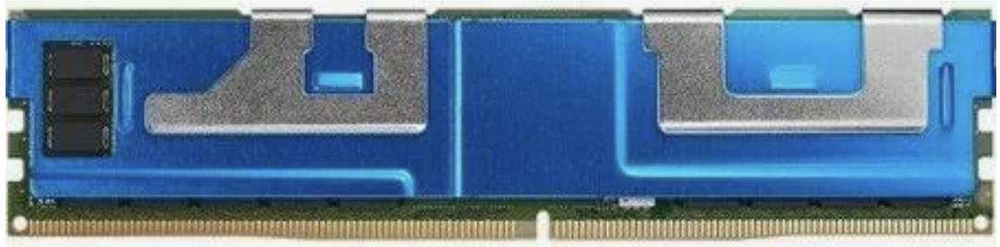
Performance Comparison

