Slide 1

Spark Streaming
Large-scale near-real-time stream processing
大数据处理
毛波
厦门大学 信息学院

Slide 2
What is Spark Streaming?
Framework for large scale stream processing
  Scales to 100s of nodes
  Can achieve second scale latencies
  Integrates with Spark’s batch and interactive processing
  Provides a simple batch-like API for implementing complex algorithm
  Can absorb live data streams from Kafka, Flume, ZeroMQ, etc.

Slide 3
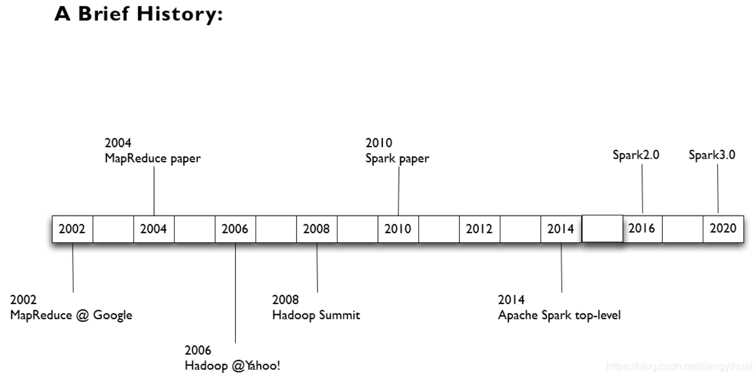

Slide 4
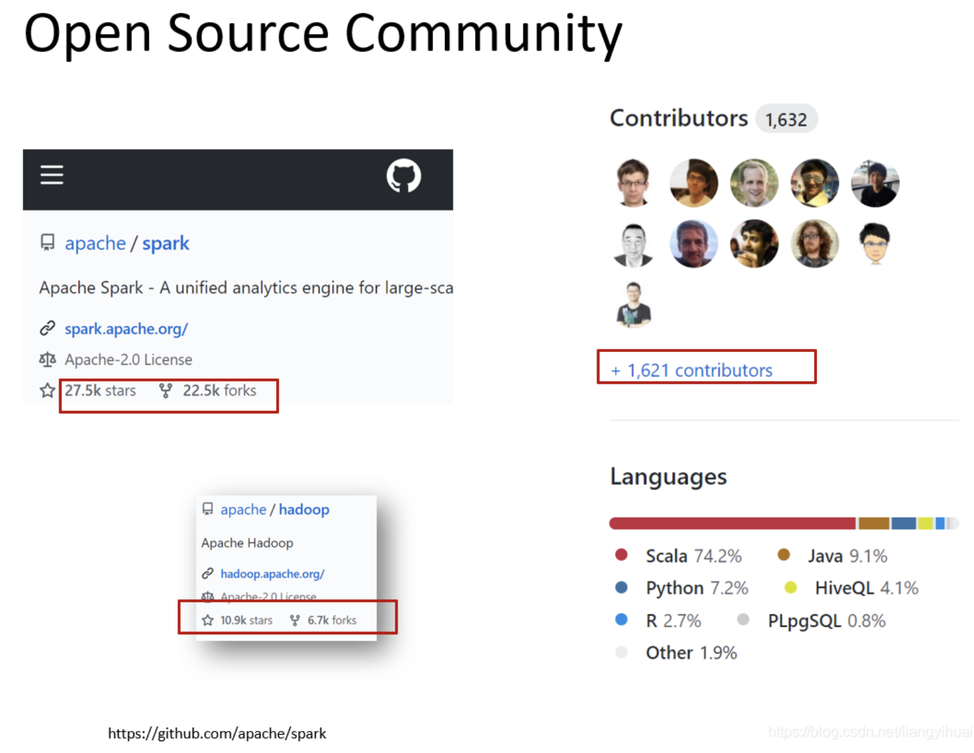
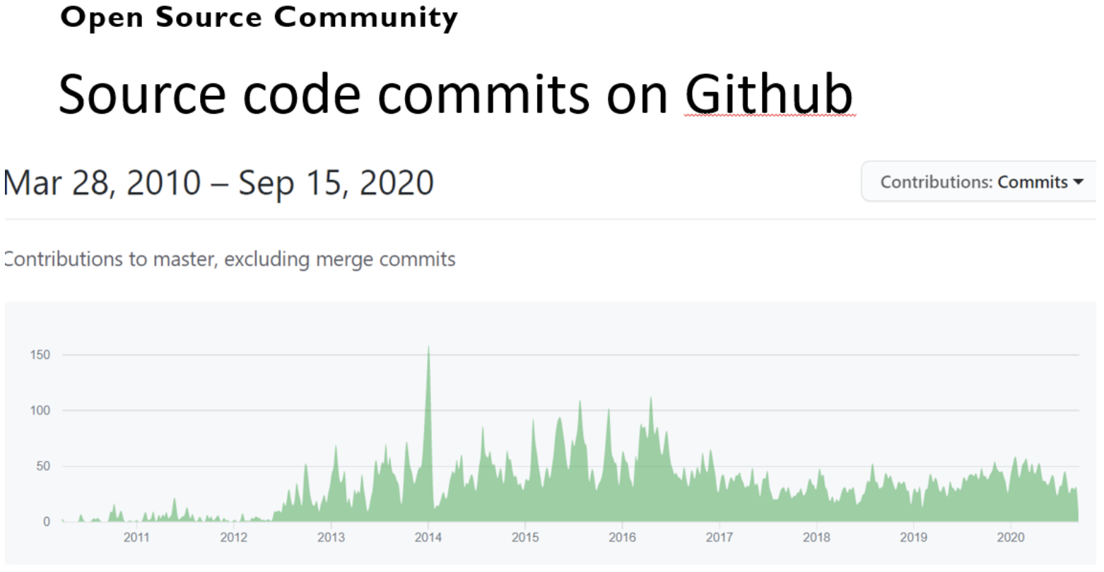

Slide 5
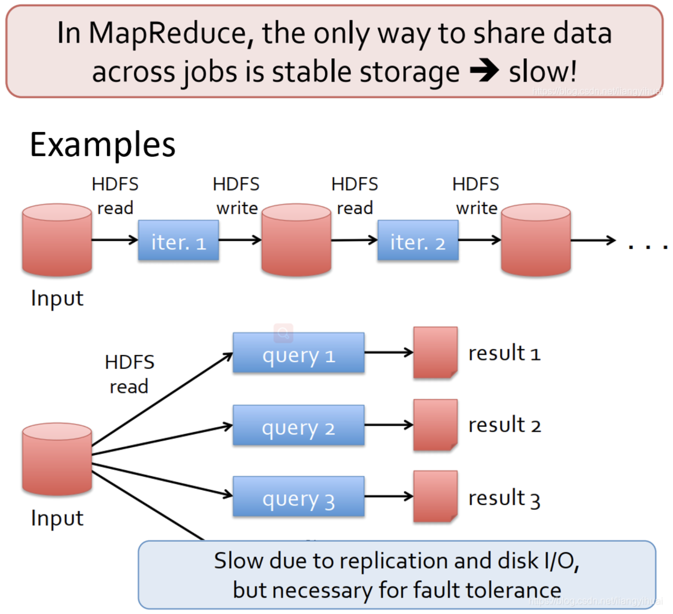
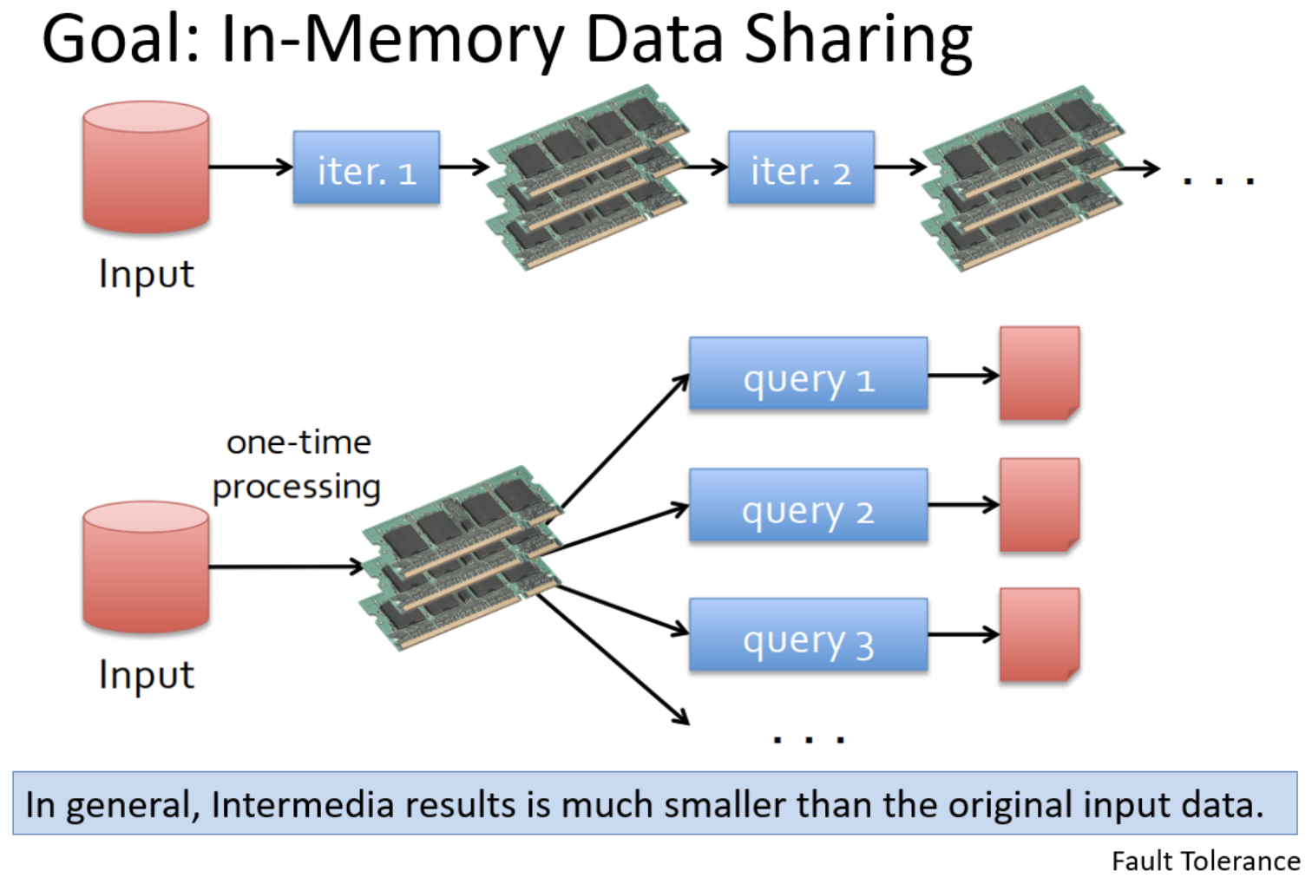

Slide 6

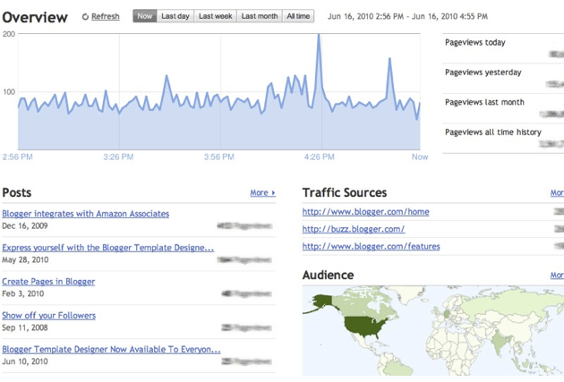
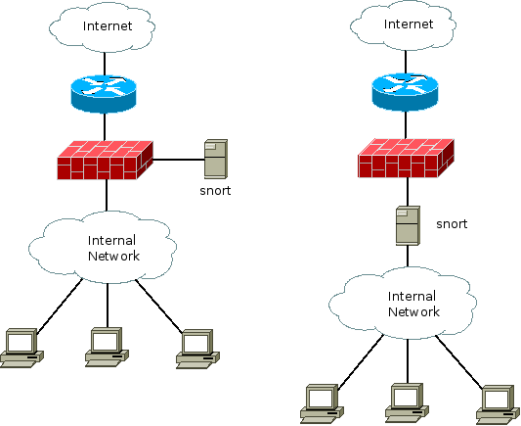
Motivation
Many important applications must process large streams of live data and provide results in near-real-time
  Social network trends
  Website statistics
  Intrustion detection systems
  etc.
Require large clusters to handle workloads
Require latencies of few seconds

Slide 7
Need for a framework …
… for building such complex stream processing applications
But what are the requirements
from such a framework?

Slide 8
Requirements
Scalable to large clusters
Second-scale latencies
Simple programming model

Slide 9
Case study: Conviva, Inc.
Real-time monitoring of online video metadata
  HBO, ESPN, ABC, SyFy, …
Two processing stacks
Custom-built distributed stream processing system
  1000s complex metrics on millions of video sessions
  Requires many dozens of nodes for processing
Hadoop backend for offline analysis
Generating daily and monthly reports
Similar computation as the streaming system

Slide 10



Case study: XYZ, Inc.
Any company who wants to process live streaming data has this problem
Twice the effort to implement any new function
Twice the number of bugs to solve
Twice the headache
Two processing stacks
Custom-built distributed stream processing system
  1000s complex metrics on millions of videos sessions
  Requires many dozens of nodes for processing
Hadoop backend for offline analysis
Generating daily and monthly reports
Similar computation as the streaming system

Slide 11
Requirements
Scalable to large clusters
Second-scale latencies
Simple programming model
Integrated with batch & interactive processing

Slide 12

Stateful Stream Processing
Traditional streaming systems have a event-driven record-at-a-time processing model
  Each node has mutable state
  For each record, update state & send new records
State is lost if node dies!
Making stateful stream processing be fault-tolerant is challenging
mutable state
input
records
node 1
node 3
input
records
node 2
Notes:
Traditional streaming systems have what we call a “record-at-a-time” processing model. Each node in the cluster processing a stream has a mutable state. As records arrive one at a time, the mutable state is updated, and a new generated record is pushed to downstream nodes. Now making this mutable state fault-tolerant is hard.

Slide 13
Existing Streaming Systems
Storm
  Replays record if not processed by a node
  Processes each record at least once
  May update mutable state twice!
  Mutable state can be lost due to failure!
Trident – Use transactions to update state
  Processes each record exactly once
  Per state transaction updates slow

Slide 14
Requirements
Scalable to large clusters
Second-scale latencies
Simple programming model
Integrated with batch & interactive processing
Efficient fault-tolerance in stateful computations

Slide 15
What is the main difference between
Spark & Hadoop?

Slide 16
Spark Streaming

Slide 17
Discretized Stream Processing
Run a streaming computation as a series of very small, deterministic batch jobs
live data stream
Spark
Streaming
Chop up the live stream into batches of X seconds
Spark treats each batch of data as RDDs and processes them using RDD operations
Finally, the processed results of the RDD operations are returned in batches
batches of X seconds
Spark
processed results

Slide 18
Discretized Stream Processing
Run a streaming computation as a series of very small, deterministic batch jobs
live data stream
Spark
Streaming
Batch sizes as low as ½ second, latency ~ 1 second
Potential for combining batch processing and streaming processing in the same system
batches of X seconds
Spark
processed results

Slide 19
Example 1 – Get hashtags from Twitter
val tweets = ssc.twitterStream(<Twitter username>, <Twitter password>)
DStream: a sequence of RDD representing a stream of data
Twitter Streaming API
batch @ t+1
batch @ t
batch @ t+2
tweets DStream
stored in memory as an RDD (immutable, distributed)

Slide 20
Example 1 – Get hashtags from Twitter
val tweets = ssc.twitterStream(<Twitter username>, <Twitter password>)
val hashTags = tweets.flatMap (status => getTags(status))
new DStream
transformation: modify data in one Dstream to create another DStream
batch @ t
batch @ t+1
batch @ t+2
tweets DStream
flatMap
flatMap
flatMap
hashTags Dstream
[#cat, #dog, … ]
new RDDs created for every batch
…

Slide 21
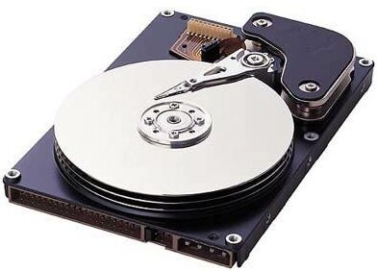
Example 1 – Get hashtags from Twitter
val tweets = ssc.twitterStream(<Twitter username>, <Twitter password>)
val hashTags = tweets.flatMap (status => getTags(status))
hashTags.saveAsHadoopFiles("hdfs://...")
output operation: to push data to external storage
batch @ t
batch @ t+1
batch @ t+2
tweets DStream
flatMap
flatMap
flatMap
hashTags DStream
save
save
save
every batch saved to HDFS

Slide 22
Java Example
Scala
val tweets = ssc.twitterStream(<Twitter username>, <Twitter password>)
val hashTags = tweets.flatMap (status => getTags(status))
hashTags.saveAsHadoopFiles("hdfs://...")
Java
JavaDStream<Status> tweets = ssc.twitterStream(<Twitter username>, <Twitter password>)
JavaDstream<String> hashTags = tweets.flatMap(new Function<...> { })
hashTags.saveAsHadoopFiles("hdfs://...")
Function object to define the transformation

Slide 23
Fault-tolerance
RDDs are remember the sequence of operations that created it from the original fault-tolerant input data
Batches of input data are replicated in memory of multiple worker nodes, therefore fault-tolerant
Data lost due to worker failure, can be recomputed from input data
tweets
RDD
input data replicated
in memory
flatMap
hashTags
RDD
lost partitions recomputed on other workers

Slide 24
Key concepts
DStream – sequence of RDDs representing a stream of data
  Twitter, HDFS, Kafka, Flume, ZeroMQ, Akka Actor, TCP sockets
Transformations – modify data from on DStream to another
  Standard RDD operations – map, countByValue, reduce, join, …
  Stateful operations – window, countByValueAndWindow, …
Output Operations – send data to external entity
  saveAsHadoopFiles – saves to HDFS
  foreach – do anything with each batch of results

Slide 25






Example 2 – Count the hashtags
val tweets = ssc.twitterStream(<Twitter username>, <Twitter password>)
val hashTags = tweets.flatMap (status => getTags(status))
val tagCounts = hashTags.countByValue()
batch @ t
batch @ t+1
batch @ t+2
tweets
flatMap
flatMap
flatMap
hashTags
map
map
…
map
tagCounts
[(#cat, 10), (#dog, 25), ... ]
reduceByKey
reduceByKey
reduceByKey

Slide 26
Example 3 – Count the hashtags over last 10 mins
val tweets = ssc.twitterStream(<Twitter username>, <Twitter password>)
val hashTags = tweets.flatMap (status => getTags(status))
val tagCounts = hashTags.window(Minutes(10), Seconds(1)).countByValue()
sliding window operation
window length
sliding interval

Slide 27
Example 3 – Counting the hashtags over last 10 mins
val tagCounts = hashTags.window(Minutes(10), Seconds(1)).countByValue()
t-1
t
t+1
t+2
t+3
hashTags
sliding window
countByValue
count over all the data in the window
tagCounts

Slide 28
Smart window-based countByValue
val tagCounts = hashtags.countByValueAndWindow(Minutes(10), Seconds(1))
t-1
t
t+1
t+2
t+3
hashTags
countByValue
add the counts from the new batch in the window
subtract the counts from batch before the window
–
+
tagCounts
+
?

Slide 29
Smart window-based reduce
Technique to incrementally compute count generalizes to many reduce operations
  Need a function to “inverse reduce” (“subtract” for counting)
Could have implemented counting as:
hashTags.reduceByKeyAndWindow(_ + _, _ - _, Minutes(1), …)

Slide 30
Demo

Slide 31
Fault-tolerant Stateful Processing
All intermediate data are RDDs, hence can be recomputed if lost
t-1
t
t+1
t+2
t+3
hashTags
tagCounts

Slide 32
Fault-tolerant Stateful Processing
State data not lost even if a worker node dies
  Does not change the value of your result
Exactly once semantics to all transformations
  No double counting!

Slide 33
Other Interesting Operations
Maintaining arbitrary state, track sessions
  Maintain per-user mood as state, and update it with his/her tweets
tweets.updateStateByKey(tweet => updateMood(tweet))
Do arbitrary Spark RDD computation within DStream
  Join incoming tweets with a spam file to filter out bad tweets
  tweets.transform(tweetsRDD => {
  tweetsRDD.join(spamHDFSFile).filter(...)
  })

Slide 34
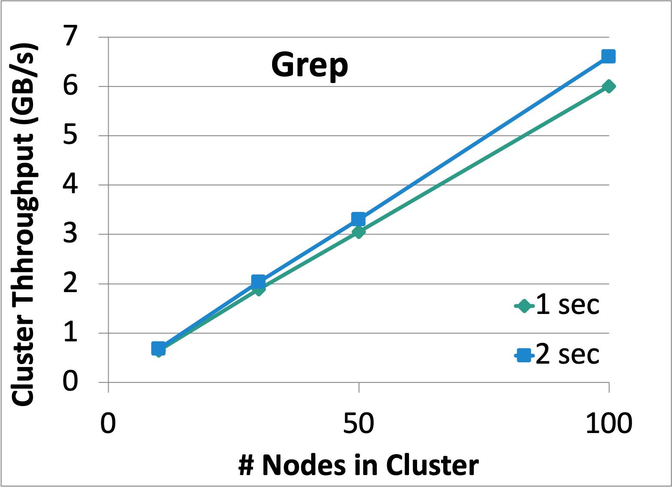
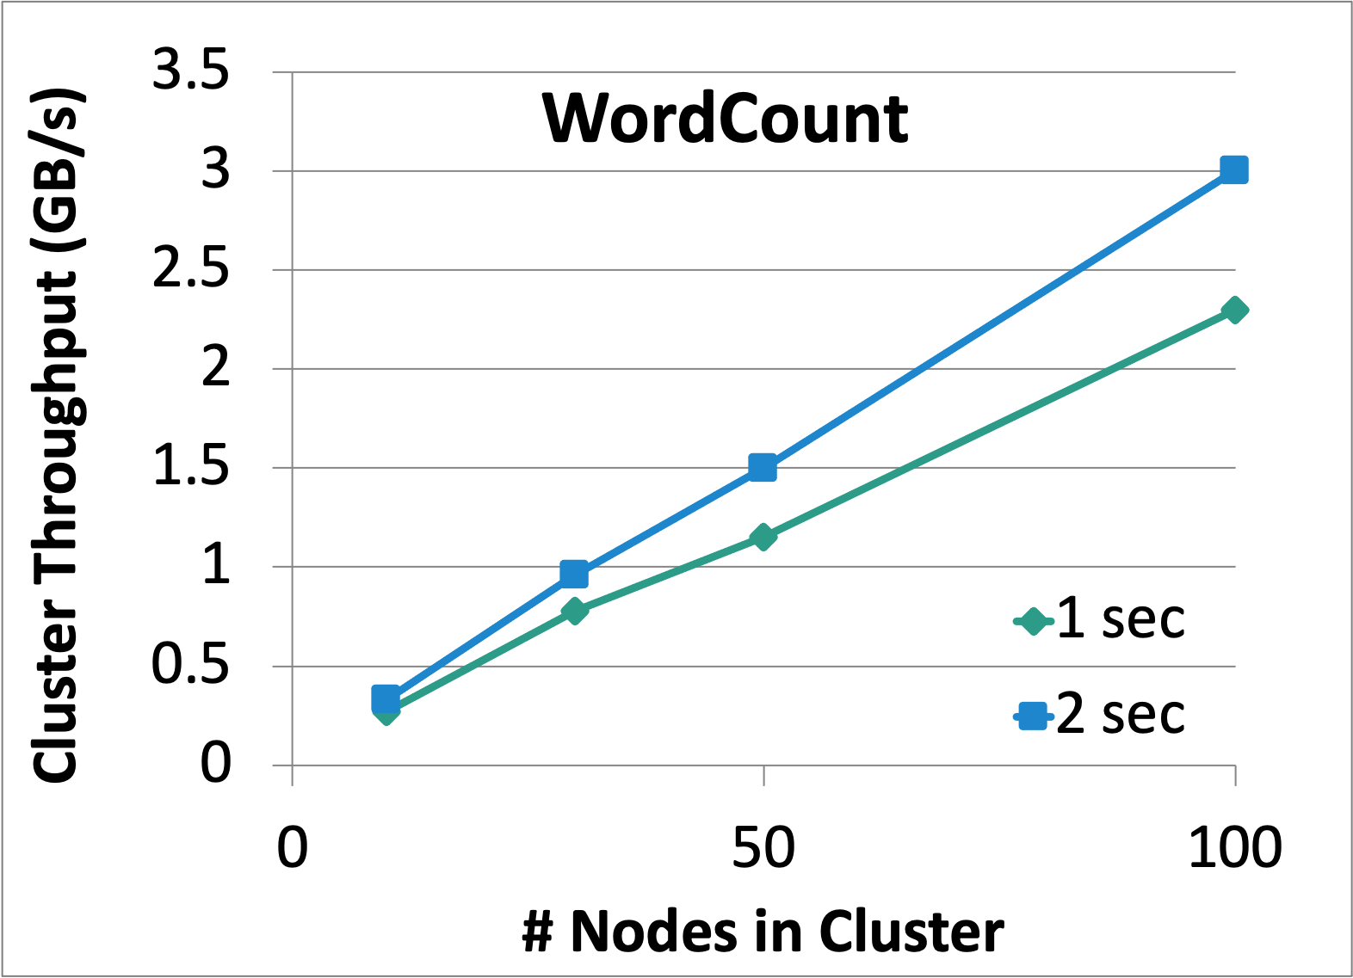
Performance
Can process 6 GB/sec (60M records/sec) of data on 100 nodes at sub-second latency
  Tested with 100 streams of data on 100 EC2 instances with 4 cores each

Slide 35
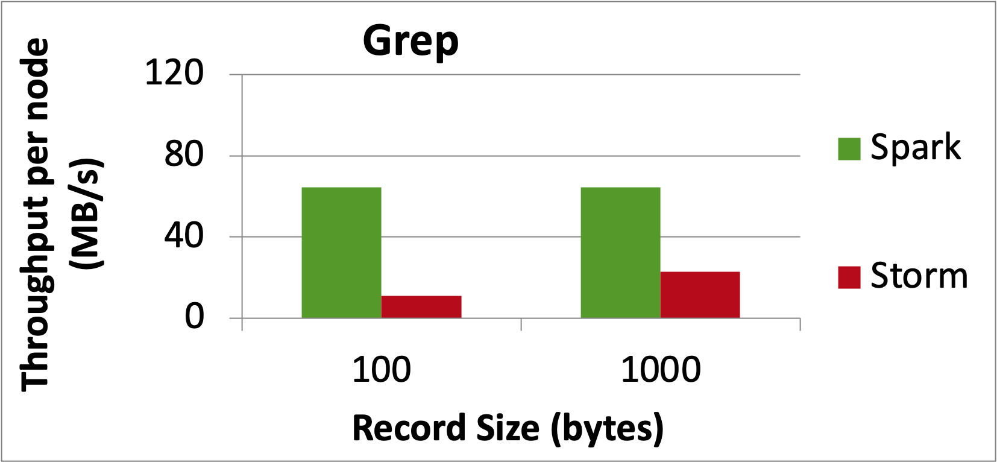
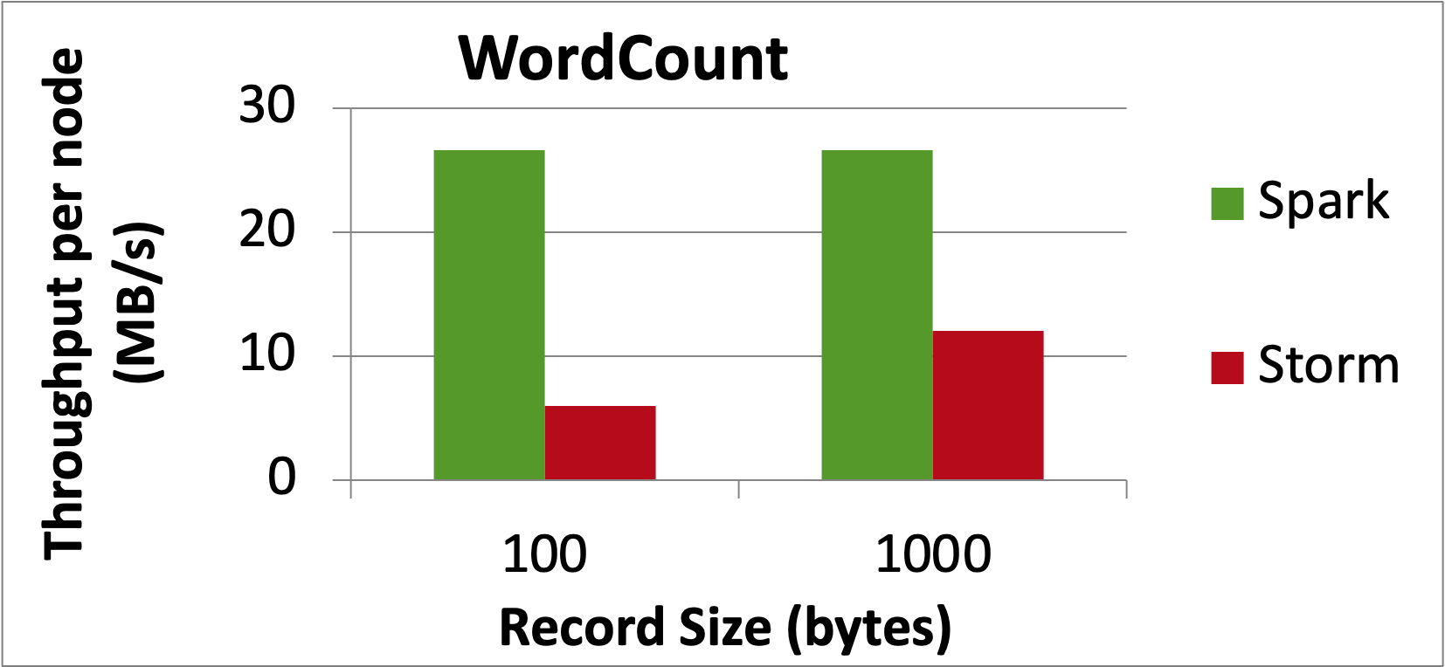
Comparison with Storm and S4
Higher throughput than Storm
Spark Streaming: 670k records/second/node
Storm: 115k records/second/node
Apache S4: 7.5k records/second/node
Notes:
Streaming Spark offers similar speed while providing FT and consistency guarantees that these systems lack

Slide 36
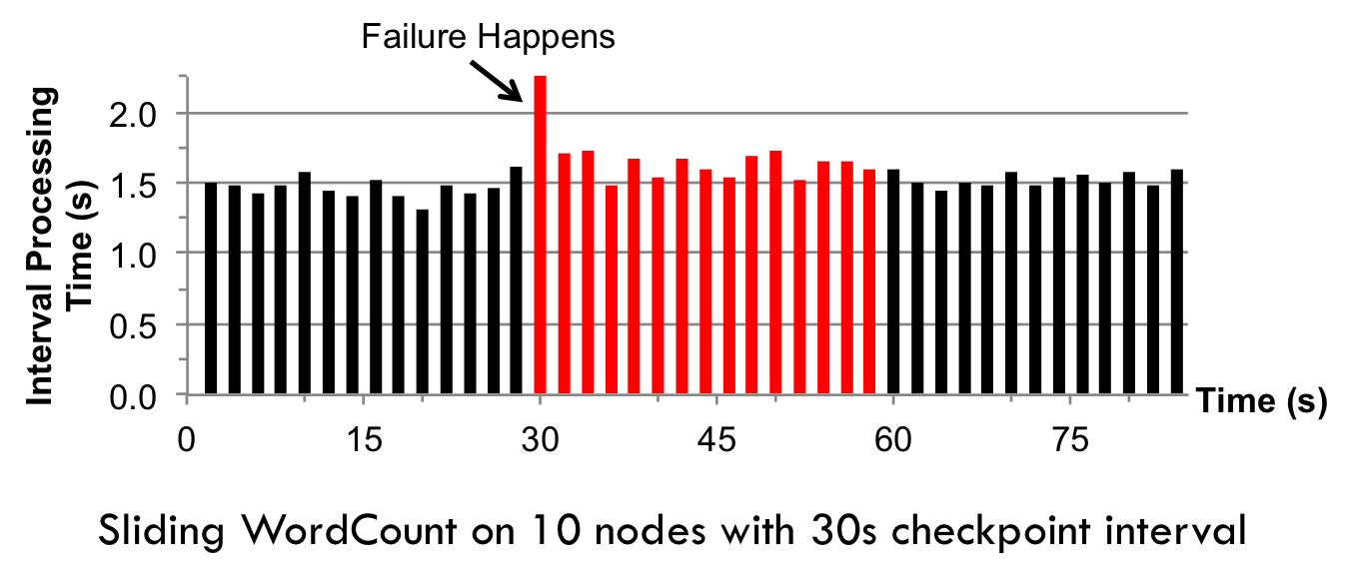
Fast Fault Recovery
Recovers from faults/stragglers within 1 sec

Slide 37
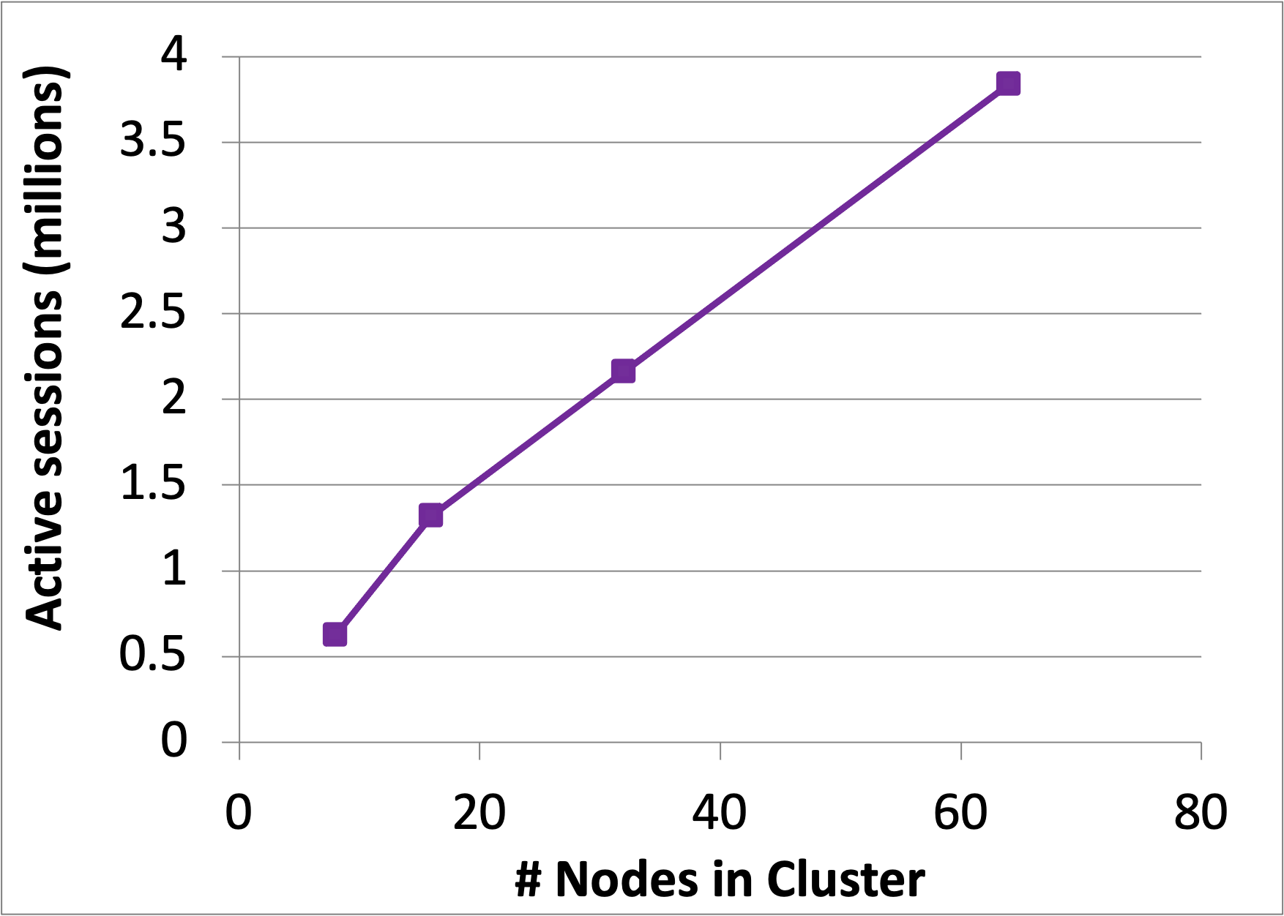
Real Applications: Conviva
Real-time monitoring of video metadata
Achieved 1-2 second latency
Millions of video sessions processed
Scales linearly with cluster size

Slide 38
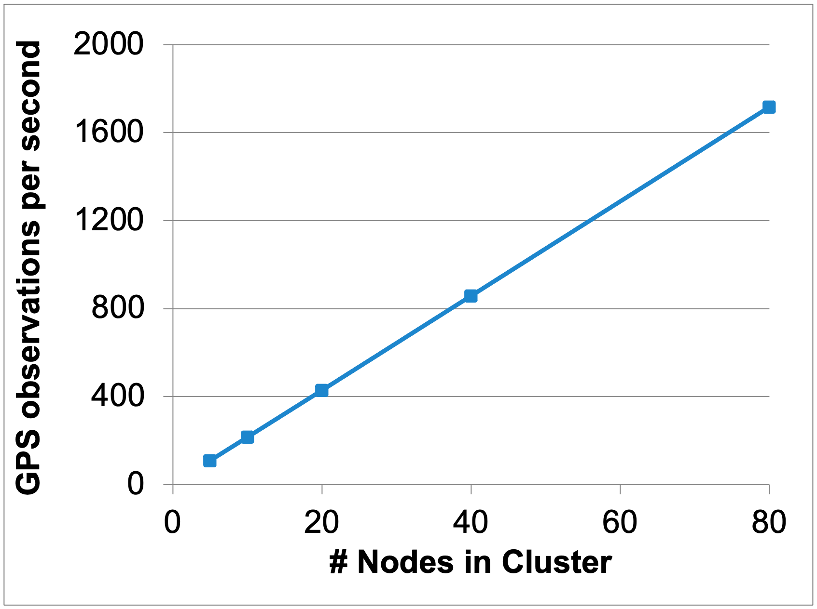
Real Applications: Mobile Millennium Project
Traffic transit time estimation using online machine learning on GPS observations
Markov chain Monte Carlo simulations on GPS observations
Very CPU intensive, requires dozens of machines for useful computation
Scales linearly with cluster size

Slide 39
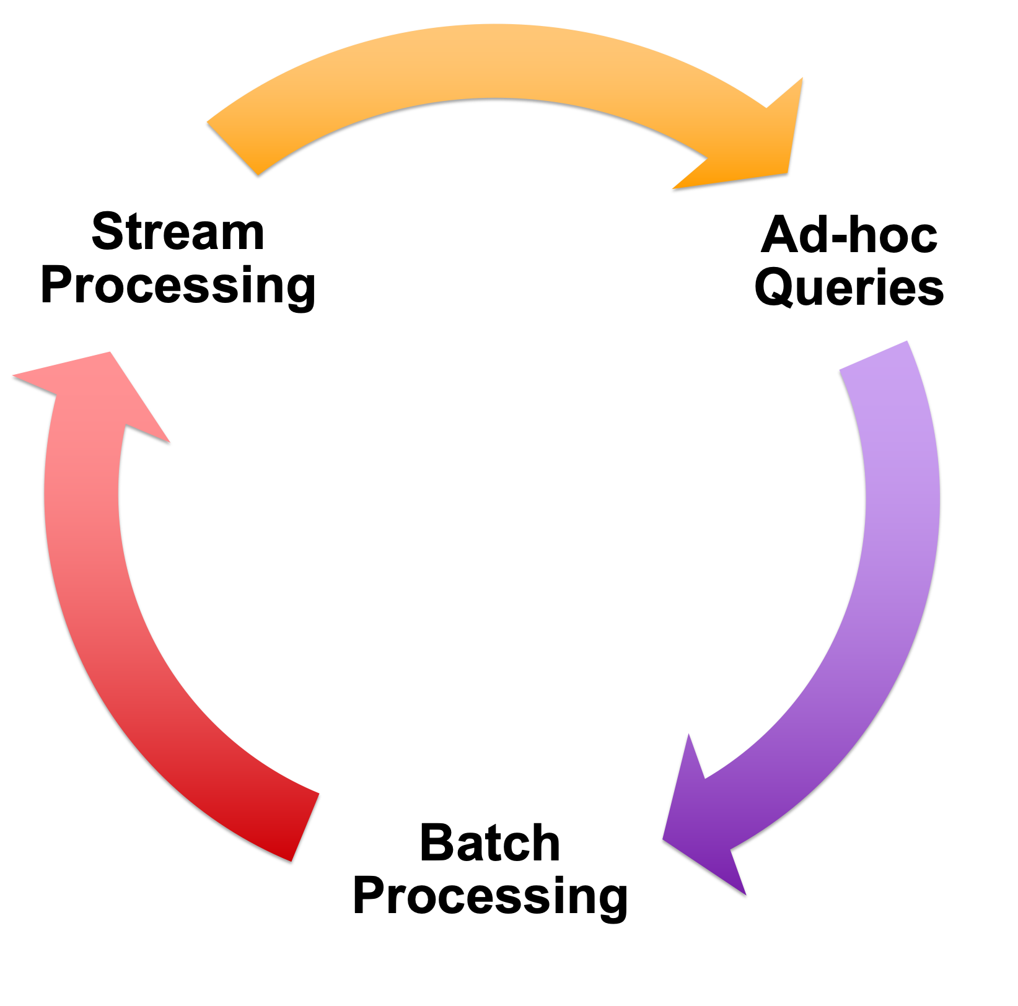
Vision - one stack to rule them all
Spark
+
Shark
+
Spark
Streaming

Slide 40
Spark program vs Spark Streaming program
Spark Streaming program on Twitter stream
val tweets = ssc.twitterStream(<Twitter username>, <Twitter password>)
val hashTags = tweets.flatMap (status => getTags(status))
hashTags.saveAsHadoopFiles("hdfs://...")
Spark program on Twitter log file
val tweets = sc.hadoopFile("hdfs://...")
val hashTags = tweets.flatMap (status => getTags(status))
hashTags.saveAsHadoopFile("hdfs://...")

Slide 41
Vision - one stack to rule them all
Explore data interactively using Spark Shell / PySpark to identify problems
Use same code in Spark stand-alone programs to identify problems in production logs
Use similar code in Spark Streaming to identify problems in live log streams
$ ./spark-shell
scala> val file = sc.hadoopFile(“smallLogs”)
...
scala> val filtered = file.filter(_.contains(“ERROR”))
...
scala> val mapped = file.map(...)
...
object ProcessProductionData {
def main(args: Array[String]) {
val sc = new SparkContext(...)
val file = sc.hadoopFile(“productionLogs”)
val filtered = file.filter(_.contains(“ERROR”))
val mapped = file.map(...)
...
}
}
object ProcessLiveStream {
def main(args: Array[String]) {
val sc = new StreamingContext(...)
val stream = sc.kafkaStream(...)
val filtered = file.filter(_.contains(“ERROR”))
val mapped = file.map(...)
...
}
}

Slide 42
Vision - one stack to rule them all
Explore data interactively using Spark Shell / PySpark to identify problems
Use same code in Spark stand-alone programs to identify problems in production logs
Use similar code in Spark Streaming to identify problems in live log streams
$ ./spark-shell
scala> val file = sc.hadoopFile(“smallLogs”)
...
scala> val filtered = file.filter(_.contains(“ERROR”))
...
scala> val mapped = file.map(...)
...
Spark
+
Shark
+
Spark
Streaming
object ProcessProductionData {
def main(args: Array[String]) {
val sc = new SparkContext(...)
val file = sc.hadoopFile(“productionLogs”)
val filtered = file.filter(_.contains(“ERROR”))
val mapped = file.map(...)
...
}
}
object ProcessLiveStream {
def main(args: Array[String]) {
val sc = new StreamingContext(...)
val stream = sc.kafkaStream(...)
val filtered = file.filter(_.contains(“ERROR”))
val mapped = file.map(...)
...
}
}

Slide 43
Alpha Release with Spark 0.7
Integrated with Spark 0.7
  Import spark.streaming to get all the functionality
Both Java and Scala API
Give it a spin!
  Run locally or in a cluster
Try it out in the hands-on tutorial later today

Slide 44
Summary
Stream processing framework that is ...
  Scalable to large clusters
  Achieves second-scale latencies
  Has simple programming model
  Integrates with batch & interactive workloads
  Ensures efficient fault-tolerance in stateful computations
For more information, checkout the paper: http://tinyurl.com/dstreams

