Slide 1
Word Chain Game
By using Parallel & Contribute Computing
Soyeon Ju
George Lopez

Slide 2
Project Time Line
Progressing…
~Sep.18
Decide subject
Set up the plan
~ Oct 16
Build the code for game
Research for background knowledge
66%
~Nov.20
Build the code for server
and Connect
~Nov.27
Wrap up
(%)
0
10
20
30
40
50
60
70
80
90
100

Slide 3

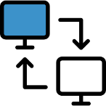

Composition? Construction? Organization?
We are using…
JAVA
Client - Server
30%
Word
Chain
Game
40%
20%
UI
10%
ETC

Slide 4
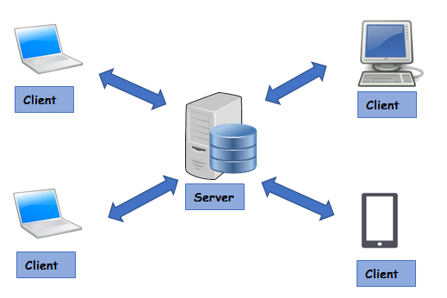
Client – Server Model
The Client-Server model has all nodes on a network acting as ‘clients’. When
these systems need to access a resource, they all request the resource from
particular location known as a server.
A server provides a specific resource
for a network, such as a file location,
database, internet, email or printer.

Slide 5
How to work
Please describe…
1. How to check the word
2. Way of calculate the score
3.

Slide 6
Game Rules
Please describe…
1. Basic rule
2.
3. Time limit
4. Get a Score

Slide 7
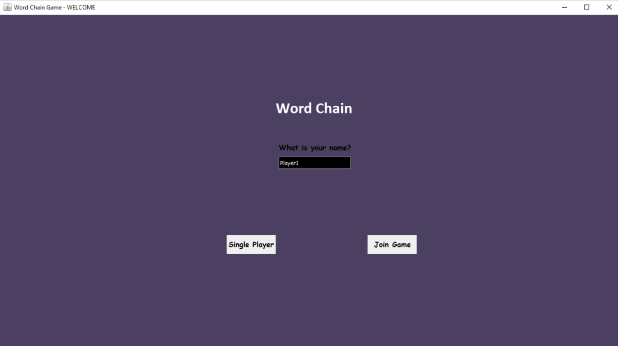
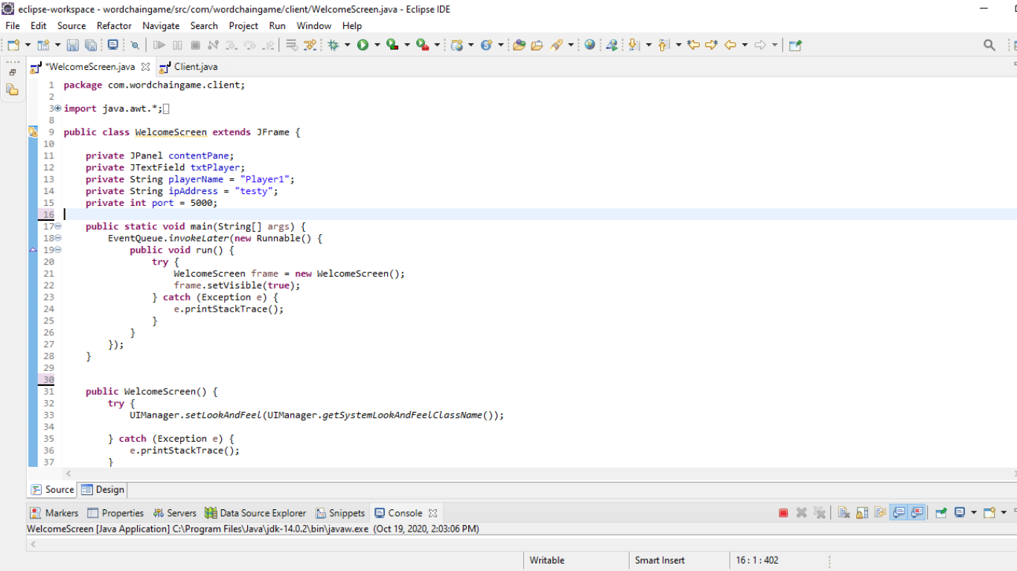
Welcome Screen - Code

Slide 8
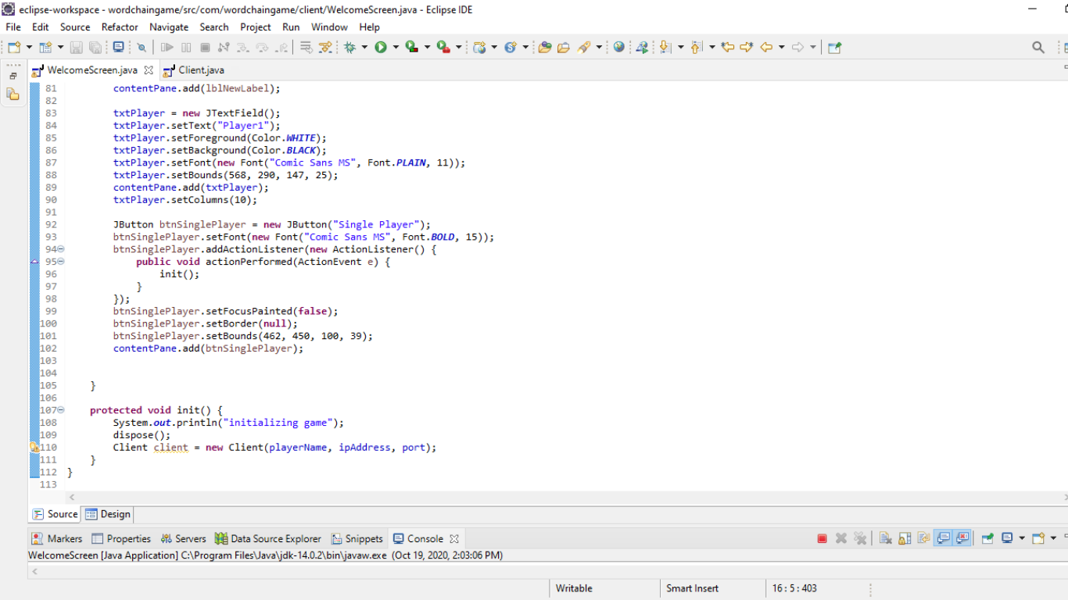
Client Initialize Code

Slide 9
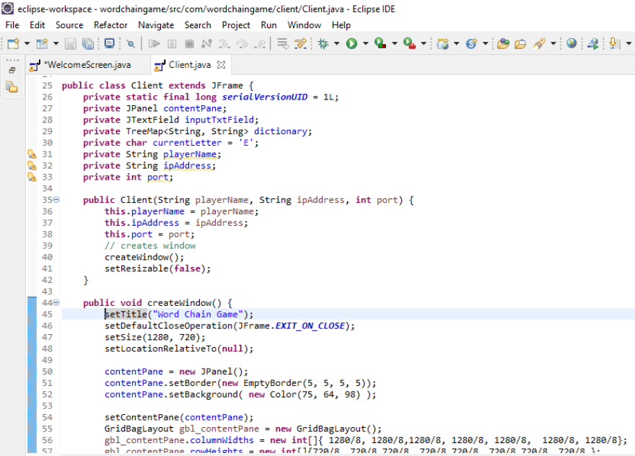
Client – Constructor - Code

Slide 10
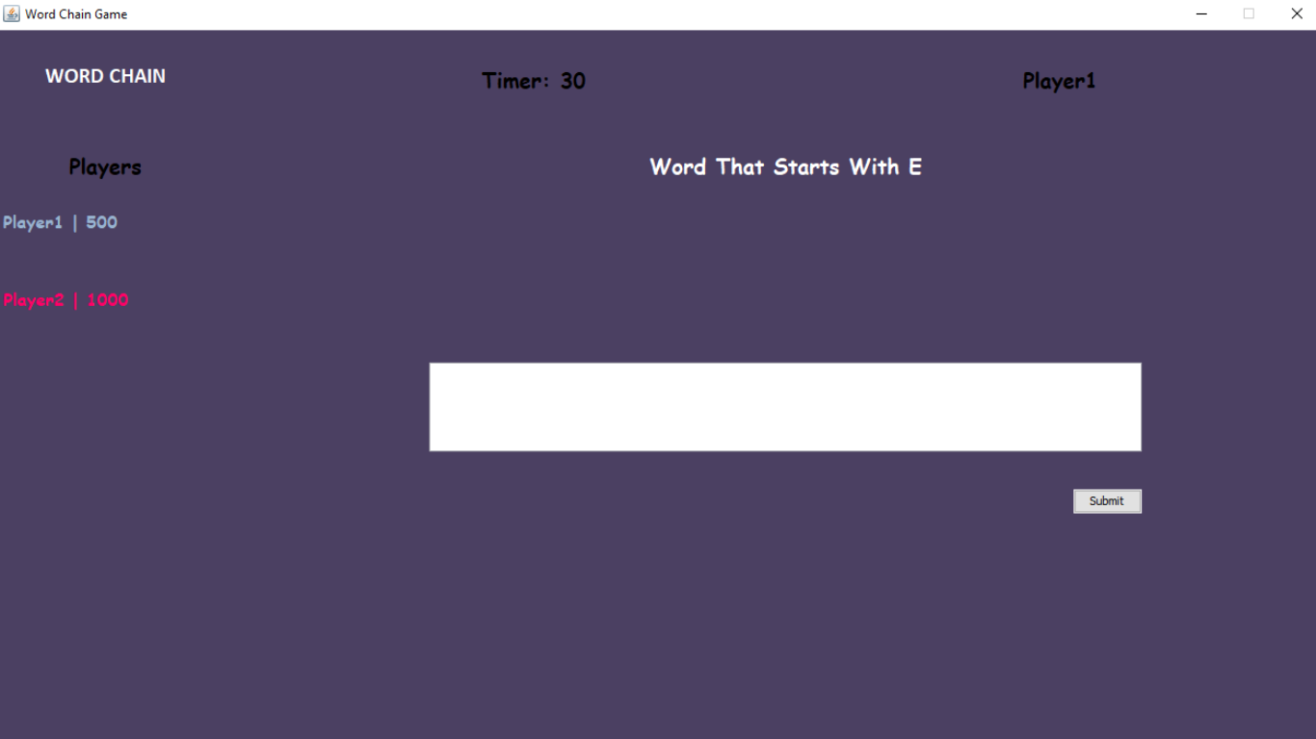
Client Screen

Slide 11
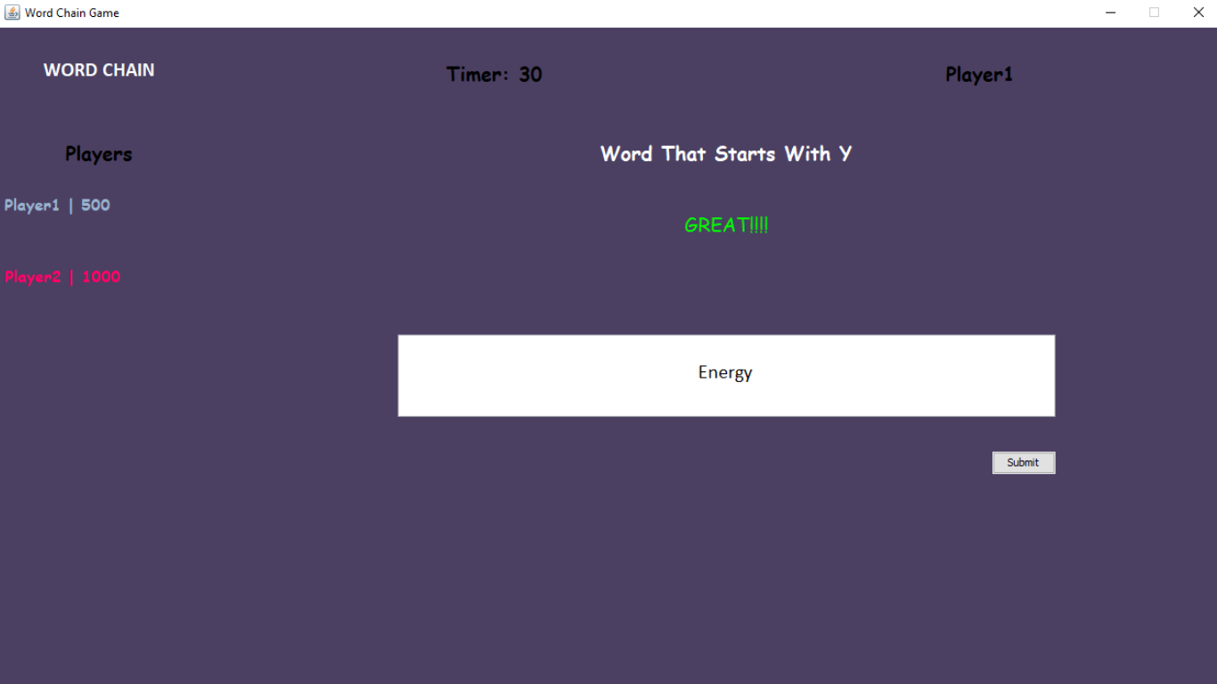
Feedback - Screen

Slide 12
Easy & Difficulty
Everything
Blah Blah
Coding maybe,,,?
Blah Blah
Your sudden class…
Blah Blah
Set a Role,,??
Mostly Goerge did….

Slide 13
Feedback
You can just ignore what I wrote and fill up please.
To be honest, I have no idea what I should put it this ppt
cause you did everything for coding… (Thanks)
Please the contents, write or correct anything as you want and let me know if you want to add /delete something..
I think you might be presenter on behalf of out group lol

