Slide 1
Interactive Web Apps Using R Shiny
July-2021
TCS Confidential

Slide 2
DEG Role in the Business 4.0 World
Business 4.0 behaviors: Mass personalization, Creating exponential value, Leveraging ecosystems and Embracing risk are enabled by the digital pillars of Intelligent, Agile, Automated and on the Cloud
Driving Enterprise Agile Transformation in TCS
Coaching projects to leverage Automation
Designing processes to work in new technologies
Bring the best of TCS for project delivery, leveraging the larger ecosystem
Proactively governing risks
TCS Internal

Slide 3
Transformation Approach -> DEG 4.0
Capabilities
Conventional Delivery Models
Manual and need-based automation
IT Metrics Driven Delivery
Unpredictable Customer escalations
Struggle in Delivering Complex Programs
Internal optimization
Living Agile
Machine first Delivery
Growth and Transformation driven
Smooth, Predictable Delivery
Risk-based Project/Customer Management
Benchmarked Delivery Leadership
100% Agile DEG
Redefined Delivery Processes for new ways of working (Agile, MFDM etc.)
Customer Business Metrics based Delivery
Reimagined Delivery Governance
Improved Delivery Assurance
Benchmarked with industry models and competition
Today
Future
TCS Internal

Slide 4
DEG 4.0 Capabilities and Epics
100% Agile DEG
Redefined Delivery Processes
Improved Delivery Assurance
Define Agile DEG Products Catalogue
Develop DEG Agile Workforce
Collaboration and Lean tools to deploy Agile practices
Reimagined Delivery policies for new ways of working
Fit-for-purpose Delivery processes for traditional services
Define Processes and Estimation models for New Services
Define and brand TCS Way of Working
Kanban based iQMS Deployment
Data Quality governance
Integrated Contracts Compliance
Improve Estimation Rigor
Reimagined Delivery Governance
Customer Business Metrics based Delivery
Benchmark with Industry models and competition
Redefined Delivery Governance and Program Recovery process
Deploy Proactive alerts for Risk Management and escalation management
CEO Delivery Dashboard
Continuous assurance and audits
Business Metrics for all Industry Segments
Measure and Govern Business Metrics for identified Projects
Identify and Amplify Success Stories of Business Metrics Performance
Competition Benchmarking Report
CMMI V2 adoption
Reimagine CSS survey
Productivity benchmarking and continuous improvement
TCS Internal

Slide 5

DEG - Yearly Planning Process
Organizational Priorities & Objectives
Unit DEG Plan
Corporate DEG Priorities & Objectives
Unit Business Objectives
Leadership Inputs
DEG Score Card Analysis
External Audit and Assessment requirements
Pulse Feedback - DEG

Slide 6
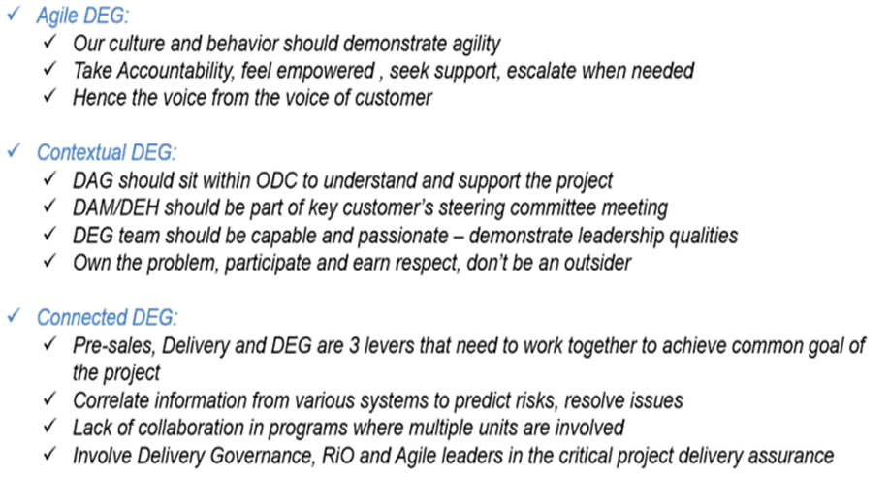
Corporate DEG Objectives – Voice of Business Heads
TCS Internal

Slide 7
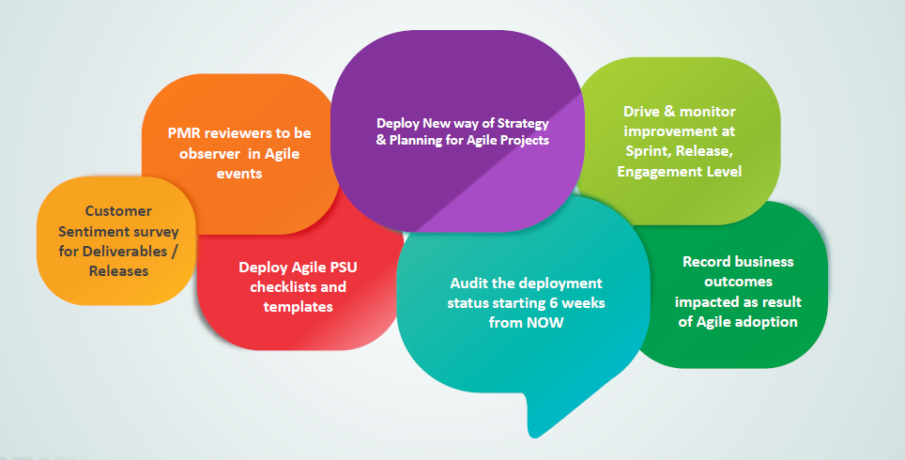
Corp DEG Key Asks for Agile Projects
TCS Internal

Slide 8
EAS-EGP Unit Objectives
Operational Excellence
Increase Revenue by (30%) for Infor, Microsoft, QAD and Netsuite
Make Additional Revenue from new Products (Zuora, IFS, Coupa and Anaplan)
Focus on Niche Platform and Cloud ERP
Retain Competent Workforce
Improve Customer Satisfaction and create referenceable customers
Delivery Excellence
Critical Programs – Milestone Tracking, Quality Assurance
Delivery Competency Drive and Improvement
Improve On time Delivery(OTD) in projects
Sustain and Improve % DFD compliance at unit level
Defect Reduction in Projects
Elimination of Root Causes for Top Causes of Defects
TCS Internal

Slide 9
Unit Delivery Assurance Plan - 1/3
Focus Areas | Goals | Key Initiatives | Target | Planned Closure
Delivery Metrics Compliance | 1.Improve % of projects reporting defects in IPMS 2. Improve OTD and DFD metrics values | 1.Drive to increase number of projects reporting defects in IPMS through offline or IQA/EQA and FI (Defect Analysis) 2. Metrics Data entered by projects have to be proactively verified by respective DAFs at the end of every month (Pulse Analysis- 2019) Increase the value of OTD & DFD within the unit by adopting best practices (Quarterly Analysis ) 4. More Rigor in Facilitation to understand Delivery Challenges and suggest Mitigation Activities (Pulse Analysis 2019) | 1. Improve projects reporting defects count by 50% 2. 100% for applicable projects 3. OTD, DFD > 99% 4. 2 Potential RED Projects identification by Each DAF/per quarter | March 2020
Agile Compliance | Reduce Agility Debt | Improve the Agile Projects Assessed by encouraging new assessments by the teams Complete Agile maturity assessment of all pending projects to reach 100% Adopt more standard and advanced maturity practices in Agile projects Conduct Living Agile sessions to improve Agile Practitioners Collaborate with unit heads to increase Agile Ninja Coaches Publish Agile dashboard to all stakeholders to drive Agility Debt Weekly call with Unit UAL and DAFs to drive the 6 scorecard parameters Publish Agile Bytes (small information flyers) in sub units Participate in Agile Audit and PMRs Align with Corporate Monthly Activities discussed in VCON | SFDC - 35.9% ECM - 43.0% NGP - 55.7% Primary - 49.8% Overall target is to reduce agility debt < 50 % for all units | Sep’ 2019
TCS Internal

Slide 10
Unit Delivery Assurance Plan - 2/3
Focus Areas | Goal | Key Initiatives | Target
Customer Advocacy | Improved CSI Improved customer focus | Drive improvement in CSI through rigorous / effective action planning Complete Causal Analysis in time through rigorous action planning Involve BRM and important stakeholders from beginning of CSS cycle Prepare process documentation to facilitate causal analysis and CSS initiation Conduct CSS process awareness sessions for Prime Use CSS analytics in Ultimatix to drive improved CSI Ensure Correctness of client format feedback | 93.0 % - H1 93.5 % - H2
Customer Advocacy | Reduce Low CSI response | Focused drive to reduce low CSI responses Low CSI call action items tracking with rigor Delivery Head and Delivery Managers involved in low CSI action planning Connect with accounts derived from Account Hotspot analysis Ensure BRM and onsite stakeholder sign-off for action planning Raise PMR action item in case CSS or CSS causal not done effectively | < 10 % H1 and H2
Customer Advocacy | Improve CSS Coverage | Improve CSS coverage by timely follow up Connect and escalate to senior management , onsite BRM Execute correct cross DU tagging and account level CSS Prepare process documentation to facilitate CSS initiation Conduct Weekly CSS call with Delivery Partners and Delivery Heads Publish Weekly Dashboard to key stakeholders | 97 % H1 & H2

Slide 11
Unit Delivery Assurance Plan - 3/3
Focus Areas | Goal | Key Initiatives | Target
Customer Advocacy | Capture Customer appreciations and complaints | Send awareness mailers and facilitate project teams for logging customer appreciations and complaints Coach DAFs to keep note of customer complaints and appreciation received by project and facilitate to log them Any customer complaints received from channels other than project team should be communicated by DEH and Governance team to DAFs for logging | 5% of projects to log
Customer Advocacy | Facilitate Lifeline Survey nominations and action planning | Drive Lifeline Survey –Nominations , reconciliation , driving coverage by connecting the Unit Heads from ISU and our EAS HSDU Track action planning and closure for Lifeline surveys | 100 %

Slide 12
ACG Plan for FY 20
Focus Areas | Goal | Key Initiatives | Target
Audit Effectiveness | Improve Audit Effectiveness | Improve Audit Report quality by sharing simple audit questionnaire and onsite questionnaire | > 90 % Process Areas Coverage in audit Reports
 |  | Sub DU wise Auditor's refresher’s session. | 2 sessions/qtr Auditors refresher training
 |  | Avoid Reschedule audits more than 2 times. Weekly Dashboard on pending audits to Delivery Heads and Delivery Managers | Only 2% Audits to be conducted in last 2 weeks of a quarter
Closure of Non-Compliances | Improve On-Time closure of NCRs | Define Internal SLA for NCR closure as 5 calendar days from NC raised. | Targeting 100% Ontime closure of Major NCRs Targeting 80% Ontime closure of Minor NCRs
 |  | Weekly Dashboard to all stakeholders. | 100% compliance - On time publishing the weekly Dashboard
 |  | Weekly call for Overdue NCRs along with DE Leads and DAFs | 100% compliance in publishing weekly status of NCRs to DEG team
Increase Auditors Pool | Decrease Backlog audits | To check the Inactive Auditors Pool and move to Active auditors, and escalate to Delivery leadership team regularly to increase auditor pool. | 25% increase in Auditors pool by FY March 20.
 |  | Increase Senior auditor ( CON and Above ) usage in audits | 10% Increase in Sr. Auditors in pool for every 6 months
TCS Internal

Slide 13
Unit Performance Improvement (PI) Plan FY 20 – 1/2
Focus Area | Goal | Key Initiatives | Target
Performance Improvement in Agile | Reduction in Agile Debt | Opportunity identification in inspect & adapt events Improvement story addition to product backlog Prioritization and selection by PO during sprint planning Improvement stories execution during sprint(s) | Agile debt closer to the target of 50%
Metrics Analysis Driven Improvements | Adherence to Org level metrics Goals | Periodic metrics trend analysis and monitoring to identify improvement opportunities Ensure availability of account Service Improvement Plan Periodic governance to ensure compliance to all the PI Plans | OPM/CAR stories in ImpAct for all Operations metrics improvement opportunities at Account/Unit level- 100%
Opportunity Driven Improvements | Drive RiO work bench assessment based Improvements | Drive RiO based improvements in Accounts : −Incorporate RiO Workbench recommendations in Account PI Plan/SIP −Create PI stories in ImpAct for implemented recommendations −Periodic governance with Unit/ Account RiO teams Drive incremental operations improvements in projects | SIP/Acct. PI Plan Compliance -80% RiO WB/SDEF recommendations incorporated in AO Projects – 100%
Goal Driven Improvements | CSS Attribute on PI PI Focus | Follow corporate approach of goal driven improvement for Unit, Account and Projects Ensure PI Contractual obligations are captured in Account PI Plan/SIP Periodic governance with accounts/projects to ensure compliance to PI Plans | CSS PI Attribute Score (Ops) > 4.5 PI Focus in Accts(Ops) - 100%
TCS Internal

Slide 14
Unit Performance Improvement (PI) Plan FY 20 – 2/2
Focus Area | Goal | Key Initiatives | Target
Drive Competency | Improve PI Competency | Drive PI competency improvement initiatives in the unit | * E0- 65%; E2 11%
Improve PI Focus | Improve PI Focus | Capture all improvements in ImpAct PI focus in operation projects Drive PI projects to improve CSS PI attribute score | PI Focus in Projects –85% (100% for Operations projects) PI Focus in Accounts –80% (100% for Operations projects) CSS PI Attribute Score > 4.5
Platform Enablement | ImpAct documentation Improvement | Ensure compliance to Account PI Plan/SIP Improve articulation of PI benefits Document unit level process changes from PI appropriately Improve rigor of RCA using 5-Why & Fishbone techniques | Ensure compliance to Account PI Plan/SIP 80% Articulation of PI benefits in terms of cost savings, cost avoidance, incremental revenue, effort savings, FTE reduction
Improve Visibility | Improve PI initiative visibility in the Accounts/Unit | Provide award nominations Cascade communications | 2 nominations for best PI project award
TCS Internal

Slide 15
Unit Rigor in Operations (RiO) Plan FY 20
Focus Area | Goal | Key Initiatives | Target
RiO Awareness and Competency | Improve and Sustain RiO Awareness | Collaborate with the RiO Leaders / Champions to improve and sustain RiO awareness | E0 - 100% of Associates in AO projects E1 - 10% of E0 Associates E2 - 20% of E1 Associates
Driving Operations Excellence | BICM Deployment Do's and Don'ts Deployment | Drive Operations Excellence in all Top Accounts o RiO Workbench / Service Desk Workbench assessments o Adopting Emerging Practices BICM Deployment Do's and Don'ts Deployment | 50% improvement in BICM deployment in projects from the current state 100% projects to deploy Dos’ and Don’ts
Risk Mitigation and Driving Improvements | RAQ checklist Deployment Risk Mitigation | Delivery Governance for AO / IO engagements through RiO network Replicate Operations Best Practices across all Accounts Drive CSI improvement for Operation | 90% Risks to identify a valid risk Mitigation plan
Customer Satisfaction Survey | Operations CSS–Low CSI Responses, Attributes CSI (Risk Management, Proactive Improvements) | Drive Improvement initiatives to improve CSS | Low CSI Responses: 10% or less in AO Projects Risk Management, Proactive Improvements: 90% or above in AO Projects
TCS Internal

Slide 16
Unit DEG - Performance Improvement Plan FY 20
Sl. | Functional Area | Improvement Objectives | Performance Measure | Baseline Performance | Target Performance | Trigger for Improvement | Improvement Initiative(s) | Planned Closure Date
1 | Delivery | Reduce percentage of defects attributed to the cause "Incorrect coding" by 50% from Q4 FY18 baseline value for non-maintenance projects. - EGP | % Defects | Incorrect coding (25%) | 50 | Unit Metric Analysis FY19-20 Q4 | Reduction of defects attributed to the cause incorrect coding by 50% | 30-Sep-19
2 | Delivery | Improve Proactive Ideation Innovation EAS-NGP - EGP | CSS Attribute 14 :Proactive Ideation Innovation --EGP | 4.37 | 4.5 | CSS Analysis H2 FY18-19 | Improve "CSI-Proactive Ideation Innovation" Score | 31-Mar-20
3 | Delivery | Improve %$ Hard savings by 50% as compared to FY 18-19 for the unit EAS-NGP | $ Hard Saving | $ 0.05M | >50% improvement | NGP Unit Score Card FY18-19 Q4 | Improve $Hardsavings for the Unit | 31-Mar-20
4 | Delivery | Increase in % Gross Marging for the EAS MSFT Unit | $ Saving - PI projects | $ 0.0M | >50% improvement | MSFT Unit Score Card FY18-19 Q4 | Improve $Hardsavings for the Unit | 31-Mar-20
5 | Delivery | Improved Audit Report Fianlization time by 15% for EAS NGP by Q1 end FY-19-20 | Audit Report finalization time | 82.35% | 15% Improvement | EAS NGP Unit Score Card FY18-19 Q4 | Improve Audit Report Finalization time for EAS NGP | 30-Sep-19
6 | Delivery | Improved Audit Report Fianlization time by 65% for EAS SFDC by Q1 end FY-19-20 | Audit Report finalization time | 20.00% | 65% Improvement | EAS NGP Unit Score Card FY18-19 Q4 | Improve Audit Report Finalization time for EAS SFDC | 30-Sep-19
7 | Delivery | Agile Metric performance improvement | Key Agile Metrics Performance(Velocity, Srpint Burn down etc) | - | 50% | Unit Metric Analysis FY19-20 Q4 | Improvement in performance of key agile metric such as velocity, sprint burn down rate etc through better sprint planning/execution and effective usage of tool features | 30-Dec-19
8 | Delivery | Reduction in Agile Debt | Key Agile Metrics Performance(Velocity, Srpint Burn down etc) | 54 | 50% | Unit Metric Analysis FY19-20 Q4 | Improvement in performance of key agile metric such as velocity, sprint burn down rate etc through better sprint planning/execution and effective usage of tool features | 30-Sep-19
TCS Internal

Slide 17
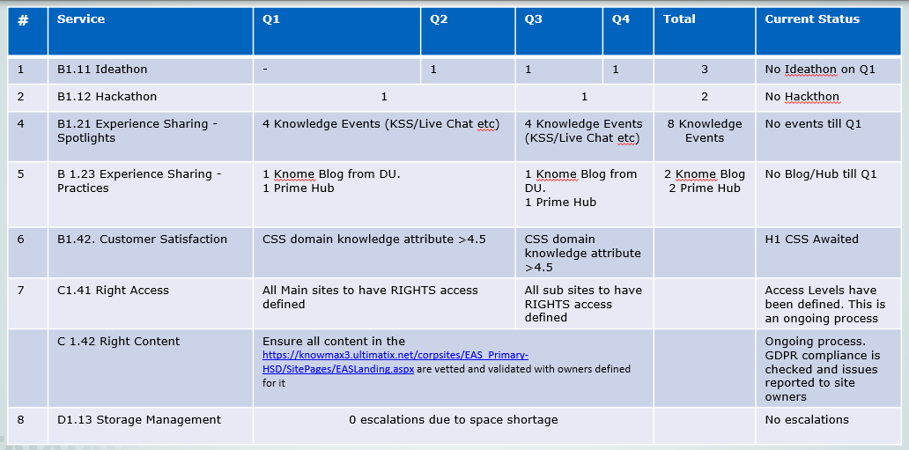
KM Plan
TCS Internal

Slide 18
DEG Governance
Area | Frequency | Focus Area | Participants
DEG Review by DU Head | Quarterly | All areas | DEH, Governance team, DE Leads and Leadership team
DEH Review | Weekly | DEG areas | Entire DEG team
DAG Review | Weekly | DAG areas (eUPP, CSS etc.) | DAM and Governance Team
ACG Review | Weekly | Audit areas | ACM and ACF, Governance Team
KM Review | Weekly | KM Areas | KC and Governance team
PI & RiO Review | Monthly/ Weekly | PI Areas | PI Champion and Governance Team
DP Review | Monthly/Weekly | DP Areas | DP PO, Unit DAM, PI Champion
Critical Projects Review | Weekly for Red and Amber Projects | Account specific focus | Governance team
Delivery Heads Review | Monthly | DEG Score Card | Gov Team, DE Leads, DEH, Sub Unit Delivery Heads
TCS Internal

Slide 19
DEG Competency Tracker
TCS Internal

Slide 20
EAS – Organization Structure
Global Head -EAS
(Akhilesh Tiwari)
Oracle Head
(Split into 8 sub units )
SFDC Head
(Michael S O'Bannon)
ECM Head
(Kottai A)
MSFT
(Rohit Kale)
NGP Head
(Subodh Biswas)
SAP Head
(Prashant Sirgur)
Integration CoE Head
(Mousumi B)
Niche CRM Head
(Aarti Devi)
Niche HCM Head
(Ram Subramanian)
NGP
(Sridhar
Rajagopalan)
DEH
(Eileena Varghese)
DEH
(Bharat Kothari)
DEH
(Mandira Chatterjee)
TCS Internal

Slide 21
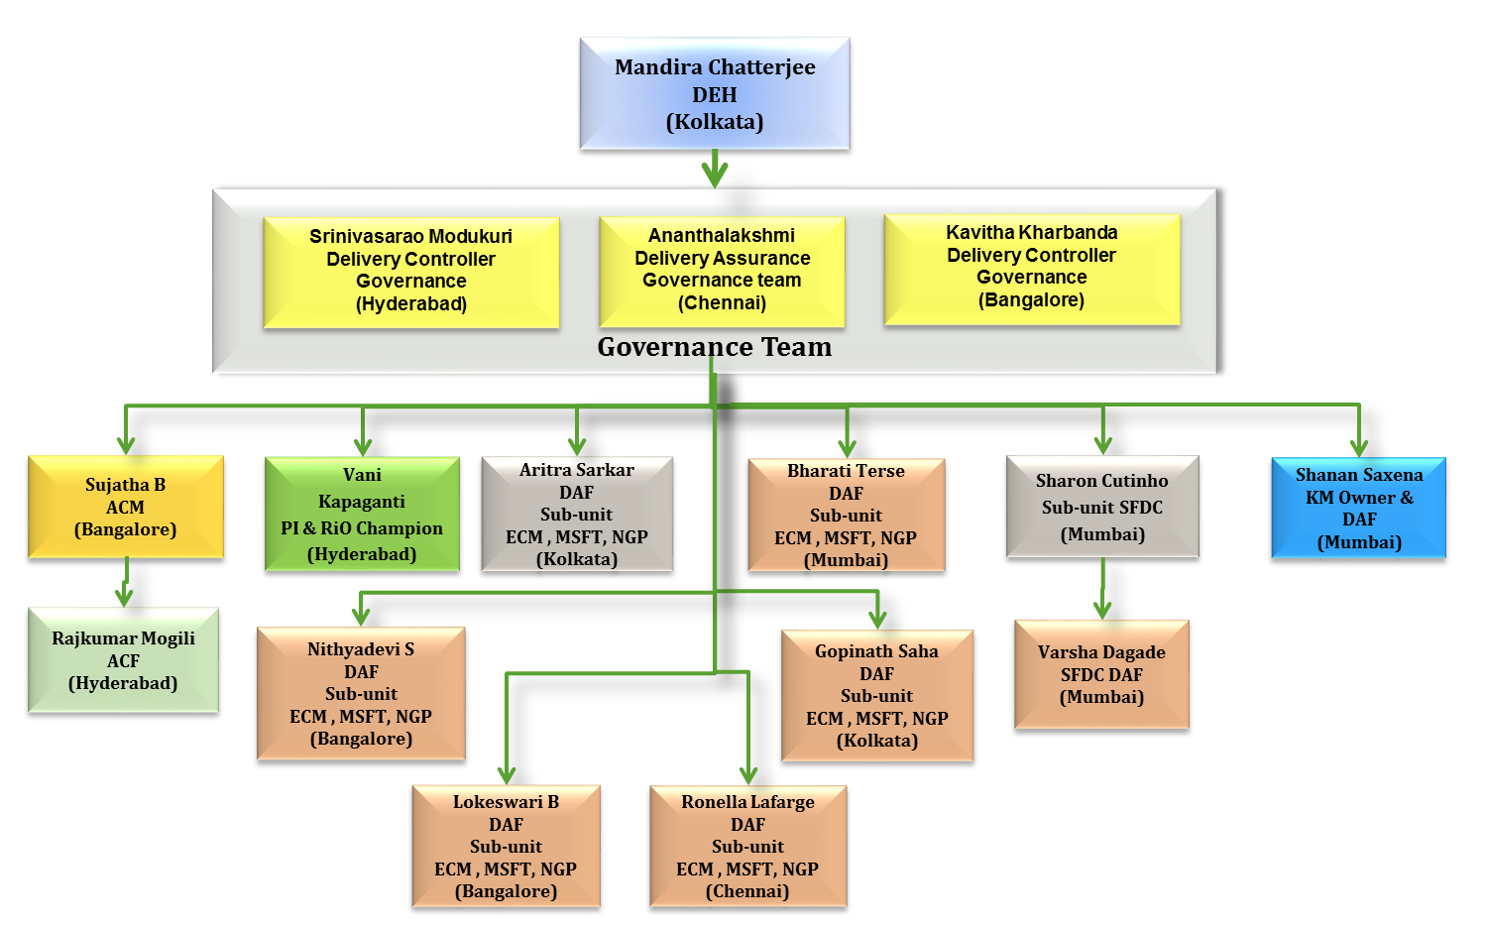
EAS EGP DEG – Organization Structure

Slide 22
EAS EGP DEG - Risks & Mitigation
Risks , Issues , Challenges & Mitigation Plan are maintained in EGP DEG Risk register as below.
TCS Internal

Slide 23
Thank You
A Bayer Group Presentation
Reach me at 1556492@tcs.com

