Slide 1
RISHAB’s APP
FOOD ORDERING SYSTEM
Presented By
Tarun Prasad T
Thanseer Hishak
G Udaykiron Chowdary
Umarani

Slide 2
TABLE OF CONTENTS
Problem Statement
01
04
Deliverables
Motivation
02
05
Requirements
Objective
03
06
UML Diagrams

Slide 3
PROBLEM STATEMENT
These days the students are living a busy life. Thus, they don’t have time to stand in long queues.
Rishab is a drink shop receives lot of orders everyday, but students and teachers must wait in long queues to order their drinks.
Thus, our project aims to solve this by providing an app to order their food which helps the students/teachers to skip long queues.

Slide 4
MOTIVATION
To design a software application to solve the waiting time in queues.
Reducing the wait time to order making it easier for the customers.
Reduce the workload of staffs to take orders.

Slide 5
OBJECTIVE
—
The main objective of the software is to create a web-app that can handle the order requests and to generate bill, enabling users to order drinks online and the staffs to manage their orders.

Slide 6
DELIVERABLES
WEB APP
ORDERING
ORDER MANAGEMENT
Fully working web-app that can use it by SSNite.
Placing orders to rishab through our web app.
Helps the staff of rishab to manage their orders.

Slide 7
MODEL USED : AGILE
Agile methods break tasks into smaller iterations, or parts do not directly involve long term planning.
Each iteration is considered as a short time "frame" in the Agile process model, which typically lasts from one to four weeks.
Each iteration involves a team working through a full software development life cycle including planning, requirements analysis, design, coding, and testing before a working product is demonstrated to the client.

Slide 8
REQUIREMENTS
To enable customers to order through the web app after registering / logging in.
To enable staffs to manage orders, update products pricing details.
To generate unique ID for each order.

Slide 9
TECHNOLOGY STACK
HTML CSS JS
DJANGO
OTP API

Slide 10
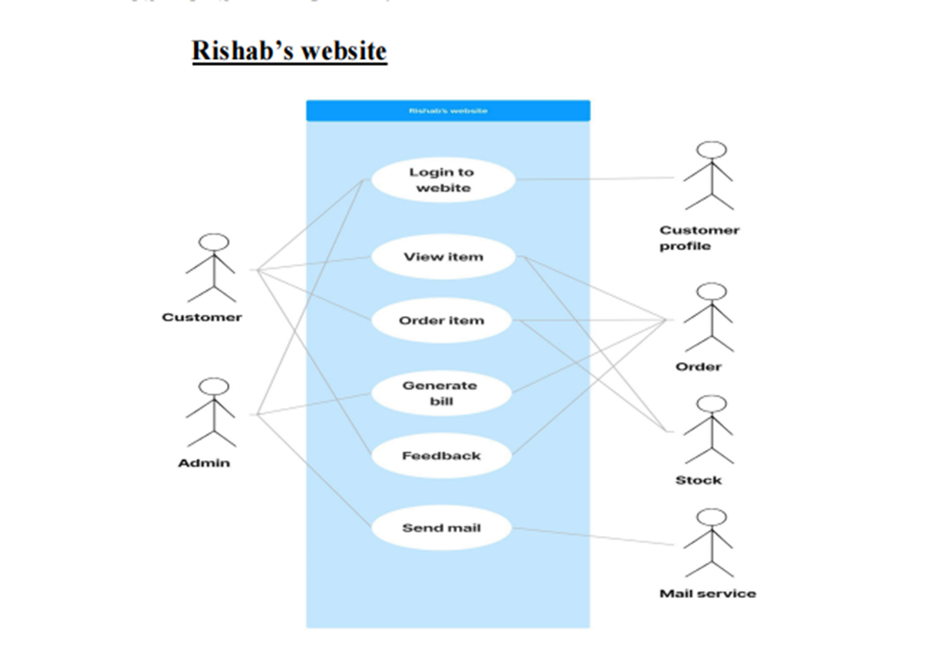
USE CASE DIAGRAM
RISHAB’S-APP

Slide 11
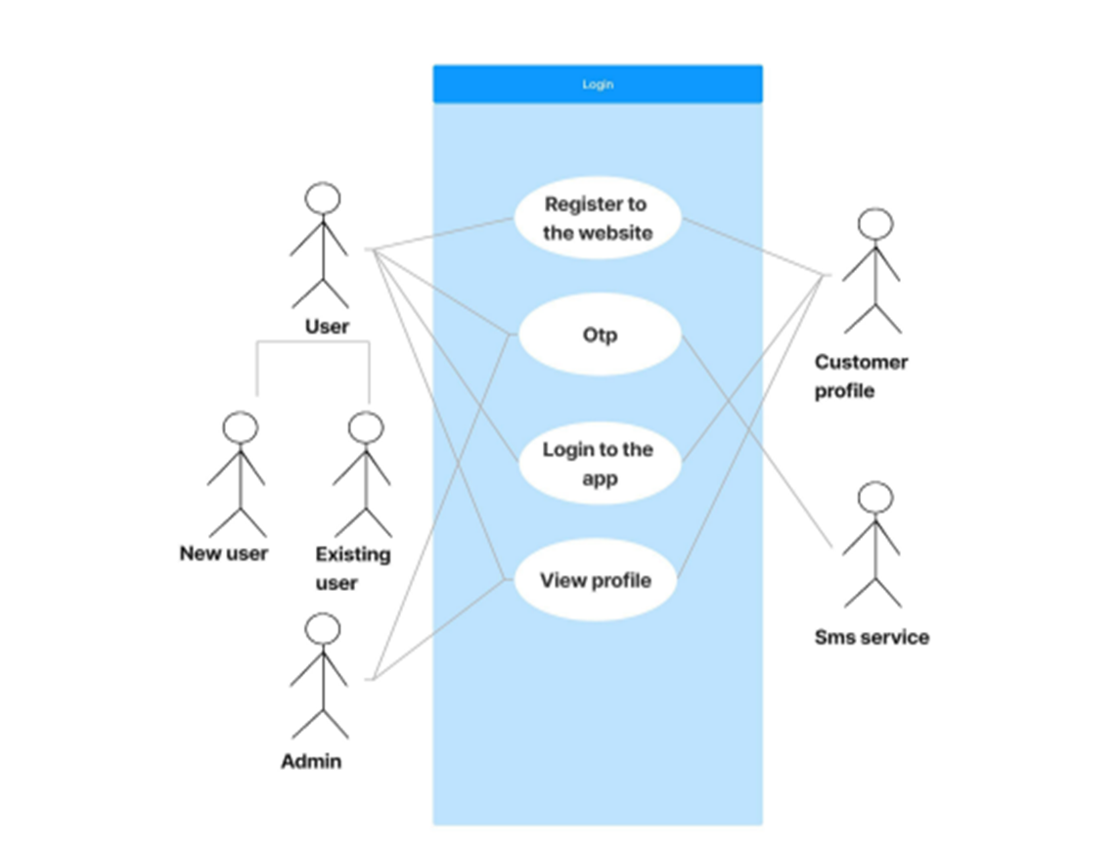
USE CASE DIAGRAM
LOGIN MODULE

Slide 12
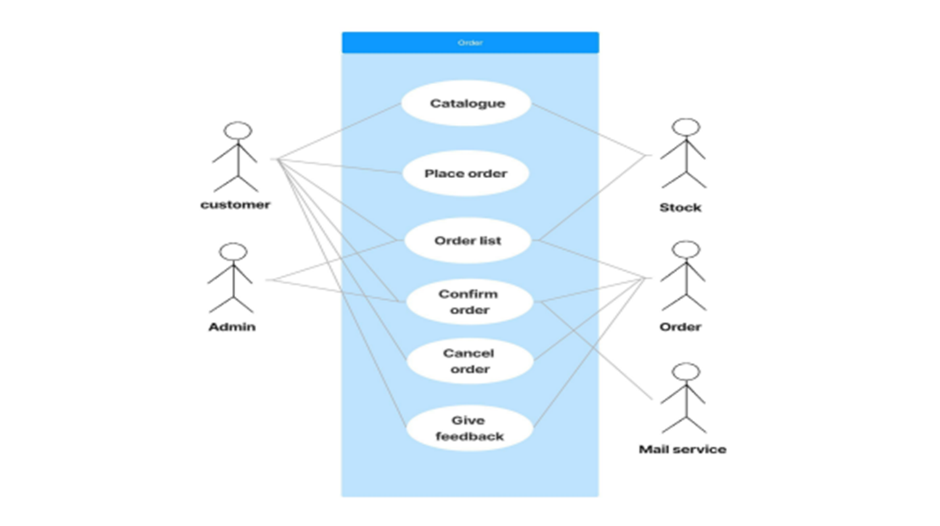
USE CASE DIAGRAM
ORDER MODULE

Slide 13
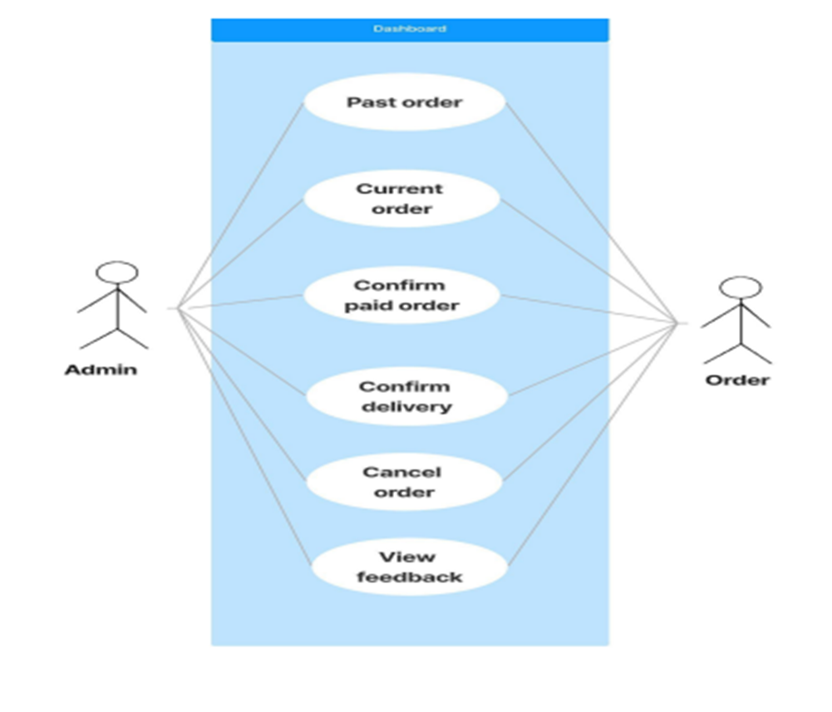
USE CASE DIAGRAM
DASHBOARD MODULE

Slide 14
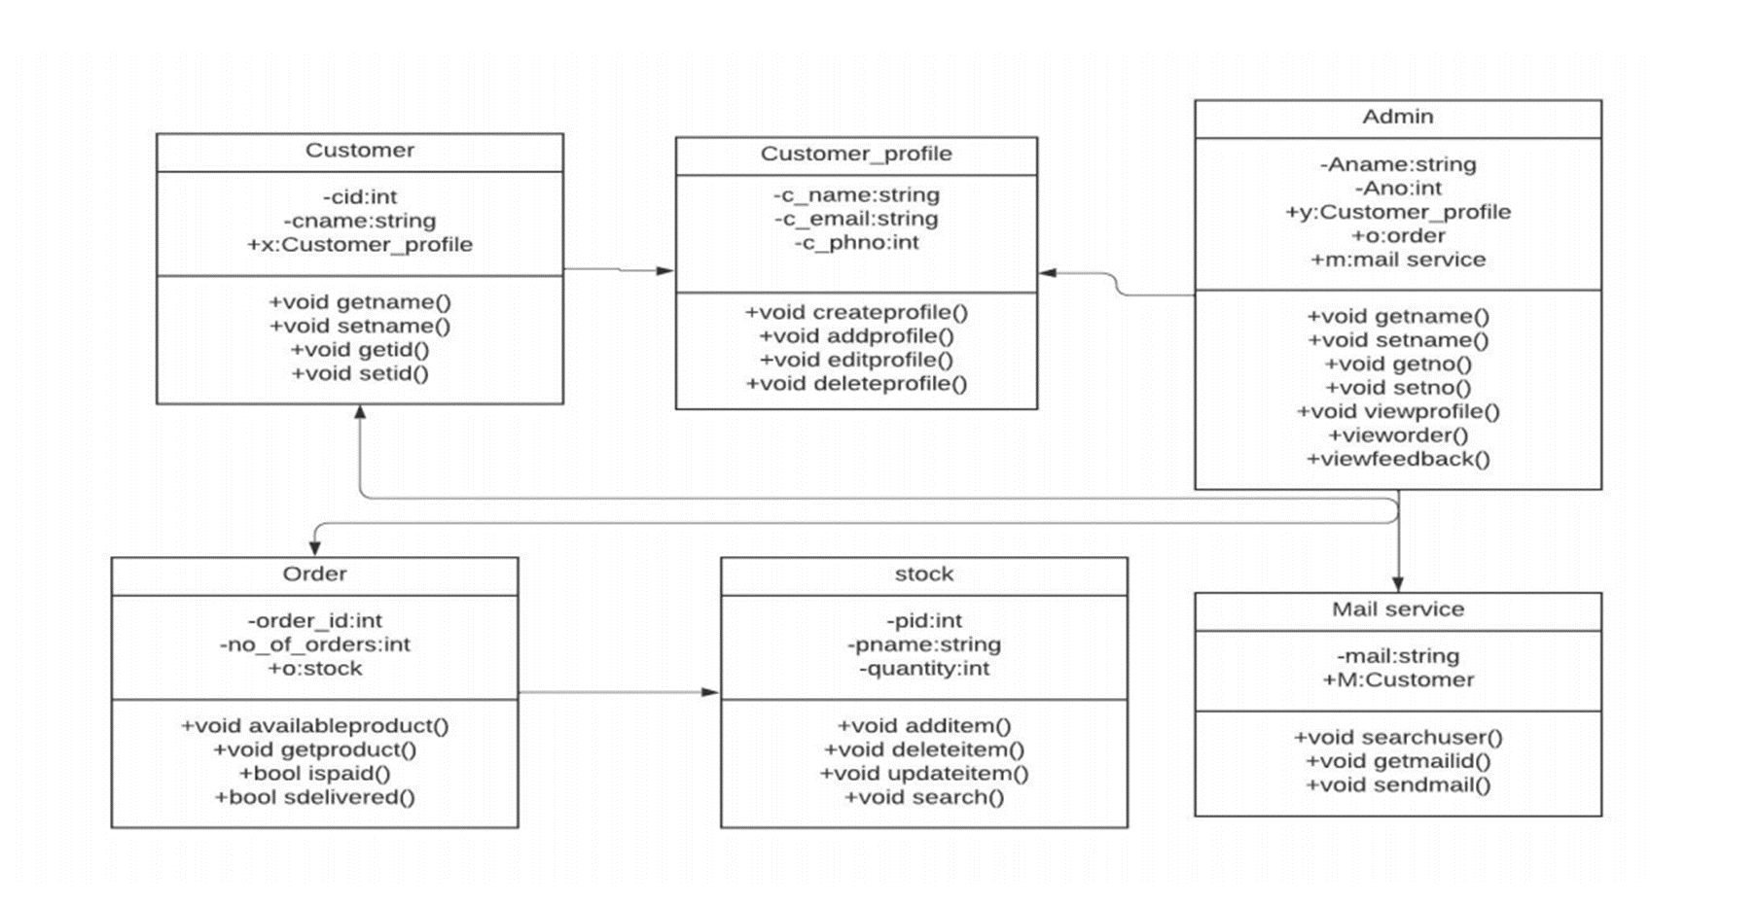
CLASS DIAGRAM
RISHAB’S APP

Slide 15
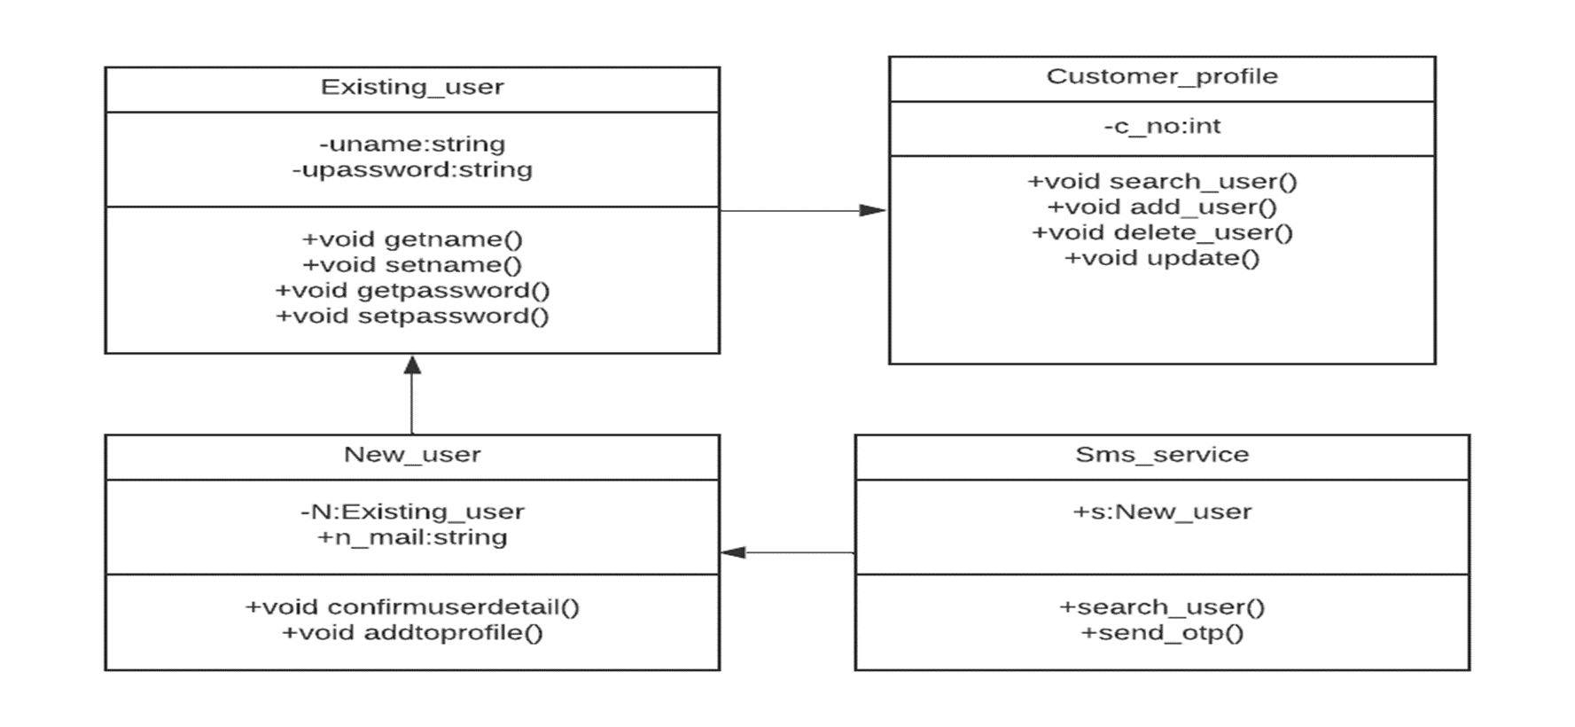
CLASS DIAGRAM
LOGIN MODULE

Slide 16
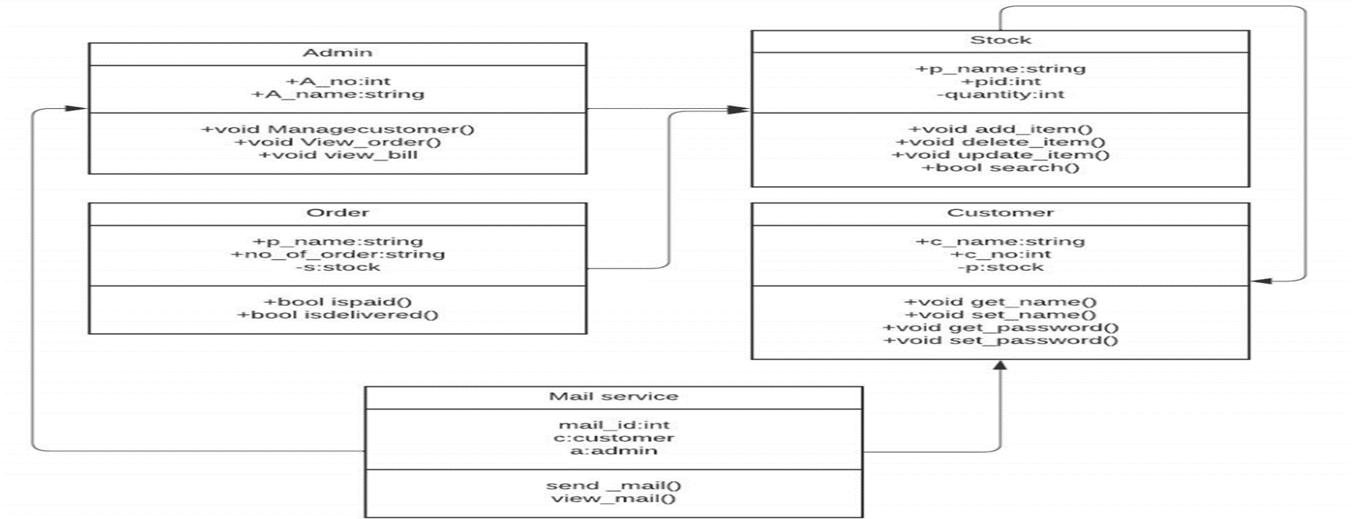
CLASS DIAGRAM
ORDER MODULE

Slide 17
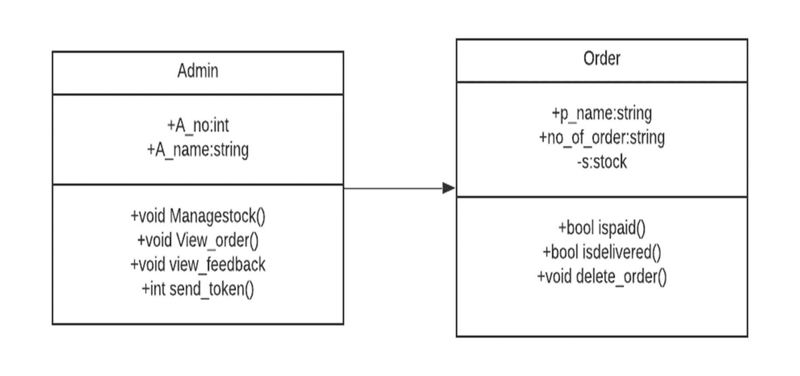
CLASS DIAGRAM
DASHBOARD MODULE

Slide 18
PROJECT OUTCOMES
The app is capable of registering new customer with otp verification , logging in to view the menu catalogue and placing orders with confirmation mail sent.
The staff of rishabs receive orders and manage their orders.

Slide 19
THANKS!

