Slide 1
Animal Jam Final Project Proposal
CS5004 – Group 3
Malik Vernon
Umer Syed-Quadri

Slide 2
Application Features
Required Features
Load animal catalog using xml file
Display full collection or favorite list in GUI
Create favorite list by adding/removing items
Save list in specific format (xml, json, csv)
Optional Features
Sort Collection based on column name, population size, speed, average weight, diet, location
Filter Collection column name, population size, speed, average weight, diet, location
Stretch Goals
Add search feature to lookup animal by name

Slide 3

Model View Controller Design Pattern
Model:
Keep track of Collection and Lists
Load animal collection from XML File
Save list to output stream based on specified format
Sort list based on column
Filter list based on criteria
View:
Implement overall application GUI
Listeners for input objects based on actions by user
Display updated lists
Display error dialog
Controller:
Glue logic between View and Model
Provide Interface to view for user actions
Interact with model to perform actions on Lists

Slide 4
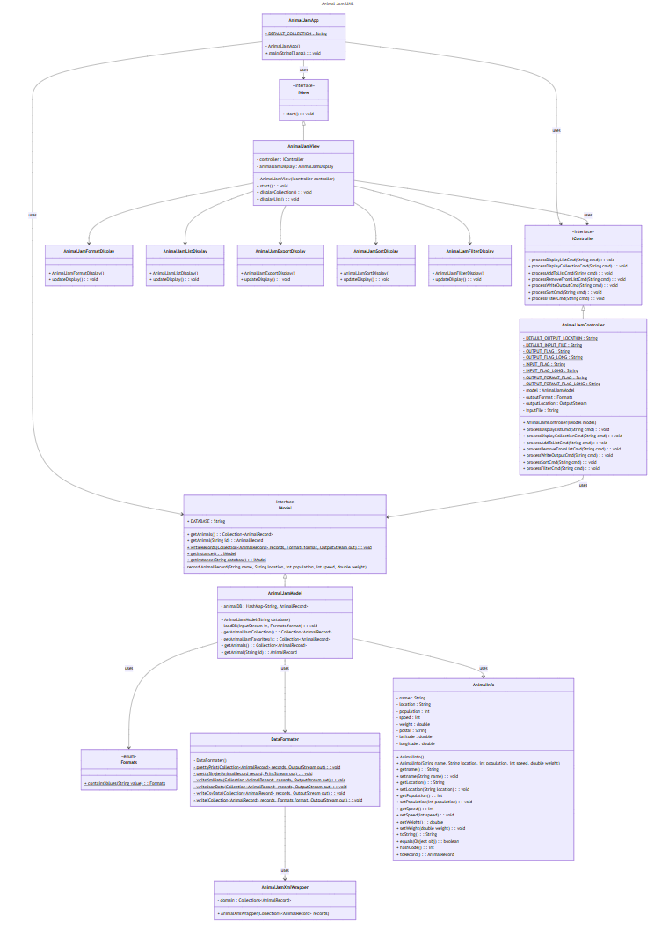
Initial UML

Slide 5
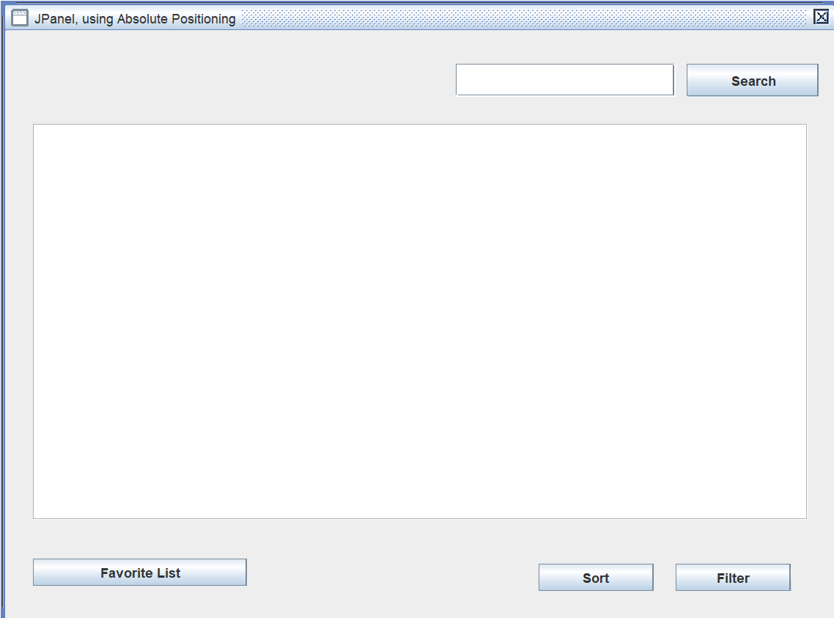
Proposed GUI View
Jpanel to display full collection – table format with header with scroll bars
Button to add/remove animals to/from favorite list
Button to view favorite list
Button to remove animals from favorite list
Button to sort the lists

Slide 6
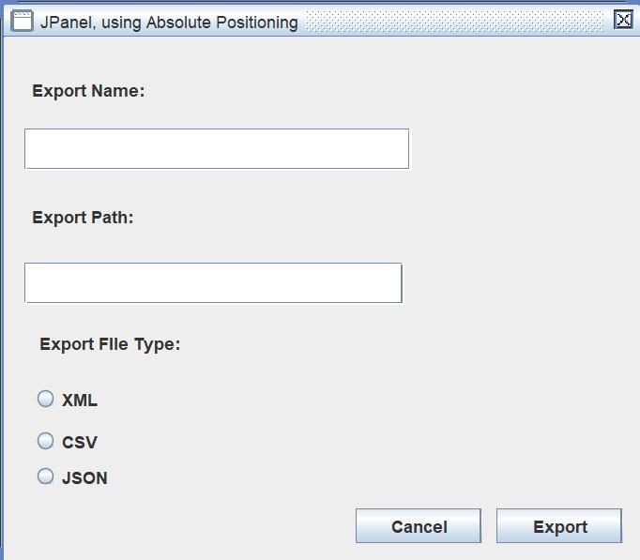
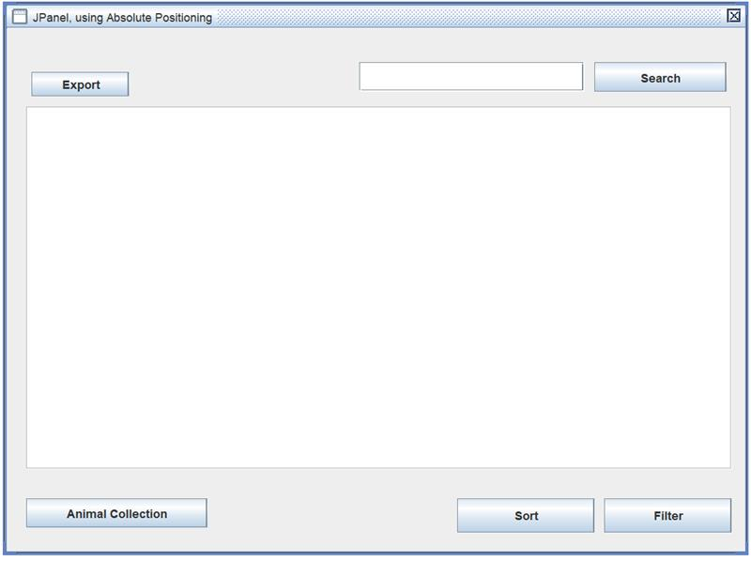
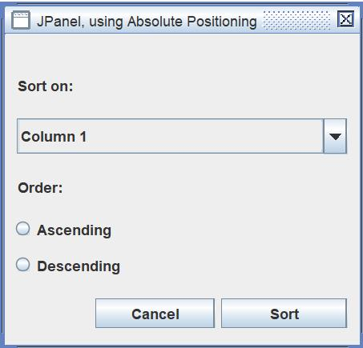
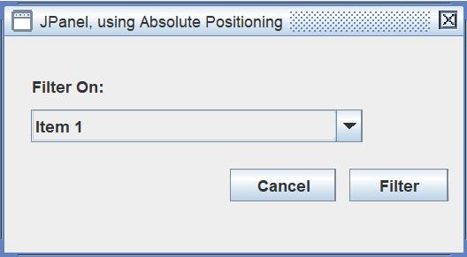
Proposed GUI View
Button to view full collection table
Dropdown to select column to sortOn
RadioButton for ascending or descending
Button to filter collection
Dropdown to select column to filter
Textbox for search by name
Button to search
Button to save list to a file
Textbox for output filename
Checkbox for file format

Slide 7
Proposed Controller Interface
processOutputFormat(String formatStr)
processOutputFilename(String filename)
processAddToList()
prcessRemoveFromList()
processFilterCmd(String filterStr)
processSortCmd(String sortStr)
processSearchCmd(String searchStr)

Slide 8
Proposed Model Interface
loadCollection(String filename)
writeFIle(String filename, Format format)
addToList(AnimalData item)
removeFromList()
filter(String filter, AnimalCol sortOn, boolean ascending)
Default filter = “all”
Default sortOn = AnimalCol.Name
Default ascending = true
search(String name)

Slide 9
Division of Labor
View components – Malik
Model components – Umer
Controller components – Umer
Model unit testing – Umer
View testing (screenshots) – Malik
Controller unit test – Umer
File Management - Malik
Manual - Shared
Design Document - Shared
Readme - Shared

Slide 10
Project Timelines
Feature: Retrieve animal data from online API – March 30
Feature: Load animal data into model – April 2
Feature: Display collection and favorite list in GUI – April 4
Feature: Model to save list in specified format – April 5
Feature: GUI to gather user input for format and sort – April 7
Feature: Controller to process commands – April 8
Feature: Model to sort lists – April 9
Feature: GUI to save out list to file – April 10
Feature: Model to filter and search lists – April 14
Feature: GUI for other optional features and stretch goals – April – 15
Feature: Test full application – April 16
Project Demo – April 17
Documentation complete – April 18

Slide 11
Check-in Schedule
Meet every Tuesday 8pm to 9pm to sync up on progress
Tuesday April 1
Tuesday April 8
Tuesday April 15
Application Testing
Thursday April 10
Wednesday April 16
Project Demo – April 17

Slide 12
Links
Project Repository
https://github.com/Sp25-CS5004-Online-Lionelle/final-project-group-3
Project Planning
https://github.com/orgs/Sp25-CS5004-Online-Lionelle/projects/4

