Slide 1
柔性机制文献汇报
Online Resource Allocation with Limited Flexibility
李天恺

Slide 2


1
Model Introduction
目录
2
Main Results
CONTENTS
3
Proof
4
Numeric Studies

Slide 3
01
Model Introduction
PART ONE

Slide 4
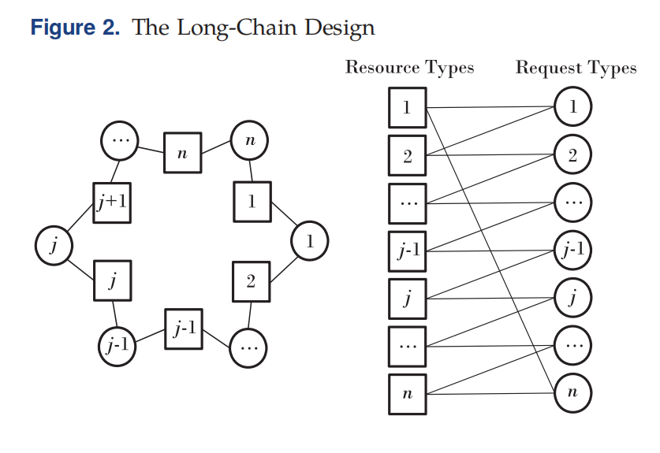
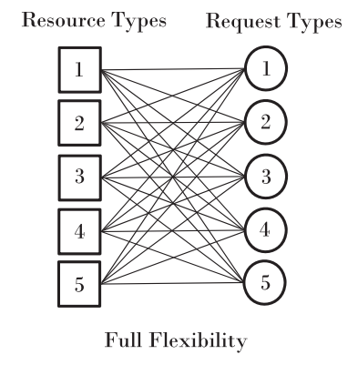
long-chain

Slide 5

ξ-霍尔条件

Slide 6
02
Main Results
PART TWO

Slide 7

Theorem 1.a

Slide 8

Theorem 1.b

Slide 9

Some Discussion

Slide 10



The Modified Greedy Policy

Slide 11


The no-resort Greedy Policy

Slide 12

primary resource first policy

Slide 13
03
Proof
PART THREE

Slide 14

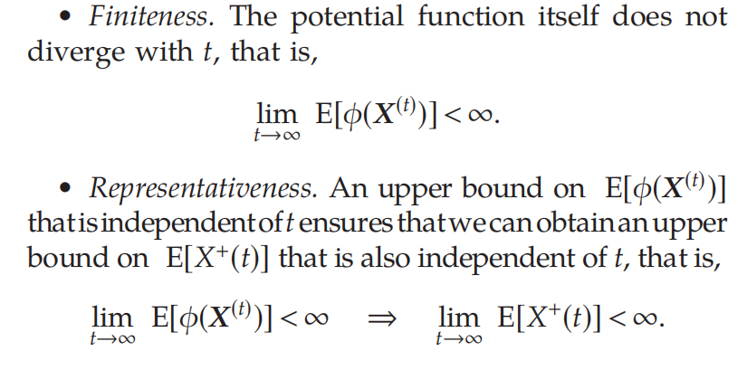


proof
首先我们注意到有：

Slide 15

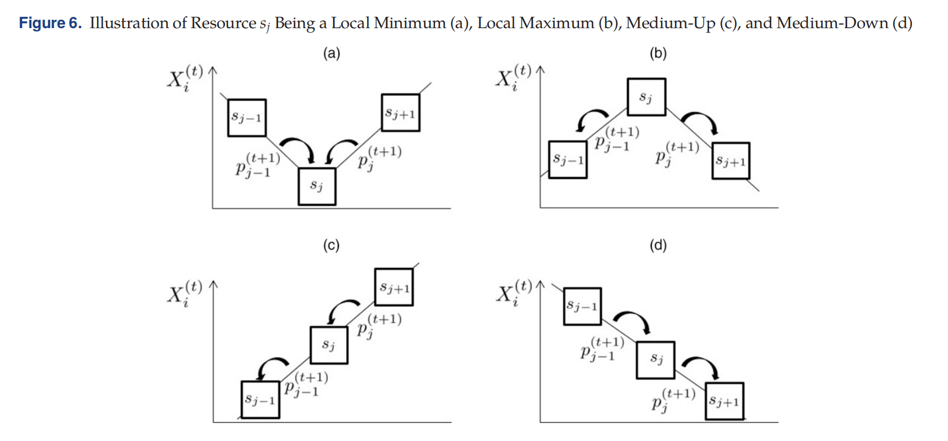
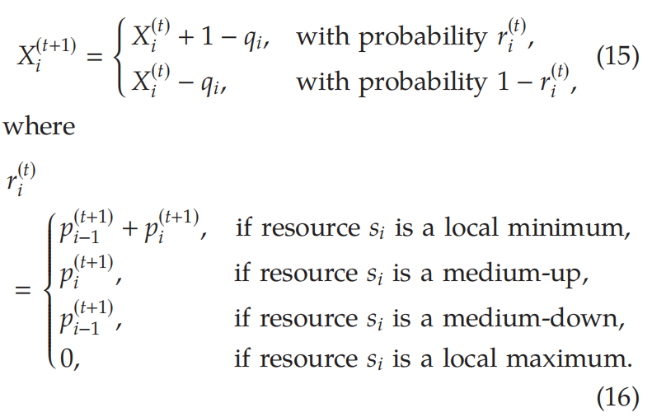
辅助函数

Slide 16

Proposition 1

Slide 17


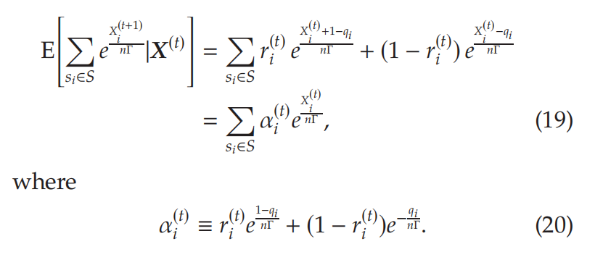

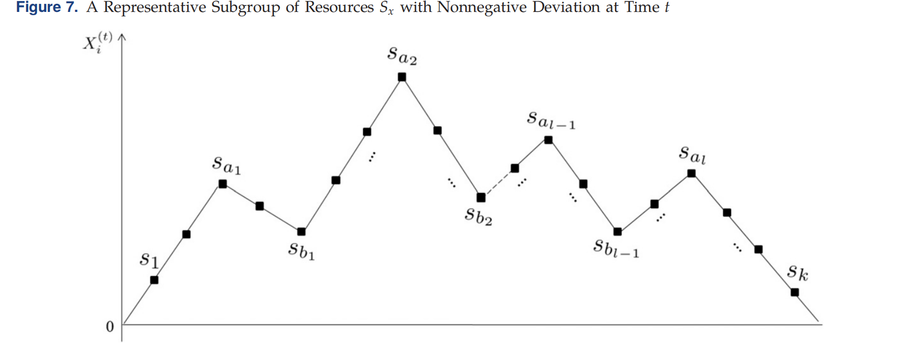

proof of Proposition 1

Slide 18
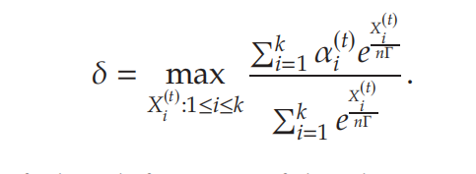

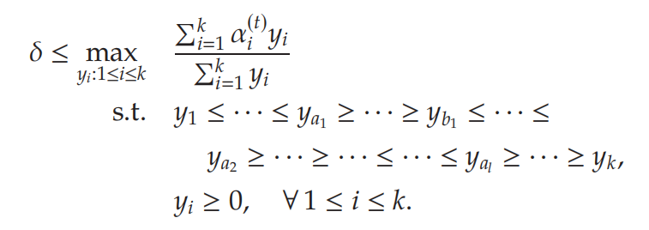

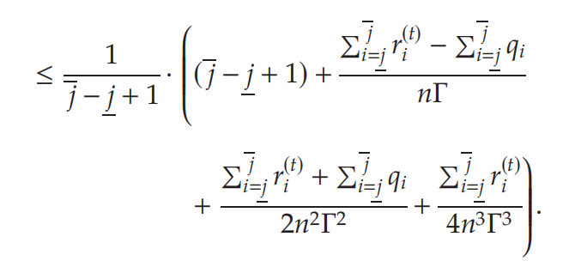
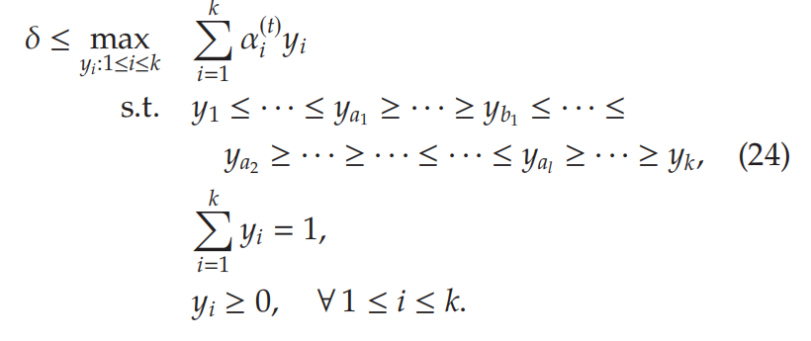




proof of Proposition 1

Slide 19

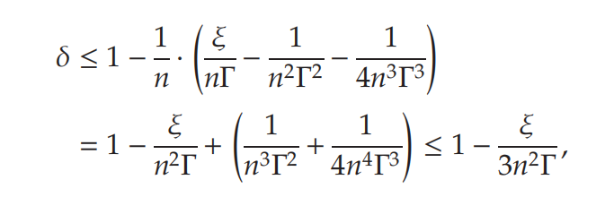

proof of Proposition 1
数归即证

Slide 20
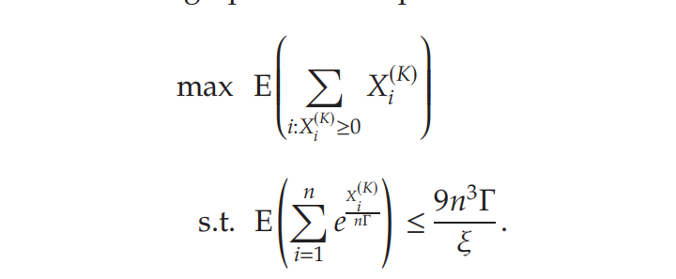


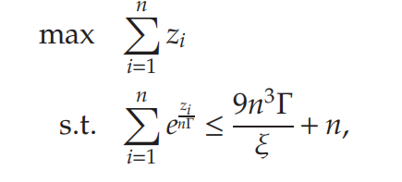

proof of Thm 1.a

Slide 21

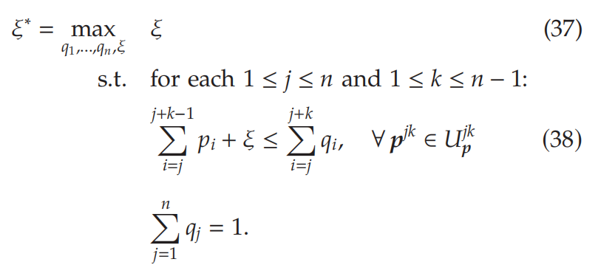

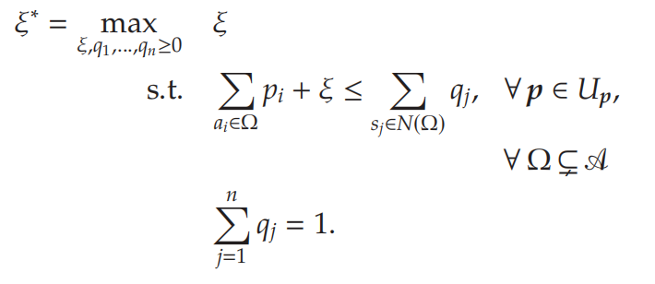

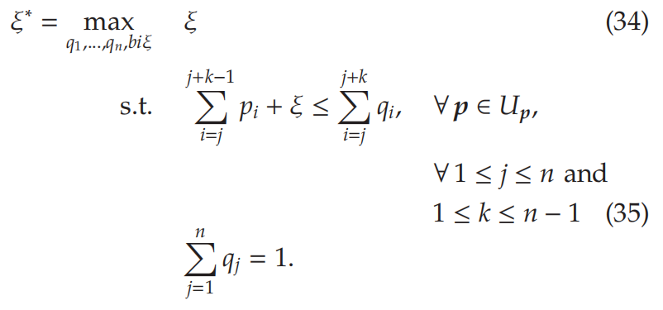
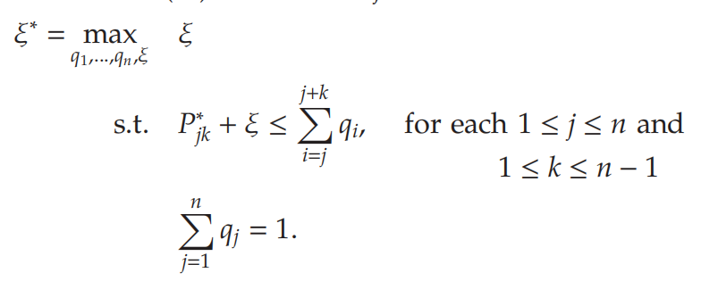
find the best ξ

Slide 22
04
Numeric Studies
PART FOUR

Slide 23
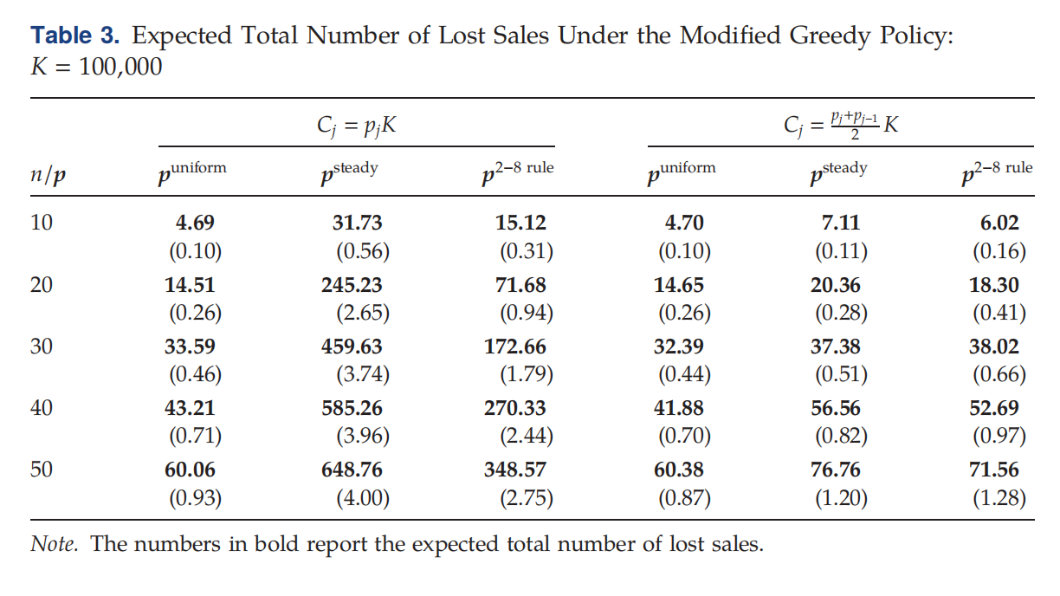


Numeric Studies

Slide 24
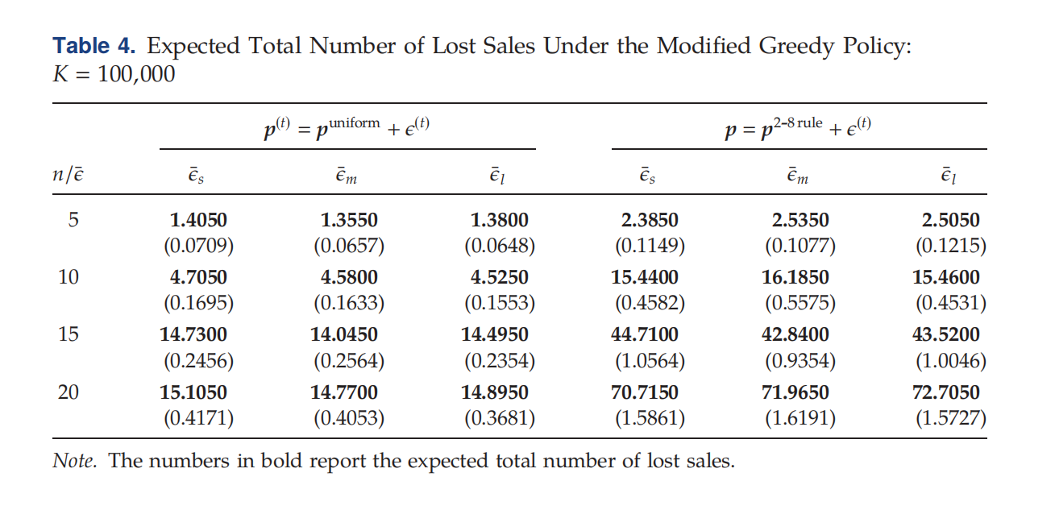

Numeric Studies

Slide 25
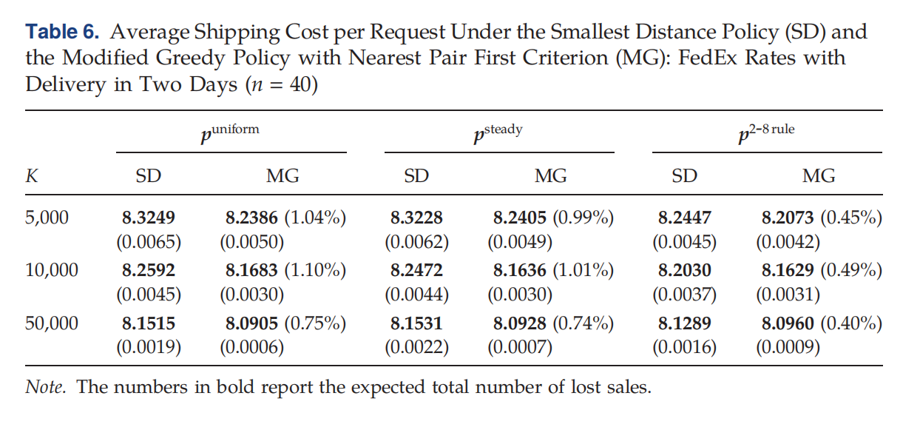
Numeric Studies

Slide 26
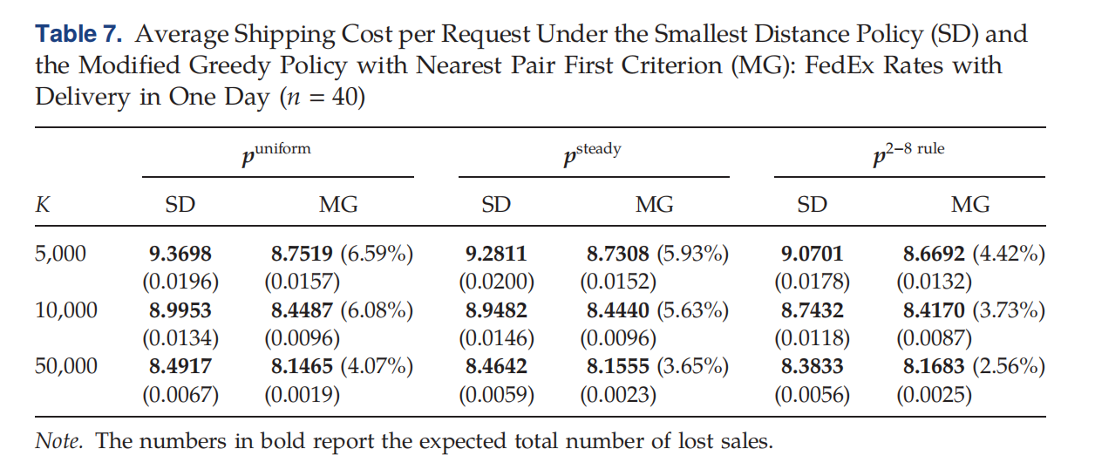
Numeric Studies

Slide 27
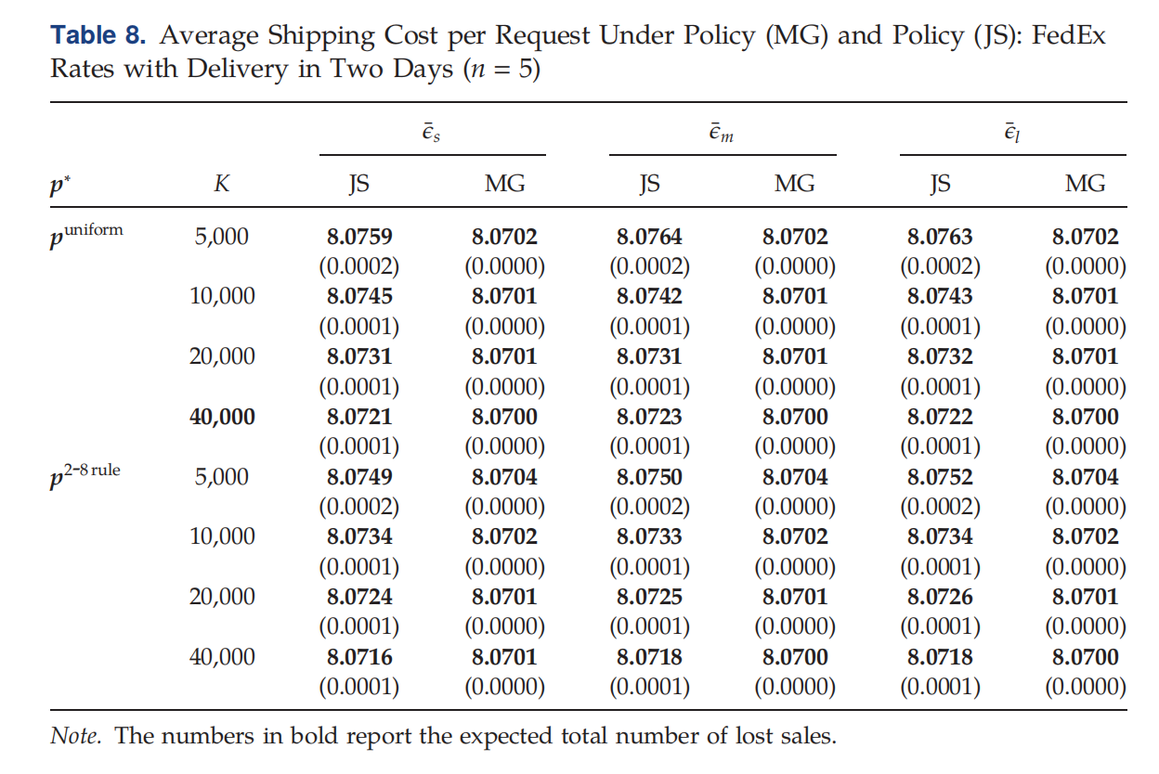
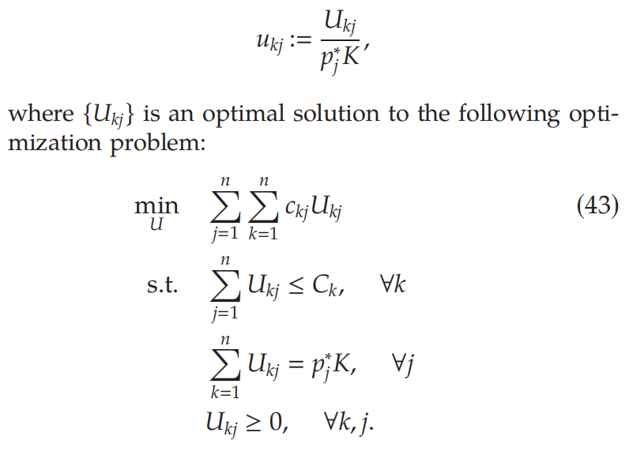
Numeric Studies

