Slide 1
Wireless network and their topologies
Part 2: Wireless
Referent: Korbinian Müller
Fach: Einführung in die Informatik
1.Semester

Slide 2
Inhalt
Topologies
History
WLAN
Alternatives

Slide 3
Point-to-Point

Slide 4
Point-to-Multipoint

Slide 5
Linie

Slide 6
Mash network

Slide 7
Mash network

Slide 8
Full connection Mash

Slide 9
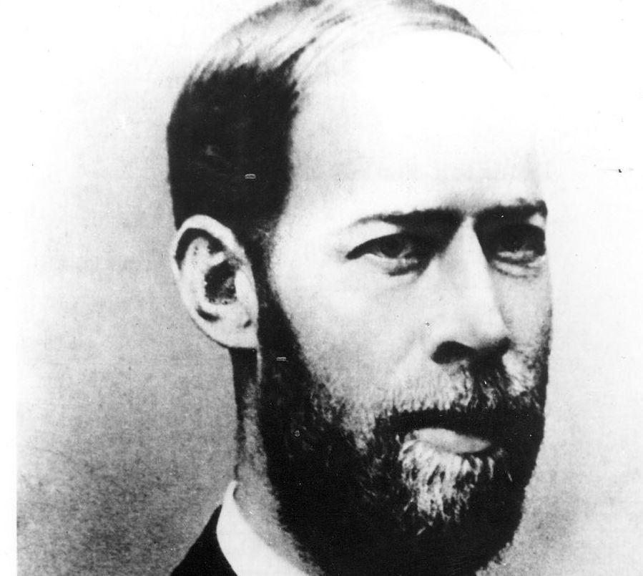
Heinrich Rudolf Hertz
1866: Electromagnetic waves
80MHz
Sending and reciving
Quelle: https://www.dhm.de/fileadmin/medien/lemo/Titelbilder/heinrichhertz.jpg

Slide 10
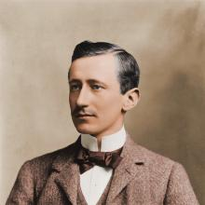
Guglielmo Giovanni Maria Marconi
Studies Hertz‘s Therories
1895: distance 2km
Wireless Telegraph & Signal Company
1901: first trans atlantic transmision
1903: Communication Roosevelt & Eduard VII
Quelle: https://prabook.com/web/show-photo-icon.jpg?id=2602255&width=220&cache=false

Slide 11
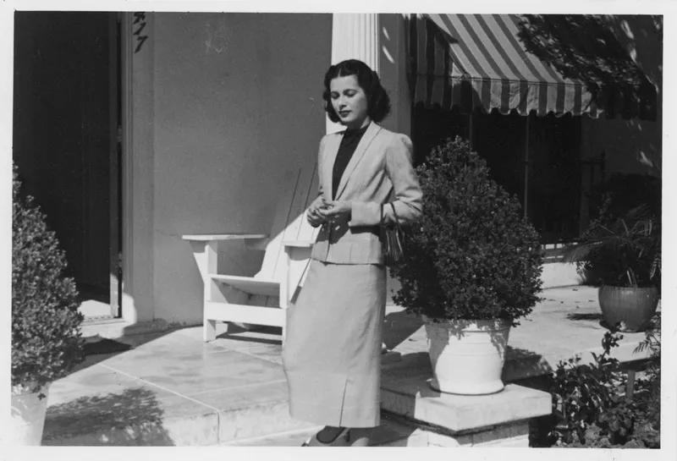
Hedy Lamarr
Actress / Engineer
Encrypted Transmission
Frequenz Hopping
Quelle:
https://i0.wp.com/prologue.blogs.archives.gov/wp-content/uploads/sites/9/2020/05/2017-2076.jpg?ssl=1

Slide 12

Victor Hayes
Developted wirless communication
Based on ISO/OSI
Helped to develop IEEE 802.11
Quelle
https://th.bing.com/th?id=OIP.zFXB4AXw3K_obhn7HEeS6AAAAA&w=80&h=80&c=1&vt=10&bgcl=6cdd62&r=0&o=6&pid=5.1

Slide 13
standard | Frequency | Speed
802.11 | 2.4GHz | 2 Mbit/s
802.11a | 5.0GHz | <54Mbit/s
802.11b | 2.4GHz | 22Mbit/s
802.11g | 2.4GHz | <54Mbit/s
802.11n6 | 2.4GHz | <600Mbit/s

Slide 14
Alternatives
Radio relay
Parabolic antennas
Line of sight
LiFi

