Slide 1
AETCOM
Attitude, ethics and communication

Slide 2
Overview
Key Part of Medical education
It is designed to enhance the interpersonal skills of healthcare professional
AIM :
More empathetic and patient centred approach to healthcare delivery

Slide 3
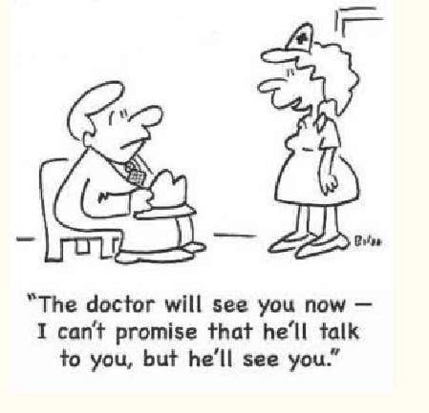
3.1 Foundations of the communication
Objectives
Highlight the significance of effective communication in clinical practice.
Equip healthcare professionals with the necessary skills to communicate effectively with patients and colleagues.

Slide 4
Communication
Meaningful exchange of thoughts, opinions or information between individuals belonging to any of the sectors of healthcare
IMG should be able to communicate to patients with patience and in respectful, non-threatening, non-judgemental and empathetic manners.
Effective Communication within the healthcare set-up fulfils the primary goal of healthcare i.e. patient well being and prevents conflict.

Slide 5
Effective Communication
Importance in Healthcare:
Essential for accurate diagnosis, patient adherence to treatment, and overall patient satisfaction.
Builds trust and rapport between healthcare providers and patients.
Patient-Centered Communication:
Involves understanding and addressing the patient's concerns, values, and preferences.
Empathetic and respectful interaction is key to patient-centered care.

Slide 6
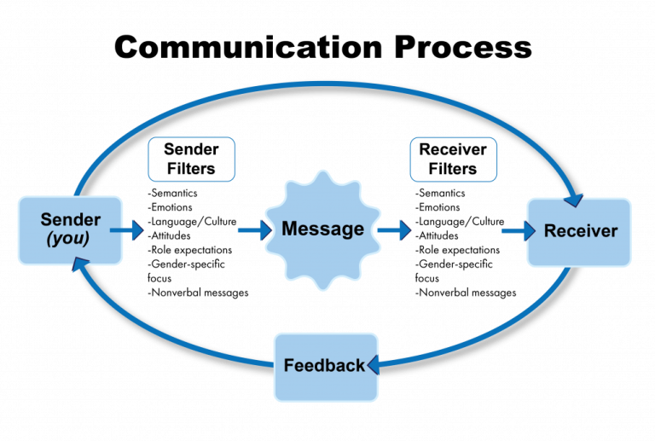
Landmarks of the communication process

Slide 7
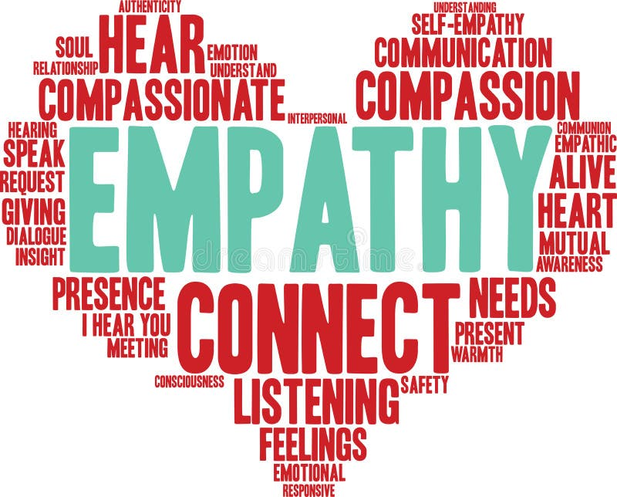

Slide 8
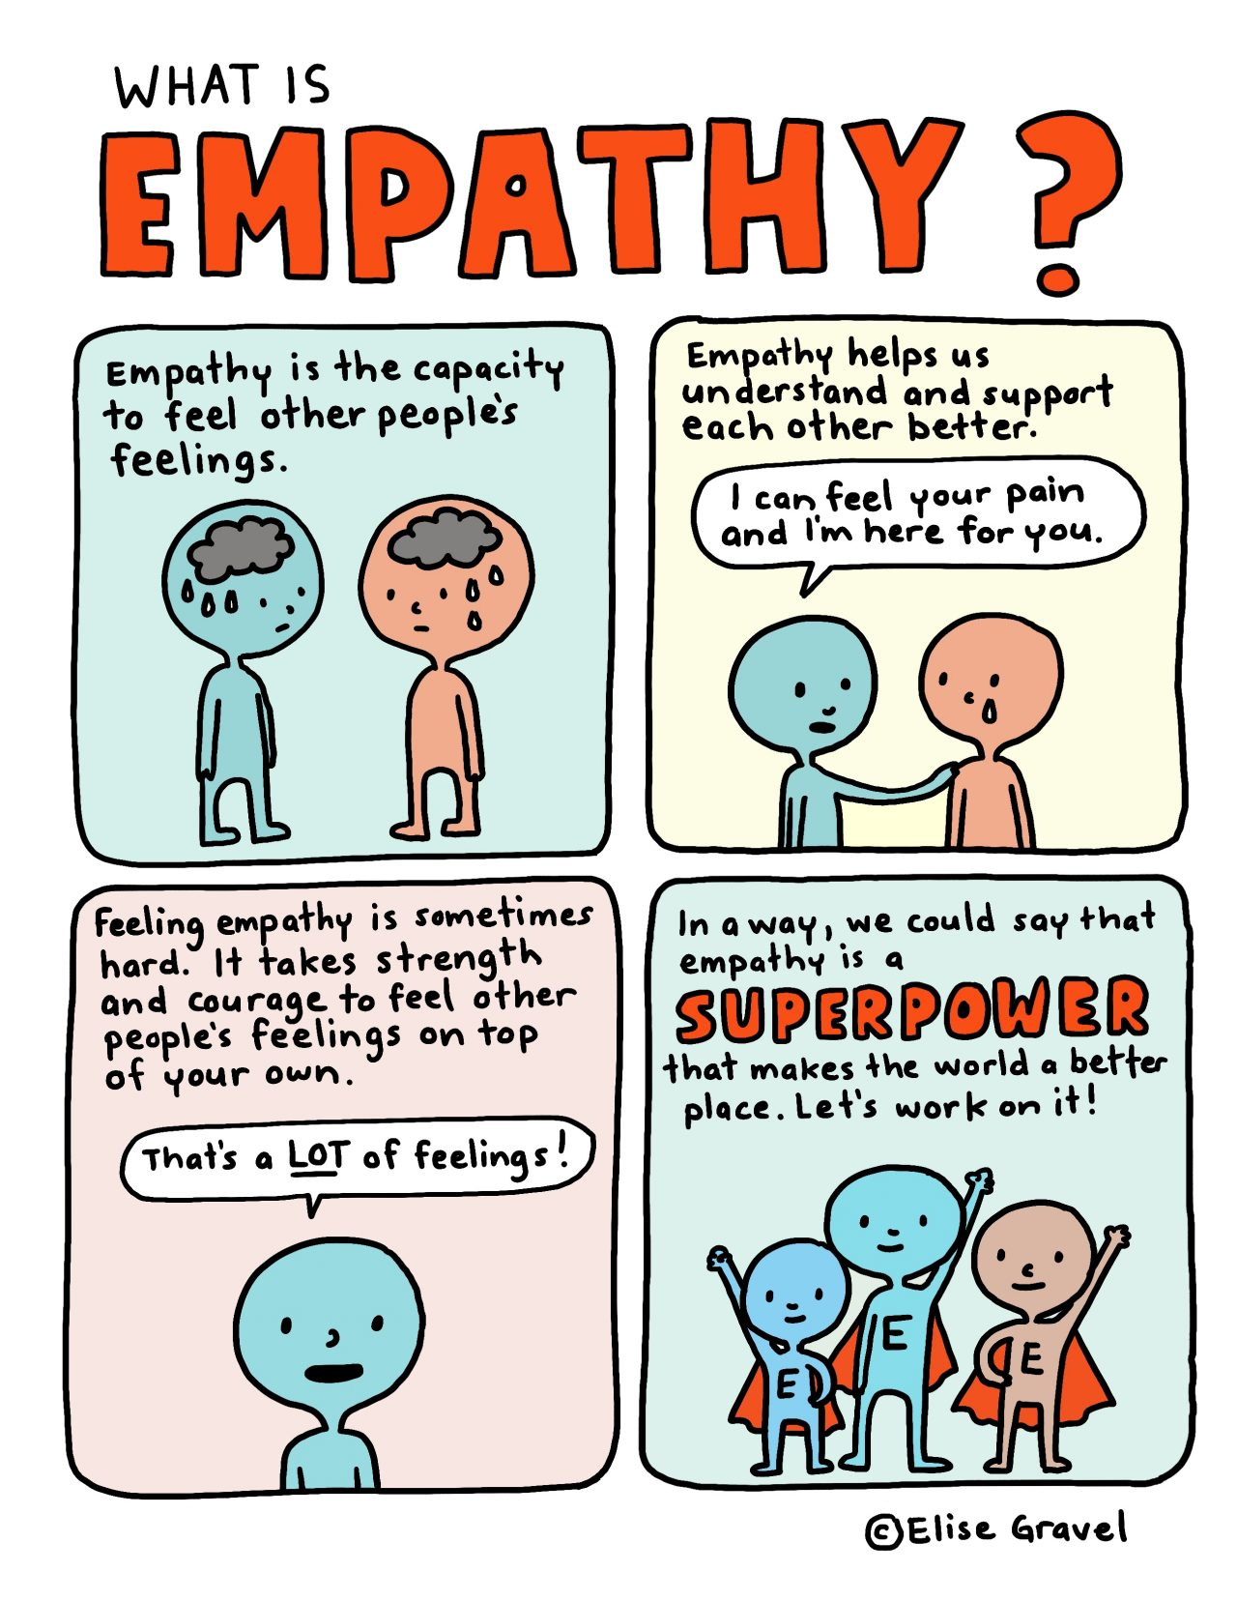

Slide 9
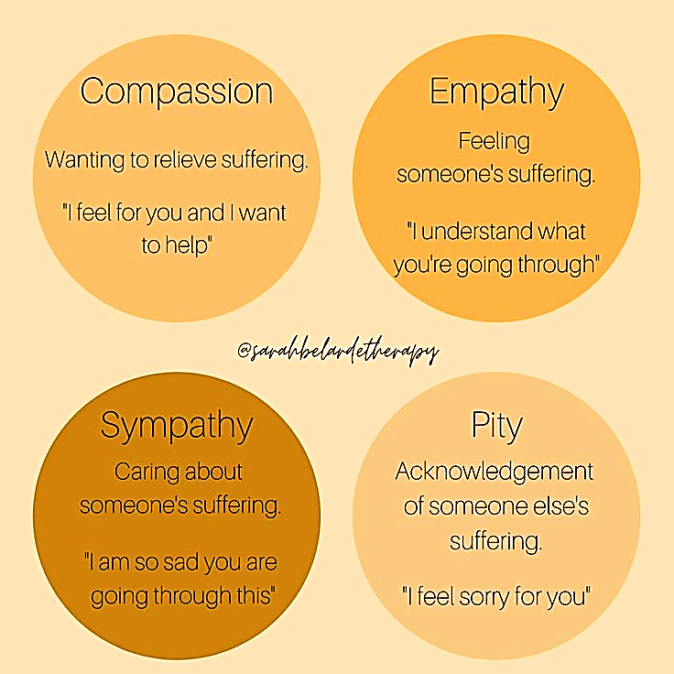

Slide 10
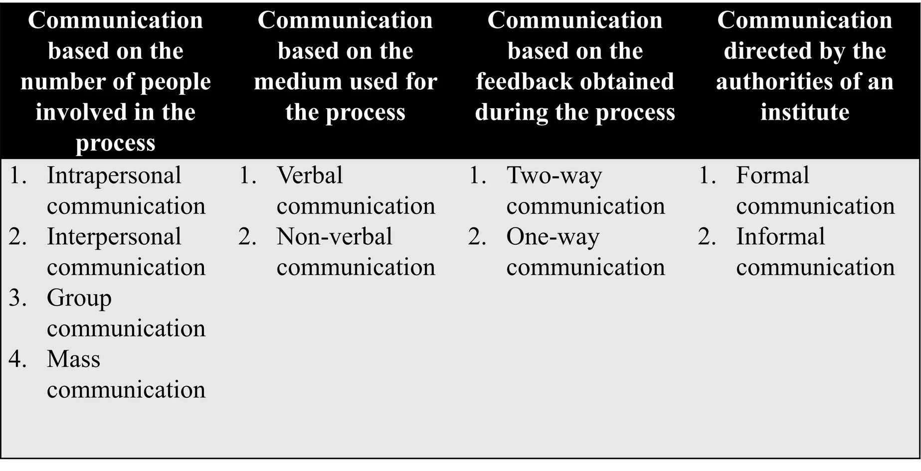
Types of communication

Slide 11
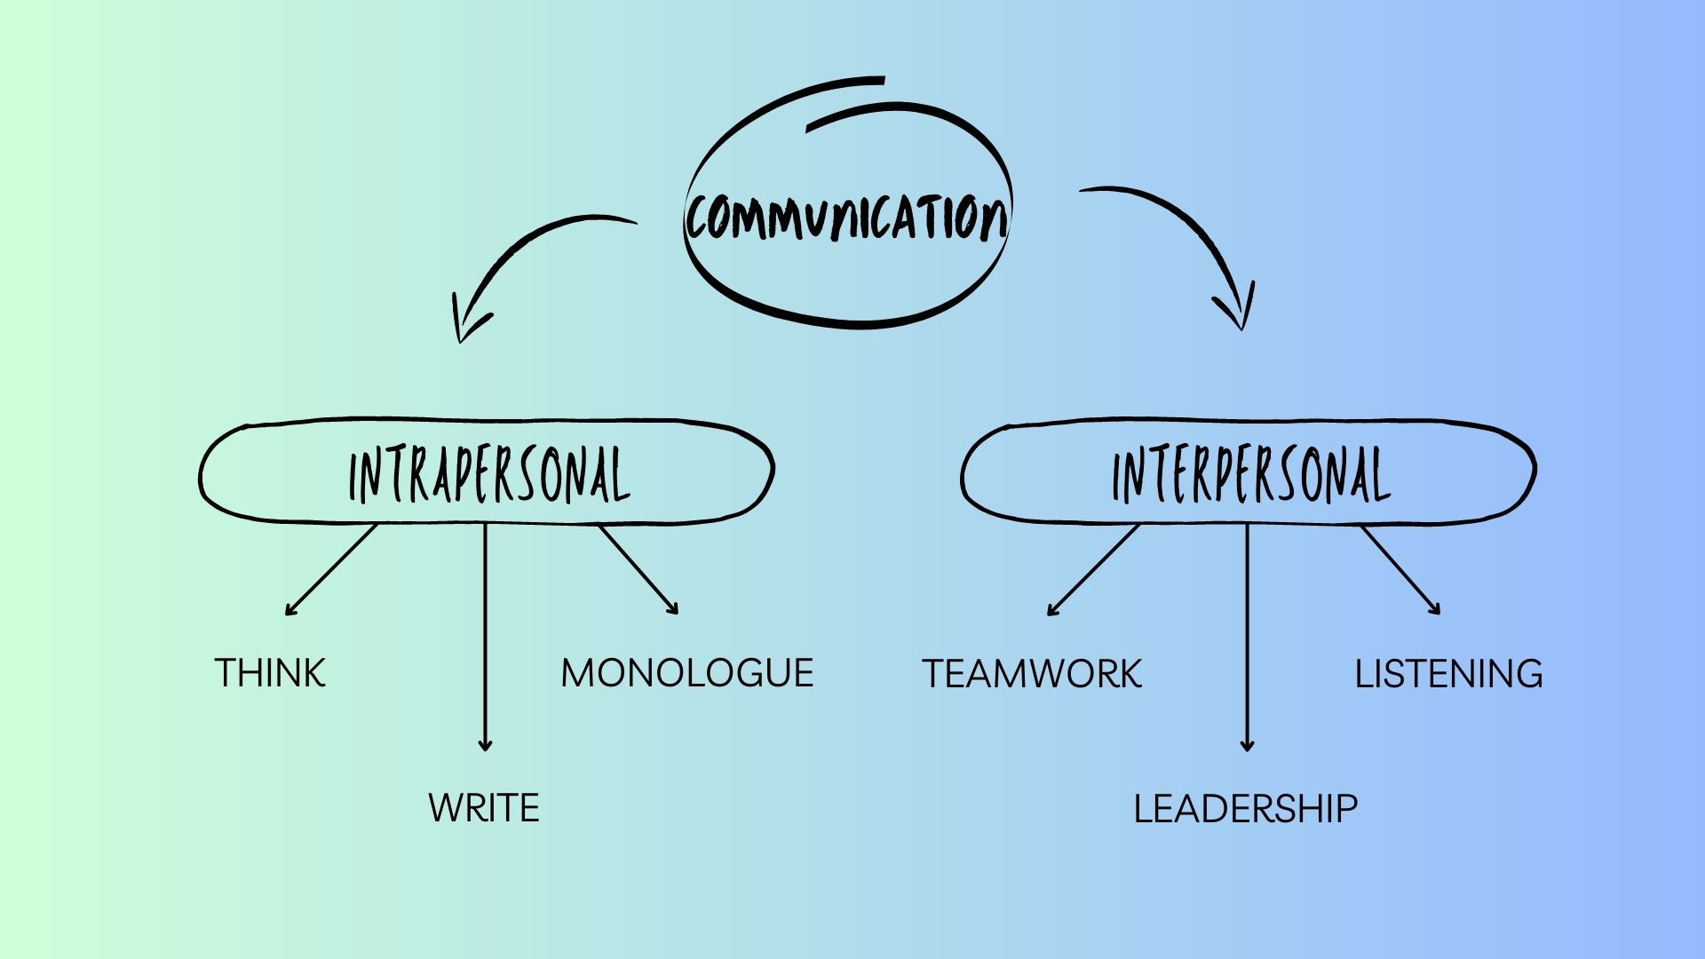

Slide 12
Key difference between group and mass communication
Audience Size: Group communication targets a smaller, more specific audience, while mass communication targets a much larger, more general audience.
Interaction: Group communication allows for direct, two-way interaction, whereas mass communication is typically one-way with limited immediate feedback.
Context: Group communication is often more personal and context-specific, while mass communication is designed to appeal to a broad audience.

Slide 13
Types of communication

Slide 14
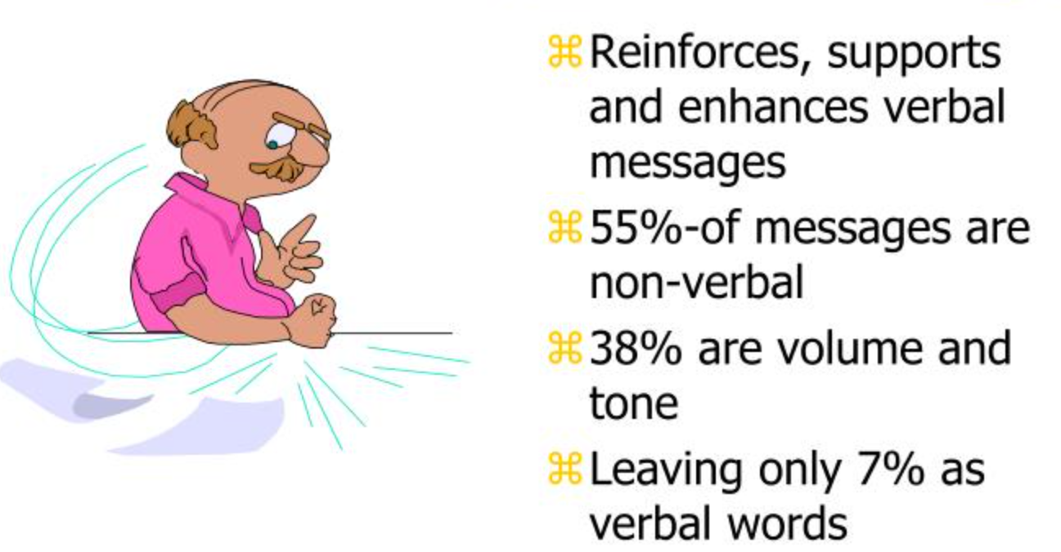
Verbal Communication
Non-verbal Communication
Loudness
Fluency
Rate of Speech
Affect
Language used
Eye Contact
Facial Expression
Gesture & Posture
Body Orientation
Distance
Appearance

Slide 15
Types of communication

Slide 16
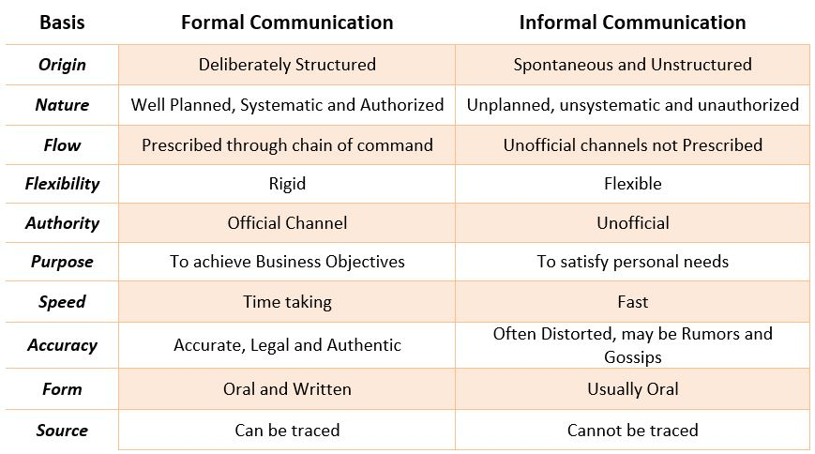

Slide 17

Communication skills

Slide 18
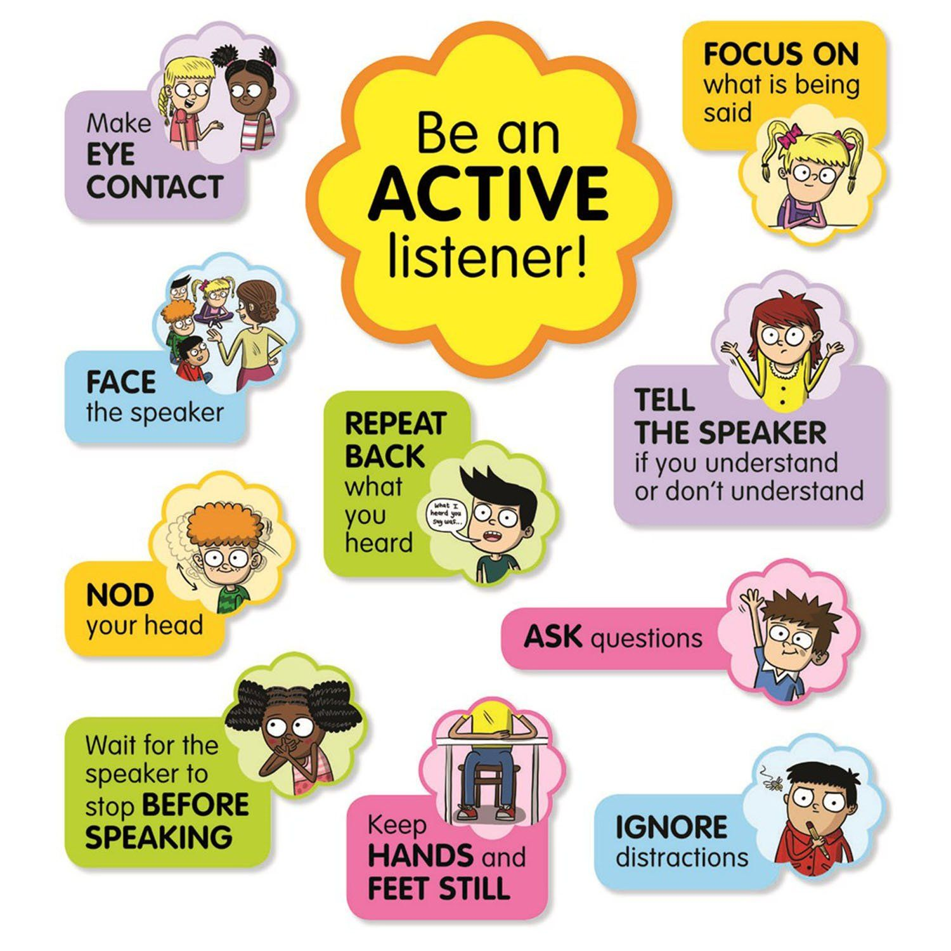
Active Listening
Techniques:
Paraphrasing: Restate the patient's words to show understanding.
Summarizing: Condense the patient's information to capture the main points.
Reflecting Emotions: Acknowledge and validate the patient's feelings.
Importance:
Demonstrates empathy and understanding.
Encourages patients to share more information.

Slide 19
Verbal Communication
Clarity: Use simple, clear language to avoid misunderstandings.
Tone: Maintain a calm and reassuring tone to put patients at ease.
Language: Avoid medical jargon when speaking with patients.

Slide 20
Non Verbal Communication
Body Language: Open posture, nodding, and appropriate gestures to show engagement.
Eye Contact: Maintain appropriate eye contact to convey attention and interest.
Facial Expressions: Use expressions to convey empathy, understanding, and compassion.

Slide 21
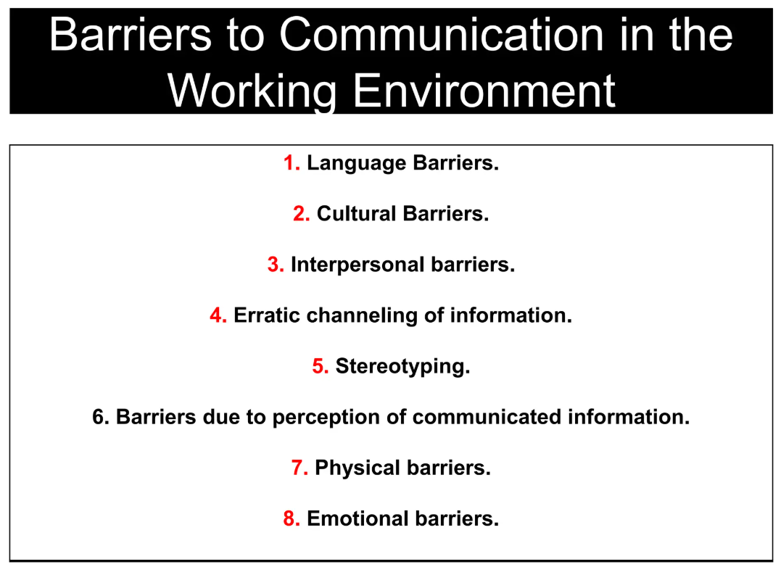

Slide 22
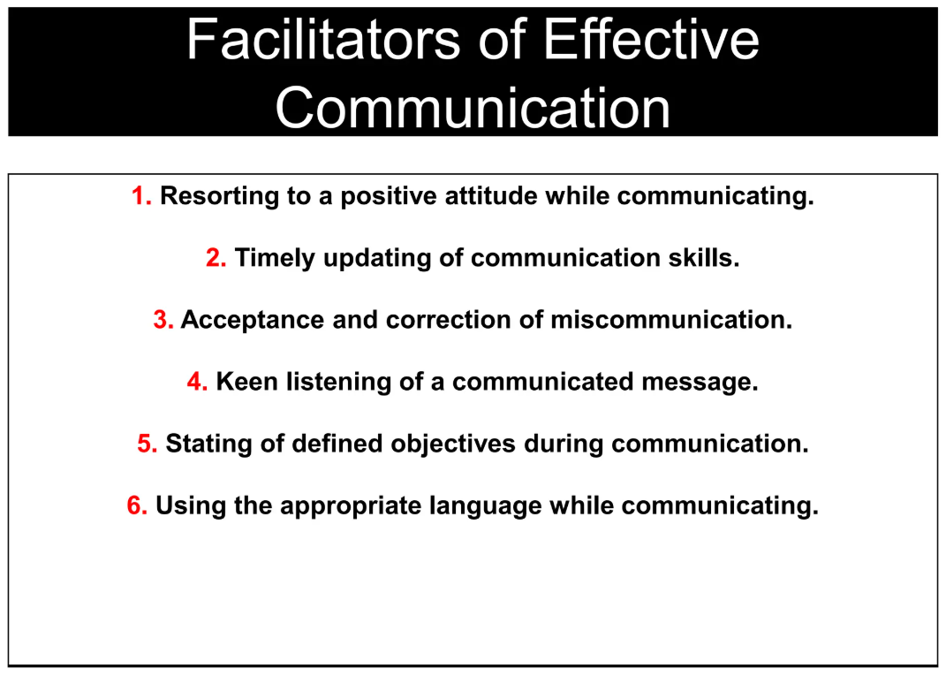

Slide 23
Essential communication elements
1. Build the doctor patient relationship
Sine quo non - "Without which, not.“
"Without (something), (something else) won't be possible.“
Patient centred approach – emphasis on patient distress and illness experience
Elicit the story of illness
Ideas, feelings and values of both parties
Patients’ active participation in decision making

Slide 24

Essential communication elements
2. Open the discussion
Patient must be allowed to complete his / her opening statement
Full set of concerns
Establish and maintain a personal connection
3. Gather Information
Open ended and closed ended appropriately
Structure, clarify and summarise information
Active listening using non verbal and verbal cues

Slide 25

Essential communication elements
4. Understand Patient perspective
Exploring various contextual factors
Acknowledge and respond to ideas, feelings and values
5. Share information
Use the language the patient can understand (avoid medical jargons)
Check for understanding
Encourage question from the patient

Slide 26
Essential communication elements
6. Reach agreement on problems and plans
Encourage the patient to participate in decisions to the extent that he / she desires
Check the patient’s willingness and ability to follow the plan
Identify and enlist resources and supports
7. Provide closure
Ask the patient about any other issues or concerns
Summarise and affirm the agreement with plan of action
Discuss the follow up

Slide 27

Essential communication elements
Aims to increase the efficiency and efficacy of physician – patient communication.
Enhance patient and physician satisfaction
Improve health outcomes

Slide 28

Thank You

