Slide 1
What Is Public Health Ethics?
Definition: A branch of ethics that guides decisions affecting populations rather than individuals.
Key distinction: Clinical ethics = patient-centered; Public health ethics = community-centered.
Example: Should a government mandate masks during an outbreak?
Is it ethical to prioritize community safety over individual freedom?
Yes—when public health risks are high, prioritizing community safety is ethically justified under the principle of non-maleficence. However, this must be balanced with respect for autonomy through transparent communication, proportional measures, and safeguards against misuse. Ethical public health protects the many without erasing the rights of the few.

Slide 2
Core Ethical Principles
Justice: Fair distribution of resources (e.g., vaccines).
Autonomy: Respecting individual choices.
Beneficence: Acting in the community’s best interest.
Non-maleficence: Avoiding harm through public policy.

Slide 3
Ethical Dilemmas in Practice
Mandatory vaccination vs. personal choice.
Contact tracing vs. privacy.
Lockdowns vs. economic survival.
Case: A TB patient refuses treatment. Should the health system intervene?
“While autonomy is a cornerstone of medical ethics, it is not unlimited. In the case of a contagious TB patient refusing treatment, the health system must first engage respectfully and offer support. If the refusal endangers others and no alternatives exist, limited intervention—such as isolation—may be ethically justified to protect public health, provided it is humane, proportionate, and legally sound.”

Slide 4
Case-Based Reflection
Present a real-world dilemma (e.g., HIV partner notification).
Ask students to analyze using ethical principles.
Encourage group discussion or role-play.
Would you breach confidentiality to protect someone’s life?
“Yes, breach confidentiality—but only if the patient poses a clear, immediate threat to someone’s life, and no other options exist. The breach must be minimal, targeted, and ethically justified by the duty to protect others from serious harm.”

Slide 5
Defining Professionalism
Core traits: Integrity, accountability, empathy, competence.
Public health lens: Professionalism includes advocacy, transparency, and responsiveness to societal needs.
Is it unprofessional to speak out against flawed health policy?
No. In fact, advocacy is a core aspect of professionalism in public health. Speaking out—when done respectfully and evidence-based—reflects integrity, accountability, and a commitment to health equity. Silence in the face of injustice is not neutrality; it’s complicity.

Slide 6
Public Health Roles
Educator: Promoting health literacy.
Advocate: Addressing social determinants.
Policy influencer: Shaping equitable health systems.
Should doctors engage in political debates about health?
“Yes, doctors should engage in political debates about health—when those debates affect patient care, public health, or ethical practice. Advocacy is not a distraction from medicine; it’s a deeper form of healing.”

Slide 7
Professional Boundaries
Respecting cultural norms during fieldwork.
Avoiding paternalism in community engagement.
Ethical conduct in research and data collection.
You’re offered a gift by a village leader—how do you respond?
“Thank you so much for your generosity. I truly appreciate the gesture and the warmth behind it. However, as a public health professional, I follow guidelines that ask us to avoid accepting personal gifts, so I must respectfully decline. I hope you understand—it’s important for us to maintain fairness and transparency in all our work.”..
Redirect the gift: “Would it be okay if we shared this with the health workers or the community center?”
Symbolic acceptance: If it’s a cultural token (e.g. garland, handmade item), you may accept it symbolically but clarify that it won’t influence decisions.

Slide 8
Understanding Medical Errors
Types: Diagnostic, procedural, communication, systemic.
Root causes: Fatigue, poor systems, lack of training.
Public health impact: Errors in outbreak reporting or vaccine delivery.

Slide 9
Why Disclosure Matters
Builds trust and promotes learning.
Upholds ethical principles: honesty, autonomy.
Encourages system improvement.
Would you disclose an error that didn’t cause harm?
Yes. Ethical disclosure is not contingent on harm—it’s rooted in honesty, transparency, and respect for patient autonomy. Even harmless errors offer learning opportunities and build trust. Disclosure affirms that the doctor–patient relationship is based on truth, not convenience.

Slide 10
Barriers to Disclosure
Fear of litigation or blame.
Lack of communication skills.
Institutional culture of silence.

Slide 11
Doctors as Social Agents
Beyond clinical care: advocacy, education, leadership.
Duty to address health inequities and social injustice.
Should doctors speak out against caste-based health disparities?
Absolutely. Doctors are not just healers—they are agents of social justice. Remaining silent on caste-based disparities perpetuates structural violence. Speaking out is not political—it’s ethical, professional, and necessary to uphold the dignity of every patient.

Slide 12
Trust & Accountability
Public expectations: transparency, compassion, competence.
Navigating misinformation and media scrutiny.
Rebuilding trust after public health failures.
A community distrusts vaccines—how do you respond?

Slide 13
What Is End-of-Life Care?
Focus on comfort, dignity, and emotional support.
Includes palliative care, hospice, and bereavement support.

Slide 14
Public Health Perspective
Ensuring access to palliative services.
Addressing cultural beliefs around death.
Promoting community-based care models.
A rural patient dies without pain relief—what failed?

Slide 15
Ethical Challenges
Advance directives and autonomy.
Assisted dying debates.
Resource allocation in terminal care.
Should terminal patients be offered every possible intervention?
Not necessarily. Ethical care prioritizes quality of life, dignity, and patient wishes over aggressive interventions. Futile treatments may prolong suffering. Respecting advance directives and offering palliative support reflects compassion, not abandonment.

Slide 16
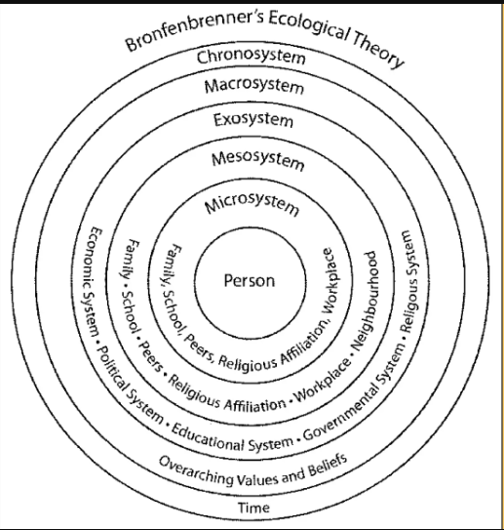


Slide 17
Socio – ecological model (SEM)
Layers: Individual → Interpersonal → Institutional → Community → Policy.
Behavior is shaped by nested systems.
Developed by Urie Bronfenbrenner.
Is vaccine hesitancy just an individual issue?
No—vaccine hesitancy is shaped by interpersonal trust, institutional credibility, cultural beliefs, and policy environments. The SEM shows us that behavior is nested in systems. Addressing hesitancy requires multi-level interventions, not just individual persuasion.

Slide 18
Application
Communication styles shaped by culture (macrosystem).
Institutional norms affect professionalism (exosystem).
Peer influence and family dynamics (microsystem).

Slide 19
Thanks

