Slide 1


Epidemiological methods

Slide 2

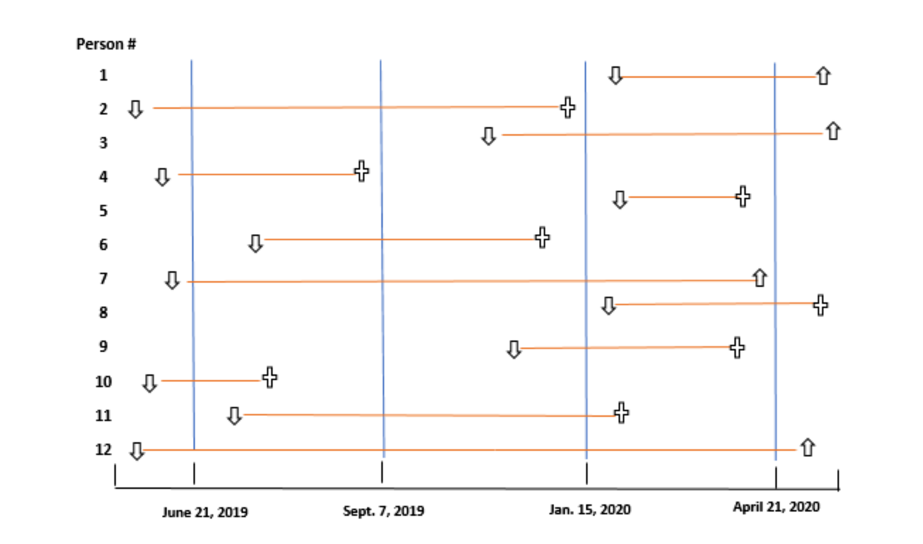

Slide 3
MCQ - 1
Which is true about DALY?
Life is adjusted for disease
Premature death is adjusted for disability
Life expectancy free of disability
Years lost to premature death and years lived with disability adjusted for severity of disability

Slide 4
MCQ - 2
Which is the best index for burden of disease?
Case Fatality Rate
Disability adjusted life years
Dependency Ratio
Morbidity data

Slide 5
MCQ - 3
A party was attended by 110 people. Out of which 40 did not eat fruit salad. From the rest who ate fruit salad,55 developed food poisoning. What is the Attack Rate?
50
78
56
46

Slide 6
MCQ - 4
In population of 5000,number of new cases of TB is 500,old cases in same population are 150.What is the prevalence of TB?
9%
12%
13%
18%

Slide 7
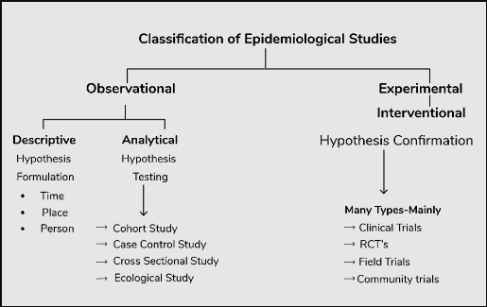

Slide 8


Descriptive study
Descriptive study is limited to a description of the occurrence of a disease in a population.
It is essential to have a clear definition of a case of the disease being investigated and of an exposed person.
First phase of an epidemiological investigation.
These studies are concerned with observing the distribution of disease or health-related characteristics in human populations and identifying the characteristics with which the disease in question seems to be associated.
When, Where and Who

Slide 9
Steps
1. Defining the population to be studied
2. Defining the disease under study
3. Describing the disease by
a. time
b. place
c. person
4. Measurement of disease
5. Comparing with known indices
6. Formulation of an aetiological hypothesis

Slide 10
Defining the population
Descriptive studies are investigations of populations, not individuals.
Define the “population base” not only in terms of the total number, but also its composition in terms of age, sex, occupation, cultural characters and similar information needed for the study.
The “defined population” can be the whole population in a geographic area, or more often a representative sample taken from it.
The defined population can also be a specially selected group such as age and sex groups, occupational groups, hospital patients, school children, small communities as well as wider groupings - in fact, wherever a group of people can be fairly accurately counted.

Slide 11
Defining the population
The defined population needs to be large enough so that age, sex and other specific rates are meaningful.
The community chosen should be stable, without migration into or out of the area.
Community participation must be forthcoming.
Population should not be overtly different from other communities in the region.
Health facility should be close enough to provide relatively easy access for patients requiring medical services.

Slide 12
Defining the population
The concept of ‘defined population’ (or population at risk) is crucial in epidemiological studies. It provides the denominator for calculating rates which are essential to measure the frequency of disease and study its distribution and determinants.
Epidemiologists therefore have been labelled as men in search of a denominator

Slide 13
Defining the disease
The clinician may not need a precise definition of disease (e.g., migraine) for immediate patient care. If the diagnosis is wrong, he can revise it subsequently.
Epidemiologist, whose main concern is to obtain an accurate estimate of disease in a population, needs a definition that is both precise and valid to enable him (or observers working in field conditions) to identify those who have the disease from those who do not.
The diagnostic methods for use in epidemiological studies must be acceptable to the population to be studied, and applicable to their use in large populations.

Slide 14
Operational definition
A definition by which the disease or condition can be identified and measured in the defined population with a degree of accuracy.
Tonsillitis might be defined clinically as an inflammation of the tonsils caused by infection, usually with streptococcus pyogenes.
An “operational definition” spells out clearly the criteria by which the disease can be measured. Such criteria in the case of tonsillitis would include the presence of enlarged, red tonsils with white exudate, which on throat swab culture grow predominantly S. pyogenes.
If the definition is not valid, it would be a powerful source of error in the presentation and comparability of measurements from different sources.
Certain diseases (e.g., neurological diseases) which often do not have pathognomonic signs and symptoms, disease definition is a crucial concern for the epidemiologist. In such cases, the epidemiologist frames his own definition keeping the objectives of his study in view and aiming at the same time a degree of accuracy sufficient for his purpose.
Once established, the case definition must be adhered to throughout the study.

Slide 15

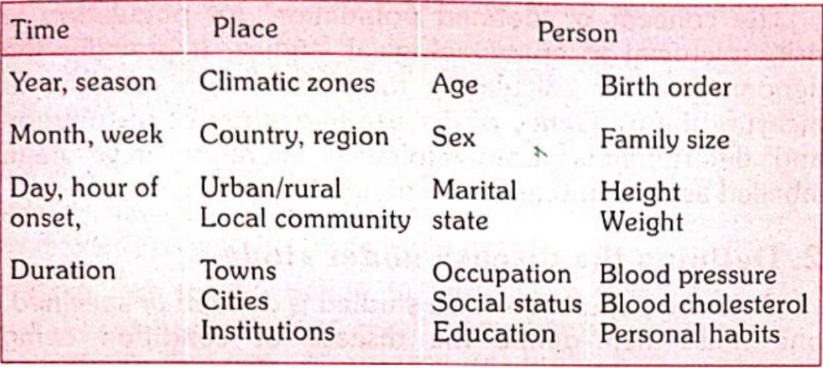
Describing the disease
The primary objective of descriptive epidemiology is to describe the occurrence and distribution of disease (or health-related events or characteristics within populations) by time, place and person, and identifying those characteristics associated with presence or absence of disease in individuals.

Slide 16
Time Distribution
The pattern of disease may be described by the time of its occurrence, i.e., by week, month, year, the day of the week, hour of onset, etc.
It raises questions whether the disease is seasonal in occurrence; whether it shows periodic increase or decrease; or whether it follows a consistent time trend.
Such studies may yield important clues about the source or aetiology of the disease, thereby suggesting potential preventive measures.
Epidemiologists have identified three kinds of time trends or fluctuations in disease occurrence.
Short – term fluctuations
Periodic fluctuations
Long term / Secular trend

Slide 17
Short term fluctuations
The best known short-term fluctuation in the occurrence of a disease is an epidemic.
Common-source epidemics are frequently, but not always, due to exposure to an infectious agent. They can result from contamination of the environment (air, water, food, soil) by industrial chemicals or pollutants,
An epidemic is defined as “the occurrence in a community or region of cases of an illness or other health-related events clearly in excess of normal expectancy”.
Epidemicity is thus relative to usual frequency of the disease in the same area, among the specified population, at the same season of the year

Slide 18
Epidemics
A. Common-source epidemics
(a) Single exposure or “point-source” epidemics.
(b) Continuous or multiple exposure epidemics
B. Propagated epidemics
(a) Person-to-person
(b) Arthropod vector
(c) Animal reservoir
C. Slow (modern) epidemics.

Slide 19
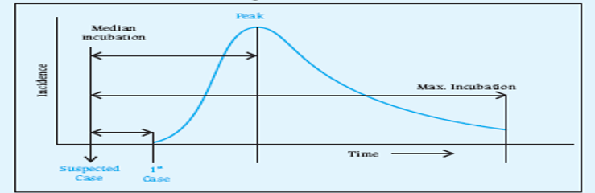
Single exposure / Point source
The epidemic curve rises and falls rapidly, with no secondary waves
The epidemic tends to be explosive, there is clustering of cases within a narrow interval of time,
All the cases develop within one incubation period of disease.

Slide 20
Continuous/ Repeated exposure
Exposure from the same source may be prolonged - continuous, repeated or intermittent – not necessarily at the same time or place.
A FSW may be a common source in a gonorrhoea outbreak, but since she will infect her clients over a period of time there may be no explosive rise in the number of cases.
A well of contaminated water, or a nationally distributed brand of vaccine (e.g. polio vaccine), or food, could result in similar outbreaks.
In these instances, the resulting epidemics tend to be more extended or irregular.
A variation to the above model is that an epidemic may be initiated from a common source and then continue as a propagated epidemic.
Water-borne cholera is a familiar example, the epidemic reaches a sharp peak, but tails off gradually over a longer period of time.

Slide 21
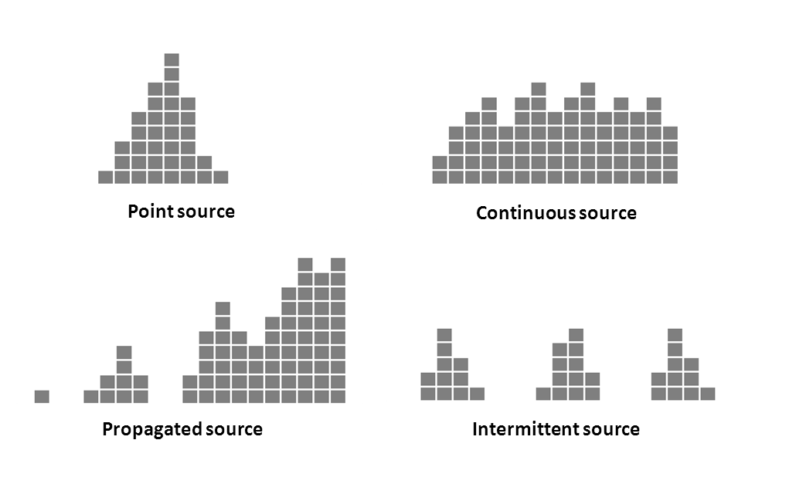
Epidemic Curve

Slide 22

Thanks

