Slide 1

Randomized Controlled trial

Slide 2

MCQ -1
Which step in the RCT involves assigning participants to different treatment groups?
a) Randomization
b) Follow-up
c) Manipulation or intervention
d) Assessment of outcome

Slide 3

MCQ -2
What is the first step in conducting a Randomized Controlled Trial (RCT)?
a) Randomization
b) Follow-up
c) Drawing up a protocol
d) Manipulation or intervention

Slide 4
MCQ - 3
What is the term used for the group of participants who receive the standard treatment or no intervention in an RCT?
a) Experimental group
b) Control group
c) Placebo group
d) Randomized group

Slide 5

MCQ - 4
What is the main benefit of blinding or masking in an RCT?
a) It ensures that all participants receive the same treatment.
b) It prevents participants from knowing the study's objectives.
c) It reduces bias and influences the treatment's true effect.
d) It increases the number of participants in the study.

Slide 6

MCQ - 5
What is the main reason for conducting an RCT with a control group?
a) To compare the intervention's effectiveness to a placebo
b) To provide an opportunity for participants to choose their treatment
c) To reduce the number of participants in the study
d) To avoid any ethical issues associated with medical interventions

Slide 7

Manipulation
Intervene or manipulate the study (experimental) group
Deliberate application
Withdrawal
Reduction of the suspected causal factor
This manipulation creates an independent variable
Final outcome, which constitutes the dependent variable

Slide 8

Follow up
Examination of the experimental and control group subjects
Defined intervals of time,
Standard manner, with equal intensity, under the same given circumstances
Same time frame till final assessment of outcome.
The duration of the trial is usually based on the expectation that a significant difference (e.g., mortality) will be demonstrable at a given point in time after the start of the trial.
It may be mentioned that some losses to follow-up are inevitable due to factors, such as death, migration and loss of interest. This is known as attrition

Slide 9

Assessment
Positiue results : benefits of the experimental measure such as
Reduced incidence or severity of the disease,
Cost to the health service
Negatiue results : severity and frequency of side-effects and complications, if any, including death.
The incidence of positive/negative results is rigorously compared in both the groups, and the differences, if any, are tested for statistical significance.

Slide 10
Bias & Blinding
Subject variation (Participant) – Single Blind
Subjectively feel better or report improvement if they knew they were receiving a new form of treatment.
Observer Bias (Investigator) – Double Blind
Investigator measuring the outcome of a therapeutic trial may be influenced if he knows beforehand the particular procedure or therapy to which the patient has been subjected.
Bias in evaluation (Person reporting)
Triple Blind
The participant, the investigator and the person analyzing the data are all “blind”.
Double blinding is the most frequently used method when a blind trial is conducted

Slide 11

Study design
Concurrent parallel study design
Cross over
All patients can be assured that sometime during the course of investigation, they will receive the new therapy.
Economize on the total number of patients required at the expense of the time necessary to complete the study.
Not suitable
The drug of interest cures the disease,
The drug is effective only during a certain stage of the disease
The disease changes radically during the period of time required for the study.

Slide 12
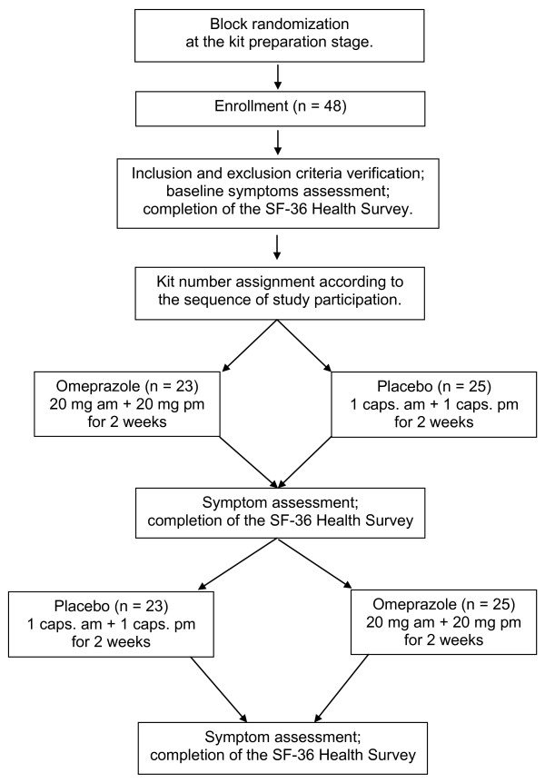
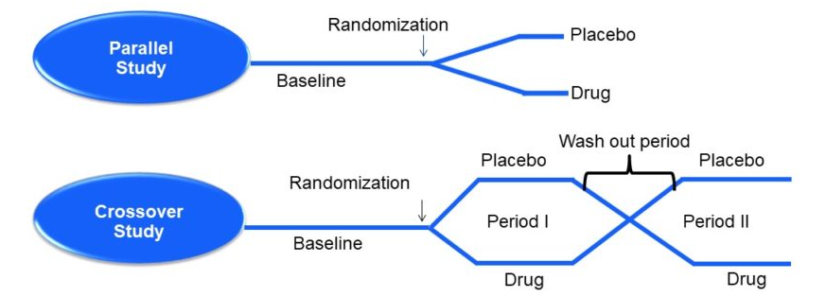

Slide 13
Types of RCT
Clinical Trial - should be carried out before any new therapy, procedure or service is introduced.
Preventive trial (primary prevention) – vaccine or chemoprophylactic trial
Analysis of a preventive trial must result in a clear statement about
The benefit the community will derive from the measure
The risks involved
The costs to the health service in terms of money, men and material resources.
Involve larger number of subjects and sometimes a longer time span to obtain results, there may be greater number of practical problems in their organisation and execution.
Risk Factor trial (subtype of preventive trial)
Intervenes to interrupt the usual sequence in the development of disease for those individuals who have “risk factor” for developing the disease; often this involves risk factor modification.

Slide 14
Types of RCT
Cessation experiments - an attempt is made to evaluate the termination of a habit (or removal of suspected agent) which is considered to be causally related to a disease. If such action is followed by a significant reduction in the disease, the hypothesis of cause is greatly strengthened.
Trial of aetiological agents – Retrolental fibroplasia
Evaluation of health services - assess the effectiveness and efficiency of health services.
Necessity of choice arises from the fact that resources are limited, and priorities must be set for the implementation of a large number of activities which could contribute to the welfare of the society.
These studies are also labelled as “health services research” studies.

Slide 15
Non – Randomized Trials
It is not always possible for ethical, administrative and other reasons to resort to a randomized controlled trial in human beings.
Smoking and lung cancer and induction of cancer by viruses have not lent themselves to direct experimentation in human beings.
Some preventive measures can be applied only to groups or on a community-wide basis (e.g., community trials of water fluoridation).
When disease frequency is low and the natural history long (e.g., cancer cervix) randomized controlled trials require follow-up of thousands of people for a decade or more. The cost and logistics are often prohibitive. These trials are rare.
Approach is sophisticated in randomized controlled trials, it is rather crude in non-randomized trials.
As there is no randomization in non-experimental trials, the degree of comparability will be low and the chances of a spurious result higher than where randomization had taken place.
The validity of causal inference remains largely a matter of extra-statistical judgement.

Slide 16
Types – Non Randomized trial
Uncontrolled trials
Trial with no comparison groups
Even in these uncontrolled trials, one is using implied “historical controls”, i.e., the experience of earlier untreated patients affected by the same disease.
Initially uncontrolled trials may be useful in evaluating whether a specific therapy appears to have any value in a particular disease, to determine an appropriate dose, to investigate adverse reactions, etc.
Natural experiments
Where experimental studies are not possible in human populations, the epidemiologist seeks to identify “natural circumstances” that mimic an experiment

Slide 17
Types – Non Randomized trial
Before and after comparison Studies
Without control - In order to establish evidence in before and after comparison studies, the following are needed;
Data regarding the incidence of disease, before and after introduction of a preventive measure must be available
There should be introduction or manipulation of only one factor or change relevant to the situation, other factors remaining the same, as for example, addition of fluorine to drinking water to prevent dental caries
Diagnostic criteria of the disease should remain the same
Adoption of preventive measures should be over a wide area
Reduction in the incidence must be large following the introduction of the preventive measure, because there is no control,
Several trials may be needed before the evaluation is considered conclusive.
With Control - epidemiologist tries to utilize a “natural” control group

Slide 18
Evaluation of preventive measures
How much will it benefit the community ?
Effectiveness of the preventive measure and the acceptance of the measure by the community.
The combined outcome of effectiveness and acceptability is measured by the difference in the incidence rate among the experimental and control groups,
What are the risks to the recipients?
Immediate and long-term risks,
Cost in money and manpower?
This is done to find out whether the preventive measure is economical and practical in terms of money spent.

Slide 19

Thank You

