Slide 1
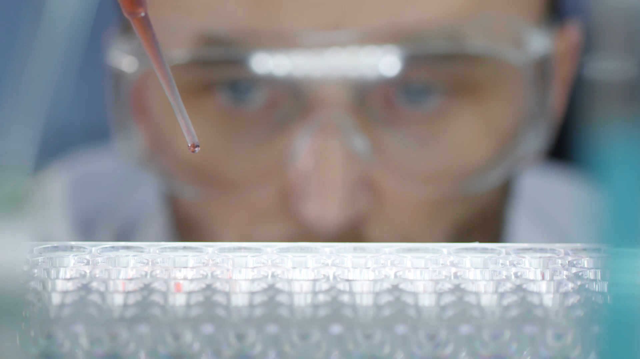
Experimental study

Slide 2
MCQ -1
20 pregnant women were asked about the history of smoking when they came for regular antenatal visits and then followed up to see how many of them had low birth weight babies. What is the type of study?
a. Case Control
b. Prospective cohort
c. Cross-sectional
d. Ecological

Slide 3
MCQ - 2
The ratio between the incidence of disease among exposed and non-exposed is called:
a. Causal risk
b. Relative risk
c. Attributable risk
d. Odds ratio

Slide 4
MCQ - 3
Hawthorne effect is seen in:
a. Case control study
b. Cohort study
c. Cross-sectional study
d. Retrospective cohort study

Slide 5
MCQ - 4
Case control study is used for study of:
a. Common diseases
b. Uncommon diseases
c. Rare diseases
d. Unknown diseases

Slide 6
MCQ - 5
Confounding can be removed by:
a. Assign confounders equally to both cases and controls
b. Stratification
c. Matching
d. All of the above

Slide 7
MCQ - 6
The analytical study where population is the unit of study is:
a. Cross sectional
b. Ecological
c. Case control
d. Cohort

Slide 8
MCQ - 7
Case control study is a type of ?
a. Descriptive epidemiological study
b. Analytical study
c. Longitudinal study
d. Experimental epidemiological study

Slide 9
MCQ - 8
Cohort study does not include:
a. Expensive
b. Study of chronic diseases
c. Incidence rate calculated
d. Starts with the disease

Slide 10
MCQ - 9
Which is not an analytical study?
a. Case-control
b. Cohort
c. RCT
d. Cross-sectional

Slide 11
MCQ - 10
All can be used as controls in a study of genetic condition except:
a. Hospital controls
b. Sibling controls
c. Neighbourhood controls
d. General population

Slide 12

Animal studies

Slide 13
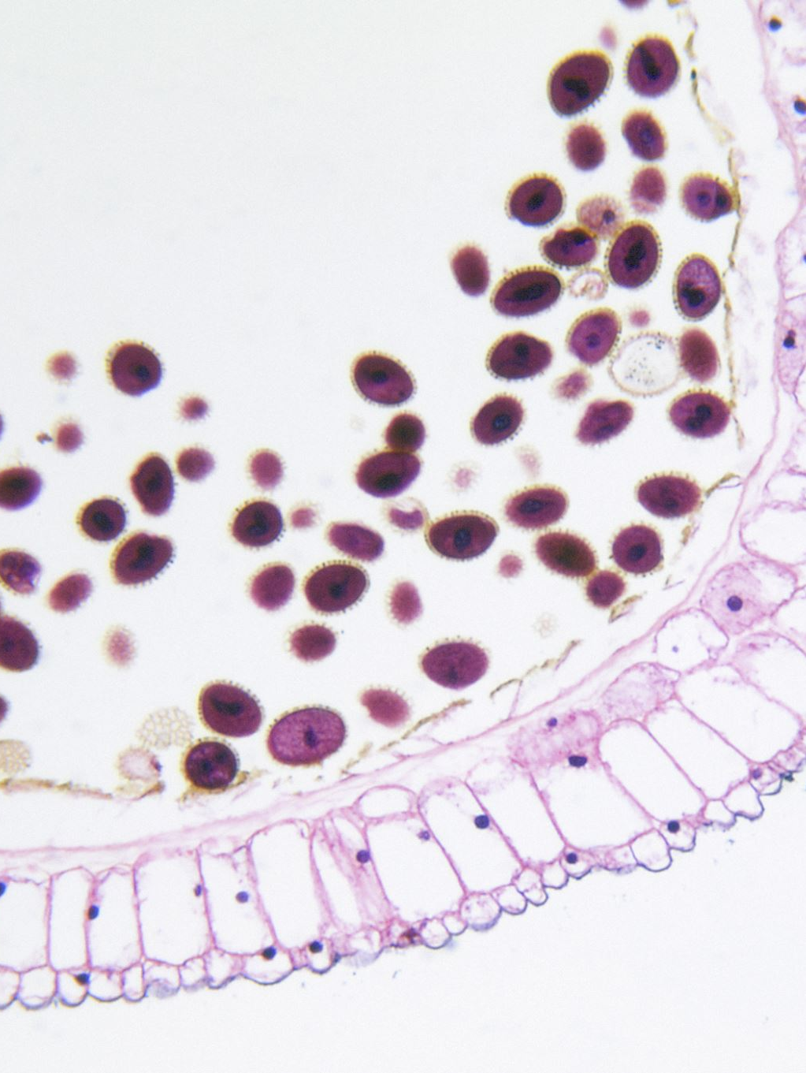
Applications
Experimental reproduction of human disease
Confirm aetiological hypothesis
Study the pathogenetic phenomena
Testing the efficacy of preventive and therapeutic measures
Completing the natural history of disease.
Naturally occurring leprosy has been found in armadillos.

Slide 14
Advantages
Experimental animals can be bred in laboratories and manipulated easily
Multiply rapidly and enable the investigators to carry out certain experiments (e.g., genetic experiments)
Limitations
Not all human diseases can be reproduced in animals.
All the conclusions derived from animal experiments may not be strictly applicable to human beings.

Slide 15
Human Experiments - History
James Lind – Scurvy
Edward Jenner – Small pox
Finlay and Reed – yellow fever
Goldberger - pllagra

Slide 16
Considerations
Most incisive approach to scientific problem, ethical and logistic considerations
The benefits of the experiment have to be weighed against risks involved.
The volunteers should be made fully aware of all possible consequences.
When an illness is fatal (e.g., excessive haemorrhage) and the benefit of treatment (e.g., blood transfusion) is self-evident, it would be ethically unacceptable to prove or disprove the therapeutic value of blood transfusion
It is equally unethical if a drug or procedure is brought into general use without establishing its effectiveness by controlled trials.
The thalidomide disaster and the occurrence of carcinoma of the vagina in the offspring of pregnant women treated with diethylstilbestrol

Slide 17
Types
Randomized controlled trials (i.e., those involving a process of random allocation)
Non-randomized or ‘non-experimental’ trials (i.e., those departing from strict randomization for practical purposes, but in such a manner that nonrandomization does not seriously affect the theoretical basis of conclusions).

Slide 18
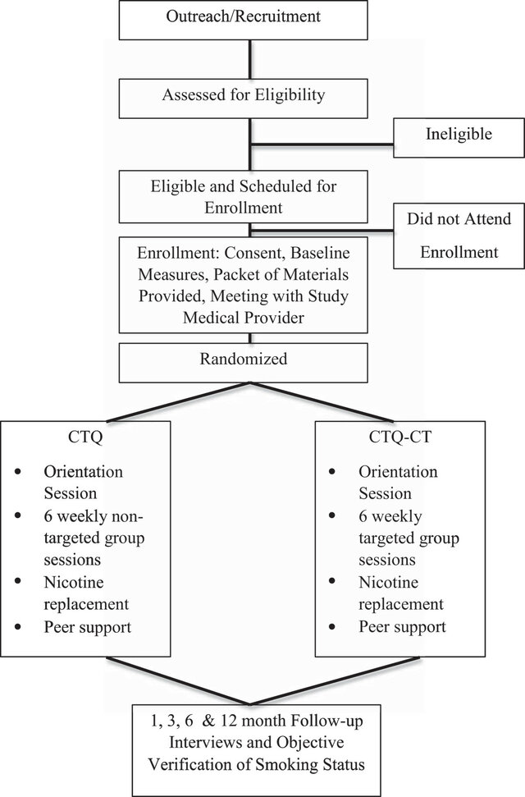
RCT
For new programmes or new therapies, the RCT is the No.l method of evaluation. The basic steps in conducting a RCT include the following :
1. Drawing up a protocol.
2. Selecting reference and experimental populations.
3. Randomization.
4. Manipulation or intervention.
5. Follow-up.
6. Assessment of outcome.

Slide 19

Protocol
Study is conducted under a strict protocol.
Specifies
Aims and objectives of the study
Questions to be answered,
Criteria for the selection of study and control groups,
Size of the sample,
The procedures for allocation of subjects into study and control groups,
Treatments to be applied - when and where and how to what kind of patients,
Standardization of working procedures
Schedules as well as responsibilities of the parties involved in the trial,
Essential especially when a number of centres are participating in the trial.
Once a protocol has been evolved, it should be strictly adhered to throughout the study.
The protocol aims at preventing bias and to reduce the sources of error in the study.
Preliminary test runs (Pilot test) or short test runs : To find out the
Feasibility or operational efficiency of certain procedures,
Unknown effects,
The acceptability of certain policies.
It is important that the final version of the protocol should be agreed upon by all concerned before the trial begins.

Slide 20
Reference and experimental population
Reference / Targeted
Population to which the findings of the trial, if found successful, are expected to be applicable
As broad as mankind or it may be geographically limited or limited to persons in specific age, sex, occupational or social groups.
Experimental / Study
Derived from the reference population
The participants or volunteers must fulfil the following three criteria :
They must give “informed consent”
They should be representative of the population to which they belong (i.e., reference population)
They should be qualified or eligible for the trial.

Slide 21

Randomization
Heart of controlled trial - It will give the greatest confidence that the groups are comparable
Randomization is an attempt to eliminate “bias” and allow for comparability.
Entire study population can be stratified into sub-groups according to the variable, and individuals within each sub-group can then be randomly allocated into study and control groups
It is always desirable to check that the groups formed initially are basically similar in composition.
Randomization is done only after the participant has entered the study
Randomization is best done by using a table of random numbers.
The essential difference between a randomized controlled trial and an analytical study is that in the latter there is no randomization.
The only option left to ensure comparability in analytical studies is by matching.
One can only match those factors which are known to be important. There may be other factors which are important but whose effect is not recognized or cannot be determined.

Slide 22

Allocation Concealment
Allocation concealment is a when the person (or system) responsible for allocating people to different treatment groups and control groups:
Doesn’t know what the next treatment allocation will be and
Conceals the results of the allocation from others.
A Centralized telephone randomization center (like this one) uses randomization to allocate patients to groups. The database is independent and thus is not accessible to study personnel except to receive a treatment assignment for a specific patient.

Slide 23

Manipulation
Intervene or manipulate the study (experimental) group
Deliberate application
Withdrawal
Reduction of the suspected causal factor
This manipulation creates an independent variable
Final outcome, which constitutes the dependent variable

Slide 24

Follow up
Examination of the experimental and control group subjects
Defined intervals of time,
Standard manner, with equal intensity, under the same given circumstances
Same time frame till final assessment of outcome.
The duration of the trial is usually based on the expectation that a significant difference (e.g., mortality) will be demonstrable at a given point in time after the start of the trial.
It may be mentioned that some losses to follow-up are inevitable due to factors, such as death, migration and loss of interest. This is known as attrition

Slide 25

Assessment
Positiue results : benefits of the experimental measure such as
Reduced incidence or severity of the disease,
Cost to the health service
Negatiue results : severity and frequency of side-effects and complications, if any, including death.
The incidence of positive/negative results is rigorously compared in both the groups, and the differences, if any, are tested for statistical significance.

Slide 26
Bias & Blinding
Subject variation (Participant) – Single Blind
Subjectively feel better or report improvement if they knew they were receiving a new form of treatment.
Observer Bias (Investigator) – Double Blind
Investigator measuring the outcome of a therapeutic trial may be influenced if he knows beforehand the particular procedure or therapy to which the patient has been subjected.
Bias in evaluation (Person reporting)
Triple Blind
The participant, the investigator and the person analyzing the data are all “blind”.
Double blinding is the most frequently used method when a blind trial is conducted

Slide 27

Study design
Concurrent parallel study design
Cross over
All patients can be assured that sometime during the course of investigation, they will receive the new therapy.
Economize on the total number of patients required at the expense of the time necessary to complete the study.
Not suitable
The drug of interest cures the disease,
The drug is effective only during a certain stage of the disease
The disease changes radically during the period of time required for the study.

Slide 28
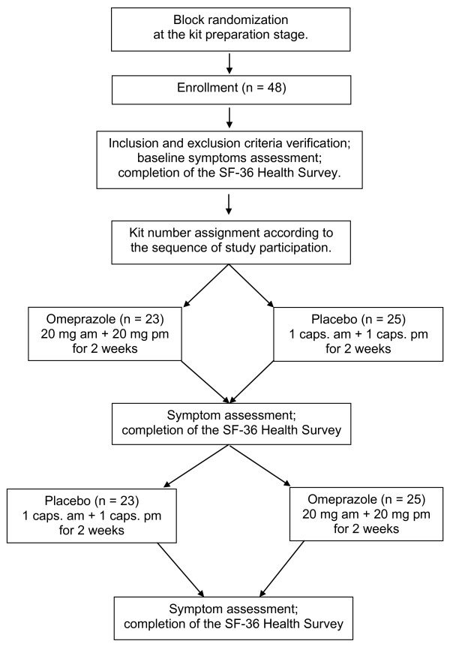
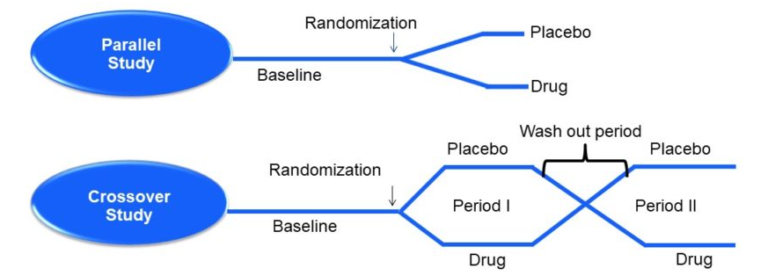

Slide 29
Types of RCT
Clinical Trial - should be carried out before any new therapy, procedure or service is introduced.
Preventive trial (primary prevention) – vaccine or chemoprophylactic trial
Analysis of a preventive trial must result in a clear statement about
The benefit the community will derive from the measure
The risks involved
The costs to the health service in terms of money, men and material resources.
Involve larger number of subjects and sometimes a longer time span to obtain results, there may be greater number of practical problems in their organisation and execution.
Risk Factor trial (subtype of preventive trial)
Intervenes to interrupt the usual sequence in the development of disease for those individuals who have “risk factor” for developing the disease; often this involves risk factor modification.

Slide 30
Types of RCT
Cessation experiments - an attempt is made to evaluate the termination of a habit (or removal of suspected agent) which is considered to be causally related to a disease. If such action is followed by a significant reduction in the disease, the hypothesis of cause is greatly strengthened.
Trial of aetiological agents – Retrolental fibroplasia
Evaluation of health services - assess the effectiveness and efficiency of health services.
Necessity of choice arises from the fact that resources are limited, and priorities must be set for the implementation of a large number of activities which could contribute to the welfare of the society.
These studies are also labelled as “health services research” studies.

Slide 31
Non – Randomized Trials
It is not always possible for ethical, administrative and other reasons to resort to a randomized controlled trial in human beings.
Smoking and lung cancer and induction of cancer by viruses have not lent themselves to direct experimentation in human beings.
Some preventive measures can be applied only to groups or on a community-wide basis (e.g., community trials of water fluoridation).
When disease frequency is low and the natural history long (e.g., cancer cervix) randomized controlled trials require follow-up of thousands of people for a decade or more. The cost and logistics are often prohibitive. These trials are rare.
Approach is sophisticated in randomized controlled trials, it is rather crude in non-randomized trials.
As there is no randomization in non-experimental trials, the degree of comparability will be low and the chances of a spurious result higher than where randomization had taken place.
The validity of causal inference remains largely a matter of extra-statistical judgement.

Slide 32
Types – Non Randomized trial
Uncontrolled trials
Trial with no comparison groups
Even in these uncontrolled trials, one is using implied “historical controls”, i.e., the experience of earlier untreated patients affected by the same disease.
Initially uncontrolled trials may be useful in evaluating whether a specific therapy appears to have any value in a particular disease, to determine an appropriate dose, to investigate adverse reactions, etc.
Natural experiments
Where experimental studies are not possible in human populations, the epidemiologist seeks to identify “natural circumstances” that mimic an experiment

Slide 33
Types – Non Randomized trial
Before and after comparison Studies
Without control - In order to establish evidence in before and after comparison studies, the following are needed;
Data regarding the incidence of disease, before and after introduction of a preventive measure must be available
There should be introduction or manipulation of only one factor or change relevant to the situation, other factors remaining the same, as for example, addition of fluorine to drinking water to prevent dental caries
Diagnostic criteria of the disease should remain the same
Adoption of preventive measures should be over a wide area
Reduction in the incidence must be large following the introduction of the preventive measure, because there is no control,
Several trials may be needed before the evaluation is considered conclusive.
With Control - epidemiologist tries to utilize a “natural” control group

Slide 34

Thanks

