Slide 1

Immunizing Agents

Slide 2
Types
Vaccines
Immunoglobulins
Antisera

Slide 3
Vaccines
Vaccine is an immuno-biological substance designed to produce specific protection against a given disease, it stimulates the production of protective antibody and other immune mechanisms.
Types
Live Vaccines
Killed whole organism / Inacivated
Sub-unit

Slide 4
Live vaccines
Live vaccines are more potent immunizing agents than killed vaccines
Live organisms multiply in the host and the resulting antigenic dose is larger than what is injected.
Live vaccines have all the major and minor antigenic components
Live vaccines engage certain tissues of the body
The persistence of latent virus.
Live vaccines should not be administered to persons with immune deficiency diseases or to persons whose immune response may be suppressed because of leukaemia, lymphoma or malignancy or because of therapy with corticosteroids, alkylating agents, antimetabolic agents, or radiation.
Pregnancy is another contraindication unless the risk of infection exceeds the risk of harm to the foetus of some live vaccines.
When two live vaccines are required they should be given either simultaneously at different sites or with an interval of atleast 3 weeks.
In the case of live vaccines, protection is generally achieved with a single dose of vaccine.
An additional dose is given to ensure seroconversion, e.g., 95 to 98 per cent of recipient will respond to single dose of measles vaccine. The second dose is given to ensure that 100 per cent of persons are immune. The other exception is polio vaccine which needs three or more doses to be given at spaced intervals to produce effective immunity.
Live vaccines usually produce a durable immunity, but not always as long as that of the natural infection.

Slide 5
Live vaccines
When two live vaccines are required they should be given either simultaneously at different sites or with an interval of atleast 3 weeks.
In the case of live vaccines, protection is generally achieved with a single dose of vaccine.
An additional dose is given to ensure seroconversion, e.g., 95 to 98 per cent of recipient will respond to single dose of measles vaccine. The second dose is given to ensure that 100 per cent of persons are immune. The other exception is polio vaccine which needs three or more doses to be given at spaced intervals to produce effective immunity.
Live vaccines usually produce a durable immunity, but not always as long as that of the natural infection.

Slide 6
Live vaccines
Tuberculosis (BCG)
Yellow fever
Polio (OPV)
Measles
Mumps
Rubella
Typhoid
Varicella
Rotavirus
Cholera
Cold-adapted influenza
Rotavirus reassortants
Zoster

Slide 7
Inactivated / killed vaccines
Inactivated vaccines are produced by growing virus or bacteria in culture media and then inactivating them with heat or chemicals (usually formalin).
They are usually safe but generally, less efficacious than live vaccines. For example,
Cholera vaccine offers only 50 per cent protection.
The efficacy of 3 doses of pertussis vaccine is about 80 per cent in the first three years, and almost “nil” 12 years after immunization.
Killed vaccines usually require a primary series of 2 or 3 doses of vaccine to produce an adequate antibody response, and in most cases “booster” injections are required.
Killed vaccines are usually administered by subcutaneous or intramuscular route.
The only absolute contraindication to their administration is a severe local or general reaction to a previous dose.

Slide 8
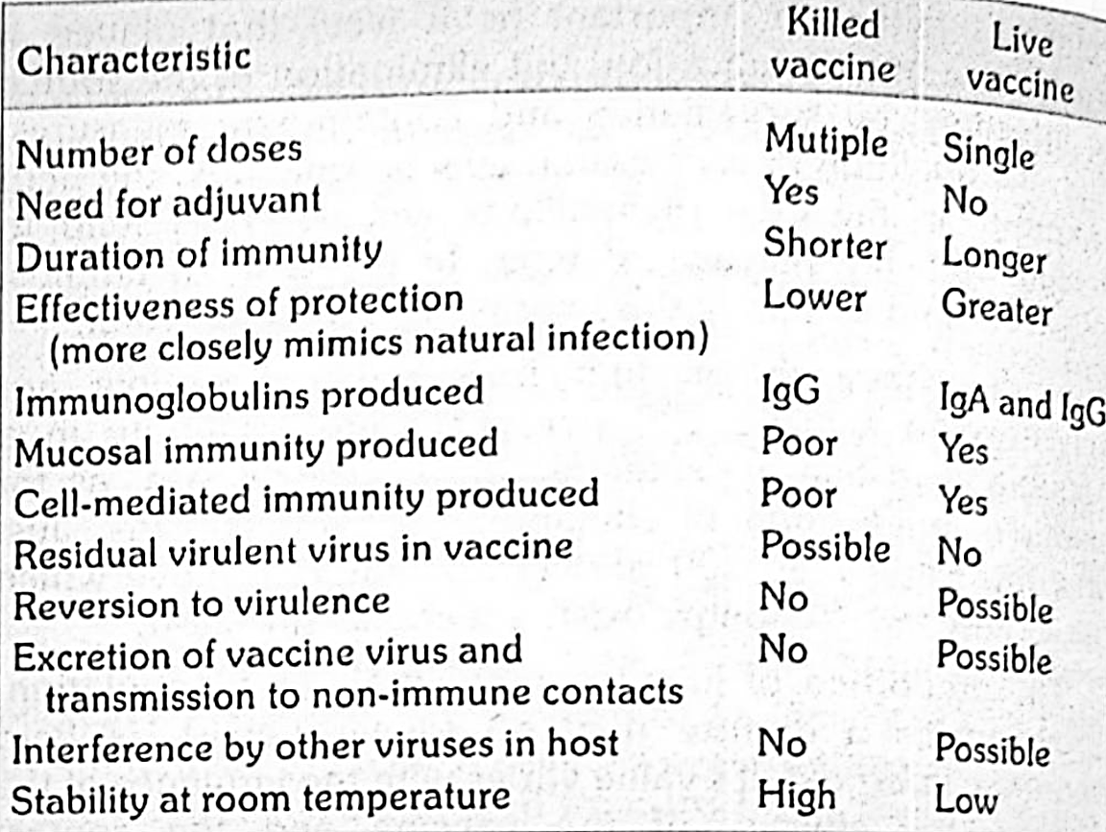
Inactivated / killed vaccines

Slide 9
Inactivated / killed vaccines
Typhoid
Cholera
Plague
Pertussis
Influenza
Typhus
Polio (IPV)
Rabies
JE
TBE
HAV
COVID-19

Slide 10
Subunit
Toxoid
Exotoxins
Diphtheria, Tetanus
Protein
Single / combination of protein
Acellular pertussis, influenza vaccine (hemagglutinin and neuraminidase
Recombinant protein
HBV
Lyme disease
Cholera toxin B
HPV
COV1D-19

Slide 11
Subunit
Polysaccharide
Capsular shell
Complement-mediated killing and opsonophagocytic
Pneumococcus, Meningococcus, Hib, Typhoid (Vi)
Conjugated
Children under two years of age do not respond well to antigens, such as polysaccharides.
Hib, Pneumococcus, MenACWY

Slide 12
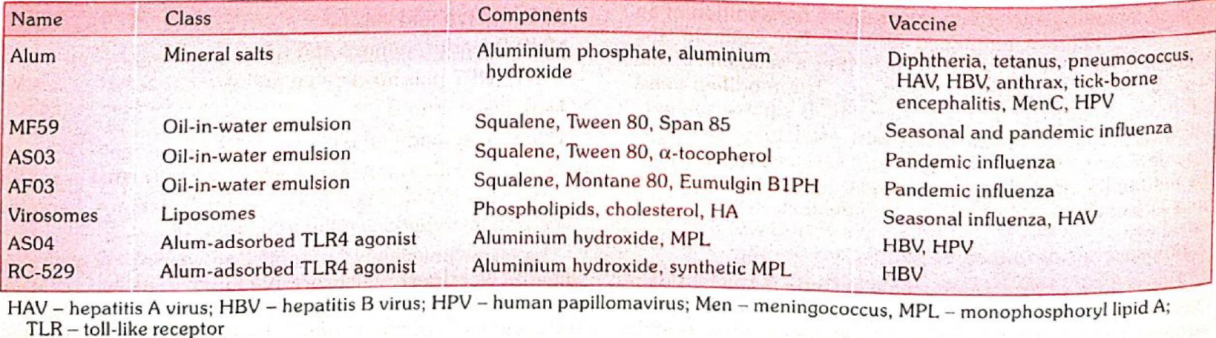
Other components - adjuvants
To enhance the immune response by degree and/or duration, making it possible to reduce the amount of immunogen per dose or the total number of doses needed to achieve immunity.
Rarely, they may cause injection site reactions, including subcutaneous nodules, sterile abscess, granulomatous inflammation or contact hypersensitivity

Slide 13
Other components
Antibiotics
Antibiotics are used during the manufacturing phase to prevent bacterial contamination of the tissue culture cells in which the viruses are grown. For example, MMR vaccine and IPV each contains less than 25 micrograms of neomycin per dose (less than 0.000025g).
Preservatives
These are chemicals (e.g. thiomersal, formaldehyde) added to killed or subunit vaccines in order to inactivate viruses, detoxify bacterial toxins, and to prevent serious secondary infections as a result of bacterial or fungal contamination
Stabilizers
To confirm product quality or stability, compounds may be added to vaccines for a variety of manufacture-related issues: controlling acidity (pH); stabilizing antigens through necessary steps in the manufacturing process, such as freeze drying; and preventing antigens from adhering to the sides of glass vials with a resultant loss in immunogenicity. Examples of such additives include potassium or sodium salts, lactose, human serum albumin and a variety of animal proteins, such as gelatine and bovine serum albumin

Slide 14
Immunoglobulins
Hepatitis A, C and B
Rubella
Varicella zoster
Measles
Rabies
Tetanus
Rh Isoimmunization

Slide 15
Antisera
Diptheria
Tetanus
Gas gangrene – Cl. Perfringes
Rabies
Botulism

Slide 16
Cold chain
System of storage and transport of vaccines at low temperature from the manufacturer to the actual vaccination site.
The success of national immunization programme is highly dependent on supply chain system for delivery of vaccines and equipment, with a functional system that meets 6 rights of supply chain
-The right vaccine in the right quantity at the right place at the right time in the right condition (no temperature breaks in cold chain) and at the right cost

Slide 17
Sensitivity to heat
Group A to Group F ➔ most sensitive to least sensitive to heat
Group A – OPV
Group B – Influenza
Group C - Inactivated poliovirus (IPV), Japanese encephalitis (freeze-dried), Measles or measles-rubella or measles-mumps-rubella (freeze-dried)
Group D – Cholera, DTaP-hepatitis B-Hib-IPV(hexavalent), DTwP or DTwP-hepatitis B-Hib (pentavalent), Hib (liquid), Rotavirus (liquid and freeze-dried), Rubella (freeze-dried), Yellow fever (freeze-dried)
Group E - Bacillus Calmette Guerin (BCG), Human papillomavirus (HPV), Japanese encephalitis (JE), Tetanus, TD, Td
Group F - Hepatitis B, Hib (freeze-dried), Meningococcal A, Pneumococcal

Slide 18
Sensitivity to freezing
Vaccines that are sensitive to freezing and should be protected from sub-zero temperature are :
Cholera
DTaP-hepatitis B-Hib-IPV (hexavalent)
DTwP or DTwP-hepatitis B-Hib (pentavalent)
Hepatitis B (Hep B)
Hib (liquid)
Human papillomavirus (HPV)
Inactivated poliovirus (IPV)
Influenza
Pneumococcal
Tetanus, DT, Td
Rotavirus (liquid and freeze-dried)

Slide 19
Sensitivity to light
BCG, measles, measles-rubella, measles-mumps-rubella and rubella.
These vaccine are supplied in dark glass vials that give them some protection; but they should be kept in their secondary packaging for as long as possible during storage and transportation.

Slide 20
Health facility
Adequately protect vaccines by doing the following :
Keep vaccines in appropriate vaccine refrigeration equipment;
Use a temperature monitoring device to ensure temperatures remain between + 2°C and +8°C;
Transport vaccines to immunization sessions in a vaccine carrier, correctly packed, using coolant packs that have been properly prepared
During immunization sessions, fit a foam pad (if available) at the top of the vaccine carrier.

Slide 21
Health facility
At the health facility, one person must have overall responsibility for managing the vaccine cold chain. A second person can fill in when the primary person is absent.
Their responsibilities should include :
Checking and recording vaccine temperatures twice daily; typically in the morning and at the end of the session or day;
Properly storing vaccines, diluents and water packs;
Handling preventive maintenance of the cold chain equipment.
All health workers in a facility should know how to monitor the cold chain and what to do if temperature is out of range.

Slide 22
Cold chain equipment - Storage → Electrical
Walk in freezers - -15°C to -25°C, national, state and regional vaccine stores
Walk in Coolers - +2°C to +8°C; large quantities of all UIP vaccines like BCG, hepatitis B, DPT, pentavalent, 1PV, measles and TT.
They have two identical cooling units and a standby generator with automatic start and stop function.
Government medical store depots, state and regional vaccine stores.
WICs have been installed in some district vaccine stores based on the target beneficiary and requirement.
Deep freezer - -15°C to -25°C, District level and above level only (storing OPV for 3 months),
At subdistrict level (freezing icepacks)
The DF which is used for storing vaccines should not be used for preparation of icepacks, as it may increase the cabinet temperature and can be potentially harmful to the vaccines (OPV).
However adequate frozen icepacks can be kept permanently inside the vaccine storing DF for increasing the hold-over time.

Slide 23
ILR / Freezer – DOs and DONTs
Do
DONT
Keep the equipment in cool room away from direct sunlight and at least 10 ems away From the wall;
Keep the equipment levelled;
Fix the equipment through voltage stabilizer;
Keep vaccines neatly with space between the stacks for circulation of air;
Keep the equipment locked and open only when necessary;
Defrost periodically, supervise the temperature record;
If vaccines are kept in cartons, make holes on the sides of the cartons for cold air circulation.
Do not keep any object on these equipment;
Do not store any other drug;
Do not keep drinking water or food in them;
Do not keep more than one months requirements at PHC level;
Do not keep date expired vaccines.
Reconstituted bcg, rotavirus vaccine and measles vaccines can be kept at +2°c to +8°c for maximum of 4 hours and je vaccine for 2 hours.
Do not keep any used vials in the cold chain
Return the unused vaccine vials from session site to the PHC on the same day in the cold chain through alternative vaccine delivery.
Keep the box labeled “returned unused” in the ilr for all unused vaccines that can be used in the subsequent session, but discard vaccines that have been returned unopened more than three times

Slide 24
Cold chain equipment - Storage → Solar
Solar Refrigerator Battery Drive
It is a refrigerator cum freezer having basket for storing of vaccine and freezing of ice-packs. It has two separate compartments :
1. Vaccine storage compartment maintains temperature range of +2°C to + 8°C.
2. Freezer compartment is for storing frozen ice-pack maintaining temperature upto -7°C.
Solar Refrigerator direct drive
The “direct drive” technology uses the sun’s energy to freeze water or other phase change material and then uses the cooling from that “ice bank” to keep the refrigerator cold during night and cloudy days. These refrigerators are wired directly to the photovolatic generators.

Slide 25
Cold chain equipment - Storage → Non - Electric
Cold boxes
Cold boxes are supplied to all peripheral centres.
These are used mainly for transportation of the vaccines.
Before the vaccines are placed in the cold boxes, fully frozen ice packs are placed at the bottom and sides.
The vaccines are first kept in cartons or polythene bags.
The vials of DPT, DT, TT, vaccines and diluents should not be placed in direct contact with the frozen ice packs.
Vaccine carriers
Vaccine carriers are used to carry small quantities of vaccines (16-20 vials) for the out of reach sessions.
4 fully frozen ice-packs are used for lining the sides, and vials of DPT, DT, TT and diluents should not be placed in direct contact with frozen ice-packs.
The carriers should be closed tightly.

Slide 26
Cold chain equipment - Storage → Non - Electric
Day carriers
Day carriers are used to carry small quantities of vaccines (6-8 vials) to a nearby session.
Two fully frozen packs are to be used. It is used only for few hours period.
Ice packs
The ice packs contain water and no salt should be added to it. The water should be filled upto the level marked on the side. If there is any leakage such ice-packs should be discarded.
The risk of cold chain failure is greatest at sub-centre and village level.
For this reason, vaccines are not stored at the sub-centre level and must be supplied on the day of use.

Slide 27
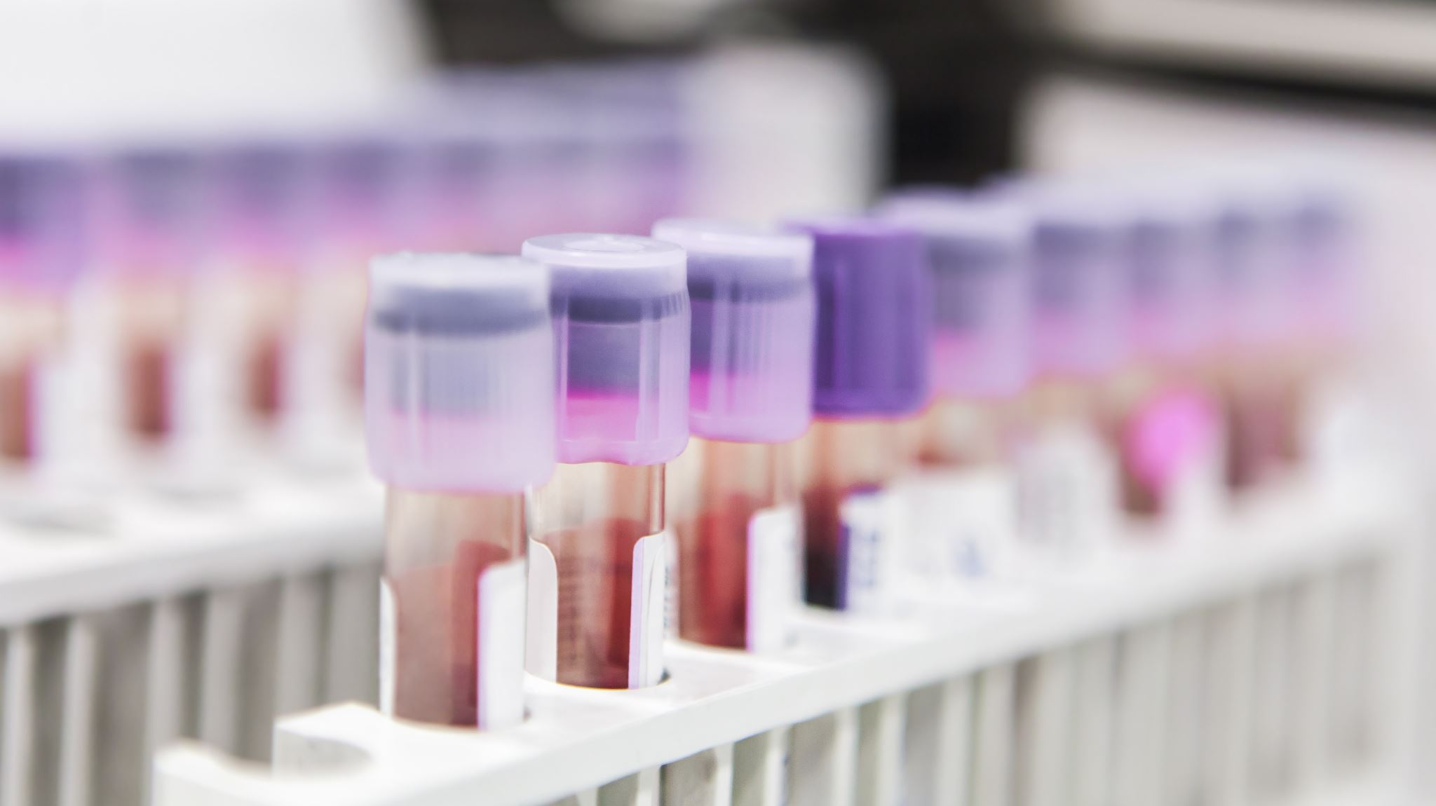
Open vial policy, VVM and shake test

Slide 28

Thank you

