Slide 1
DIABETES

Slide 2
Contents ….
Definition & Types
Problem statement (World, India, Economic Impact)
Risk factor (Agent, Host, Environment) & Risk assessment
Clinical features
Goals for management, Screening, Investigations & Diagnostic criteria
Life style modification (Diet, Physical activity)
OHA & Insulin
Complications & its management & assos conditions

Slide 3
DIABETES
Heterogenous group of disesease
Syndrome of multiple etiologies
Characterized – chronic hyperglycaemia
Disturbances - Carbohydrate, Fat and Protein metabolism
Resulting from defects in insulin secretion, action or both.
Associated with long term complications, involving organs like eyes, kidneys, nerves, heart and blood vessels
1 of 4priority NCDs targeted

Slide 4
TYPES
TYPE 1
Insulin-dependent, juvenile or childhood-onset
TYPE 2
Non-insulin-dependent or adult-onset diabetes
Gestational diabetes
Monogenic diabetes, pancreatic diabetes, drug-induced
Others
IFG, IGT
MRDM (malnutrition related) -WHO
(American Diabetes Association and the World Health Organisation, diabetes can be classiﬁed into four)
MODY- Maturity onset Diabetes of Young
Partial failure / damage to beta cells

Slide 5
Problem statement - World
NCDs -70% of all deaths worldwide, 3/4 in low- and middle-income countries.
Prevalence of DM & CHD - urban > rural
8th leading cause of death.
46% - unaware that they have DM (24-62%)
1/7 -births affected by GDM
Notes:
(CDCS & chronic lung disease)..108 million in 1980

Slide 6
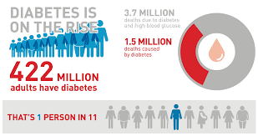
Global prevalence 8.5% -2014
6/10 – DM by 2040

Slide 7
Problem statement - India
Second largest number of people with diabetes in the world.
NCD- 42% deaths in India.
Prevalence of DM – 62.47/1000 population.
The IDF estimates –72.9 million people with DM in India in 2017
The prevalence of diabetes in urban India has increased from 2% in the 1970s to over 20% at present and the rural areas are also fast catching up.
Delhi - 29.8 lakh people
Notes:
Diabetic foundation of india - aiims

Slide 8
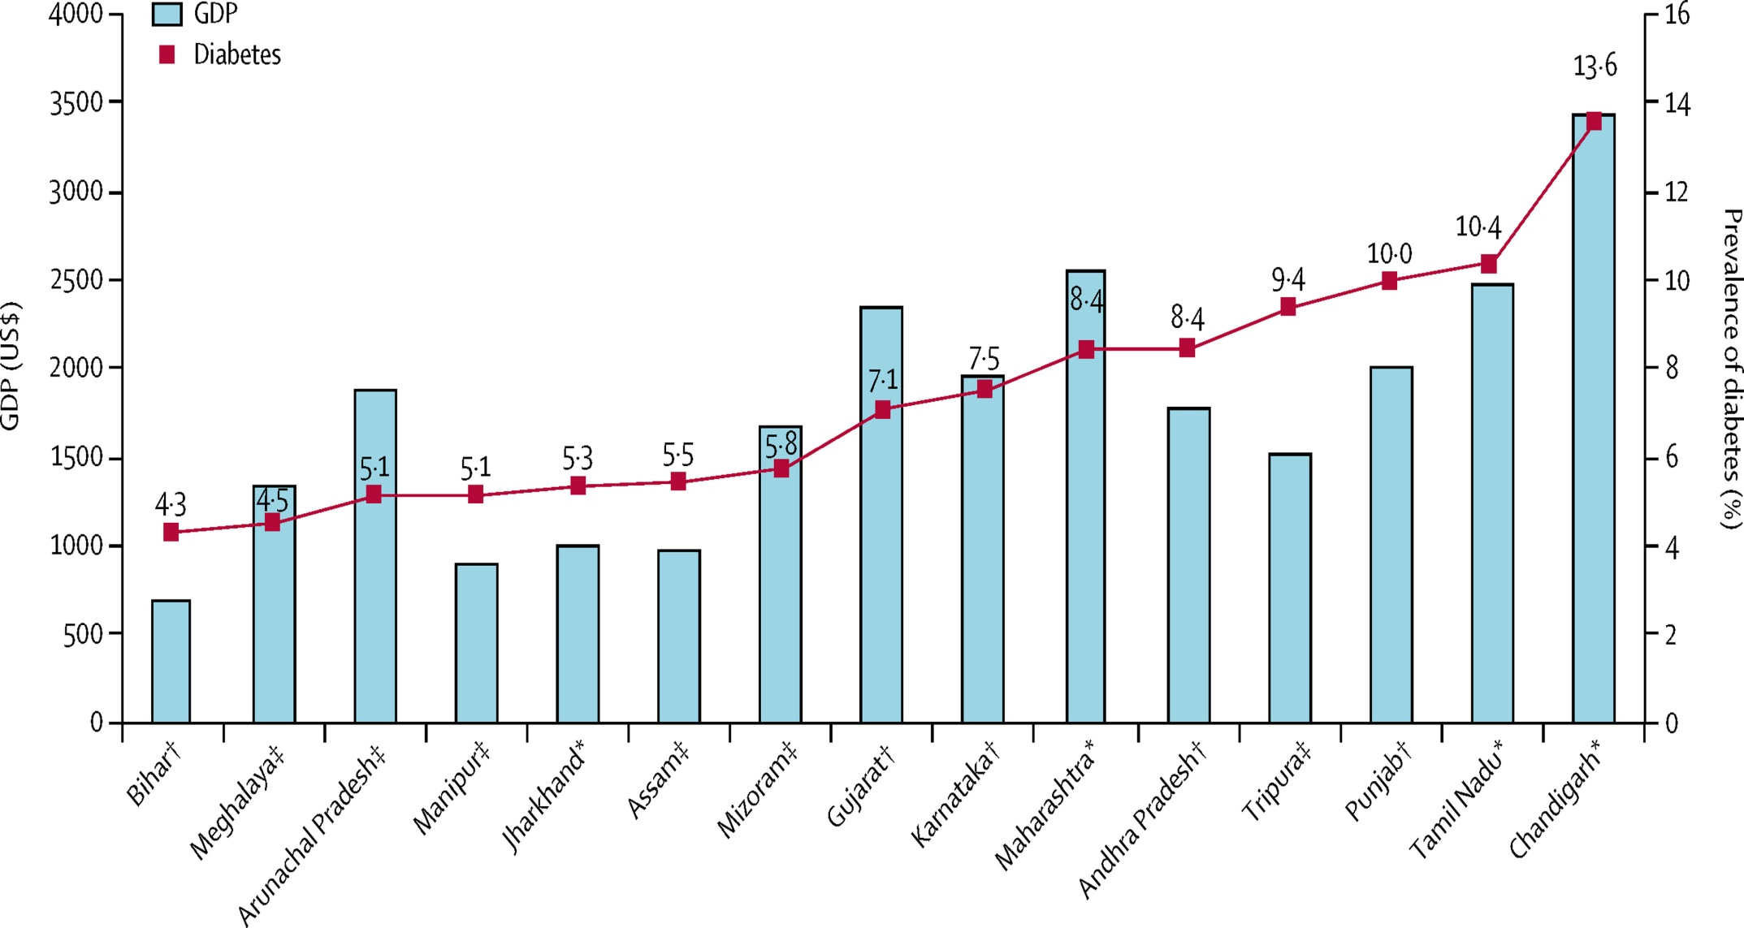
DM prevalence in Indian states
Adults >20 years
Notes:
ICMR INDIAB STUDY 14 STATES 1 UT

Slide 9
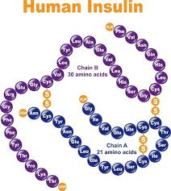
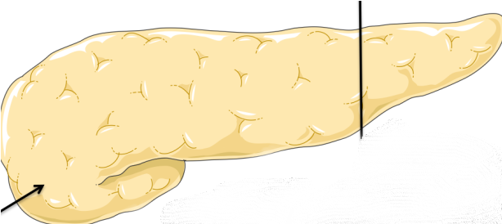
Agent
Structural defect / Diseased
Destruction of beta cells
Viral infec-Rubella, Mumps, Coxakie B4
Auto antibodies
Genetic defects –
Structure/ function of Insulin
Auto ab against insulin
Dec insulin senstivity at receptors

Slide 10

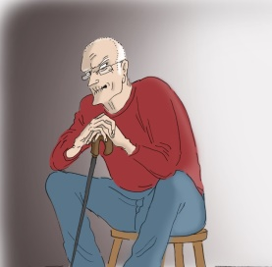
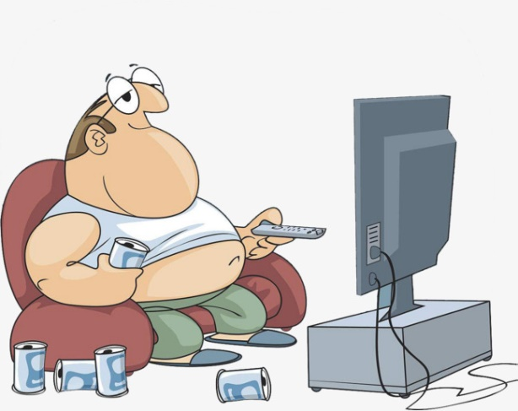

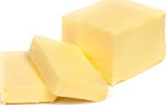
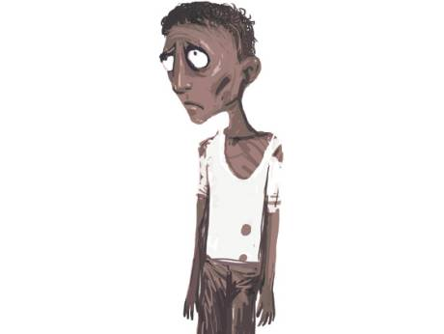

Host factors
Age
Obesity
Heavy smokers Risk -elevated for about 10 years after cessation
Sex
equal in western world,
SEAR – inc in males
Saturated fat (butter, ghee and hydrogenated fats) and cholesterol (red meat, eggs, organ meat).
Dec insulin receptors on target cells
Physical inactivity + Junk food
Genetic
Identical twins 90% Type 2
Malnutrition
Deficiency: Chromim , Cu, Zn
IUGR children with rapid catch up growth
Notes:
FIND OUT HOW MUCH EACH FAC CONTRIBUTEs Obesity - strongest risk factor (1 /3 - overweight & 1 / 10 - obese in 2014 )
- Over-feeding during infancy, childhood and adolescence. Familial obesity. BMI (children) -85 to<95th percentile – overweight >95th percentile – obesity
WC- >90 cm M, >80 cm F

Slide 11
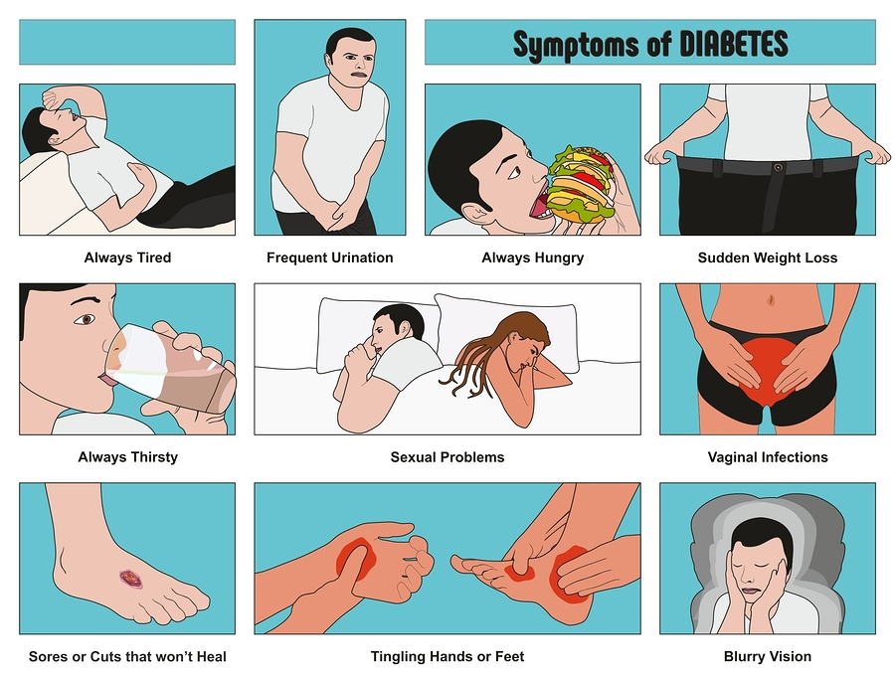
Clinical features
1/5 – can recognise features. (F>M)
Many will have no symptoms.
38%
81%
43%
31%
70%
67%
Notes:
Insulin- protein synthesis Osmotic symptoms Recurrent urogenital infections/ vulvo vaginal candidiasis Generalised pruritus

Slide 12
CONTROL & MANGEMENT
Primordial
Prevent the risk factors for diabetes
LSM
Primary
Stage of prediabetes/ RF+ to prevent the onset of diabetes.
Regular health check up, Life style Modification
Secondary
Prevent onset of complications in already diagnosed DM
Screening, Diet, physical activity(LSM ) & OHA / Insulin
Tertiary
Developed diabetic complication
Evidence-based, Affordable, Cost-effective,Population-wide & Multisectoral Interventions.

Slide 13
Goals For Management
Glycaemic control
Prevention of acute & chronic complications.
Relief from symptoms of diabetes and improvement in quality of life.
Identify & manage comorbidities (obesity, HT and dyslipidaemia )
Prevent infections.
Advise behavioural changes for: optimal physical activity, smoking, tobacco, alcohol & stress.
WHO – Diabetes 0% rise by 2025

Slide 14
POPULATION-BASED PREVENTION
Strong indications – Population based programmes aimed at Modifiable Risk Factors can reduce the incidence of diabetes.
e.g Population-based data from Cuba show a fall in type 2 diabetes during a period of economic crisis when the population experienced a reduction in calorie intake and a simultaneous increase in physical activity.
Notes:
No direct evidence

Slide 15
How to screen
Screening - OGTT (75 gm glucose) or RBS.
HbA1c is also recommended for screening; (India limitations).
Normal glucose tolerance - after 3 years.
Prediabetes - Annually.
SCREENING FOR ALL
No evidence of benefit
No system should be established without consideration of whether local health-care resources are sufficient to cope with this extra workload.

Slide 16
Whom to screen
*Family history of diabetes
Overweight/obese (BMI /WC)
*H/o HT (≥130/80 mmHg)
*History of dyslipidaemia
Sedentary physical activity
History of GDM or birth to macrosomia child (BW > 3.5 kg)
H/o CVD / Cerebrovascular disease
<18 yrs if, obese + *

Slide 17
OGTT
On normal diet (at least 200 g carb/ day) - at least 3 days before the test.
Overnight fast - 8-10 hours
Two blood samples: Fasting and 2 hours after glucose load.
Glucose load - 75 g of glucose (1.75 g/ kg BW for children, max 75 g) - in at least 250 ml of water.
Drunk within 5 minutes.
The second sample -2 hours after the glucose load.
Should be resting and refrain from smoking in between the two sample.
Notes:
75 G anhydrous GLUCOSE = 82.5 G ORAL GLUCOSE

Slide 18
HbA1c
Directly proportional to blood glucose concentration
HbA1c >7
Irreversible bond with Hb
Destroyed only at death of RBC (life cycle of RBC - 120 days)

Slide 19
Diagnostic criteria
 | NORMOGLYCEMIA | PREDIABETES | DIABETES
FPG (mg/dl) | < 110 | 110-125 (IFG) | ≥126
2-h PG (mg/dl) | <140 | 140-199 (IGT) | ≥ 200
HbA1c | <5.7% | 5.7-6.4% | ≥ 6.5%
Random plasma glucose (mg/dl) |  |  | ≥ 200

Slide 20
LIFE STYLE MODIFICATION
1. TOBACCO: Quit smoking and tobacco chewing .
2. STRESS: Do meditation, yoga, long outdoor walk, exercise & hobbies ( reading, gardening, painting etc)
3. DIET & ALCOHOL
4. PHYSICAL ACTIVITY
5. DIABETES EDUCATION
In-depth information about diabetes (complications & treatment)
Appropriate self care & monitoring skills
Awareness of resources for self care
Notes:
Who 3 pillars – to prevent 80% of DM…. Stress management is essential
WHO TARGETS – 10% REDUCTION IN PHYSICAL INACTIVITY, TOBACCO USE DEC 30 % IN DIET SALT INTAKE DEC 30%, ALCOHOL 10% REDUC

Slide 21
TO AVOID
TO ADD
Small meals at regular frequent interval.
Plant foods – complex carbohydrates & fibre- dec Blood glucose, cholesterol &Triglyceride
Plenty of fruits & vegetables - satiety & micronutrients.
Fibre – increase transit time of food
Whole grains and nuts.
Refined carbohydrates - fast absorption of glucose
Sugar, salt, sugary soft drinks and alcohol.
Limit fat intake and shift from saturated to unsaturated fats. Trans-fat rich foods (vanaspati , bakery products and sweets).

Slide 22
DIABETIC DIET
Optimum nutrition - Energy balance, WFH , normal growth & development
(severe fasting – don’t )
25 kcals/kg ideal body weight/day - moderately active patient with diabetes.
The change in the daily calorie should not be more than 500 calories/day (gradual)
Complex Carbohydrates . Manage total carbohydrate.
3 main meals and 1-2 snacks
FIBRE
40 g/day (2000 Kcals).
PROTEINS
12-15 %. Supplementing cereal and pulse (4:1 ratio) - protein quality & satiety.
Notes:
Obese inactive, sedentary men/women - 20 kcal/kg of present weight
Normal BMI, sedentary men/women - 22 – 25 kcal/kg
Normal BMI, active men/women - 30 kcal/kg
Thin/Very active - 40 kcal/kg
Salt who target – 30% dc.. Protein 12% of total energy

Slide 23
TREATMENT
SULFONYLUREAS
All SU cause weight gain & hypoglycaemia, least with Glipizide and Gliclazide.
1ST gen drug | Duration of action | Side effects
Chlorpropomide | 36 – 60 hr | Cholestatic jaundice Disulfiram like action Dilutional hyponatremia
Tolbutamide | 6-12 hr | Hypothyroid (iodine uptake inhibitor)
2nd gen drug | Features
Glibenclamide | Oral safe in pregnancy
Glicazide | Anti platelet action
Glimepiride- (M.C) | Preferred drug in angina (all others cause vasoconstriction)
Min-max dose: 1 – 8g
Dosing: Single
Action : 16 – 24
Excretion : Urine (60%) Bile (40%)

Slide 24
1 BIGUANIDES
DOC
T2DM with obesity
PCOS
Drug | Min Dose | Max Dose | Action | Excretion
Metformin | 250 mg | 2500 mg | 4-8 hr | Urine
Metformin SR | 500 mg | 2500 mg | 18-24 hr | Urine
ACTION
No action on beta cells
Act on liver- Inhibit gluconeogenesis & glycogenolysis
(not much hypoglycemic effect)
Inhibit Intestinal absorption of glucose hexose
Stimulates glucose utilization
Control macro vascular complications
S.E
Anemia
(inh vit B12 absorption)
Excreted in kidney
Radiocontrast study- stop 1 day before & after study.
C/I in RENAL failure
Notes:
Penformin

Slide 25
MEGLITINIDE
Onset : Rapid
Action : Short
Use :Treat post prandial hyperglycaemia
Adv : Safe in renal failure (expt- glyburide)
ALPHA GLUCOSIDASE INHIBITOR
Action : In Intestine , Dec glucose absorption
Use: Dec PP Hyperglycemia,
Treat Pre Diabetic (also if F/h/o +)
S.E – Flatulence, Gaseous Distension, Diarrhoea
C/I: IBD
Drugs: Acarbose, Voglibose
Min- max dose: 0.2 - 0.9 Dose: 1- 3
Action :1 - 1.5
Excretion :Urine (5%), Faeces (95%)

Slide 26
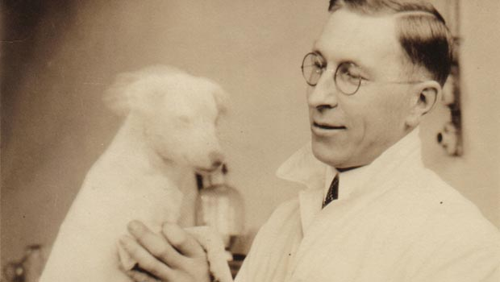
INSULIN
Fredrick Banting (Nobel prize) – 1920 Insulin
Max dec in HbA1c
S.E- Hypoglycaemia
Weight gain ( well correlated with the total daily dose of insulin).

Slide 27
INDICATION IN TYPE 2
At diagnosis:
Symptomatic hyperglycaemia – LOW, Polyuria, Polydipsia, Polyphagia
Fasting > 270 mg/dl or HbA1c >9%
Severe infections
Presence of ketosis
Other situations :
Not responding to optimal doses / Intolerant / C/I to OHA.
Acute hyperglycaemia/ DKA/ HHS / Lactic acidosis.
Stress – Acute MI, Stroke, Acute infections, TB, Trauma & hospitalisation.
Pregnancy and lactation.
Peri-operative state.
Hepatic and Renal failure / transplantation.

Slide 28
Ultra short acting Onset :10-20 min Action : 3-4 hr | Lispro | Treat PP Hyperglycemia Premixed Insulin –Lispro + Aspart Co-formulation –IDegAsp (70/30)
 | Aspart
 | Glulysine
Short acting Onset : 30 min Action: 5-6hr | Regular insulin* | S.C I.V –DKA, ↑K⁺ , Hyperosmolar coma
 | Semi Lente
Intermediate | Lente | Semi + ultra Lente Mixtard – 30:70 50:50
 | NPH isophane*
Longer acting | Ultra lente, Detemer, Glargine Degludec | Sustained, peakless, no sudden hypoglycemia Act in acidic ph 48 hr (3 dose / wk)
Inhaled Insulin | Exubera Affrezza | Dec bioavailability, COPD , Bronchospasm , Bronchogenic ca
Notes:
– neutral protamine Hagedorn (NPH)
Premixed- mixtures of regular and NPH insulin in 25/75, 30/70, 50/50 proportion
Regular insulin 30min onset of action – so given 30 min b4 food
All insulin act in neutral ph except glargine- so cant be mixed with any

