Slide 1
Minerals

Slide 2

Introduction
More than 50 chemical elements are found in the human body, which
are required for growth, repair and regulation of vital body functions.
Minerals can be categorized into 3 groups:
Major minerals
Tface minerals
Trace contaminants without known function: Lead, mercury, boron, and aluminum

Slide 3
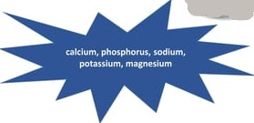
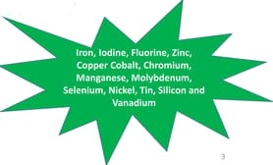

Introduction
Major Minerals
° Also known as Macro-minerals
They are vita! tD health
Required in the diet by more than 100mg per day
Trace Minerals
° Also Known as Micro-minerals
They are Vital to health
Required less than 20mcg per day

Slide 4

Function of Minerals
° As Constituents of bones and teeth: Ca, P, Mg
° As Constituents of soft tissues (liver): P
As soluble salts that give to body fluid and cell content, their composition and Stability that are essential for life— Na, K, Cl, P
Specific functions:
Formation of Haemoglobin- Fe
Formation of thyroxine- Iodine
Constitution of enzymes and hormones: Zn in Carbonic Anhydrase and Insulin
Cobalt- constituent of Vit-B12

Slide 5
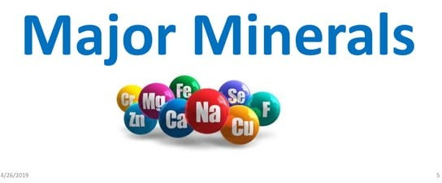


Slide 6

Calcium
Macro-mineral
Constitutes 1.5-2% of the body weight of an adult human.
An average adult body contains about 1200 gm of calcium of which
>98% present in bones.
Calcium in blood: 10 mg
The developing fetus requires about 30 g of calcium.
° Severe Sweating— loss of 42-121mg/day

Slide 7

Calcium- Absorption
Vitamin D crucial for absorption.
Diet: Some substances hinder absorption.
Calcium source affects absorption rate.
Age impacts absorption efficiency.
Hormones regulate absorption.
Calcium-binding proteins facilitate transport.
Stomach acid needed for breakdown.
Certain meds may affect absorption.
Exercise enhances absorption.
Medical conditions can impair absorption

Slide 8
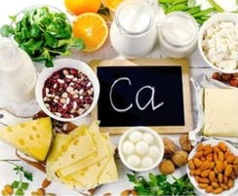

Calcium-Sources
Milk and milk Products
Cow mllk- 1200mg
Human Milk- 300mg
Egg and Fish
° Cheapest dietary sources:
Green leafy vegetables (presence of oxalates
Cereals (bioavailability reduces by Phytate)
Water- 200mg/day

Slide 9
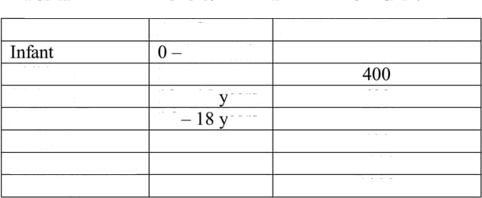

Calcium-Requirement
ICMR recommended dietary allowances for Calcium
Age Group
12 months I — 9 years
RDA for calcium ing/day 500
Children Children Adolesent Adult
Pregnant women
10 — 15 ears
16 ears
600
500
400
1000
1000

Slide 10

Calcium- Function
Bone formation
Teeth Formation: formation of dentin and enamel
Physiological Process.
Essential for the clotting of blood as it is required for prothrombin activation
Regulates the permeability of the capillary walls and ion transport across the cell membranes
Contraction of the heart and skeletal muscle
Reg dates the excitability of the nerve fibres
Acts as an activator for enzymes such as rennin and pancreatic lipase

Slide 11

Calcium- Disorder
Calcium Deficiency
Effects in Adults:
Osteoporosis
Effects in Children:
Decreased rate of growth
Loss of Calcium from Bone leading to development of Osteoporosis
Hyperplasia of parathyroid gland
Hyper-irritability and tetany leading to death

Slide 12

Calcium- Treatment
° Giving diet containing 1-1.5gm calcium along with 400-800IU Vit D

Slide 13

Phosphorus
Phosphorus makes up about 0.65—1.1% of the adult body 1-600 g)
85%-Bones and teeth, 15%- soft tissue
Exist in 2 forms:
As Inorganic salts :
Calcium Phosphates in Bones and teeth
Phosphates of Na and K in soft tissues
In combination with organic compounds
Phospholipids-lecithin, Cephalin
Nucleoproteins and Nucleic Acids
Creatine Phosphates-ATP, ADP, NADP
Hexose Phosphates etc

Slide 14




Phosphorus-Sources
Important sources: Milk, Egg, Meat, Fish
Fair sources: vegetables
Cereals, Pulses, nuts and Oil seed contains Phytic acid or phytin
Phytic acid is the compound of inositol and phosphoric acid
Only 40-50% available for body
Phosphorus

Slide 15

Phosphorus-Requirement
Phosphorus requirements have not been specifically considered by FAO/WHO Committees

Slide 16

Phosphorus- Function
Bone and Teeth Formation: formation of dent in and enamel
° Required for formation of Phospholipids—integral part of cell structure, act as intermediate in fat transport and metabolism
Required for carbohydrate metabolism— Glycogen phosphorylation by inorganic phosphorus
Required for fa rmation of nucleic acid

Slide 17

Magnesium
Adult human body contains 25gm of Mg
- 50% present in bones in combination with Phosphorus and carbDnate

Slide 18

Magnesium- Absorption
° Average diet contains 300-400mg of magnesium
° 40-50% not absorbed
1/5 th Magnesium is excreted in urine

Slide 19

Magnesium-Requirement
° Adult: 200-300mg/day
° Older Children: 150-200mg/day
Infants and pre-school Children: 100-150mg/day

Slide 20

Magnesium- Disorder
Magnesium Deficiency:
It is characterized by Muscular weakness, vertigo and liability to convulsion, irritability, tetany, hyper-reflexia and occasionally hypo-reflexia
It is seen in Chronic alcoholics, liver cirrhosis, PEM, mal -absorbtion syndrome and toxemias of Pregnancy
Treatment:
Administration of Magnesium salts( 100mg MgCl) within 4 hours

Slide 21

Sodium
The adult human body contains about 100 g of sodium ion.
Sodium is lost from the body through urine and sweat4 that passed out in urine is regulated by the kidney but that lost by sweating is not controlled.
Depletion of NaCI causes muscular cramps.
The requirement of sodium chloride depends upon climate, occupation
and physical activity.
Adult requirement is about 5 gm per day.

Slide 22

Potassium
The adult human body contains about 250 g of potassium.
Potassium is vasoactive , increases blood flow and sustains metabolic
needs of the tissue.
Potassium supplements lower blood pressure, although the response is
slow.
High dietary sodium, low dietary potassium have been implicated in the aetiology of hypertension as evidenced by epidemiological clinical studies
The ideel desirable sodium : potassium ratio in the diet is 1:1 (in mmol).

Slide 23
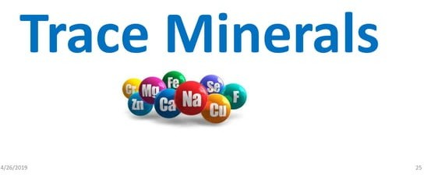


Slide 24

Iron
° The adult human body Contains between 3-4 g of iron, of which about 60-70 per cent is present in the blond (Hb iron) as circulating iron, and the rest (1 to 1.5 g) as storage iron.
° Each gram of hemoglobin contains about 3.34 mg of iron.

Slide 25

Iron- Absorption
° Iron ingested is converted to Ferrous (absorbable) form by the help of reducing substances.
° Absorption takes place from Duodenum and upper jejunum
Absorption affected by:
Whether it is Haeme Fe or Non haem
Presence of Vit-C— Increases be absorption
° Phytate, Oxalates— reduces Fe absorption

Slide 26

Iron-Requirement
Ifon Intake Recommended (RDA in mg per day) [New Guidelines]
Adult males Adult femeB
17
21
Pregnant
21
S 32
Infant
6 — 12 rronths
!Boys 13 - 15 years Girls 15 — 1ti years Boys 16 — \6 years Girls 16 - 16 years
28

Slide 27

Iron-Function
Biological importance-
Iron porphyrin (Eleme] compeunds- Haemoglobìn, Myoglobin
ENZYMES- Mitochondrial cytochromes, Microsomal cytochrome,
catalase, peroxidase
Transport and storage form- Transferrin , Ferritin, Hemosiderin

Slide 28

Iron-Sources
2 sources:
Heme sources— liver, meat, poultry and fish
Non-Heme Source- vegetable origin, e.g., cereals, green leafy vegetables, legumes, nuts, jaggery and dried fruits.
Fortified foods: Salts(India, Thailand), flour(US, Sweden, UK)

Slide 29

Iron-Disorder
° Excess Iron
Siderosis- Iron is stored in the hemosiderin - not available form
Haemochromatosis— Excess iron is absorbed from intestine and deposited in liver, spleen, pancreas, skin- leading to diabetes, liver cirrhosis, skin discoloration
Iron Deficiency

Slide 30

Iron-Disorder
° Iron deficiency Anemia
Characterized by low oxygen Carryi ng power and low Hb content in blood( 5- 9gm/100ml hlood)
Women of Child bearing age- CLINICAL FEATURE- Fatigue, lassitude, pallor
skin, giddiness
Weaned infant and young children— there is tendency of children below 3 to eat mud
Treatment:
Anemic women: Ferrous tablet (0.2g x3 times a day
Children below 12 months: 0. 2g ferrous ammonium citrate+glycerin x3times

Slide 31

Iodine
° Essential trace element
° The adult human body contains about 50 mg of iodine, and the blood level is about 8-12mg/dl

Slide 32

Iodine- Absorption
Takes place in intestine
Goitrogens interfere its absorption and utilization of Iodine— may lead
to Goiter
Goitrogens containing foods are- Cabbage, Cauliflower, Yarn

Slide 33

Iodine-Function
Constituent of T3 and T4—
Required for growth and development
Stimulate enzyme synthesis, oxygen consumption and basal metabolic rate and, thereby, affect the heart rate, respiratory rate, mobilization, and metabo|ism of carbohyd rates, lipogenesis

Slide 34
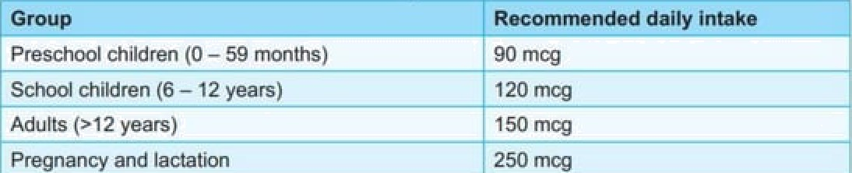

Iodine-Requirement
'. ..... ....... . ....
Preschool children (0 - 59 months)
Sckod children (6 - 12 years)
Adull6 (s12 yeer6)
Pregnency and IgcteLion
..
90 mcg
120 m‹g
150 mcg
250 mog

Slide 35

Iodine-Sources
The best sources of iodine are sea foods (e.g., sea fish,
sea salt) and cod liver oil
° Smaller amounts occur in other foods, e.g., milk, meat, vegetables, cereals,
etc.
The iodine content of fresh water is small and very variab Ie, about 1-50 micrograms/L
About 90 per cent of iodine comes from foods eaten; the
remainder from drinking water.
° Fortified Salts— lodiled salts (prophylactic) [iodized bread, iodized oil]
50 ppm at production level
30 ppm in retailer level
15 ppm at consumer level

Slide 36

Iodine-Disorder
Excess Iodine Thyrotoxicosis
It may result from prophylaxis
iodine induced thyrotoxicosis affecting mainly elderly who lived most of their life in iodine deficient area and who have had goiter for long duration

Slide 37

Iodine-Disorder
lodine Deficiency:
Simple goitre
Myxoedema— Progressive destruction of epithelial Elements by overgrowth of non- cellular component and formation of cyst and large colloid spaces — reducing gland efficiency

Slide 38
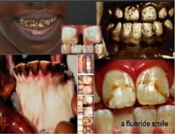

Flourine
96% of the fluoride in the body is found in bones and teeth
Required for mineralization of bones and enamel formation
Sources: Water (major sources), Food (sea fish, cheese, tea)
Require ment: 0.5-0.8 mg/L
Fluorine is often called a two-edged sword
Excess dental and skeletal fluorosis
Deficien cy- Dental caries

Slide 39
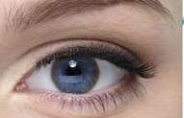

Copper
Adult body is contains about 100-150 mg Cu.
Blood Contains: 0.11gmg/100ml
Required for bone development, Elastin formation, cytochrome
oxidase function, Iron absorption, tyrosinase (melanin formation)
Deficiency-Cardiac Hypertrophy, Aortic Aneurysm, Cerebral Demyelination, Ataxia, impaired bone formation
Excess absorption: Copper is deposited in brain, descendent membrane of eyes (Kayser-Feisher ring) , liver, kidney and damaged them.
Cu requirement for adults: 2.0 mg per day.

Slide 40

Zinc
Component of >300 enzymes.
It is active in the metabolism of glucides and proteins
Required for the synthesis of insulin by the pancreas and for the immunity
function.
Zinc is present in small amounts in all tissues.
' The average adult body contains 1.4 to 2.3 g of zinc.
Zinc deficiency has been reported to result in growth failure and sexual
infantilism in adolescents, and in loss of taste and delayed wound healing
There are also reports of low circulating zinc levels in clinical disorders such as liver disease, pernicious anemia and myocardial infarction.

Slide 41
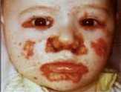

Zinc
Zn deficiency
is common in children from developing countries due to
lack of intake of animal food
high dietary phytate content
inadequate food intake
increased faecal losses during diarrhoea.
Zinc supplementation in combination with oral rehydration therapy has been shown to significantly reduce the duration and severity of acute and persistent diarrhoea
Acrodermatitis enteropathies (AE)
Loss of taste Acuity(hypogeusia)
Retardation pf growth and Genital development

Slide 42

Zinc
° Excess Zn
High Zn intake interferes with utilization and retention of Cu and thus
cause anemia
Zn Requirement: Infants: 3-5mg, Children: 10mg, Adolescent/Adult: 15mg pregnancy: 20mg, Lactation: 25mg

Slide 43

Other traces minerals
° Cobalt
° a part of the vitamin B12 molecule
No evidence of its deficiency
Recently cobalt deficiency and cobalt iodine ratio in the soil have
shown to produce goiter in humans.
Selenium
The first report that selenium deficiency may occur in man appeared in 1961, and a similar report in 1967.
° Deficiency:-3'protein-energy malnutrition

Slide 44

Other traces minerals
Molybdenum:
° Excess absorption of molybdenum has been shown to produce bony deformities.
On the other hand, deficiency of
molybdenum is associated with mouth and oesophageal cancer
Chromium
° Total body content of chromium is small, less then 6 mg A
Role in relation to carbohydrate and insulin function

Slide 45


