Slide 1

Nutrition

Slide 2
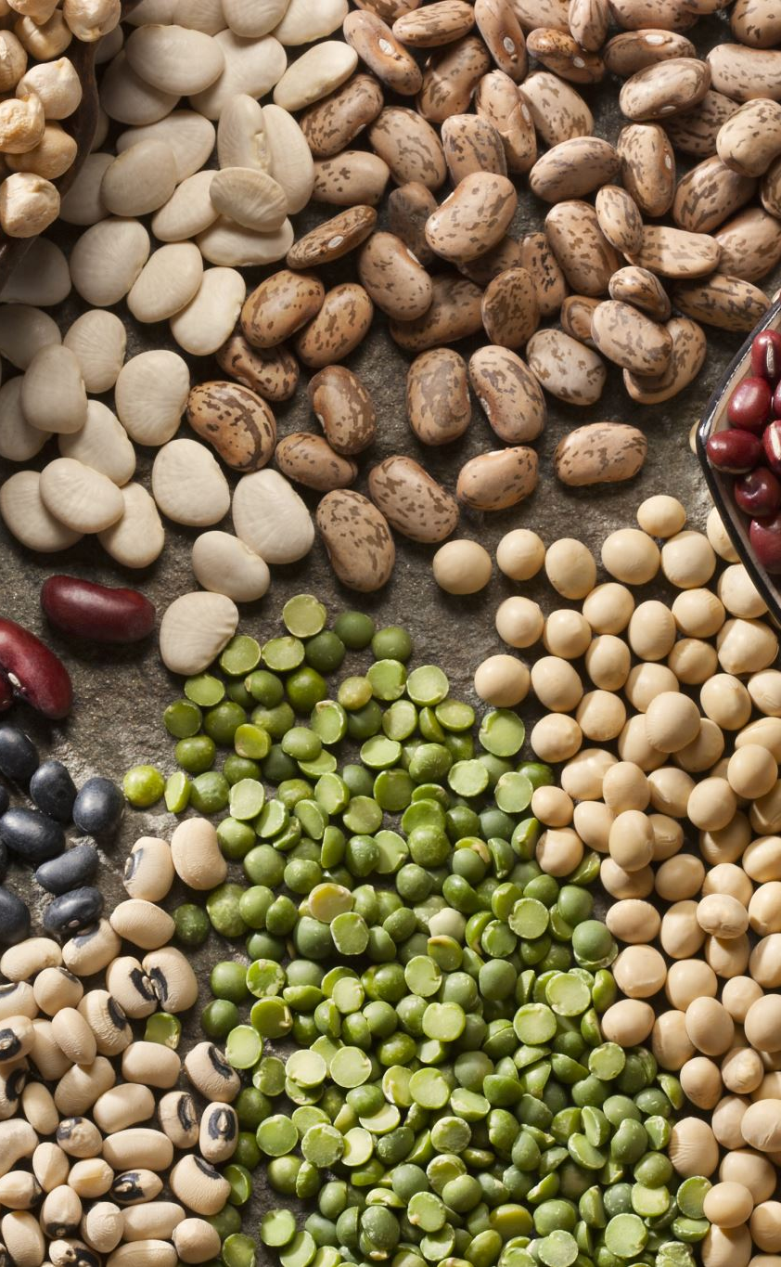
Nutrients
Nutrients are organic and inorganic complexes contained in food. There are about 50 different nutrients which are normally supplied through the foods we eat. Each nutrient has specific functions in the body. Most natural foods contain more than one nutrient.
Macronutrients : These are proteins, fats and carbohydrates which are often called “proximate principles because they form the main bulk of food. In the Indian dietary, they contribute to the total energy intake in the following proportions.
Proteins: 10 to 15 percent
Fats: 15 to 30 per cent
Carbohydrates: 50 to 80 per cent
Micronutrients : These are vitamins and minerals.
They are called micronutrients because they are required in small amounts which may vary from a fraction of a milligram to several grams.

Slide 3
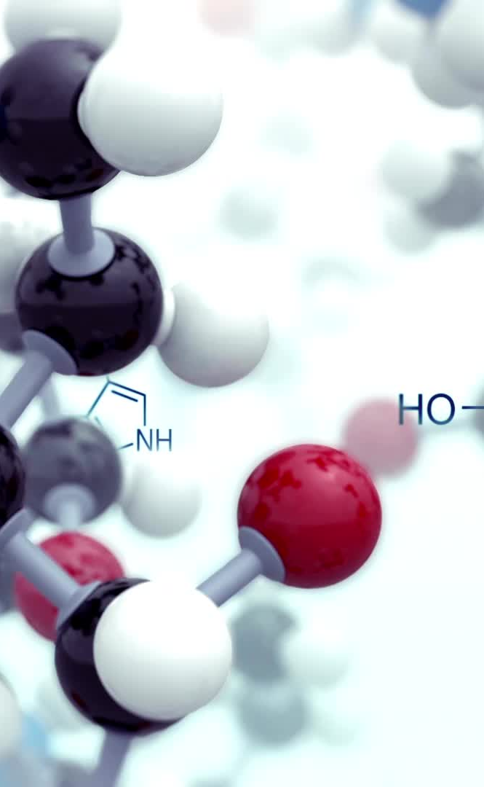
Proteins
Proteins are complex organic nitrogenous compounds.
They are composed of carbon, hydrogen, oxygen, nitrogen and Sulphur in varying amounts. Some proteins also contain phosphorus and iron and occasionally other elements.
Proteins differ from carbohydrates and fats in that they contain nitrogen, this usually amounts to about 16 per cent.
Proteins constitute about 20 per cent of the body weight in an adult.
The Indian Council of Medical Research in 2020 recommended 0.83 g protein/kg body weight per day as a safe intake for an Indian adult, assuming a median obligatory nitrogen loss of 48 mg/kg body weight.

Slide 4
Essential amino acids
Some 20 amino acids are stated to be needed by the human body, of which 9 are called “essential” because the body cannot synthesize them in amounts corresponding to its needs, and therefore, they must be obtained from dietary proteins.
They are : leucine, isoleucine, lysine, methionine, phenylalanine, threonine, valine, tryptophan and histidine.
Some of the essential amino acids have important biological functions, e.g., formation of niacin from tryptophan; the action of methionine as a donor of methyl groups for the synthesis of choline, folates and nucleic acids.
A protein is said to be “biologically complete” if it contains all the EAA in amounts corresponding to human needs.

Slide 5
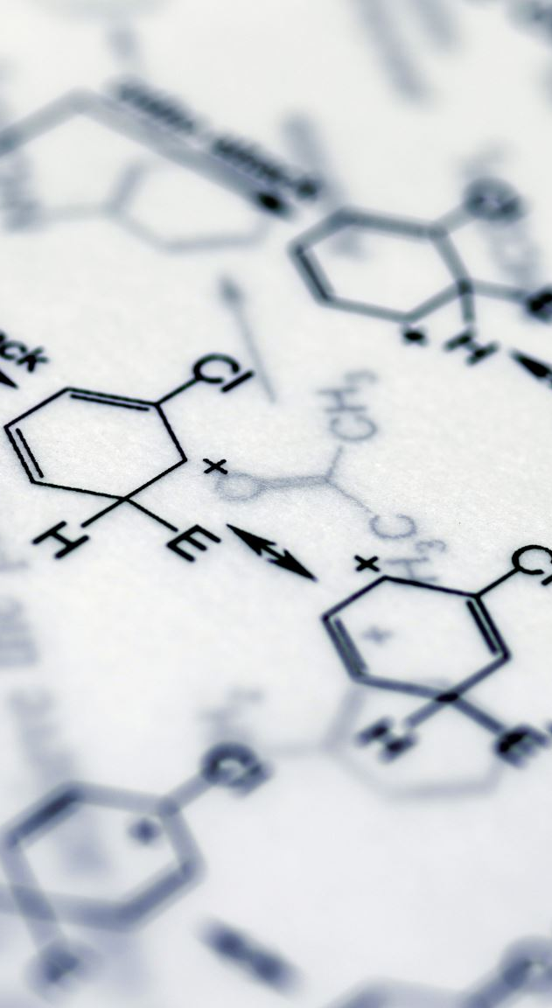
Functions
Body building, - this component is small compared with the maintenance component, except in the very young child and infant
Repair and maintenance of body tissues
Maintenance of osmotic pressure;
Synthesis of certain substances like antibodies, plasma proteins, haemoglobin, enzymes, hormones and coagulation factors.
The cell mediated immune response and the bactericidal activity of leucocyte have been found to be lowered in severe forms of protein energy malnutrition.
Proteins can also supply energy (4 kcal per one gram) when the calorie intake is inadequate, but this is not their primary function. It is considered wasteful if proteins were used for such a purpose.

Slide 6
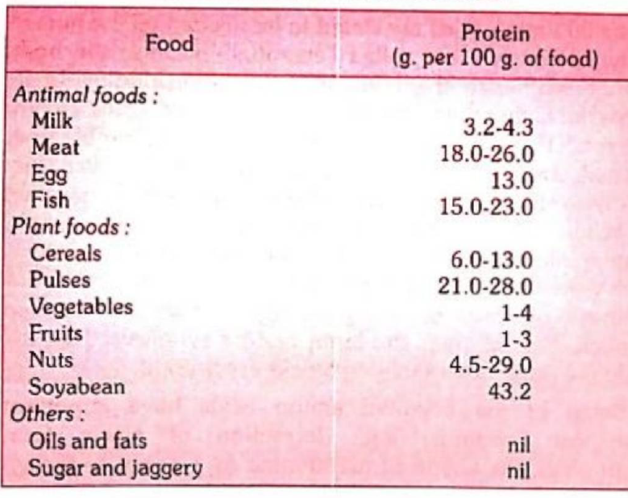
Sources
Egg proteins are considered to be the best among food proteins because of their high biological value and digestibility. They are used in nutrition studies as a “reference protein”.
Vegetable proteins are found in pulses (legumes), cereals, beans, nuts, oil-seed cakes, etc. They are poor in EAA. In developing countries such as India, cereals and pulses are the main sources of dietary protein because they are cheap, easily available and consumed in bulk

Slide 7
Supplementary action
Man derives protein not from a single source, but from a variety of food sources, animal and vegetable.
Cereal proteins are deficient in lysine and threonine; and pulse proteins in methionine. These are known as “limiting” amino acids.
When two or more of vegetarian foods are eaten together (as for example, rice-dhal combination in India) their proteins supplement one another and provide a protein comparable to animal protein in respect of EAA.
This is known as supplementary action of proteins, and is the basis of counselling people to eat mixed diets.

Slide 8

Protein metabolism
Proteins are not stored in the human body in the way that energy is stored in adipose tissue, they have to be replaced every day.
The body proteins are constantly being broken down into their constituent amino acids and then reused for protein synthesis.
The rates of turnover vary from tissue to tissue. The reutilization of amino acids is a major contributory factor to the economy of protein metabolism.
The overall rate of turnover in adult man is equivalent to replacement between 1-2 per cent of body protein each day.
It is not only the amount of protein that is maintained constant, but also the pattern of specific protein in body.
For maximum utilization of dietary proteins, the calorie intake should be adequate.

Slide 9
Evaluation and assessment
The parameters used for evaluation include the estimation of the biological value, digestibility coefficient, protein efficiency ratio and net protein utilization.
The net protein utilization (NPU) is considered of more practical value because it is the product of biological value and digestibility coefficient divided by 100. In exact terms, it is the “proportion of ingested protein that is retained in the body under specified conditions for the maintenance and/or growth of the tissues.
A battery of tests have been suggested to assess the state of protein nutrition.
These include : arm muscle circumference, the creatinine - height index, serum albumin and transferrin, total body nitrogen, etc.
At the present time the best measure of the state of protein nutrition is probably serum albumin concentration. It should be more than 3.5 g/dl, a level of 3.5 g/dl is considered mild degree of malnutrition; a level of 3.0 g/dl severe malnutrition.
Serum albumin and transferrin assess the ability of the liver to synthesize proteins.

Slide 10
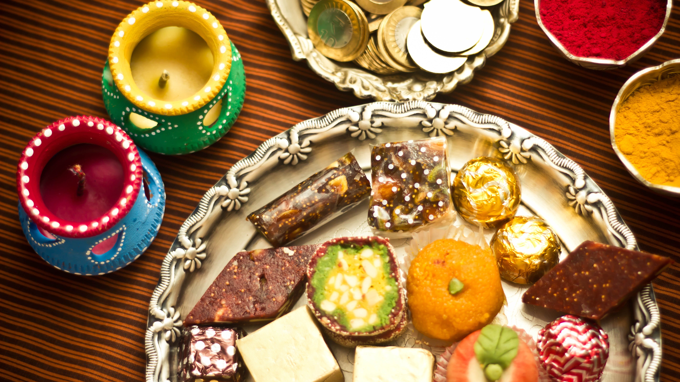
FATS

Slide 11
Fats
Fats are solid at 20 deg. C; they are called “oils” if they are liquid at that temperature.
Fats and oils are concentrated sources of energy.
They are classified as :
Simple lipids, e.g., triglycerides
Compound lipids, e.g., phospholipids
Derived lipids, e.g., cholesterol
The human body can synthesize triglycerides and cholesterol endogenously.
Most of the body fat (99 per cent) in the adipose tissue is in the form of triglycerides.
In normal human subjects, adipose tissue constitutes between 10 to 15 per cent of body weight. The accumulation of one kilogram of adipose tissue corresponds to 7,700 kcal of energy

Slide 12
Fatty acids
Fats ➔ fatty acids + glycerol
Fatty acids: Saturated – lauric, palmitic and stearic acids
Unsaturated: MUFA – oleic acid
PUFA – linoleic and α-linolenic acid
The PUFA are mostly found in vegetable oils, and the saturated fatty acids mainly in animal fats. However, there are exceptions, as for example, coconut and palm oils, although vegetable oils, have an extremely high percentage of saturated fatty acids. On the other hand, fish oils, although they are not vegetable oils, contain poly and mono-unsaturated fatty acids.
EFA - The most important essential fatty acid (EFA) is linoleic acid, which serves as a basis for the production of other essential fatty acids (e.g., linolenic and arachidonic acids).
Linoleic acid is abundantly found in vegetable oils.

Slide 13
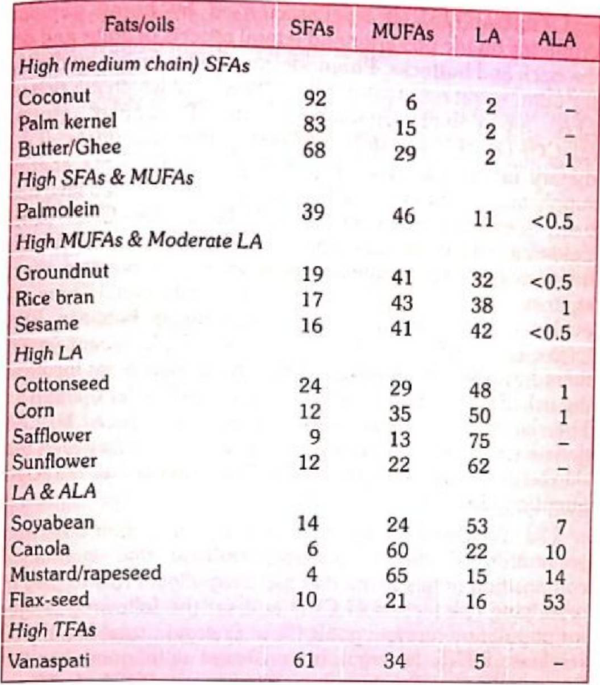
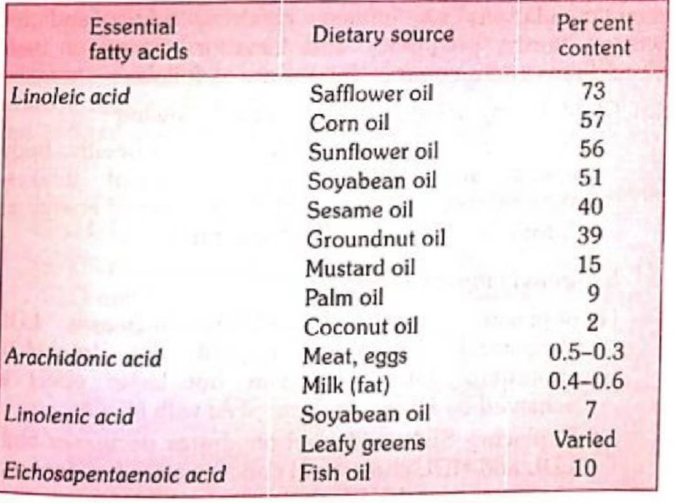

Slide 14
Sources
ANIMAL FATS : The major sources of animal fats are ghee, butter, milk, cheese, eggs, and fat of meat and fish.
Animal fats with few exceptions like cod liver oil and sardine oil are mostly saturated fats.
VEGETABLE FATS : Some plants store fat in their seeds, e.g.. groundnut, mustard, sesame, coconut, etc. They are sources of vegetable oils.
OTHER SOURCES : Small quantities of fat (invisible fat) are found in most other foods such as cereals, pulses, nuts and vegetables. For example, rice carries 3 per cent offat, wheat 3 per cent, jowar 4 per cent and bajra 6.5 per cent. Large cereal consumption, as in India, provides considerable amounts of “invisible fat”. Moreover, the body can convert carbohydrate into fat.

Slide 15
Visible and Invisible fats
Edible plant foods have a low content of fat and saturated fatty acids but they are good source of monounsaturated fatty acids and poly-unsaturated fatty acids.
In most cereals, millets, pulses and legumes, fat content ranges between 1.5 to 3 per cent. In cereals, millets and most oil seeds, linoleic acid is the major fatty acid whereas pulses, legumes, green leafy vegetables and some oil seeds (e.g. soyabean, rapeseed/mustard and flaxseed) and fenugreek are good sources of both linoleic acid and alpha-linolenic acid.
Animal foods like butter, ghee, whole milk cream, fatty cheese and fatty meats provide cholesterol and high amount of saturated fatty acids, and are natural source of trans-fatty acids.
Lean meats have a fairly high content of long chain poly-unsaturated fatty acids (PUFA).
Poultry meat contains less fat and cholesterol and have high amount of PUFA including long chain PUFA.
Egg has high cholesterol but are good source of linoleic acid, alpha-linolenic acid and docosahexaenoic acid (DHA).
Fish has less fat, saturated fatty acids and cholesterol but are good source of PUFAs.

Slide 16
Functions
Fats have always been equated with calories. They are high energy foods, providing as much as 9 kcal for every gram.
By supplying energy, fats spare proteins from being used for energy.
Besides providing energy, fats serve as vehicles for fat-soluble vitamins.
Fats in the body support viscera such as heart, kidney and intestine;
Fat beneath the skin provides insulation against cold.
Without fat, food is limited in palatability.
EFA are needed by the body for growth, for structural integrity of the cell membrane and decreased platelet adhesiveness.
Diets rich in EFA have been reported to reduce serum cholesterol and low-density lipoproteins.
Poly-unsaturated fatty acids are precursors of prostaglandin - a group of compounds, now recognized as “local hormones”; they play a major role in controlling many of the physiological functions of the body such as vascular haemostasis, kidney function, acid secretion in stomach, gastro-intestinal motility, lung physiology and reproduction.
Cholesterol is essential as a component of membranes and nervous tissue and is a precursor for the synthesis of steroid hormones and bile acids.

Slide 17
Hydrogenation and trans fatty acids
Hydrogenation - unsaturated fatty acids are converted into saturated acids and the EFA content is drastically reduced.
The main advantage of vanaspati is its ghee-like consistency and its keeping quality even in hot humid climates.
Vanaspati is lacking in fat-soluble vitamins, it is fortified with vitamins A and D by government regulation to the extent of 2500 IU of vitamin A and 175 IU of vitamin D per 100 grams.
Trans Fatty acids - Partial hydrogenation, the process used to increase shelf-lFfe of poly-unsaturated fatty acids (PUFAs) create trans fatty acids and also removes the critical double bonds in essential fatty acids.
Metabolic studies have demonstrated that trans-fatty acids render the plasma lipid profile even more atherogenic than saturated fatty acids, by not only elevating LDL cholesterol but also by decreasing HDL cholesterol.
It takes years for trans fatty acids to be flushed from the body.
Deep fried fast foods, cake mixes, cereals and energy bars, chips and crackers and whipped toppings, packaged cookies and candy, packaged doughnuts, pies and cakes are major sources of trans-fatty acids.
It is better to look for “partially hydrogenated oil” on the label of any packaged food.

Slide 18
Refined oil
Refining is usually done by treatment with steam, alkali, etc.
Refining and deodourization of raw oils is done mainly to remove the free fatty acids and rancid materials which may be present in them.
Refining does not bring about any change in the unsaturated fatty acid content of the oil.
It only improves the quality and taste of oils.
Refined oils are costly.

Slide 19
Choice of cooking oil
Use correct combination/blend of 2 or more vegetable oils (1:1)
Oil containing LA + oil containing both LA and ALA
Groundnut/Sesame/Rice bran/Cottonseed 4- Mustard/ Rapeseed
Groundnut/Sesame/Rice bran/Cottonseed + Canola
Groundnut/Sesame/Rice bran/Cottonseed + Soyabean
Palmolein + Soyabean
Safflower/Sunflower + Palm oil/Palmolein + Mustard/Rapeseed.
Oil containing high LA + oil containing moderate or low LA
Sunflower/Safflower + Palmolein/Palm oil/Olive
Safflower/Sunflower + Groundnut/Sesame/Ricebran/ Cottonseed.
Limit use of butter/ghee.
Avoid use of PHVO as medium for cooking/frying.
Replacements for PHVO
Frying : oils which have higher thermal stability – palm oil/palmolein, sesame, ricebran, cottonseed - single/blends (home/commercial)

Slide 20

Thanks

