Slide 1


Nutrition

Slide 2
Problems in public health
Low birth weight
Under nutrition
Xerophthalmia
Iodine deficiency disorders
Nutritional anemia
Endemic fluorosis
Lathyrism

Slide 3
Low Birth Weight
< 2500 gm; 18.6 % (2014)
Maternal malnutrition and anemia – significant risk factors
Other causes – hard physical labor, illness (mainly infections)
Assc factors – Short maternal stature, very young age, high parity, smoking, close birth intervals

Slide 4
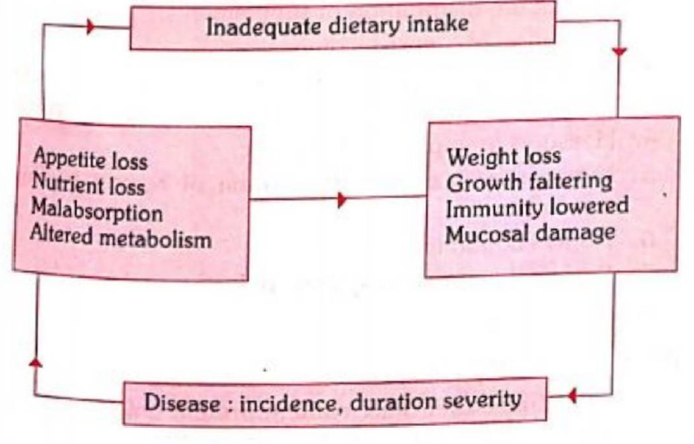
Under – Nutrition (stunting, wasting & underweight)
It is not only an important cause of childhood morbidity and mortality, but leads also to permanent impairment of physical and possibly of mental growth of those who survive.
Particularly among rural poor & urban slums
an inadequate intake of food
Cause - (food gap) both in quantity and quality, infections notably diarrhoea, respiratory infections, measles and intestinal worms which increase requirements for calories, protein and other nutrients, while decreasing their absorption and utilization.
It is a vicious circle – infection contributing to malnutrition and malnutrition contributing to infection, both acting synergistically.
Other contributory factors in the web of causation, viz. poor environmental conditions, large family size, poor maternal health, failure of lactation, premature termination of breast-feeding, and adverse cultural practices relating to child rearing and weaning such as the use of over-diluted cow’s milk and discarding cooking water from cereals and delayed supplementary feeding

Slide 5
Under nutrition
Under weight
Composite measure of stunting and wasting,
Indicator to assess changes in the magnitude of malnutrition over time.
Can result from either chronic or acute malnutrition, or both. Underweight is often used as a basic indicator of the status of a population’s health as weight is easy to measure.
Stunting
Indicator of linear growth retardation that results from failure to receive adequate nutrition over a long period or recurrent adequate nutrition over a long period or recunent infections.
It is associated with a number of long-term factors including chronic insufficient nutrient intake, frequent infection, sustained inappropriate feeding practices and poverty.
Stunting often results in delayed psycho-social and cognitive development and poor school performance.

Slide 6
Under nutrition
Wasting
Recent failure to receive adequate nutrition and may be affected by recent episodes of diarrhoea and other acute illnesses.
Causes include inadequate food intake, incorrect feeding practices, disease, and infection or, more frequently, a combination of these factors.
Shows marked seasonal patterns associated with changes in food availability or disease prevalence to which it is very sensitive.
Severe acute malnutrition (SAM)
< 3 SD Ht for Wt
Increases signficantly the risk of death in children under five years of age.
It can be an indirect cause of child death by increasing the case fatality rate in children suffering from common illnesses such as diarrhoea and pneumonia.

Slide 7
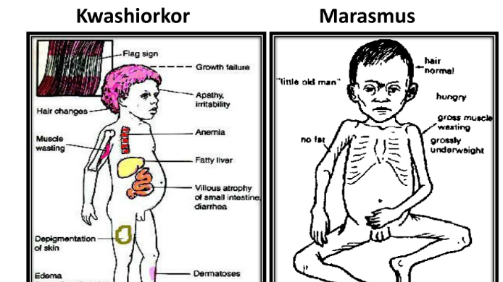

Slide 8
Early detection of PEM
Weight for age
Growth Chart
Arm Circumference
Preventive Measures
Health promotion
Directed to pregnant & Lactating Women
Promote Breaast feeding
Low cost weening food
Education
Home Economics
Spacing
Specific
Diet must contain protein rich foods
Immunization
Food Fortification
Early Dx & treatment
Surveillance
Identifying any lag in growth
Early dx & treatment of infection & diarrhea
Development of programmes for early rehydration of children with diarrhea
Deworming
Rehabilitation
Nutritional rehabilitation services
Hospital treatment
Follow – up Care

Slide 9
Xerophthalmia (dry eye)
All the ocular manifestations of vitamin A deficiency in man.
Most Common in 1- 3-year-old. Related to weaning.
Assc with PEM. Associated risk factor – ignorance, faulty feeding practice & infections.
Prevention & Control
Short term – large doses of Vit A periodically
Medium term – fortification
Long term - reduction or elimination of factors contributing to ocular disease.
To consume generously dark green leafy vegetables
Promotion of breast feeding
Immunization
Improved health services

Slide 10
Programme
1970 → 1 – 5 years; 1992 → 9 months to 3 yrs
10th five year plan – part of RCH
Promoting consumption of vitamin A rich foods by pregnant and lactating women and by children under-five years of age and appropriate breast-feeding;
Administration of massive dose of vitamin A up to five years. First dose of 100,000 1U with measles vaccination at nine months and subsequent doses of 200,000 IU each, every six months up to the age 5 years;
For sick children - all children with xerophthalmia to be treated at health facilities; all children suffering from measles to be given one dose of vitamin A if they have not received it in the previous one month; all cases of severe malnutrition to be given one additional dose of vitamin A

Slide 11
IDD
Significant extent in the “Himalaya goitre belt” which is the world’s biggest goitre belt. It stretches from Kashmir to the Naga Hills in the east, extending about 2,400 km and affecting the northern States of Jammu and Kashmir, Himachal Pradesh, Punjab, Haryana, Delhi, Uttar Pradesh, Bihar, West Bengal, Sikkim, Assam, Arunachal Pradesh, Nagaland, Mizoram, Meghalaya, Tripura and Manipur.
National Iodine deficiency disorders control programme
There are four essential components of National Iodine Deficiency Disorder control programme.
These are iodized salt, monitoring and surveillance, manpower training and mass communication
Hazards of iodization
A mild increase in incidence of thyrotoxicosis has now been described following iodized salt programmes.
An increase in lymphocytic thyroiditis (Hashimoto’s disease) has also been claimed.
The risk of iodism or iodide goitre however seems to be very small.

Slide 12
Endemic Fluorosis
Where drinking water contains excessive amounts of fluorine (3-5 mg/L)
Dental Fluorosis
Ingested during the years of tooth calcification - essentially during the first 7 years of life.
It is characterized by “mottling” of dental enamel, which has been reported at levels above 1.5 mg/L intake.
Mottling is best seen on the incisors of the upper jaw. It is almost entirely confined to the permanent teeth and develops only during the period of formation
Skeletal Fluorosis
Daily intake of 3.0 to 6.0 mg/L or more. When a concentration of 10 mg/L is exceeded, crippling fluorosis can ensue. It leads to permanent disability.
Genu valgum
Osteoporosis of the lower limbs has been reported in some districts of Andhra Pradesh and Tamil Nadu.
The syndrome was observed among people whose staple was sorghum (jowar).
Diets based on sorghum promoted a higher retention of ingested fluoride than do diets based on rice

Slide 13
Intervention
Changing the water source : new source of drinking water with a lower fluoride content (0.5 to 0.8 mg/L) if that is possible. Running surface water contains lower quantities of fluorides than ground water sources such as wells
Chemical treatment : If the above is not possible, the water can be chemically defluoridated in a water treatment plant, even though such treatment is moderately expensive.
The National Environmental Engineering Research Institute, Nagpur developed a technique for removing fluoride by chemical treatment. It is called Nalgonda technique for defluoridation of water.
It involves the addition of two chemicals (viz. lime and alum) in sequence followed by flocculation, sedimentation and filtration.
Other measures : Fluoride supplements should not be prescribed for children who drink fluoridated water. The use of fluoride toothpaste in areas of endemic fluorosis is not recommended for children upto 6 years of age.

Slide 14
Lathyrism
Paralyzing disease of humans and animals.
In the humans it is referred to as neurolathyrism because it affects the nervous system, and in animals as osteolathyrism (odoratism) because the pathological changes occur in the bones resulting in skeletal deformities
Neurolathyrism is a crippling disease of the nervous system characterized by gradually developing spastic paralysis of lower limbs, occurring mostly in adults consuming the pulse, Lathyrus sativus (Khesari dal) in large quantities.
Diets containing over 30% of this dhal if taken over a period of 2-6 months will result in neurolathyrism.
Toxin - Beta oxalyl amino alanine (BOAA). It has been isolated in crystalline form and is water soluble

Slide 15
Disease
15 – 45 years old
Latent stage : The individual is apparently healthy, but when subjected to physical stress exhibits ungainly gait.
At this stage, if the pulse is withdrawn from the diet, it will result in complete remission of the disease.
No-stick stage : the patient walks with short jerky steps without the aid of a stick. A large number of patients are found in this stage.
One-stick stage : The patient walks with a crossed gait with a tendency to walk on toes.
Muscular stiffness makes it necessary to use a stick to maintain balance,
Two-stick stage : the symptoms are more severe. Due to excessive bending of knees and crossed legs, the patient needs two crutches for support.
The gait is slow and clumsy and the patient gets tired easily after walking a short distance,
Crawler stage : Finally the erect posture becomes impossible as the knee joints cannot support the weight of the body.
There is atrophy of the thigh and leg muscles.
The patient is reduced to crawling by throwing his weight on his hands

Slide 16
Interventions
Vitamin C Prophylaxis - damages could be repaired by the daily administration of 500-1000 mg of ascorbic acid for a week or so. The damage could also be prevented by generous provision of ascorbic acid in the lathyrogenic diet.
Banning the crop
Removal of toxins
Steeping – soaking for 2 hours, washing then drying
Parboiling
Education
Genetic approach

Slide 17
Food Borne Diseases
Food-borne intoxications
Due to naturally occurring toxins in some foods:
Lathyrism (beta oxalyl amino-alanine)
Endemic ascitis (Pyrrolizidine alkaloids).
Due to toxins produced by certain bacteria:
Botulism
Staphyloccus poisons
3. Due to toxins produced by some fungi :
Aflatoxin
Ergot
Fusarium toxins
4. Food-borne chemical poisoning:
Heavy metals, e.g., mercury (usually in fish), cadmium (in certain shellfish) and lead (in canned food)
Oils, petroleum derivatives and solvents (e.g., Trycresyn phosphate or TCP)
Migrant chemicals from package materials
Asbestos
Pesticide residues (DDT, BHC)
Food-borne infections
Bacterial diseases
Typhoid fever, Paratyphoid fever, Salmonellosis, Staphylococcal intoxication, Cl.perfringens illness, Botulism, B.cereus Food Poisoning, E.coli diarrhoea, Non-cholera vibrio illness,V.parahaemolyticus infection. Streptococcal infection, Shigellosis Brucellosis.
Viral diseases
Hepatitis A and E, Norovirus Gastroenteritis.
Parasites
Taeniasis Hydatidosis, Trichinosis, Ascariasis, Amoebiasis, Oxyuriasis

