Slide 1
Nutrition

Slide 2
Fats & disease
Obesity - A diet, rich in fat, can pose a threat to human health by encouraging obesity. In fat people, adipose tissue may increase upto 30 %.
Phrenoderma - Deficiency of essential fatty acids in the diet is associated with rough and dry skin, a condition known as phrenoderma or “toad skin”.
Reported in Kerala, Karnataka and Gujarat. It is characterized by horny papu|ar eruptions on the posterior and lateral aspects of limbs and on the back and buttocks.
Cured rapidly by the administration of linseed or safflower oil which are rich in EFA, along with vitamins of the B-complex group

Slide 3
Fats & disease
Coronary Heart disease - High fat intake (i.e, dietary fat representing 40 per cent or over of the energy supply and containing a high proportion of saturated fats) has been identified as a major risk factor for CHD.
Epidemiological studies indicate that LDL and VLDL fractions are atherogenic and HDL exerts a protective effect against the development of artherosclerosis. There is evidence indicating an inverse relationship between EFA intake and CHD mortality
Cancer : In recent years, there has been some evidence that diets high in fat increase the risk of colon cancer and breast cancer.
OTHERS: The skin lesions of kwashiorkor and those induced by EFA deficiency are similar. The possible association between the skin lesions of kwashiorkor and EFA deficiency has attracted attention.

Slide 4
Recommendations
The WHO/FAO Expert Group on diet, nutrition and prevention of chronic diseases endorse that qualitative composition of fats in the diet has a significant role to play in modifying risk factors of CVD and set the following ranges for population nutrient goals (% of Energy): total fat, 15-30 (at least 20%E (energy) is consistent with good health);
Saturated fatty acids less than 10 per cent;
PUFAs 6-10 percent
n-6 about 5-8 per cent; n-3 about 1-2 per cent;
Trans fattyacids less than 1 per cent
Cholesterol less than 300 mg a day

Slide 5
Fat requirements
Recommendations for dietary fats for Indians have been revised taking into account the recent FAO and WHO recommendations for :
Total fat, individual fatty acids and health promoting non-glyceride components;
Source of dietary fats in Indians: and availability of fat.
The recommendations are directed towards meeting the requirements of optimal foetal and infant growth and development, maternal health and for combating chronic energy deficiency in children and adults, and diet related non-communicable diseases in adults.
Taking into account the unfavourable effect of low fat – high carbohydrate diets and the energy requirement set on the basis of age, physiological status and physical activity, the minimum intakes of visible fat for Indian adults have been based on the sedentary, moderate and heavy physical activity and set at 25. 30 and 40 g/d for adult man. and 20, 25 and 30 g/d for adult women as against a single level recommendation earlier.
The minimum level of total fat should be 20 per cent of energy. To furnish 20 per cent of total energy, diet of pregnant and lactating mothers should contain at least 30 grams of visible fat.

Slide 6
Carbohydrates
Main source of energy, providing 4 kcals per gram.
Carbohydrate is also essential for the oxidation of fats and for the synthesis of certain non-essential amino acids.
There are three main sources of carbohydrates, viz., starches, sugar and cellulose.
Starch is basic to the human diet. It is found in abundance in cereals, roots and tubers. Sugars comprise monosaccharides (glucose, fructose and galactose) and disaccharides (sucrose, lactose and maltose). These free sugars are highly water soluble and easily assimilated. Free sugars along with starches constitute a key source of energy. Cellulose which is the indigestible component of carbohydrate with scarcely any nutritive value, contributes to dietary fibre.
The carbohydrate reserve (glycogen) of a human adult is about 500 g. This reserve is rapidly exhausted when a man is fasting. If the dietary carbohydrates do not meet the energy needs of the body, protein and glycerol from dietary and endogenous sources are used by the body to maintain glucose haemostasis.

Slide 7

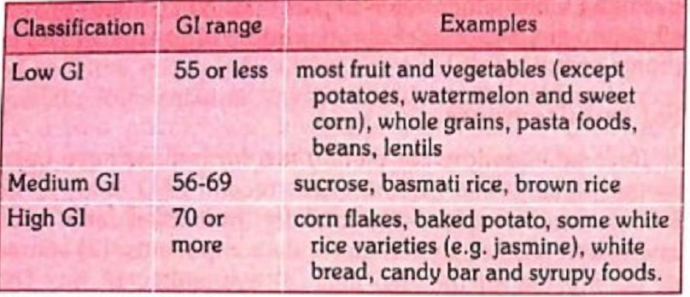
Glycemic Index
Glycaemic index of a food is defined by the area under the two-hour blood glucose response curve (AUC) following the ingestion of a fixed portion of test carbohydrate (usually 50 g) as a proportion (%) of the AUC of the standard (either glucose or white bread).
Some foods containing different fractions of soluble and insoluble fibres favour slow release of sugar into small intestine and its absorption into blood (reduced peak and prolonged rate).
They are therefore termed low glycaemic index foods as compared to high glycaemic foods with readily digestible and absorbable sugar.
The concept has practical utility in management of diabetes and control of obesity

Slide 8
Dietary Fibre
Dietary fibre is the remnants of the edible part of plants and analogous carbohydrates that are resistant to digestion and absorption in the human small intestine with complete or partial fermentation in the human large intestine.
It includes polysaccharides, oligosaccharides, lignin and associated plant substances.
Dietary fibre exhibits one or more of either laxation (faecal bulking and softening; increased frequency; and or regularity), blood cholesterol attenuation, and or blood glucose attenuation. Organic acids (butyric acid) and polyols (sorbitol) are also considered as part of fibre. Animal foods do not contain any fibre.

Slide 9
Types & Sources
Dietary fibres have been characterized by its source, e.g., cereal, vegetable and fruits or its solubility in water – soluble (partly or fully) or insoluble. Both characters of solubility are essential for health promotion.
Digestibility of fibre is determined by physiochemical and structural properties of the dietary component and the process used. When exposed to longer duration of degradative conditions in large intestine, more fibre is digested. It forms the substance for fermentation by intestinal microbes.
It is through this mechanism that part of energy from resistant starch is rendered available. Apart from the energy yielding reactions during digestion, at different pH, the action of enzymes on dietary fibres promotes interaction between nutrients. It also changes the pattern of microbes colonizing the colon and thus the metabolic products of such fermentation over the time.

Slide 10
Types & Sources
Original estimates of fibre covered all that was insoluble in boiling water or in dilute acid and alkali conditions. It was reported as ‘crude fibre’, which may include all structural fibre, cellulose, lignin and haemicellulose.
It is related to digestibility and has the property of holding water and swelling properties of the diet. It adds to the bulk of the food, favours satiety, increases transit time of the food in the gut and is an active substrate in the large intestine for release of important functional components like organic acids and nutraceuticals. Mostly complex carbohydrates, such as polysaccharides i.e. cellulose, haemicellulose, pectin and a variety of gums, mucilages form the fibre.

Slide 11
Advantages
Associated with reduced incidence of coronary heart disease.
The mechanism of its action is attributed to its binding to bile salts and preventing its reabsorption and thus reducing cholesterol level in circulation.
The fibre, particularly the gum and pectin, when ingested with a diet, are reported to reduce post-prandial glucose level in blood. Recent studies have shown that gum present in fenugreek seeds, which contains 40 per cent gum, is most effective in reducing blood glucose and cholesterol compared to other gums.

Slide 12
Disadvantages
Fibre have no metabolic effects.
Too much of fibre can decrease the absorption of valuable micronutrients, There is conflicting evidence as to whether fibre tends to bind some vitamins and minerals like calcium, magnesium, iron and zinc, and reduce their bio-availability.
People who eat well-balanced diet obtain enough roughage.

Slide 13
Recommendations
Intake in excess of 60 g of fibre over a day can reduce the nutrient absorption and cause bowel irritation.
A daily intake of about 30 grams of dietary fibre per 2000 kcal is desirable.
The estimates of dietary fibre intake in different income segments reported from western India are :
Rural - 39 grams per day for men and 30 g/day for women;
Tribal - 19 g/day for men and 15 g/day for women;
Industrial - 41 g/day for men and 31 g/day for women;
High income group - 31 g/day for men and 21 g/day for women;
Middle income group - 43 g/day for men and 22 g/day for women
Low income group - 24 g/day for men and 20 g/day for women

Slide 14

Thanks

