Slide 1

Trace Minerals

Slide 2
Major minerals
 | Phosphorus | Sodium | Potassium | Magnesium
Presence in body | Bones and teeth 400 – 700g | All body fluids 100g | 250g | Bones, all body cells, 25g (hlf in bones)
Role | All metabolism | Osmotic pressure | Vasoactive, inc blood flow | Normal metabolism of Ca & K
Intake | Equal to Calcium, Infant 1 : 1.5 | 5g /d | Desirable as 1:1 to sodium | 440mg/d
Food stuff | Widely distributed | Present in most of the food, also added as table salt | Widely in dood
Deficiency | Rarely occur | Present as Muscular cramps |  | Irritability, tetany, hyper-reflexia, occasionally hyporeflexia
Excess |  | >10g / d, hypertension
Remarks | Present as phytin so only 40 – 60% absorbed | Loss - Sweat, Urine, Depends on climate, occupation and physical activity, | Dec blood pressure, slow response | Def occur in Chronic alcoholics, cirrhosis, toxemia of preg, PEM, malabsorption

Slide 3
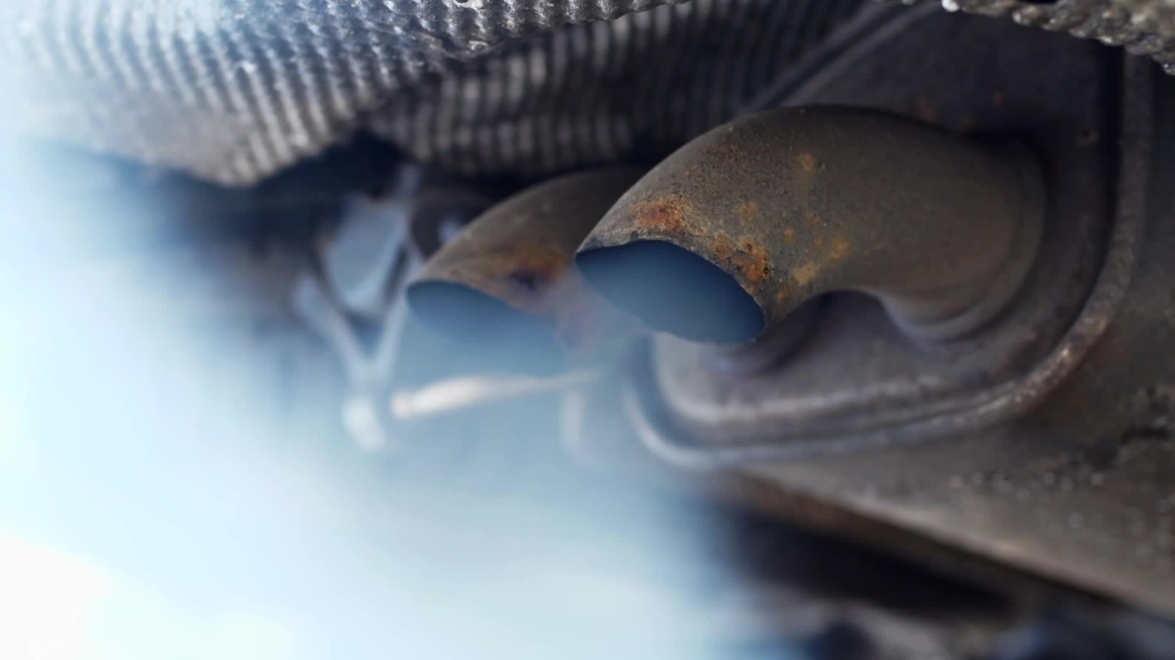
Trace Minerals

Slide 4
 | Iron
Presence | 3 – 4 g (60 – 70% in blood), 1 – 1.5 g as storage, 3.34mg / g hemoglobin
Function | Hemoglobin, neurodevelopment, thermo-homeostasis, muscle activity, catecholamine metabolism, myoglobin, cytochromes catalase. Central func - oxygen transporter
Source | Heme – liver, meat, poultry and fish; also inc absorp of non – heme iron Breast milk – 0.2mg/dl Non – heme: cereals, leafy veg, legumes, nuts, jaggery Bioavailability of non-heme is low d/t phytates (bran), phosphates (yolk), tannins (tea), oxalates (veg). Significant amount – iron cooking vessels
Absorption | Duodenum, upper small intestine; promoters – ascorbic acid. Dec in case of duodenal dis (celiac dis, tropical sprue). Less than 5% absorbed Iron →plasma ferritin → store(liver, kidney, marrow, spleen)
Losses | 1mg/d in adults, 12.5mg per menstrual cycle. Hemorrhage – Physio (menstruation, childbirth), patho (hookworm, malaria, hemorrhoids, pud). Basal losses (sweat, bile, desquamated surface cells) IUD – inc loss by 35 to 146%, hormonal contraceptive dec loss by 50%
Evaluation of Iron status | Hemoglobin concentration, serum iron concentration ( 0.8 – 1.8 mg/l; <0.5 is iron def) Serum ferritin – most sensitive, reflect iron storage, <10mcg/l indicate absence of stored iron Transferrin saturation - > 15%, Normal value – 30%

Slide 5
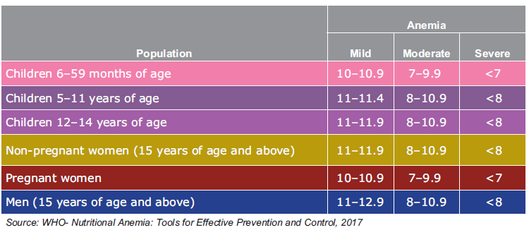
Anemia

Slide 6
6*6*6
Intervention
Prophylactic IFA
Deworming
Intensified year-round Behaviour Change Communication Campaign (Solid Body, Smart Mind) including ensuring delayed cord clamping
Testing of anemia using digital methods and point of care treatment
Mandatory provision of Iron Folic Acid fortified foods in public health programmes
Addressing non-nutritional causes of anemia in endemic pockets, with special focus on malaria, haemoglobinopathies and fluorosis

Slide 7
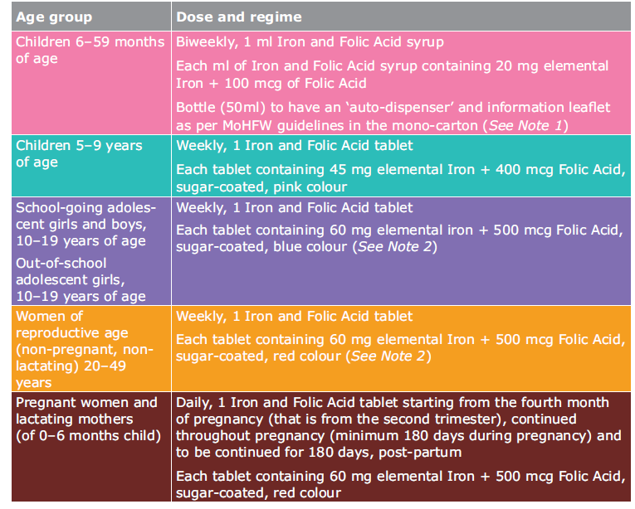

Slide 8
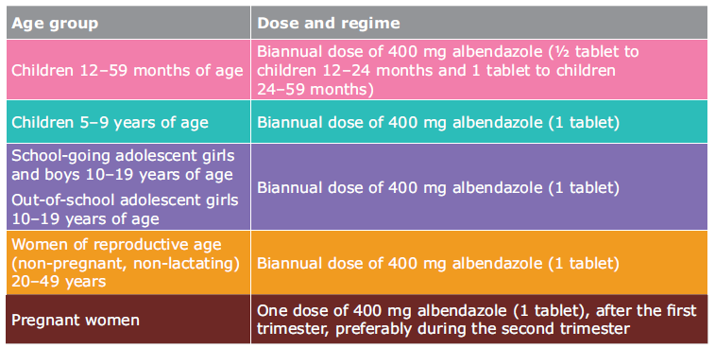

Slide 9
6 institutional mechanism
Intra-ministerial coordination
National AMB Unit
National Centre of Excellence and advanced research on Anemia Control
Convergence with other ministeries
Strengthening supply chain and logistics
AMB Dashboard and Digital Portal

Slide 10
Iodine and Fluorine
 | Iodine | Fluorine
Presence and role | 50mg (8 – 12mcg/dl in blood), Thyroid hormones | Bones and Teeth, normal mineralization of bones and dental enamel
Sources | Sea foods(sea fish, sea salt), cod liver oil. Other food – milk, meat, veg, cereals. Fresh water 1 – 50 mcg. 90% from food. Def is geo-chemical in nature | Drinking water, foods – sea fish, cheese & tea. Usual content – 0.5mg/l, fluorosis endemic area – 3 – 12 mg/l
Deficiency | Spectrum – Iodine deficiency disorders | Dental caries
Excess |  | Dental and skeletal flurosis
Requirements | 150mcg / d; 250mcg /d during preg | Drinking water - 0.5 to 0.8 mg /l temperate countries where the water intake is low - 1 to 2 mg /l
Remark | Goitrogens – interfere with Iodine utilization. Brassica group of veg. cyanoglycosides, thiocyanates | Double edged sword

Slide 11
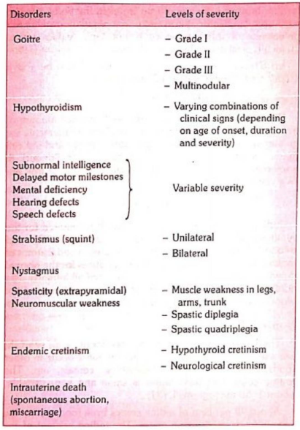

Slide 12

Copper
Adult body contains about 100-150 mg Cu.
Blood Contains: 0.11gmg/100ml
Required for bone development, Elastin formation, cytochrome
oxidase function, Iron absorption, tyrosinase (melanin formation)
Deficiency-Cardiac Hypertrophy, Aortic Aneurysm, Cerebral Demyelination, Ataxia, impaired bone formation
Excess absorption: Copper is deposited in brain, descendent membrane of eyes (Kayser-Feisher ring) , liver, kidney and damaged them.
Cu requirement for adults: 2.0 mg per day.

Slide 13
Zinc
Component of >300 enzymes.
It is active in the metabolism of glucides and proteins
Required for the synthesis of insulin by the pancreas and for the immunity function.
The average adult body contains 1.4 to 2.3 g of zinc.
Zinc deficiency has been reported to result in growth failure and sexual infantilism in adolescents, and in loss of taste and delayed wound healing
There are also reports of low circulating zinc levels in clinical disorders such as liver disease, pernicious anemia and myocardial infarction.
Zn deficiency is common in children from developing countries due to
lack of intake of animal food
high dietary phytate content
inadequate food intake
increased faecal losses during diarrhoea.
Zinc supplementation in combination with oral rehydration therapy has been shown to significantly reduce the duration and severity of acute and persistent diarrhoea
Acrodermatitis enteropathies (AE)
Loss of taste Acuity(hypogeusia)
Retardation pf growth and Genital development

Slide 14

Zinc
° Excess Zn
High Zn intake interferes with utilization and retention of Cu and thus
cause anemia
Zn Requirement: Infants: 3-5mg, Children: 10mg, Adolescent/Adult: 15mg pregnancy: 20mg, Lactation: 25mg

Slide 15

Other traces minerals
Cobalt
Part of the vitamin B12 molecule
No evidence of its deficiency
Recently cobalt deficiency and cobalt iodine ratio in the soil have
shown to produce goiter in humans.
Selenium
The first report that selenium deficiency may occur in man appeared in 1961, and a similar report in 1967.
Deficiency:-3'protein-energy malnutrition

Slide 16

Other traces minerals
Molybdenum:
Excess absorption of molybdenum has been shown to produce bony deformities.
Deficiency of molybdenum is associated with mouth and oesophageal cancer
Chromium
° Total body content of chromium is small, less then 6 mg
Role in relation to carbohydrate and insulin function

Slide 17
Rice
Milling
The milling process deprives the rice grain of its valuable nutritive elements (thiamine, riboflavin, protein). The losses may be upto 15 per cent of protein, 75 per cent of thiamine and 60 per cent of riboflavin and niacin.
People subsisting mainly on white or polished rice are prone to beriberi.
Washing & Cooking
The rice grain is subjected to further loss of essential nutrients during the process of washing and cooking.
Washing in large quantities of water would remove upto 60 per cent of the water-soluble vitamins and minerals. It is therefore best to cook rice in just enough water (about 2 measure of water for 1 measure of rice).

Slide 18
Parboiling
Parboiling (partial cooking in steam) is ancient Indian technique of preserving the nutritive quality of rice
The technique recommended by the Central Food Technological Research Institute, Mysore is known as the hot soaking process.
The process starts with soaking the paddy (unhusked rice) in hot water at 65 to 70 deg. C for 3 to 4 hours, which swells the grain. This is followed by draining of water and steaming the soaked paddy in the same container for 5 to 10 minutes. The paddy is then dried and later homepounded or milled.
During the steaming process, a greater part of the vitamins and minerals present in the outer aleurone layer of the rice grain are driven into the inner endosperm
With subsequent milling, even to a high degree, the nutrients are not removed. During the drying process, the germ gets attached more firmly to the grain. In addition, the heat used in drying hardens the rice grain.
It results in the grain becoming more resistant to insect invasion and more suitable for storage than raw rice. The starch also gets gelatinized which improves the keeping quality of rice.
The serious disadvantage of parboiling is the development of a peculiar smell or off flavor ’ which some consumers do not relish. Modern methods of parboiling rice have been developed by which the finished product does not give any bad odour.

Slide 19
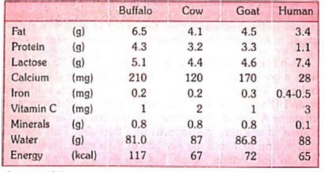
Milk
Protein – chief protein is casein as Calcium caseinogenate. Other protein are lactalbumin and lactoglobulin
Animal milk contain three times the protein than human milk
It’s a complete protein.
Human milk contain more of tryptophan and sulphur containing amino acids.
Human milk contain more of linoleic and oleic acids
Contain all known minerals needed by body. Good source of all vitamins except vitamin C

Slide 20
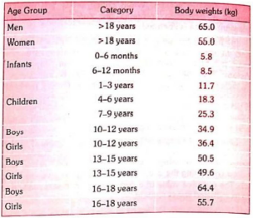
Reference Body weight

Slide 21
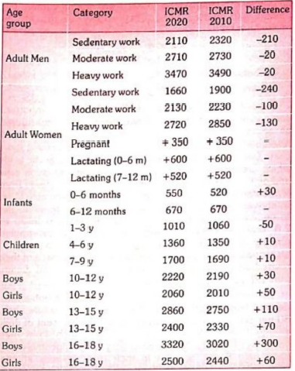
Energy requirements

Slide 22
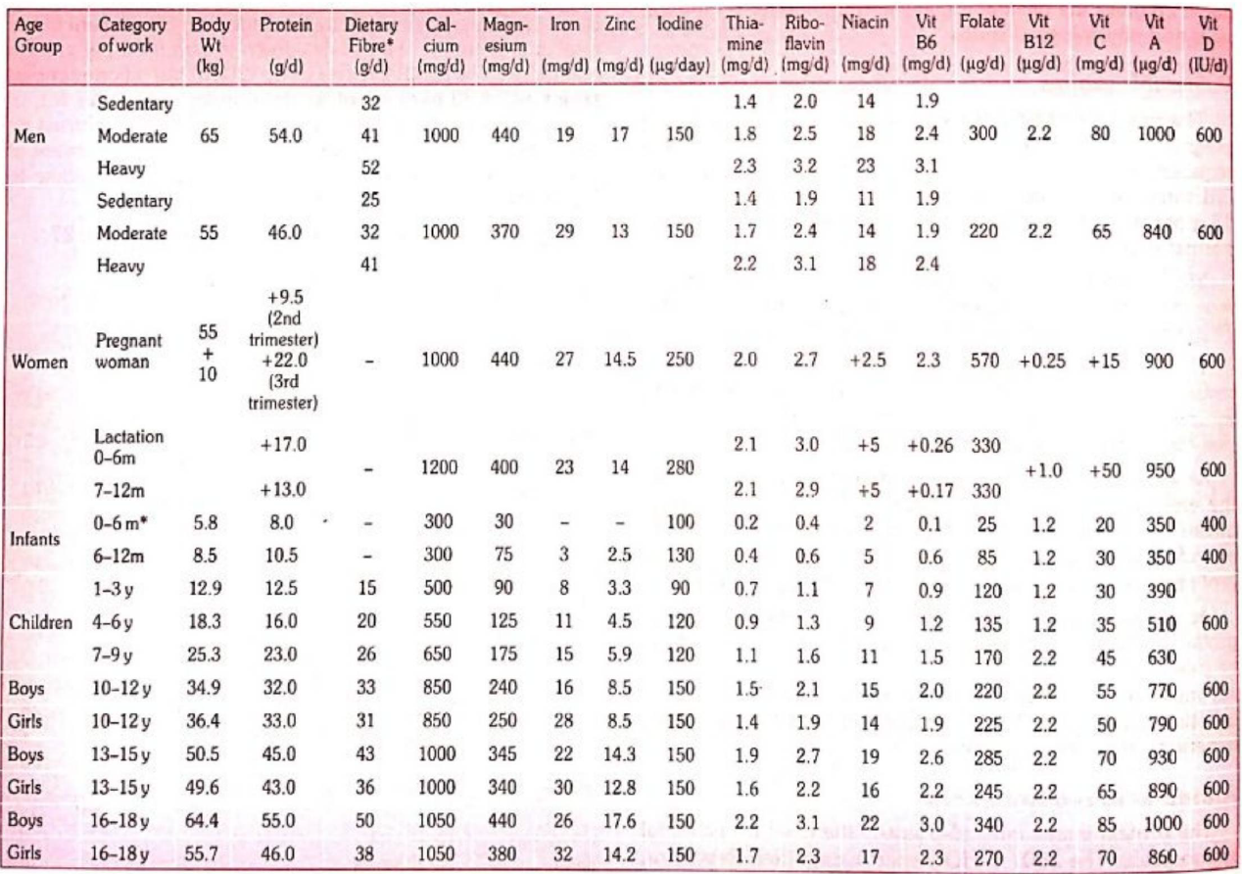
RDA

Slide 23
Dietary Goals
Dietary fat should be limited to approximately 15-30 per cent of total daily intake;
Saturated fats should contribute no more than 10 per cent of the total energy intake; unsaturated vegetable oils should be substituted for the remaining fat requirement;
Excessive consumption of refined carbohydrate should be avoided; some amount of carbohydrate rich in natural fibre should be taken;
Sources rich in energy such as fats and alcohol should be restricted;
Salt intake should be reduced to an average of not more than 5 g. per day; (salt intake is more in tropical countries. In India it averages 15 g. per day);
Protein should account for approximately 10-15 per cent of the daily intake; and
Junk foods such as colas, ketchups and other foods that supply empty calories should be reduced.

Slide 24
Food Hygiene
Milk – Source of infection: Dairy animal, Handler, environment
Infections of animals that can be transmitted to man:
Primary importance :
Tuberculosis
Brucellosis
Streptococcal infections
Staphylococcal enterotoxin poisoning
Salmonellosis
Q fever.
Lesser importance :
Cow-pox
Foot and mouth disease
Anthrax
Leptospirosis
Tick-borne encephalitis.
Infections primary to man that can be transmitted through milk:
Typhoid and paratyphoid fevers
Shigellosis
Cholera
Enteropathogenic Escherichiacoli (EEC)
Non-diarrhoeal diseases
(a) Streptococcal infections
(b) Staphylococcal food poisoning
(c) Diphtheria
(d) Tuberculosis
(e) Enteroviruses
(f) Viral hepatitis

Slide 25
Clean and safe milk
Healthy and clean animal - Milk from a healthy udder contains only a few organisms and these are relatively unimportant.
The premises where the animal is housed and milked should be sanitary.
The milk vessels must be sterile and kept covered. The water supply must be bacteriologically safe.
Milk handler must be free from communicable diseases, and before milking they must wash their hands and arms. Where possible, milking machines must be used.
Milk should be cooled immediately to below 10 deg.C after it is drawn to retard bacterial growth.
Methylene blue reduction test : It is an indirect method for detection of microorganisms in milk.
The test is carried out on the milk accepted for pasteurization.
It is based on the observation that bacteriae growing in milk bring about a decrease in the colour imparted to milk.
In conducting the test, definite quantities of methylene blue are added to 10 ml of milk and the sample is held at a uniform temperature of 37 deg C until the blue colour has disappeared.
The milk which remains blue the longest is considered to be of the best quality and a scale of grading different milk samples, on the basis of the time required to reduce a definite quantity of methylene blue has been worked out. The test thus serves as confirmation of heavy contamination and compared with direct counts of bacteriae, it saves time and money.

Slide 26
Pasteurization
Holder (Vat) Method – 63 – 66 deg C for 30 minutes, quickly cooled to 5 deg C. small and rural communities
HTST Method: 72 deg C for 15 seconds, rapidly cooled to 4 deg C. most widely used method
UHT: 2 stages, 2nd stage – 125 deg C at high pressure for few seconds. Rapidly cooled and bottled
Kills 90% of bacteria
Keeping quality of 8 to 12 hours at 8 deg C
Phosphatase test: phosphatase enzyme get destroyed at 60 deg C
Standard plate count: < 30,000 bacterial count / ml
Coliform count: absent in 1 ml of milk

Slide 27
Slaughter House
Model Public Health Act (1955) in India
Location : Preferably away from residential areas.
Structure : Floors and walls upto 3 feet should be impervious and easy to clean.
Disposal of wastes : Blood, offal, etc. should not be discharged into public sewers but should be collected separately.
Water supply : should be independent, adequate and continuous.
Examination of animals: Ante mortem and post mortem examination to be arranged. Animals or meat found unfit for human
consumption should be destroyed or denatured.
Storage of meat : Meat should be stored in fly-proof and rat-proof rooms; for overnight storage, the temperature of the room all be maintained below 5 deg C.
Transportation of Meat shall be transported in fly-proof covered vans.
Miscellaneous: Animals other than those to be slaughtered should not be allowed inside the shed.

Slide 28
Next Class
Problems in public health
Factors in selected disease
Social aspect
Food borne disease
Food toxicants
National Nutrition Policy
Community Nutrition Programmes

Slide 29

Thanks

