Slide 1
AIR

Slide 2
Air of occupied room
CHEMICAL CHANGES
Progressively contaminated by carbon dioxide and the oxygen content decreases.
An average person at rest gives off 0.7 c.ft of carbon dioxide per hour; this may increase up to 2 c.ft. during physical activity.
In a mixed gathering comprising all age groups, the per capita output of carbon dioxide is taken as 0.6 c.ft. per hour

Slide 3
Physical changes
Rise in temperature : A man at rest gives off approximately 400 Btu per hour.
One Btu (British Thermal Unit) is the quantity of heat required to raise the temperature of one pound of water by 1 deg. F.
Under conditions of physical exertion, the heat output may go up to 4.000 Btu.
Increase of humidity . The expired air contains about 6 per cent of water vapour.
An adult person at rest releases an average 700 gms. of water vapour per 24 hours in the form of perspiration.
Human being releases 18.4 gms of water vapour per hour when sleeping and upto 175 gms of water vapour when engaged in vigorous exercise.

Slide 4
Physical changes
Decrease in air movement: In crowded places, the natural movement of air is impeded
Body odours : Unpleasant odours arise from foul breath, perspiration, bad oral hygiene, dirty clothes and other sources.
The production of body odours depends upon the social status, age and personal hygiene of the People
Bacterial pollution : The exhaled air contains microorganisms in suspension. These are principally saprophytic bacteria and may include pathogenic bacteria.
These organisms are discharged into the air during conversation, coughing, sneezing and loud talking.

Slide 5
Discomfort
The oxygen content may be reduced to 18 per cent and the carbon dioxide content may be raised to over 5 per cent, without adverse effects, provided the temperature and humidity are kept satisfactory.
Temperature, humidity, air movement and heat radiation determine the “cooling power” of the air with respect to the human body.
“The problems of ventilation arc physical, not chemical: cutaneous not respiratory”.

Slide 6
Thermal Comfort
AIR TEMPERATURE : Air temperature alone was not an adequate index of thermal comfort.
AIR TEMPERATURE AND HUMIDITY
COOLING POWER : Air temperature, humidity and air movement were considered together and expressed as “cooling power” of the air.
An instrument was devised by Hill called the Kata Thermometer to measure the cooling power.
A dry Kata reading of 6 and above, and a wet Kata reading of 20 and above, were regarded as indices of thermal comfort.
Further researches have shown that the Kata cooling powers are also not reliable indices of comfort conditions.
EFFECTIVE TEMPERATURE : Effective temperature is an arbitrary index which combines into a single value the effect of temperature, humidity and movement of the internal air on the sensation of warmth or cold felt by the human body.

Slide 7
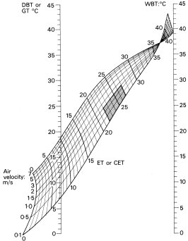
Effective temperature
This scale was evolved in 1923 after a long series of experiments carried out in the Pittsburgh Laboratory of the American Society of Heating and Ventilation Engineers by Houghton and Yaglou.
Two scales are available one of which refers to men who are stripped to the waist and the other to men who are fully clad in indoor clothing.
A criticism of the effective temperature scale is that it ignores the effects of a radiation from the surrounding structures.
CORRECTED EFFECTIVE TEMPERATURE : This Index is an improvement over the Effective Temperature Index.
Instead of the dry bulb temperature, the reading of the Globe Thermometer is used to allow for radiant heat.
That is, the C.E.T. scales deal with all the four factors namely, air temperature, velocity, humidity and mean radiant heat.

Slide 8
Comfort zones
McARDLE’S MAXIMUM ALLOWABLE SWEAT RATE : McArdle and associates took 4.5 litres of sweat excreted in four hours as the maximum allowable sweat rate compatible with physiological normal reaction of acclimatized, healthy young men for repeated exposures to heat.
They prepared a chart from which the “predicted four hour sweat rate” (P4SR) can be obtained from any combination of dry and wet bulb temperature of the air, mean radiant air temperature and air velocity, under different work intensity.

Slide 9
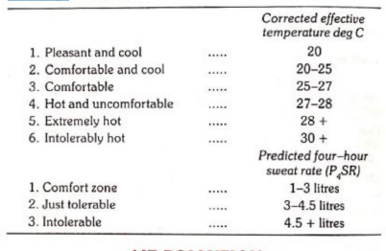
Comfort zones
Comfort zones may be defined as the range of ETs over which most adults feel comfortable.
There is no unanimous decision on a single zone of comfort for all people because comfort is quite a complex subjective experience which depends not only on physical, physiological factors, but also on psychological factors which are difficult to determine.
Considering only the environmental factors, ‘comfortable thermal conditions are those under which a person can maintain normal balance between production and loss of heat, at normal body temperature and without sweating.

Slide 10
Ventilation
The modern concept of ventilation implies not only the replacement of vitiated air by a supply of fresh outdoor air, but also control of the quality of incoming air about its temperature, humidity and purity with a view to provide a thermal environment that is comfortable and free from risk of infection

Slide 11
Standards
Cubic space : Minimal fresh air supply ranging from 300 to 3,000 c.ft. per hour per person.
The widely quoted standard is that of De Chaumont who advocated a fresh air supply of 3,000 c.ft. per person per hour on the following grounds:
It was observed that so long as the amount of carbon dioxide due to respiration was not more than 2 parts in 10,000 parts of air, the air of the rooms seemed fresh and did not sensibly differ from outdoor air.
Assuming that an average person expires 0.6 c.ft. of carbon dioxide per hour, and that 0.0002 c.ft. of CO2 in one c.ft. of air as the “permissible impurity”, it was calculated that 0.6/0.0002 or 3,000 c.ft. of air would be required by a man at rest per hour.
This standard of ventilation is no longer followed

Slide 12
Standards
Air change : Air change is more important than the cubic space requirement.
It is recommended that in the living rooms, there should be 2 or 3 air changes in one hour; in work rooms and assemblies 4 to 6 air changes. If the air is changed more frequently, i.e., more than 6 times in one hour, it is likely to produce a draught which should be avoided.
Based on this concept, it is now considered that a space of 1,000 to 1,200 c.ft. per person is quite sufficient. The number of air changes per hour is calculated by dividing the total hourly air supply to the room by the cubic capacity of the room.

Slide 13
Standards
Floor space: Floor space per person is even more important than cubic space.
Heights in excess of 10 to 12 feet are ineffective from the point of view, of ventilation, as the products of respiration tend to accumulate in the lower levels.
Therefore, in calculating cubic space requirements, heights over 10 to 12 feet are not considered.
The optimum floor space requirements per person vary from 50 to 100 sq.ft.

Slide 14
Types of ventilation (Natural)
Natural ventilation is the simplest system of ventilating small dwellings, schools and offices. In this method, reliance is placed on certain forces which operate in nature.
THE WIND : When it blows through a room, it is called perflation.
When there is an obstruction, it bypasses and exerts a suction action at its tail end - this is called aspiration.
Doors and windows facing each other provide “cross-ventilation”.
Back to back houses do not permit cross ventilation and therefore, their construction is not allowed.
DIFFUSION : Air passes through the smallest openings or spaces by diffusion.
This is a slow process and therefore, is not relied upon as the sole means of ventilation.

Slide 15
Types of ventilation (Natural)
INEQUALITY OF TEMPERATURE : Air flows from high density to low density; it rises when slightly heated and escapes from openings provided high up in the room.
The outside air which is cooler and more dense will enter the room through inlets placed low.
The greater the temperature difference between outside and inside air, the greater the velocity of the incoming air.
In the tropics the outside air may be hotter than the inside and the reverse may take place.
These properties of air are utilized to best advantage by the proper location of windows, doors, ventilators and skylights.
The chief drawback of natural ventilation is that it is not possible to regulate the velocity of the incoming air nor to adjust its temperature or humidity.

Slide 16
Mechanical ventilation
Exhaust ventilation
In this system, air is extracted or exhausted to the outside by exhaust fans usually driven by electricity. As air is exhausted, a vacuum is Seated which induces fresh air to enter the room through windows, doors and other inlets. Exhaust ventilation is generally provided in large halls and auditoria for removal of vitiated air.
The exhaust fans are housed in apertures in the external walls, high up near the roof which facilitate removal of the upper layers of the heated light air.
The ventilation may be regulated by adjusting the speed of the fans.
Local exhaust ventilation is widely used in industries to remove dusts, fumes and other concentrated contaminants at their source.

Slide 17
Mechanical ventilation
PLENUM VENTILATION : In this system, fresh air is blown into the room by centrifugal fans so as to create a positive pressure, and displace the vitiated air.
Plenum or propulsion system is used for supplying air to airconditioned buildings and factories.
Air is delivered through ducts at desired points. This system is of limited utility.
BALANCED VENTILATION: This is a combination of the exhaust and plenum systems of ventilation.
The blowing fan must balance the exhaust fan. When this system is employed, the natural system of ventilation is entirely dispensed with.

Slide 18
Mechanical ventilation
“The simultaneous control of all, or at least the first three of those factors affecting both the physical and chemical conditions of the atmosphere within any confined space or room.
These factors include temperature, humidity, air movement, distribution, dust, bacteria, odours and toxic gases, most of which affect in greater or lesser degree the human health and comfort”.
Air conditioning is popular in large institutions, hospitals, industries and dwellings.
Its use in operation theatres is of value in control of pathogenic organisms in the air.
The air is filtered when drawn into an air conditioner system from the room.
Excess humidity is removed and the air is circulated back into the room after heating or cooling it. to bring room temperature to required comfort zone.
Mixing some percentage of fresh air with recirculated air is regulated.
Large institutions or hospitals often install central air conditioning system for entire building, instead of installing equipment for individual rooms.
Better controls and economy is achieved in central air conditioning.

Slide 19
Light
Good lighting is essential for efficient vision. If the lighting conditions-are not ideal, the visual apparatus is put to strain which may lead to general fatigue and loss of efficiency.
SUFFICIENCY: The lighting should be sufficient to enable the eye to discern the details of the object as well as the surroundings without eye strain.
An illumination of 15 to 20 foot candles (1 foot candle = 10.76 Lux) is accepted as a basic minimum for satisfactory vision. The illumination requirements vary from as little as 5 foot candles in stairways and corridors to 100 foot candles in some industries.
DISTRIBUTION : The distribution of light should be uniform, having the same intensity, over the whole field of work. If there are contrast differences in light, it will strain the eyes and affect adversely the visual acuity.
Proper dispersal of light, without the production of shadows is therefore necessary for efficient vision.

Slide 20
Light
ABSENCE OF GLARE . Glare is excessive contrast.
The best example of glare is the automobile headlights at night, the same lights during daylight would not cause glare owing to the absence of excessive contrast.
Glare may be a direct glare from a light source or reflected glare from sources such as table tops and polished furniture.
Glare causes annoyance. The eye cannot tolerate glare because it causes acute discomfort and reduces critical vision.
ABSENCE OF SHARP SHADOWS : Slight shadows are inevitable, but sharp and contrasting shadows are disturbing. Like glare, shadows cause confusion to the eye and therefore should not be present in the field of vision.
STEADINESS : The source of light should be constant. It should not flicker because flickering causes eye strain and may lead to accidents.

Slide 21
Light
COLOUR OF LIGHT : The colour of light is not very important so long as the intensity is adequate. Since natural light has a soothing effect on the eye, the artificial light should as far as possible approximate the daylight colour.
SURROUNDINGS : When a black object is viewed against a dark background, recognition is difficult.
High levels of illumination will be required where there is little colour contrast.
For efficient vision, colour schemes in rooms are important.
Ceilings and roofs should have a reflection factor of 80 per cent; walls 50 to 60 per cent; furniture 30 to 40 per cent.
There should not be much reflection from the floor, not more than 15 to 20 per cent.
Contrasting colours are often used to prevent accidents, e.g., culverts, bridges, etc.

Slide 22
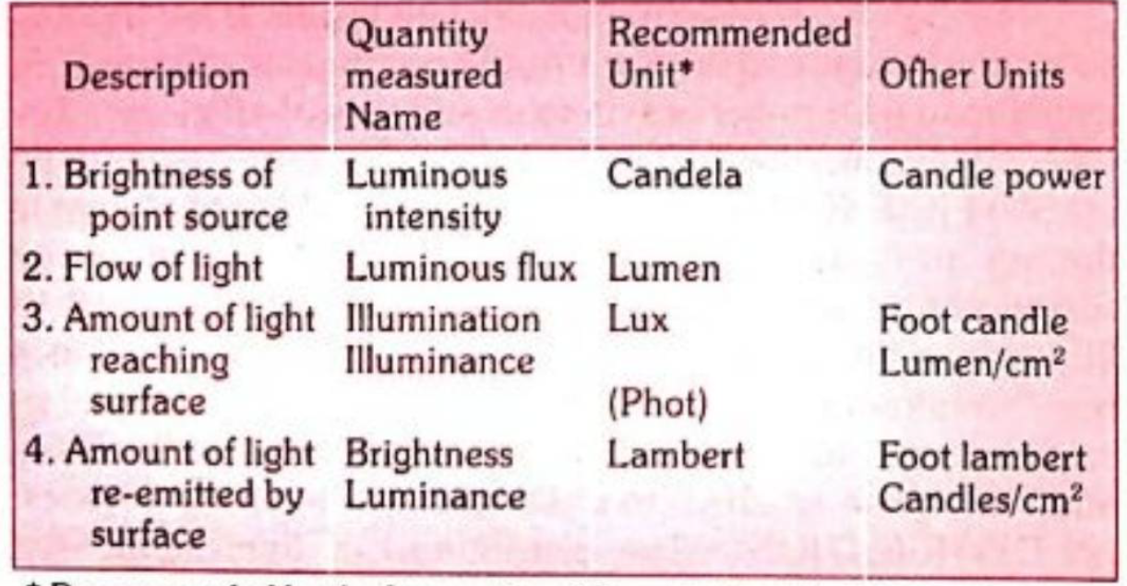
Measurement of light
What we perceive as light is a narrow wavelength band of electromagnetic radiation from about 380 to 780 nm. Light containing all visible waves is perceived as white.
The four measures are :
Luminous intensity - which is the “power” of a light source considered as a point radiating in all directions; this is measured as candela or candle power.
Luminous flux - which is the flow of light related to a unit of solid angle measured in lumen.
Illumination or illuminance - which is the amount of light reaching a surface measured in lux per unit area
Brightness or luminance - which is the amount of light reflected from a surface measured in lamberts.

Slide 23
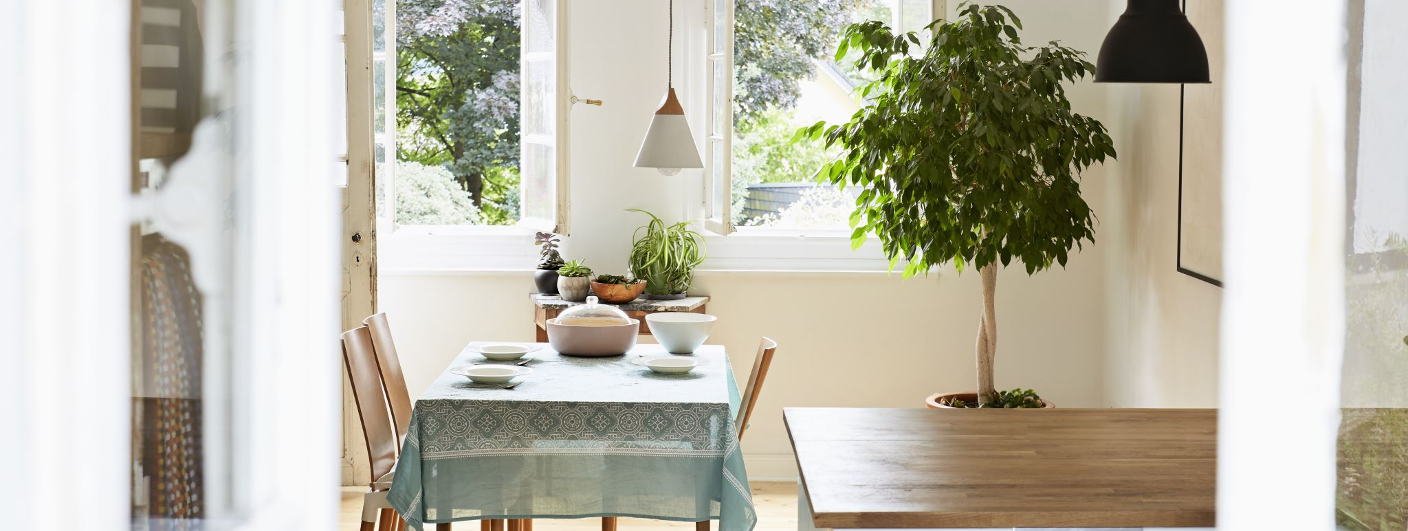
Thank you

