Slide 1

Environment and Health

Slide 2
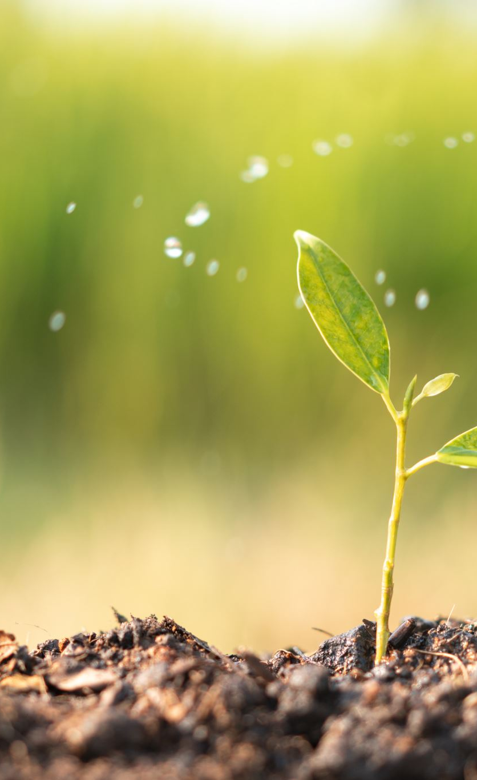
Definition and Components
External factors - living and non-living, material and non-material — which surround man.
In its modern concept, environment includes not only the water, air and soil that form our environment but also the social and economic conditions under which we live.
Physical : Water, air, soil, housing, wastes, radiation, etc.
Biologic : Plant and animal life including bacteria, viruses, insects, rodents and animals.
Social : Customs, culture, habits, income, occupation, religion etc.

Slide 3
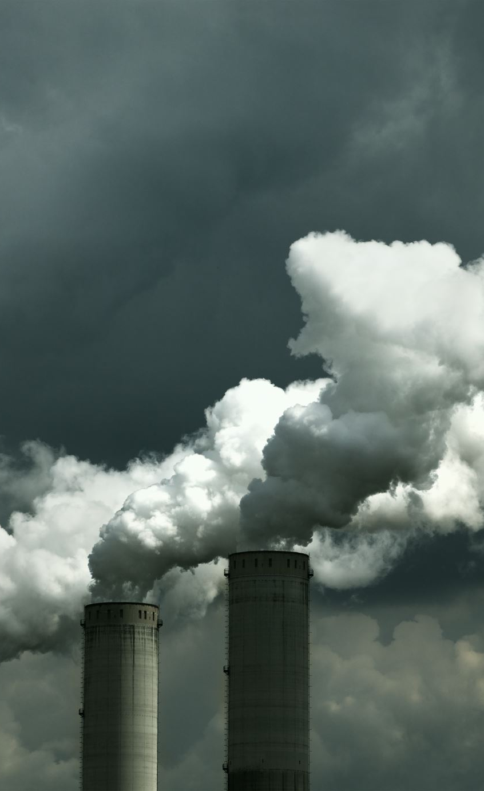
Ill health and environment
Water pollution, soil pollution, air pollution, poor housing conditions, presence of animal reservoirs and insect vectors of diseases which pose a constant threat to man’s health.
Man is responsible for the pollution of his environment through urbanization, industrialization and other human activities.
In 1972 the UN conference on the Human Environment focused worldwide attention on the environmental hazards that threaten human beings.

Slide 4

Sanitation
The dictionary meaning of the word sanitation is “the science of safe-guarding health.”
National Sanitation Foundation of the USA, which is as follows : ‘Sanitation is a way of life. It is the quality of living that is expressed in the clean home, the clean farm, the clean business, the clean neighborhood and the clean community.
Being a way of life, it must come from within the people; it is nourished by knowledge and grows as an obligation and an ideal in human relations.
Defined by WHO as “the control of all those factors in man’s physical environment which exercise or may exercise a deleterious effect on his physical development, health and survival”.

Slide 5

Services required
Proper environmental health now requires the services of:
The public health qualified doctor
The epidemiologist
The public health engineer
The town planner
The sociologist
The economist
The health inspector.
A combined multi-disciplinary programme of action is needed to achieve a healthy environment.

Slide 6

Health for all
Two of the changes needed to achieve “Health for All” are concerned with
Healthy environment
Healthy lifestyle
Require initiatives by the individual, the family and the community

Slide 7

Poor environmental sanitation
Unsafe water, polluted soil, unhygienic disposal of human excreta and refuse, poor housing, insects and rodents.
Air pollution is also a growing concern in many cities.
The high death rate, infant mortality rate, sickness rate and poor standards of health are in fact largely due to defective environmental sanitation.
Since more than 70 per cent of the population of India live in rural areas, the problem is one of rural sanitation.
The first step in any health programme is the elimination through environmental control of those factors which are harmful to health.

Slide 8

Water

Slide 9
Water
There can be no state of positive health and well-being without safe water.
Water that is easily accessible, adequate in quantity, free from contamination, safe and readily available throughout the year.
Water is not only a vital environmental factor to all forms of life, but it has also a great role to play in socio-economic development of human population.
Each country should develop its own water resources agency which would collect all pertinent data on water resources, exploitation and hydrogeology.
In 1981, the 34th World Health Assembly in a resolution emphasized that safe drinking water is a basic element of “primary health care” which is the key to the attainment of “Health for All by the year 2000 AD”.
The Millennium Development Goals and SDG 6 included safe water and sanitation in the attainable goals.
Water is integrated with other PHC components because it is an essential part of health education, food and nutrition, and also MCH.

Slide 10
Safe and Wholesome water
Water intended for human consumption should be both safe and wholesome. This has been defined as water that is
Free from pathogenic agents;
Free from harmful chemical substances;
Pleasant to the taste, i.e., free from colour and odour
Usable for domestic purposes.
Water is said to be polluted or contaminated when it does not fulfil the above criteria

Slide 11

Water requirement
The basic physiological requirements for drinking water have been estimated at about 2 liters per head per day. (For survival needs)
The consumption of water, however, depends upon climate conditions, standard of living and habits of the people.
A daily supply of 150-200 liters per capita is considered as an adequate supply to meet the needs for all urban domestic purposes.
In India 40 liters of water supply per capita per day was the set target to be achieved in rural areas.
It must be available close to the people, else they must spend hours and a lot of energy, going back and forth to obtain it and the water is often polluted in the process.

Slide 12

Uses of water
Conventionally, it has been convenient and economical to provide a single water supply sufficient in quantity to serve all uses and suitable in quality to meet drinking requirements, even though only a small fraction of the total water supply is used for drinking.
The uses of water include :
Domestic use : on domestic front, water is required for drinking, cooking, washing and bathing, flushing of toilets, gardening etc.
Public purposes : cleaning streets, recreational purposes like swimming pools, public fountains and ornamental ponds, fire protection and public parks.
Industrial purposes : for processing and cooling;
Agricultural purpose : irrigation
Power production from hydropower and steam power;
Carrying away waste from all manner of establishments and institutions.
Water is therefore an essential factor in the economic, social and cultural development of a community. It can eliminate diseases, promote rural development and improve quality of life.

Slide 13
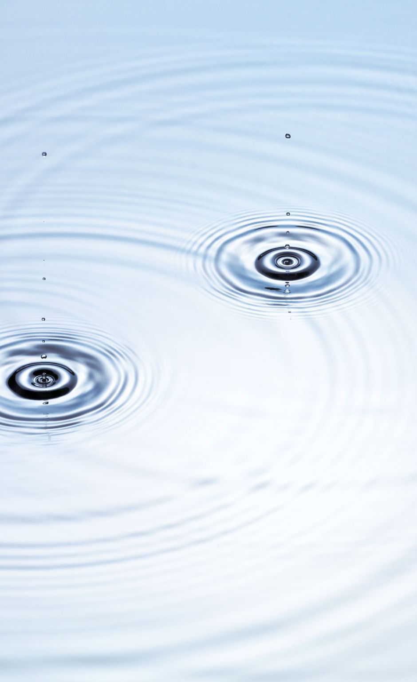
Sources of water
Water may be abstracted for use from any one of a number of points in its movement through the hydrological cycle.
The safe yield of the source must be sufficient to serve the population expected at the end of the design period, which may be 10 to 50 years in future.
The safe yield is generally defined as the yield that is adequate for 95 per cent of the year.
The selection of a source requires professional advice. In general, water sources must conform to two criteria :
The quantity must be sufficient to meet present and future requirement
The quality of water must be acceptable.

Slide 14
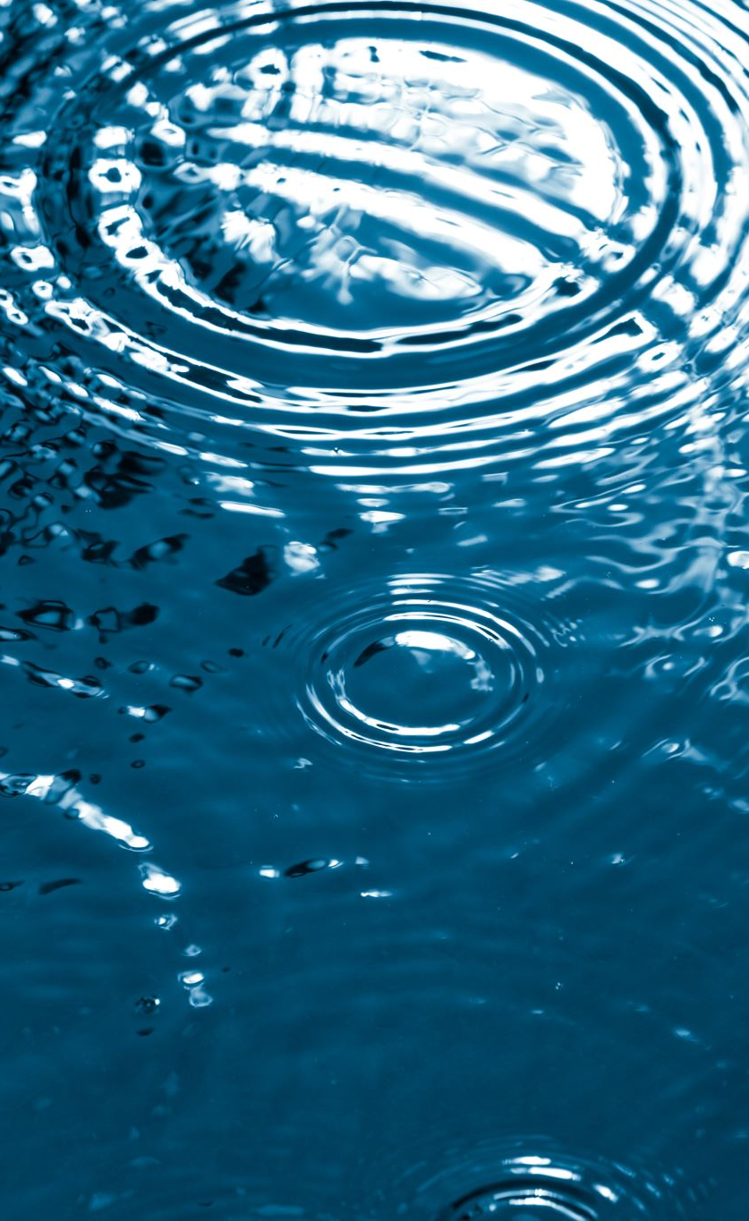
Main Sources of water
RAIN
SURFACE WATER
Impounding reservoirs
Rivers and streams
Tanks, ponds and lakes.
GROUND WATER
Shallow wells
Deep wells
Springs

Slide 15
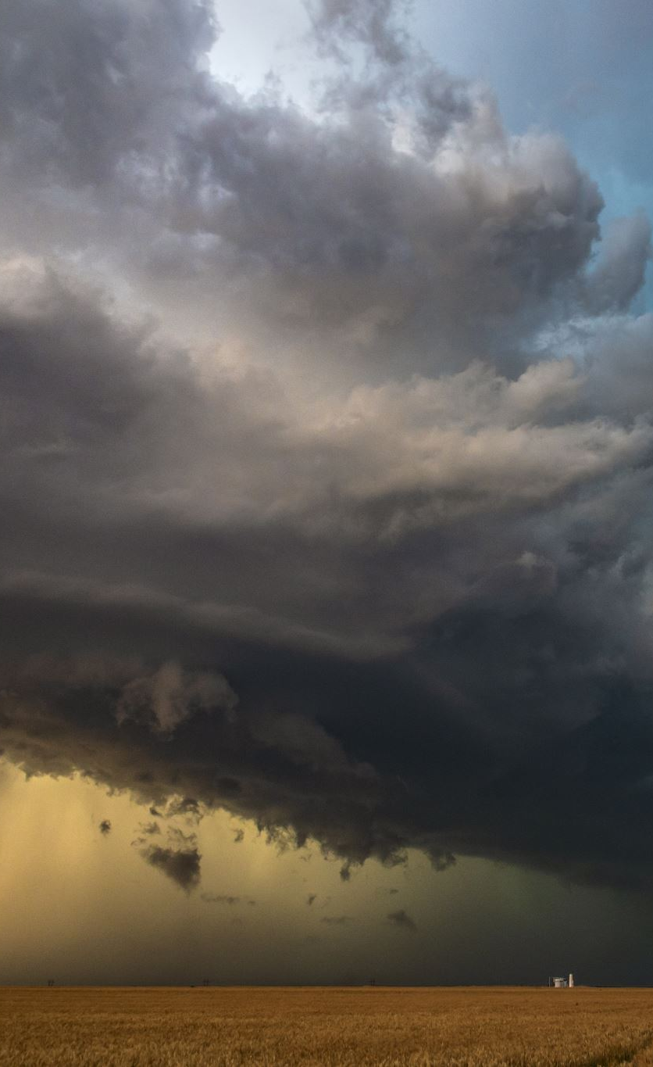
Rain
Rain is the prime source of all water.
A part of the rainwater sinks into the ground to form ground water; part of it evaporates back into the atmosphere, and some runs off to form streams and rivers which flow ultimately into the sea. Some of the water in the soil is taken up by the plants and is evaporated in turn by the leaves. These events are spoken of as water cycle .
There are very few places in the world like Gibralter which depend upon rain as a source of water supply.
CHARACTERISTICS : Rainwater is the purest water in nature.
Physically, it is clear, bright and sparkling.
Chemically, it is very soft water containing only traces of dissolved solids (0.0005 per cent). Being soft, it has a corrosive action on lead pipes.
Bacteriologically, rainwater from clean districts is free from pathogenic agents.

Slide 16

Impurities in rain
IMPURITIES : Rainwater tends to become impure as it passes through the atmosphere.
It picks up suspended impurities from the atmosphere such as dust, soot and microorganisms and gases such as carbon dioxide, nitrogen, oxygen and ammonia.
Gaseous sulphur and nitrogen oxides are emitted from power plants that use fossil fuels.
These gases react with atmospheric water, forming dilute solution of sulphuric and nitric acid. The precipitation of these acids (acid rain) has begun to have serious impacts on surface water quality and on plants etc.

Slide 17

Surface water
Surface water originates from rainwater. It is the main source of water supply in many areas.
Examples of surface water include rivers, tanks, lakes, wadis (waler source which are dry, except in rainy season), man-made reservoirs and sea water.
Surface water is prone to contamination from human and animal sources. As such it is never safe for human consumption unless subjected to sanitary protection and purification before use.
In general, surface water supplies possess a high probability of organic, bacterial and viral contamination.
Most Indian cities and towns depend upon surface water sources
Impounding Reservoirs.
Rivers and Streams,
Tanks, Ponds and Lakes.

Slide 18
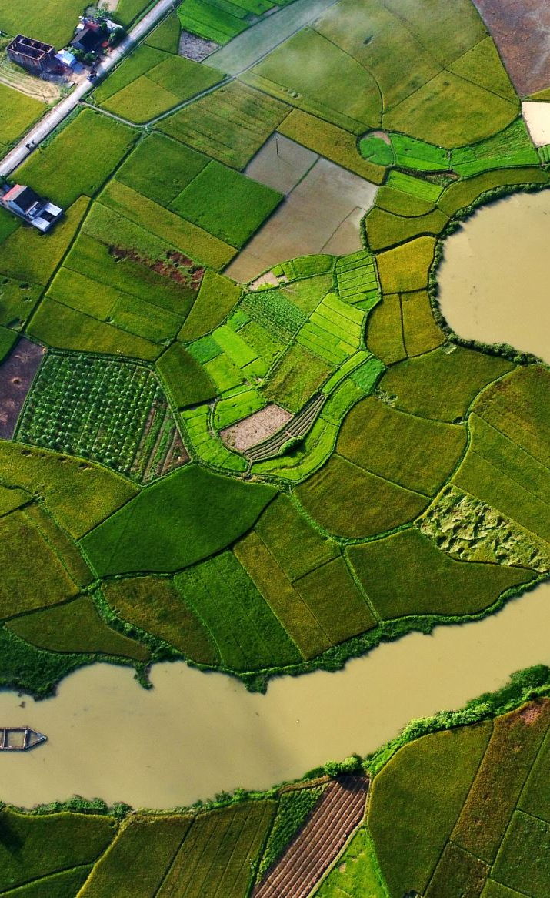
Impounding reservoir
These are artificial lakes constructed usually of earthwork or masonry in which large quantities of surface water is stored.
Dams built across rivers and mountain streams also provide large reserves of surface water. The area draining into the reservoir is called “Catchment area .
Cities such as Mumbai, Chennai and Nagpur derive their water supply from impounding reservoirs. One disadvantage of storing water for long periods in reservoirs is the growth of algae and other microscopic organisms, which impart bad tastes and odours to water.
CHARACTERISTICS : Impounding reservoirs usually furnish a fairly good quality of water.
The waler is usually clear, palatable and ranks next to rainwater in purity.
If the surrounding hills are covered with peat, the water may acquire a brownish coloration.
The water is usually soft and considered to be free of pathogenic organisms.

Slide 19
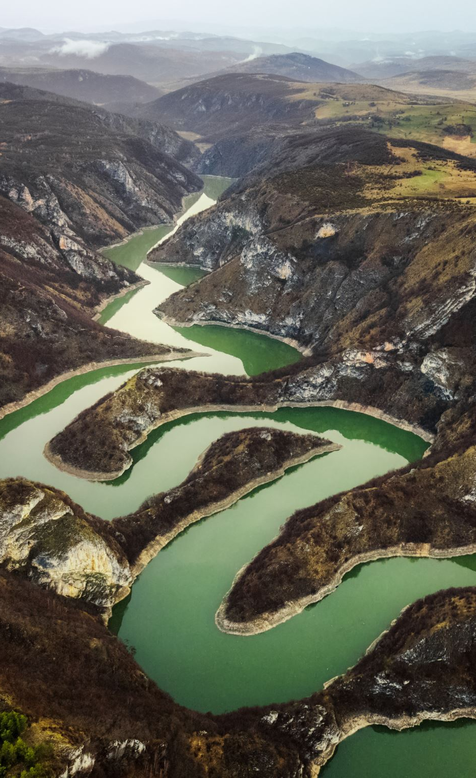
Impounding Reservoir - impurities
IMPURITIES : The upland surface water derives its impurities from the catchment area.
The sources being human habitations and animal keeping or grazing.
It is therefore very necessary to keep the catchment area free from human or animal intrusion.
The general belief that mountain streams are very pure water is often untrue. Even if there is no human habitation or cattle near, there is still a possibility of contamination caused by wild animals.

Slide 20
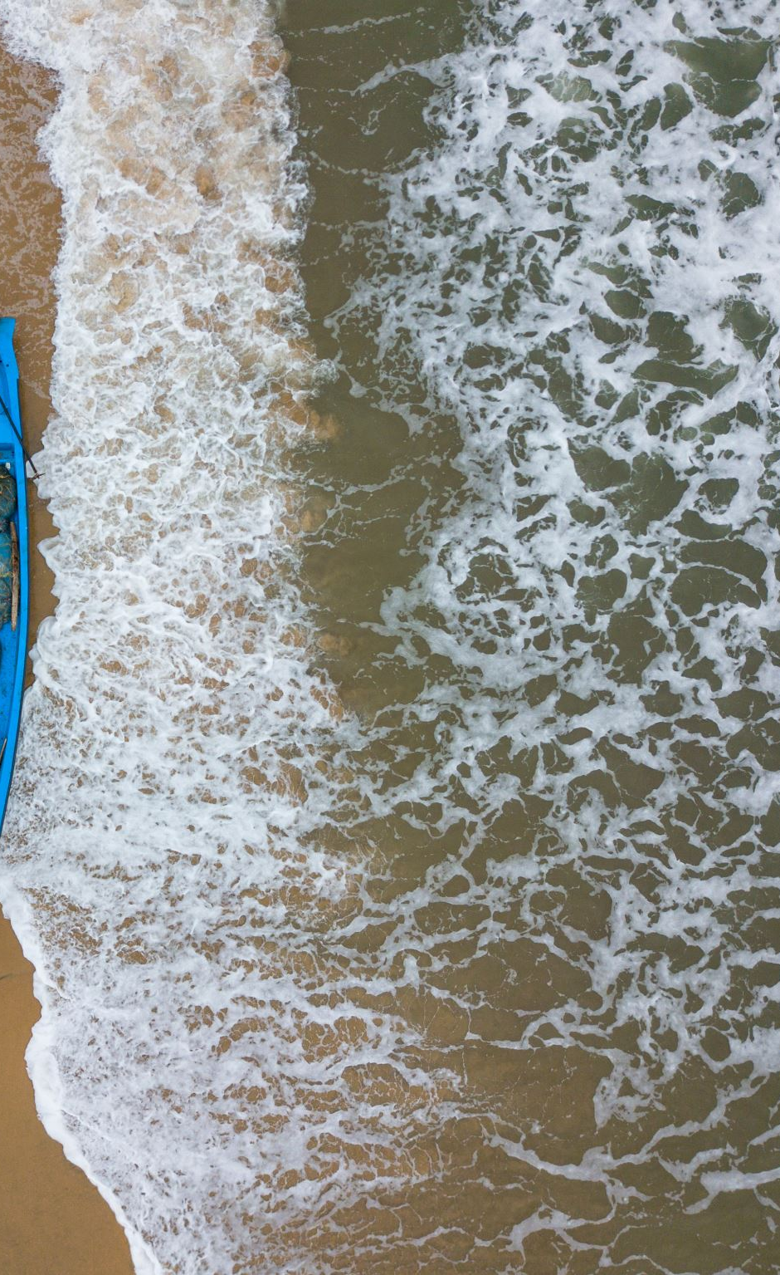
Rivers
Many rivers furnish a dependable supply of water.
Cities such as Delhi, Kolkata and Allahabad rely on river water for their needs. The chief drawback of river water is that it is always grossly polluted and is quite unfit for drinking without treatment.
CHARACTERISTICS : River water is turbid during rainy season; it may be clear in other seasons.
Clarity of water is no guarantee that the river water is safe for drinking. River water contains dissolved and suspended impurities of all kinds. The bacterial count, including the human intestinal organisms may be very high.

Slide 21

Rivers - impurities
IMPURITIES: Rivers are described as a direct connection between the alimentary canal of the people living upstream and the mouths of those below.
The impurities of river water are derived from surface washings, sewage and sullage water, industrial and trade wastes, and drainage from agricultural areas.
The customs and habits of the people like bathing, animal washing and disposal of the dead, all add to the pollution of water.
SELF-PURIFICATION : Certain amount of self-purification does occur in river water by natural forces of purification such as dilution, sedimentation, aeration, oxidation, sunlight, plant and animal life but these agencies are not sufficient to render the water potable.
River water needs purification before it can be used for drinking purposes.

Slide 22
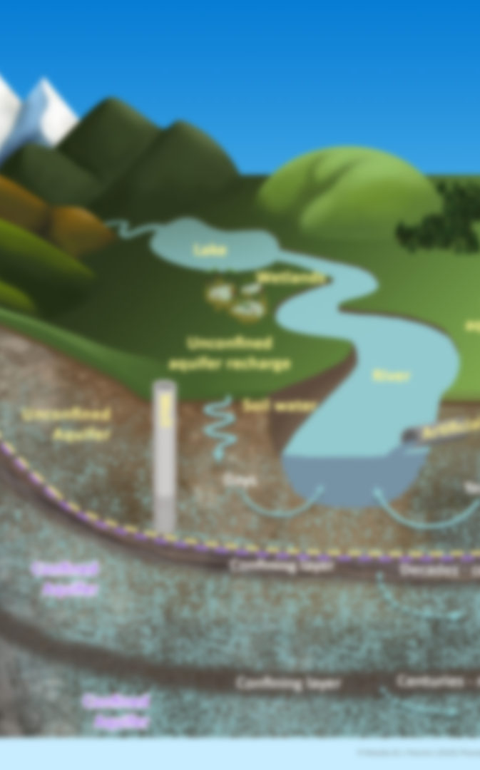
Tanks
Tanks are large excavations in which surface water is stored.
They are an important source of water supply in some Indian villages.
Tanks are recipients of contamination of all sorts. They are full of silt and colloidal matter, especially immediately after the rains. The older tanks may be full of aquatic vegetation.
Tanks are often used for washing of clothes, cattle, humans, cooking pots; children use it for swimming and there may be regular defecation around the edges which will be washed into the tank at the next rains.
Tanks are thus subjected to unlimited possibilities of contamination and arc highly dangerous, as a source of drinking water, even at the best of times.
Unfortunately, the tank water is drunk without being boiled, disinfected or having undergone treatment of any kind which is responsible for an incalculable number of cases of sickness and death, particularly of children.

Slide 23
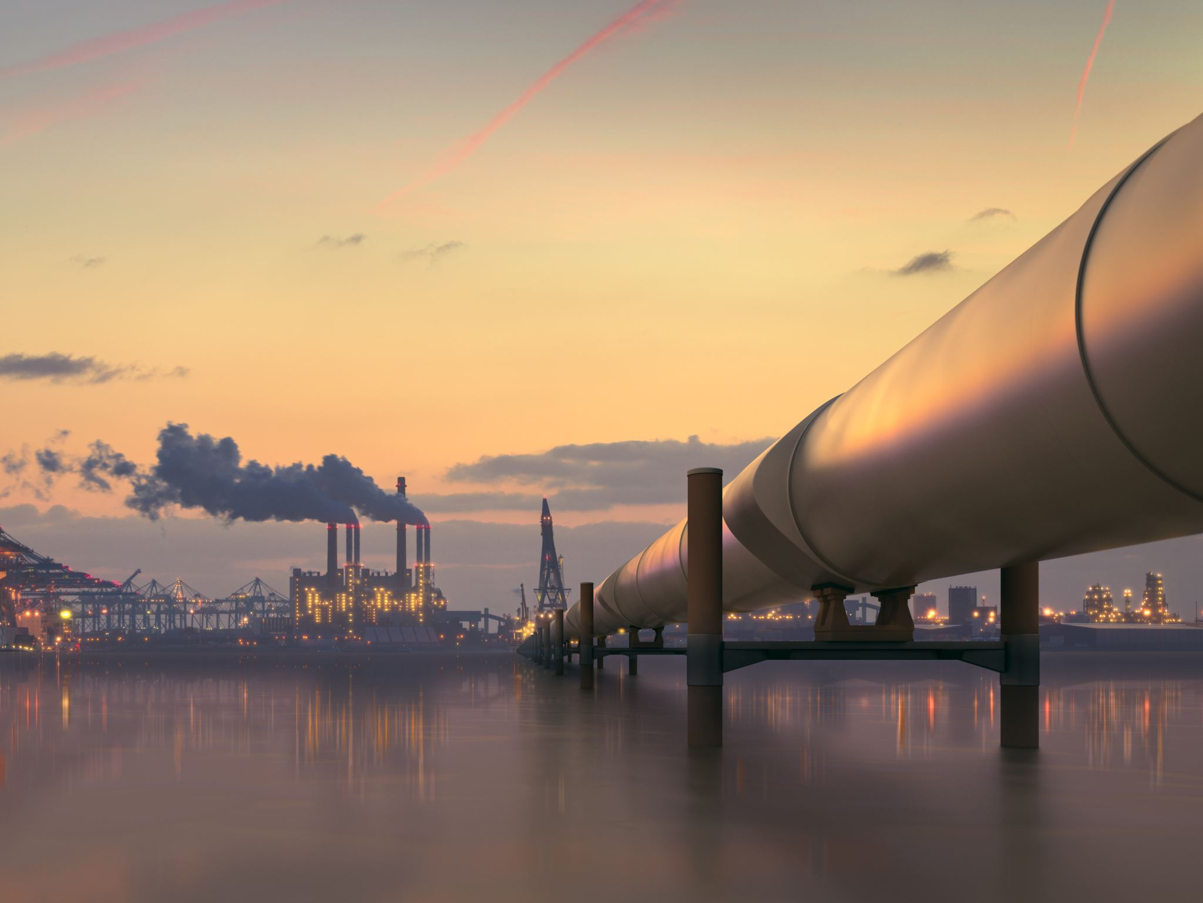
Improvement of tanks
A certain amount of natural purification does take place in tank water because of storage, oxidation and other agencies but these arc not sufficient to render the water safe.
The sanitary quality of tank water may be considerably improved by observing the following :
The edges of the tank should be elevated in order to prevent the entry of surface washings;
There should be a fence around the tank to prevent access to animals;
No one should be permitted to get into the tank directly (note the hazard of guinea worm infestation);
There should be an elevated platform from where people can draw water;
The weeds should be periodically removed; and
The tank should be cleaned at the end of the dry season.
Inspite of these precautions, from a practical point of view, it is not possible to prevent pollution of tanks as the people who consume the tank water are often among the poorest in the country and do not have sanitary concepts.
It is believed that the simplest solution consists of subjecting the tank water to some sort of sand filtration.
The addition of chlorine would undoubtedly add to the value of sand filtration.

Slide 24
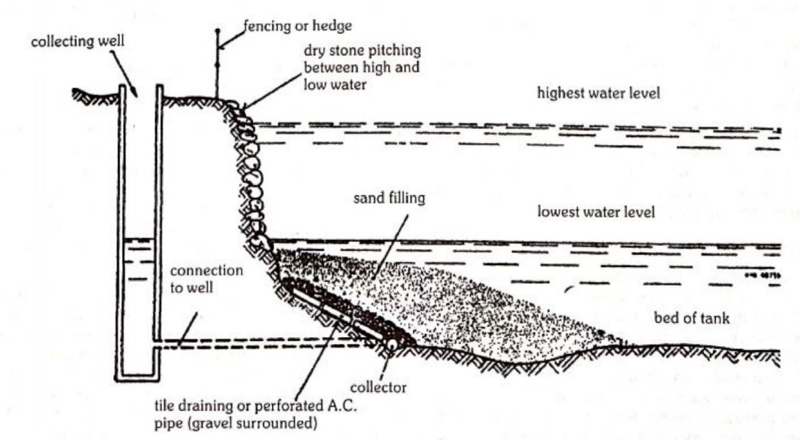

Slide 25

Sea water
Though this source is plentiful, it has great many limitations.
It contains 3.5 per cent of salts in solution.
Offshore waters of the oceans and seas have a salt concentration of 30,000 to 36,000 mg/litre (30-36 g/litre) of dissolved solids including 19,000 mg/litre of chloride, 10,600 mg/litre of sodium and 1,270 mg/litre of magnesium.
Desalting and demineralization process involves heavy expenditure.
It is adopted in places where sea water is the only source available

