Slide 1
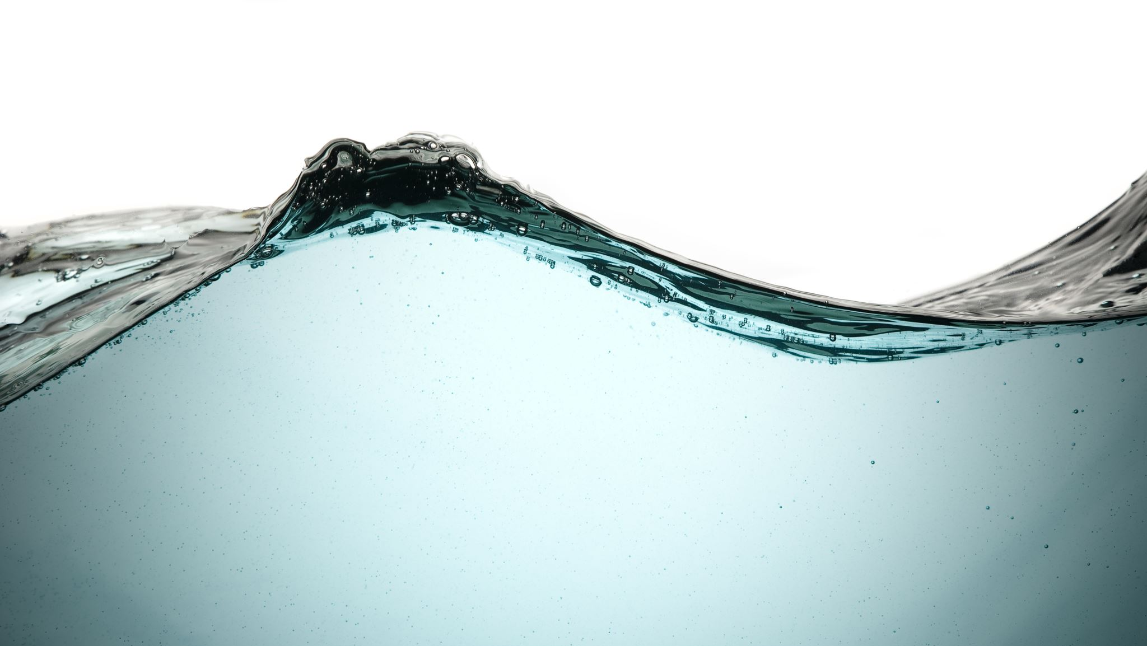
Water

Slide 2
Ground Water
Water used by humans comes mainly from land.
Limit to ground water in the world.
We should withdraw only quantities of water that can be renewed.
Cheapest and most practical means of providing water to small communities.
Superior to surface water, because the ground itself provides an effective filtering medium.
Advantages
Dis-advantages
Likely to be free from pathogenic agents;
It usually requires no treatment
The supply is likely to be certain even during dry season;
It is less subject to contamination than surface water.
It is high in mineral content, e.g., salts of calcium and magnesium which render the water hard.
It requires pumping or some arrangement to lift the water

Slide 3
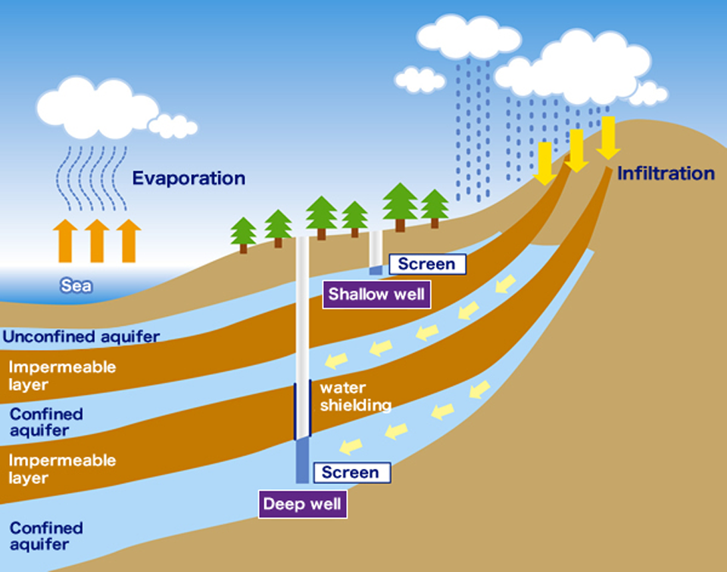
Wells
Types
Shallow wells
Deep wells
Based on construction
Dug wells
Tube wells

Slide 4
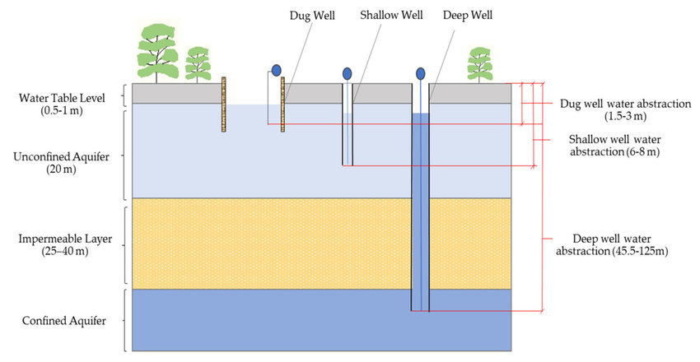

Slide 5
Shallow Wells
Deep Wells
Tap subsoil water i.e. the water from above the first impervious layer in the ground.
They yield limited quantities of water, usually dry in summer.
The water is notoriously liable to pollution unless care is taken in well construction.
Moderately hard.
Sources of contamination – latrines, urinals, drains, cesspools, soakage pits and collection of manure
More common in India
Taps water from the water-bearing stratum below the first impervious layer in the ground.
Constant Supply
Usually machine-dug and may be several hundred metres deep.
Deep wells furnish the safest water and are often the most satisfactory sources of water supply.
Much hard
Can also become a health hazard if it is open, poorly constructed and not protected against contamination
Saline intrusion: brackish taste & unfit for domestic use

Slide 6
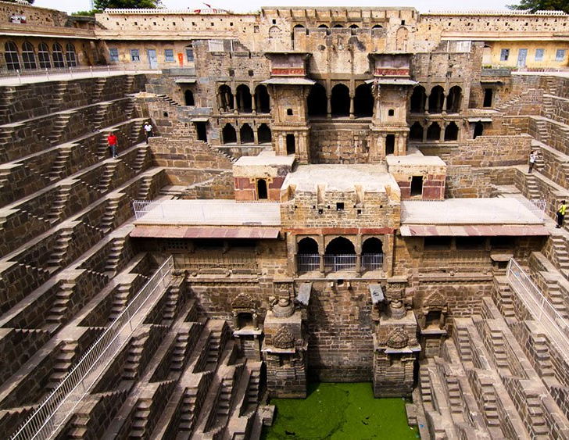
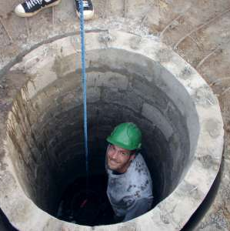
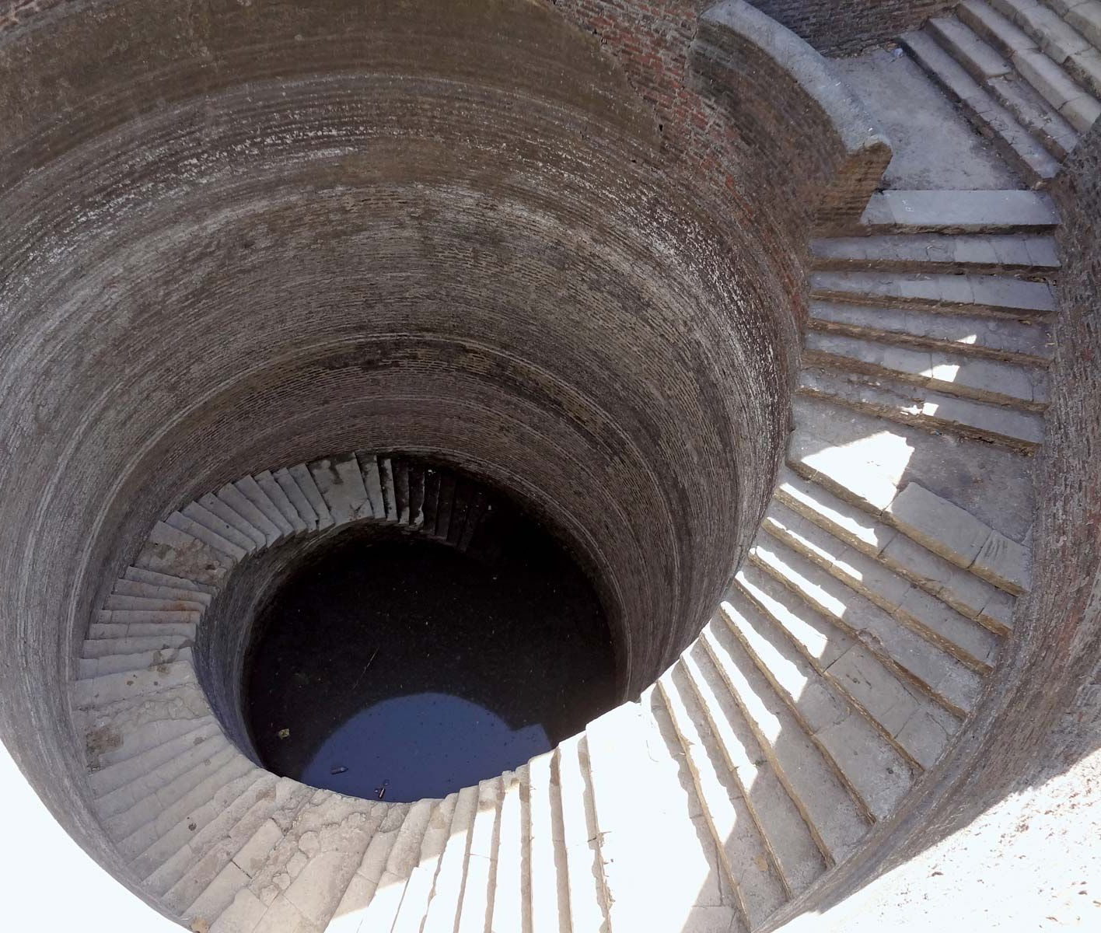
Dug Wells
The unlined kutcha well is a hole dug into the water-bearing stratum.
The masonry / pucca well is an open well, built of bricks or stones.
STEP WELLS are a kind of pucca wells which are becoming obsolete, fortunately.
Steps are constructed into these wells to enable people to descend into the well to fetch water or quench their thirst.
In these wells, there is considerable personal contact between the user and the water.
Some people may even wash their faces, hands and feet which is a common Indian custom.
The open dug wells and step wells are a health hazard to the community.

Slide 7
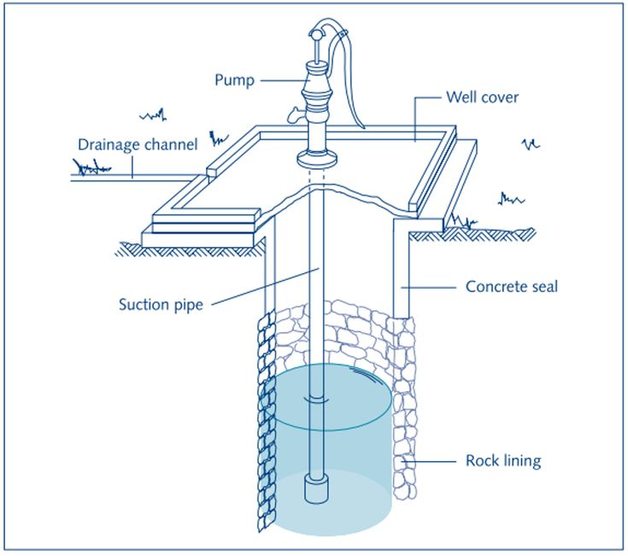
Improvement of dug wells
The unlined kutcha wells may be made sanitary by:
Deepening the bottom
Installing a hand-pump with screen
Filling the well with coarse sand up to the water level and with clay above that level.
When the material used for filling is completely consolidated a platform and drainage may be constructed.
Masonry well improvement consists:
Upper 10 feet or more of the lining water-tight
Raising the lining one foot above the ground,
Providing a reinforced concrete slab cover at the top.
One or more hand-pumps may be installed for lifting the water.
Special attention should be paid to the foundation of the pump to prevent any possible leakage of wastewater into the well.

Slide 8
Sanitary Wells
Properly located, well constructed and protected against contamination with a view to yield a supply of safe water.
LOCATION : The first step - proper site.
Located not less than 15 m (50 feet) from likely sources of contamination.
The well should be located at a higher elevation with respect to a possible source of contamination.
Well should be so located that no user will have to carry water for more than 100 m (100 yards).
LINING : The lining of the well should be built of bricks or stones set in cement up to a depth of at least 6 m (20 feet).
The lining should be carried 60-90 cm (2-3 feet) above the ground level.
PARAPET WALL : There should be a parapet wall up to a height of at least 70-75 cms (28 inches) above the ground.
PLATFORM : There should be a cement-concrete platform round the well extending at least 1 m (3 feet) in all directions.
The platform should have gentle slope outwards towards a drain built along its edges.

Slide 9
Sanitary Wells
DRAIN : There should be a pucca drain to carry off spilled water to a public drain or a soakage pit constructed beyond the “cone of filtration” (area of drainage) of the well.
COVERING : The top of the well should be closed by a cement concrete cover because the bulk of the pollution is introduced into the well directly through the open top.
Studies have shown that merely covering a well alone caused a marked improvement in the bacteriological quality of the water.
Open wells, therefore, cannot be considered sanitary
HAND-PUMP : The well should be equipped with a hand-pump for lifting the water in a sanitary manner.
Studies have shown that when a pump is fitted there is marked improvement in the bacteriological quality of the water.
The handpump should be of robust construction to withstand rough handling by the people.
There should be an efficient maintenance service and arrangements for immediate repair if the pumps go out of order.
CONSUMER RESPONSIBILITY : basic precautions at the individual and family level.
Strict cleanliness should be enforced in the vicinity of the well; personal ablutions, washing of clothes and animals, and the dumping of refuse and wastes should be prohibited.
Ropes and buckets from individual homes should not be used for drawing a supply from the well.
Water from the well should be carried in clean sanitary vessels to individual houses.
Requires health education.
QUALITY : The physical, chemical and bacteriological quality of water should conform to the acceptable standards of quality of safe and wholesome water.

Slide 10
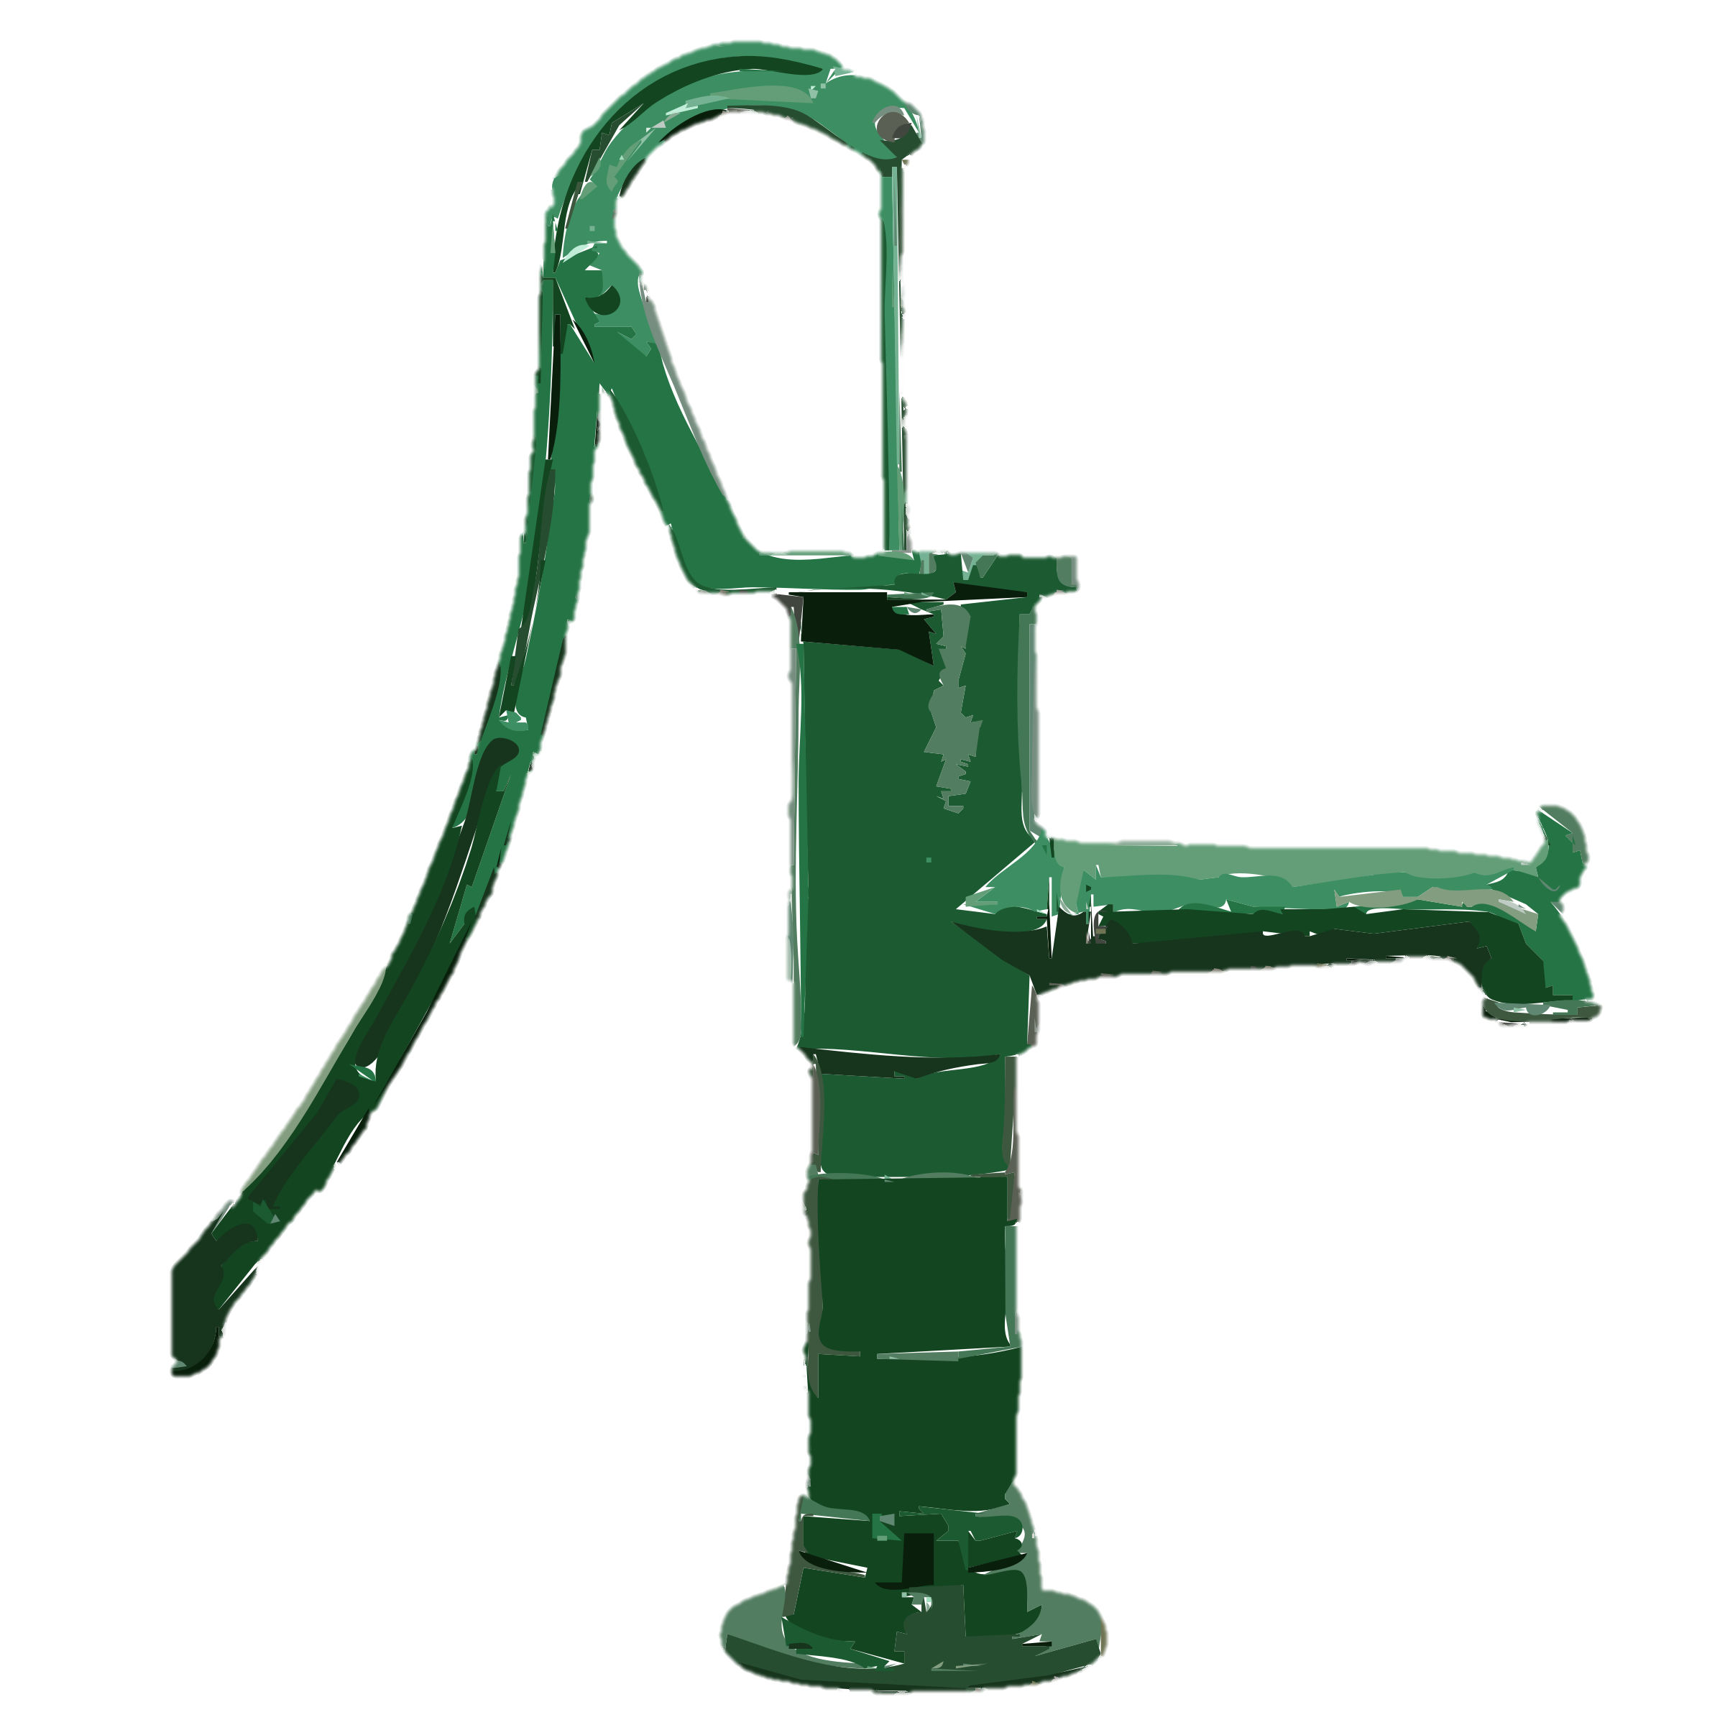





< 100m (100 yards)
> 70 – 75 cm (28 in)
Drain
> 60 – 90 cm (2 - 3 ft)
Septic Tank
Soakage Pit
> 1 m (3 ft)
> 15m (50 ft)
> 6 m (20 ft)
I – Porous Strata
I – Impervious strata
II – Porous Strata

Slide 11
Tube Wells
Tube wells are successful as a source of drinking water in many parts of India.
They yield water which is bacteriologically safe and are also cheap in comparison to other sources of supply.
Shallow tube wells or “driven wells” have become the largest individual source of water supply to the rural community.
The tube well consists of a pipe (usually galvanized iron) sunk into the water-bearing stratum and fitted with a strainer at the bottom, and a hand-pump at the top.
A water-tight concrete platform with a drain all round should be provided.
The area within 15 m of the tube well should be kept free from pollution with liquid and solid wastes.
The hand-pump should be kept in good repair.
The life of the tube well is not the same everywhere. It varies from place to place depending upon the type of strainer, quality of underground water and the nature of soil.
When the tube well is derelict, it is withdrawn and then resunk with a new strainer using as much of the withdrawn pipes as can be recovered.
Deep tube wells or bored wells are sunk by drilling through successive substrata of gravel or rock until a suitable supply of ground water is located.
They may be several hundred feet deep and require complicated mechanical drilling equipment and skilled engineering direction.
This type of wells, although costly to construct and to operate, are in many ways the ideal supply.
The yield is normally very high and does not depend upon direct rainfall in the immediate vicinity.
Chandigarh, the capital of Punjab and Haryana, derives its entire water supply from tube wells.

Slide 12
Springs
When ground water comes to the surface and flows freely under natural pressure, it is called a “spring”.
Springs may be of two types-shallow springs and deep springs.
Shallow springs dry up quickly during summer months.
Deep springs do not show seasonal fluctuations in the flow of water.
Springs are simpler to exploit, as no pumping is needed to bring the water to the surface.
Springs are exposed to contamination.
Well built protective structures are necessary to safeguard water quality.

Slide 13
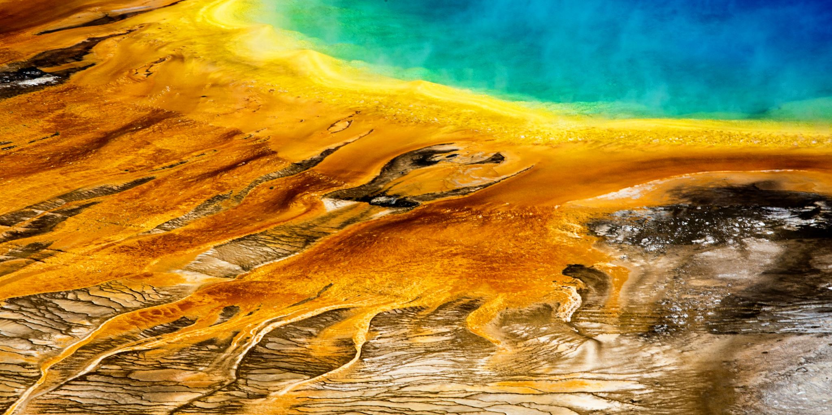

Water Pollution

Slide 14
IMPURITIES
Natural
Human Activity
Dissolved gases (CO2, H2S, N2, etc)
Dissolved minerals (Salts of Ca, Mg, Na etc)
Suspended (Clay, silt, sand and mud)
Not essentially dangerous
From atmosphere, catchment area and soil
D/t Urbanization and Industrialization
Sewage (decomposable organic matter & pathogens)
Industrial & trade wastes ( metal salts to complex synthetic organic material)
Agricultural (fertilizers & pesticides)
Physical ( heat and radio-active substances)

Slide 15
Indicators
Amount of total suspended solids,
Biochemical oxygen demand (BOD) at 20 deg. C,
Concentration of chlorides, nitrogen and phosphorus
Absence of dissolved oxygen.
Even if the source of water supply and its treatment are of a high standard, water pollution may still occur as often happens,
Due to corrosion of pipelines,
Leaky joints
Cross connections between water supply pipes and sewage drainage pipes.

Slide 16

Water Related Diseases
By the ingestion of contaminated water either directly or through food.
Using contaminated water for purpose of personal hygiene and recreation.
Developing countries carry a heavy burden of water-related diseases, the heaviest being the diarrheal diseases.

Slide 17
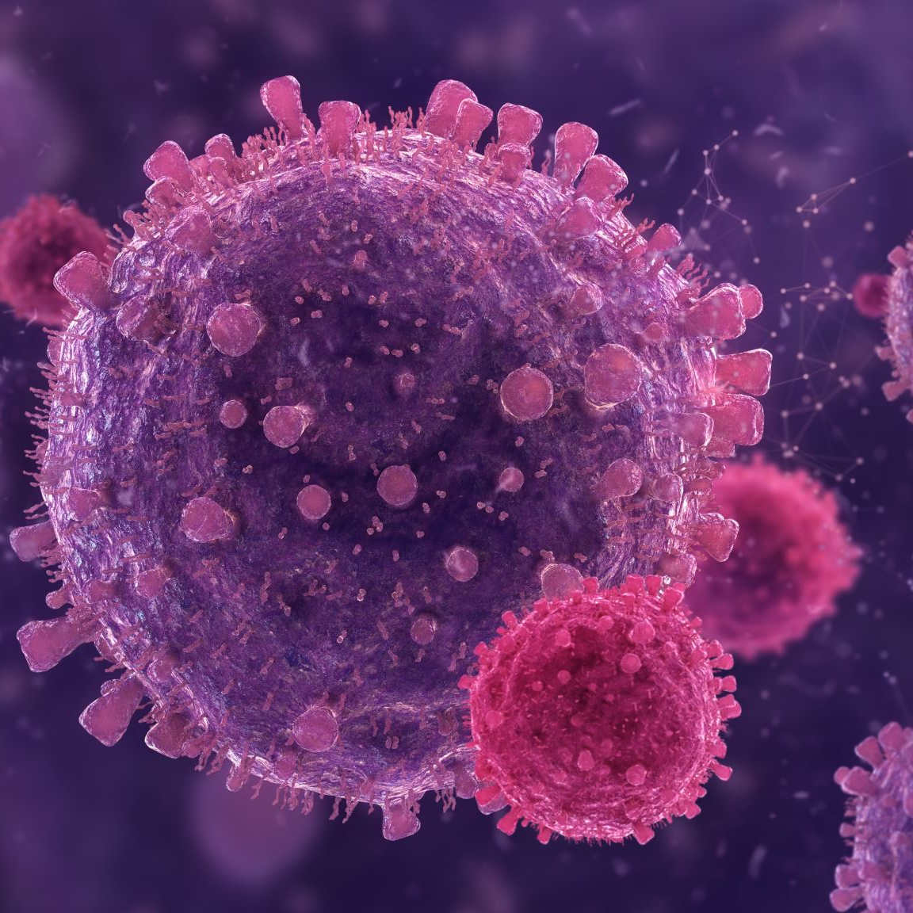
Biological (Water – borne diseases)
Presence of an infective agent:
Viral : Viral hepatitis A, hepatitis E, poliomyelitis, rotavirus diarrhea in infants.
Bacterial : typhoid and paratyphoid fever, bacillary dysentery, Esch. coli diarrhea, cholera.
Protozoal : amoebiasis. giardiasis
Helminthic : roundworm, threadworm, hydatid disease.
Leptospiral : Weil’s disease
Presence of an aquatic host :
Snail : schistosomiasis
Cyclops : Guinea worm , fish tape worm.

Slide 18
Chemical
These pollutants include detergent solvents, cyanides, heavy metals, minerals and organic acids, nitrogenous substances, bleaching agents, dyes, pigments, sulphides, ammonia, toxic and biocidal organic compounds of great variety.
Chemical pollutants may affect man’s health not only directly, but also indirectly by accumulating in aquatic life (e.g. fish) used as human food.
The present concern about chemical pollutants in water relates not so much as to their acute toxic effects on human health as to the possible long-term effects of low-level exposure.

Slide 19
Other health associations
Dental health : The presence of fluoride at about 1 mg/litre in drinking water is known to protect against dental caries, but high levels of fluoride cause mottling of the dental enamel
Cyanosis in infant : High nitrate content of water is associated with methaemoglobinaemia. This is a rare occurrence but may occur when surface water from farmland, treated with a fertilizer, gain access to the water supply
Cardiovascular diseases : Hardness of water appears to have a beneficial effect against cardiovascular diseases;
Diseases transmitted d/t inadequate use of water like shigellosis, trachoma and conjunctivitis, ascariasis, scabies.
Disease carrying insects breeding in or near water, like: malaria, filaria, arboviruses, onchocerciasis, African trypanosomiasis

Slide 20
Water Pollution Law
To protect water from being contaminated, the Indian Parliament in 1974 passed the Water (Prevention and Control of Pollution) Act.
The Act seeks to provide legal deterrent against the spread of water pollution.
The Act is a comprehensive piece of legislation.
It provides for the constitution of Central and State Water Boards and Joint Water Boards endowed with wide powers for controlling pollution.

Slide 21
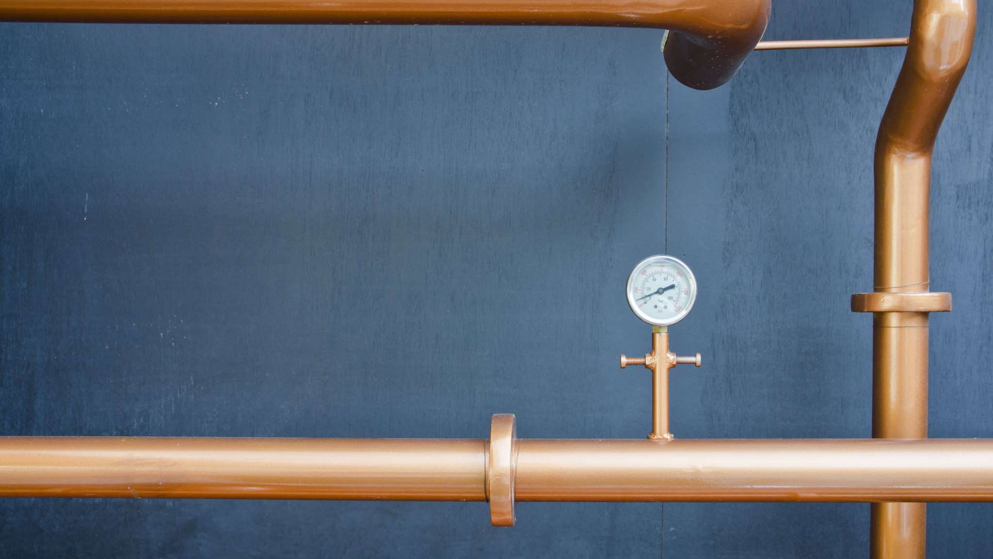
Water purification

Slide 22
Large Scale purification
The method of treatment to be employed depends upon the nature of raw water, and the desired standards of water quality.
Ground water (e.g., wells and springs) may need no treatment, other than disinfection.
Surface water (e.g.. river water) which tends to be turbid and polluted, requires extensive treatment.
The components of a typical water purification system comprise one or more of the following measures :
I. Storage
II. Filtration
III. Disinfection

Slide 23
Storage
Water is drawn out from the source and impounded in natural or artificial reservoirs. Storage provides a reserve of water from which further pollution is excluded.
Physical : About 90 per cent of the suspended impurities settle down in 24 hours by gravity.
The water becomes clearer. This allows penetration of light and reduces the work of the filters.
Chemical : The aerobic bacteria oxidize the organic matter present in the water with the aid of dissolved oxygen.
The content of free ammonia is reduced and a rise in nitrates occurs
Biological : The pathogenic organisms gradually die out.
It is found that when river water is stored the total bacterial count drops by as much as 90 per cent in the first 5-7 days.
This is one of the greatest benefits of storage.
The optimum period of storage of river water is about 10-14 days.
If the water is stored for long periods, there is likelihood of development of vegetable growths such as algae which impart a bad smell and colour to water.

Slide 24
Filtration
98-99 per cent of the bacteria are removed by filtration, apart from other impurities.
Two types of filters are in use
The “biological” or “slow sand” filters
The “rapid sand” or “mechanical” filters.
SLOW SAND OR BIOLOGICAL FILTERS
Slow sand filters were first used for water treatment in 1804 in Scotland and subsequently in London.
Elements of a slow sand filter:
Supernatant (raw) water
A bed of graded sand
An under-drainage system
A system of filter control valves

Slide 25
