Slide 1
Water Purification

Slide 2
Filtration
98-99 per cent of the bacteria are removed by filtration, apart from other impurities.
Two types of filters are in use
The “biological” or “slow sand” filters
The “rapid sand” or “mechanical” filters.
SLOW SAND OR BIOLOGICAL FILTERS
Slow sand filters were first used for water treatment in 1804 in Scotland and subsequently in London.
Elements of a slow sand filter:
Supernatant (raw) water
A bed of graded sand
An under-drainage system
A system of filter control valves

Slide 3
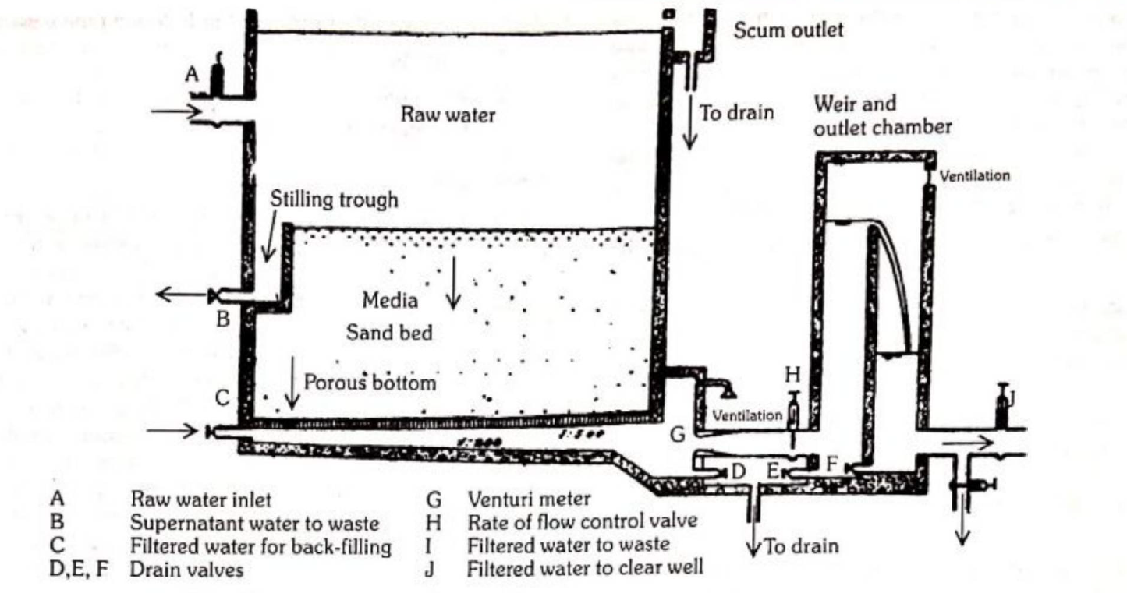

Slide 4
Supernatant Water
The supernatant water above the sand bed.
Depth varies from 1 to 1.5 meters
Important purposes :
It provides a constant head of water so as to overcome the resistance of the filter bed and thereby promote the downward flow of water through the sand beds
It provides waiting period of some hours (3 to 12 hours, depending upon the filtration velocity) for the raw water to undergo partial purification by sedimentation, oxidation and particle agglomeration,
The level of supernatant water is always kept constant.

Slide 5
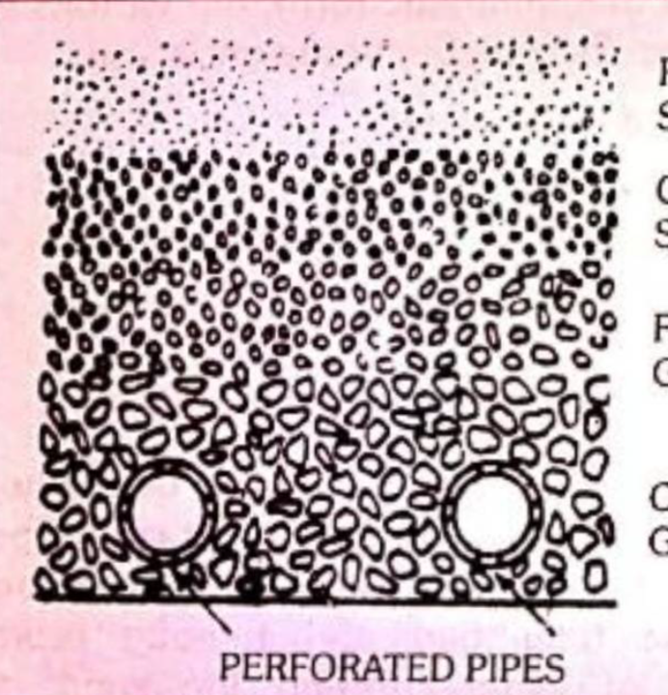
Sand Bed
The thickness of the sand bed is about 1 metre.
An “effective diameter” between 0.2 and 0.3 mm.
Should be clean and free from clay and organic matter.
The sand bed is supported by a layer of graded gravel 30-40 cm deep which also prevents the fine grains being carried into the drainage pipes.
The sand bed presents a vast surface area; one cubic metre of filter sand presents some 15,000 sq. metres of surface area.
Water percolates through the sand bed very slowly (a process taking two hours or more
Number of purification processes -
Mechanical straining, sedimentation, adsorption, oxidation and bacterial action.
Rate of filtration of water normally lies between 0.1 and 0.4 m3/hour/per square metre of sand bed surface.

Slide 6
Vital layer
Newly laid filter - merely as a mechanical strainer
Surface of the sand bed gets covered with a slimy growth known as “Schmutzdecke”, vital
layer, zoogleal layer or biological layer.
This layer is slimy and gelatinous and consists of thread like algae and numerous forms of life including plankton, diatoms and bacteria.
The formation of vital layer is known as “ripening” of the filter.
It may take several days for the vital layer to form fully, and when fully formed it extends for 2 to 3 cm into the top portion of the sand bed.
The vital layer is the “heart” of the slow sand filter.
It removes organic matter, holds back bacteria and oxidizes ammoniacal nitrogen into nitrates and helps in yielding a bacteria-free water.
Until the vital layer is fully formed, the first few days filtrate is usually run to waste.

Slide 7
Under-drainage system
Bottom of the filter bed is the under-drainage system.
It consists of porous or perforated pipes which serve the dual purpose of providing an outlet for filtered water, and supporting the filter medium above.
The filter box is an open box, usually rectangular in shape, from 2.5 to 4 metres deep and is built wholly or partly below ground.
The walls may be made of stone, brick or cement. The filter box consists from top to bottom :
Supernatant water 1 to 1.5 metre
Sandbed 1.2 metre
Gravel support 0.30 metre
Filter bottom 0.16 metre

Slide 8
Filter control
The filter is equipped with certain valves and devices which are incorporated in the outlet-pipe system.
The purpose of these devices is to maintain a constant rate of filtration.
An important component of the regulation system is the “Venturi meter” which measures the bed resistance or “loss of head”. When the resistance builds up, the operator opens the regulating valve so as to maintain a steady rate of filtration.
When the “loss of head” exceeds 1.3 metre it is uneconomical to run the filter.

Slide 9
Filter cleaning
Normally the filter may run for weeks or even months without cleaning.
At this stage, the supernatant water is drained off, and the sand bed is cleaned by scraping ’ off the top portion of the sand layer to a depth of 1 or 2 cm.
This operation may be carried out by unskilled labourers using hand tools or by mechanical equipment.
After several years of operation, and say 20 or 30 scrapings, the thickness of the sand bed will have reduced to about 0.5 to 0.8 metre.
Then the plant is closed and a new bed is constructed

