Slide 1

Housing

Slide 2
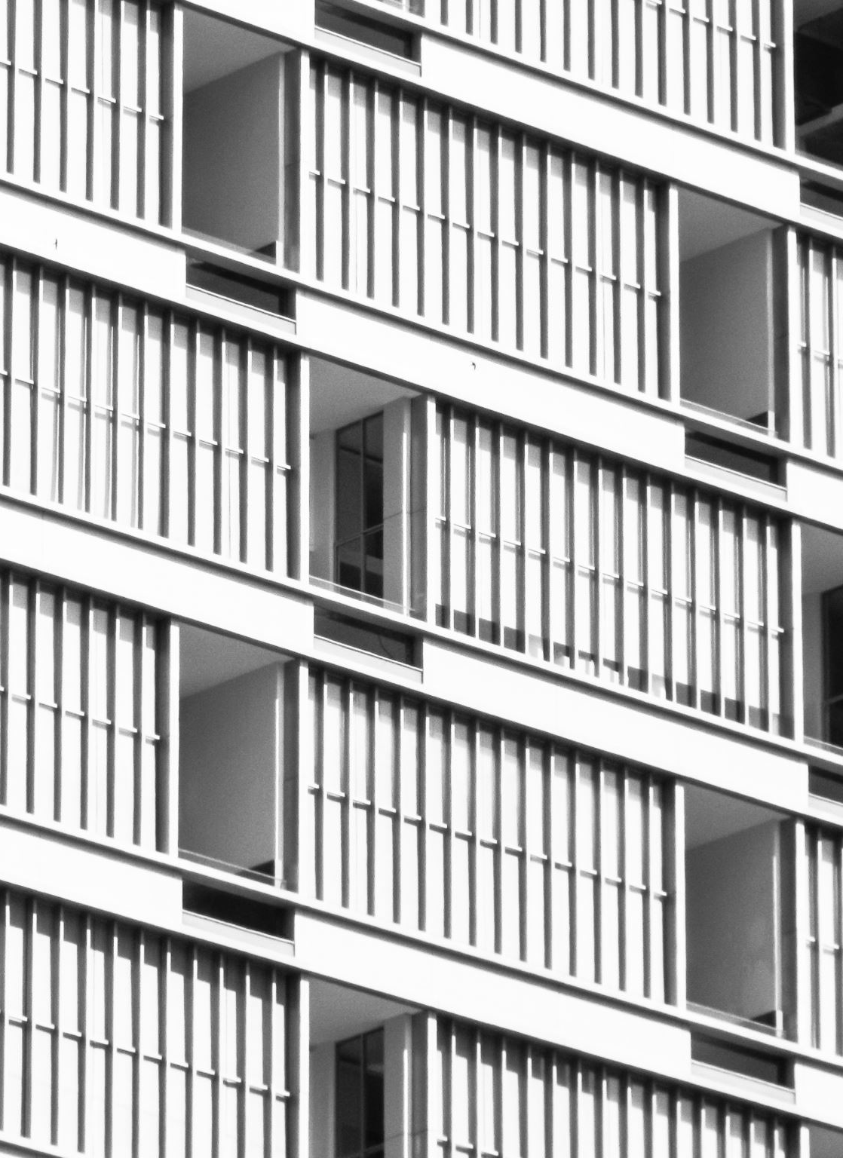
HOUSING
“Housing”, in the modern concept includes not only the ‘physical structure’ providing shelter, but also the immediate surroundings, and the related community services and facilities.
It has become part of the concept of “human settlement”, which is defined as “all places in which a group of people reside and pursue their life goals; the size of the settlement may vary from a single family to millions of people".

Slide 3
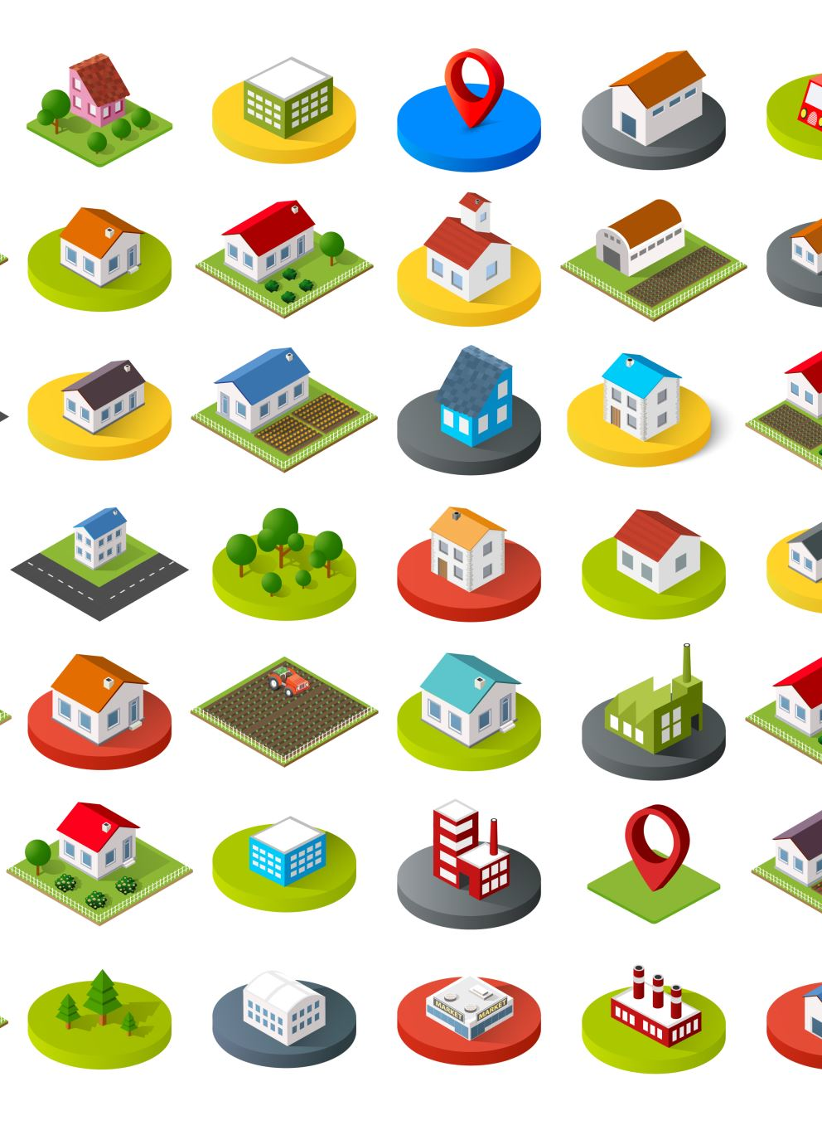
HOUSING
A WHO Expert Group (1961) on public health aspects of housing prefers to use the term “residential environment" which is defined as the physical structure that man uses and the environs of the structure including all necessary services, facilities, equipment and devices needed or desired for the physical and mental health and the social well-being of the family and the individual

Slide 4
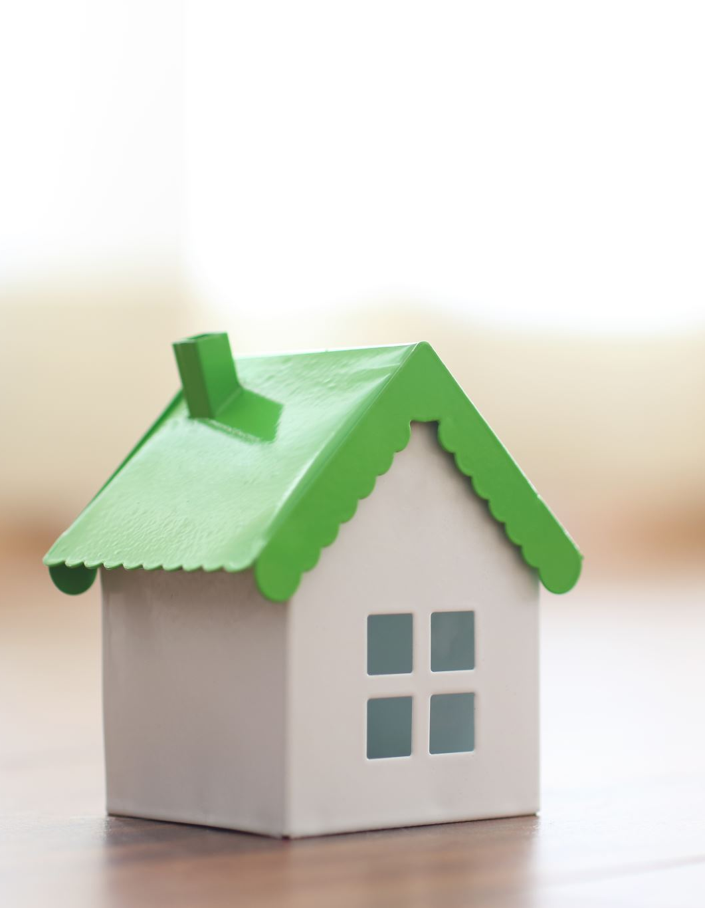
Social goals of housing
(1) Shelter : That the house should provide a sanitary shelter, which is a basic need.
(2) Family life: That the house should provide adequate space for family life and related activities, viz preparation and storage of food, meeting, sleeping, individual activities and other basic activities.
(3) Access to community facilities : A third element of housing is accessibility to community services and facilities such as health services, schools, shopping areas, places of worship etc.

Slide 5
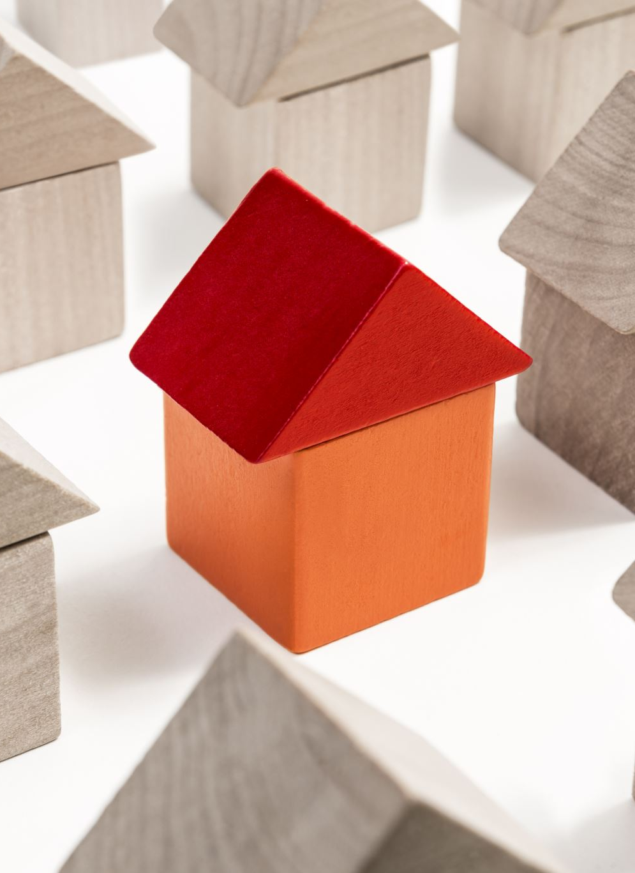
Social goals of housing
(4) Family participation in community life : Family is part of the wider community.
Community is important to family in many ways - it can offer help in times of need;
It is an important source of friends.
(5) Economic stability : Housing is a form of investment of personal savings. It provides for economic stability and well being of the family.

Slide 6
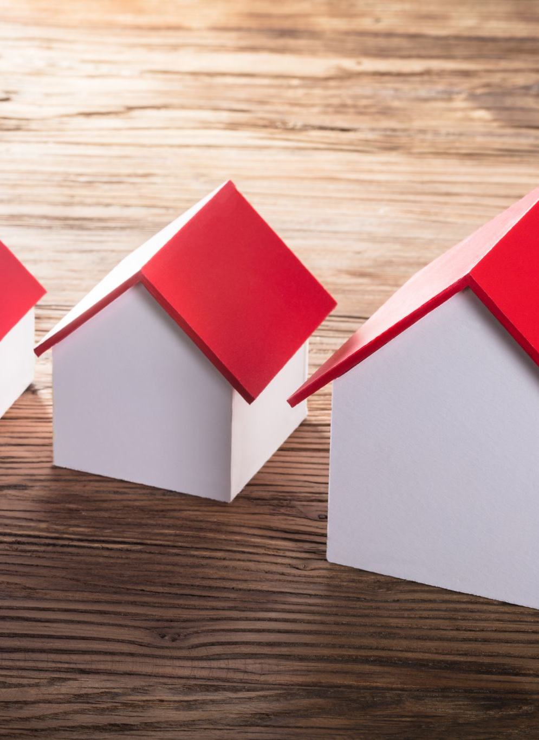
The implementation of social goals in housing requires that government should
Introduce social housing schemes;
Establish both minimum and maximum standards;
Create financial and fiscal institutions geared to helping low income people obtain credit for building or improving their houses.

Slide 7
CRITERIA FOR HEALTHFUL HOUSING
1. Healthful housing provides physical protection and shelter.
2. Provides adequately for cooking, eating, washing, and excretory functions.
3. It is designed, constructed, maintained and used in a manner such as to prevent the spread of communicable diseases.

Slide 8
CRITERIA FOR HEALTHFUL HOUSING
4. Provides for protection from hazards of exposure to noise and pollution.
5. Free from unsafe physical arrangements due to construction or maintenance, and from toxic or harmful materials.
6. Encourages personal and community development, promotes social relationships, reflects a regard for ecological principles, and by these means promotes mental health.

Slide 9
Housing standards : Site
(a) The site should be elevated from its surroundings so that it is not subject to flooding during rains
(b) The site should have an independent access to a street of adequate width
(c) It should be away from the breeding places of mosquitoes and flies
(d) It should be away from nuisances such as dust, smoke, smell, excessive noise and traffic
(e) It should be in pleasing surroundings
(f) The soil should be dry and safe for founding the structure and should be well drained.

Slide 10
“Made-soil”, i.e., ground that is levelled by dumping refuse is very unsatisfactory for building purposes for at least 20 to 25 years. The subsoil water should be below 10 feet.
SET BACK : For proper lighting and ventilation, there should be an open space all round the house - this is called “set back”.
In rural areas it is recommended that the built-up area should not exceed one-third of the total area; in urban areas where land is costly, the built-up area may be upto two-thirds.
The set back should be such that there is no obstruction to lighting and ventilation.

Slide 11

Floor
The floor should be pucca
(a) it should be impermeable so that it can be easily washed and kept clean and dry. Mud floors tend to break up and cause dust; they are not recommended
(b) the floor must be smooth and free from cracks and crevices to prevent the breeding of insects and harborage of dust.
(c) the floors should be damp-proof.
(d) the height of the plinth should be 2 to 3 feet.

Slide 12
Walls
(a) Reasonably strong
(b) Should have a low heat capacity i.e., should not absorb heat and conduct the same
(c) Weather resistant
(d) unsuitable for harborage of rats and vermin
(e) Not easily damaged
(f) Smooth.
These standards can be attained by 9-inch brick-wall plastered smooth and coloured cream or white.
ROOF : The height of the roof should not be less than 10 feet (3 m) in the absence of air-conditioning for comfort. The roof should have a low heat transmittance coefficient.

Slide 13
ROOMS : The number of living rooms should not be less than two, at least one of which can be closed for security.
The other may be open on one side if that side is a private courtyard.
The number and area of rooms should be increased according to size of family, so that the recommended floor space per person may be made available.
FLOOR AREA : The floor area of a living room should be at least 120 sq.ft. (12 sq. m.) for occupancy by more than one person and at least 100 sq.ft. (10 sq. m.) for occupancy by a single person.
The floor area available in living rooms per person should not be less than 50 sq.ft; the optimum is 100 sq.ft.

Slide 14
CUBIC SPACE : Unless means are provided for mechanical replacement of air the height of rooms should be such as to give an air space of at least 500 c.ft. per capita, preferably 1,000 c.ft.
WINDOWS : (a) Unless mechanical ventilation and artificial lighting are provided, every living room should be provided with at least 2 windows, and at least one of them should open directly on to an open space.
(b) the windows should be placed at a height of not more than 3 feet (1 m) above the ground in living rooms.
(c) window area should be l/5th of the floor area.
Doors and windows combined should have 2/5th the floor area.

Slide 15
LIGHTING : The daylight factor should exceed 1 per cent over half the floor area.
KITCHEN : Every dwelling house must have a separate kitchen.
The kitchen must be protected against dust and smoke; adequately lighted; provided with arrangements for storing food, fuel and provisions; provided with water supply; provided with a sink for washing utensils and fitted with arrangements for proper drainage.
The floor of the kitchen must be impervious.
PRIVY : A sanitary privy is a MUST in every house, belonging exclusively to it and readily accessible.
In the more developed areas of the world, the majority of dwelling units are equipped with water carriage systems.

Slide 16
GARBAGE AND REFUSE : These should be removed from the dwelling at least daily and disposed off in a sanitary manner.
BATHING AND WASHING : The house should have facilities for bathing and washing belonging exclusively to it and providing proper privacy.
WATER SUPPLY : The house should have a safe and adequate water supply available at all times.

Slide 17
Rural housing
In rural areas, the “approved” standards may be lower than in towns. The following minimum standards have been suggested :
(1) there should be at least two living rooms
(2) ample verandah space may be provided
(3) the built-up area should not exceed one-third of the total area
(4) there should be a separate kitchen with a paved sink or platform for washing utensils
(5) the house should be provided with a sanitary latrine

Slide 18
Rural housing
(6) the window area should be at least 10 per cent of the floor area
(7) there should be a sanitary well or a tube well within a quarter of a mile from the house
(8) it is insanitary to keep cattle and livestock in dwelling houses. Cattle sheds should be at least 25 feet away from dwelling houses. A cattle shed should be open on all sides; an area 8 ft.x4 ft. is sufficient for each head of cattle
(9) there should be adequate arrangement for the disposal of waste water, refuse and garbage.

Slide 19
Housing and health
Housing is part of the total environment of man and being a part, it is to some extent responsible for the status of mans health and well-being. It is difficult, however, to demonstrate the specific cause-and-effect relationships because housing embraces so many facets of environment. By deductive reasoning, a strong relationship can be established between poor housing and the following conditions :
(1) RESPIRATORY INFECTIONS : Common cold, tuberculosis, influenza, diphtheria, bronchitis, measles, whooping cough, etc.
(2) SKIN INFECTIONS : Scabies, ringworm, impetigo, leprosy.
(3) RAT INFESTATION : Plague.

Slide 20
(4) ARTHROPODS : Houseflies, mosquitoes, fleas and bugs.
(5) ACCIDENTS : A substantial proportion of house accidents are caused by some defect in the home and its environment.
(6) MORBIDITY AND MORTALITY : High morbidity and mortality rates are observed where housing conditions are sub-standard.
(7) PSYCHOSOCIAL EFFECTS : These effects must not be overlooked. The sense of isolation felt by persons living in the upper floors of high buildings is now well known to have harmful effects.
Often, also, people living in densely populated urban areas feel a similar sense of isolation which may lead to neurosis and behavior disorders.

Slide 21
Overcrowding
Overcrowding refers to the situation in which more people are living within a single dwelling than there is space for, so that movement is restricted, privacy secluded, hygiene impossible, rest and sleep difficult.
In general the risks as regards physical health are clear enough - infectious diseases spread rapidly under conditions of overcrowding.
The effects on psychosocial health are not so clear-cut, viz. irritability, frustration, lack of sleep, anxiety, violence and mental disorders. Children are said to be more affected.
In short, it is a psychosocial stress, leading to unhappiness and very probably to psychosomatic and mental disorders.

Slide 22
PERSONS PER ROOM : The degree of overcrowding can best be expressed as the number of persons per room, i.e., number of persons in the household divided by the number of rooms in the dwelling. The accepted standards are:
1 room ………. 2 persons
2 rooms ………. 3 persons
3 rooms ……….. 5 persons
4 rooms ……….. 7 persons
5 or more rooms ..... 10 persons (additional 2 for each further room)

Slide 23
(2) FLOOR SPACE : The accepted standards are :
110 sq.ft. (11 sq. m.) or more .... 2 persons
90-100 sq.ft (9-10 sq.m.) ...... 1 1/2 persons
70-90 sq.ft. (7-9 sq. m.) ……. 1 person
50-70 sq.ft. (5-7 sq.m.) ……. 2 person
Under 50 sq.ft (5 sq. m) ……. Nil
(A baby under 12 months is not counted; between 1 to 10 years counted as children half a unit).
SEX SEPARATION : Overcrowding is considered to exist if 2 persons over 9 years of age, not husband and wife, of opposite sexes are obliged to sleep in the same room.

Slide 24
Indicators of housing
In recent years the use of indicators has become widespread for the measurement of quality of life. The indicators for housing may be classified as :
(1) Physical: These are based on floor space, cubic space, room height, persons per room, rooms per dwelling, environmental quality (e.g., air, light, water, noise, sewage disposal, etc).
(2) Economic indicators : These are cost of the building, rental levels, taxes, expenditure on housing, etc.
(3) Social indicators : The following were proposed at an inter-regional seminar on the Social Aspects of Housing, organized by the UN in 1975.

Slide 25
Indicators related to prevention of illness :
(1) Frequency of illness due to inadequate sewage and garbage collection.
(2) Frequency of illness associated with contaminated water source.
(3) Frequency of insect borne diseases.
(4) Frequency of illness due to overcrowding.
(5) Frequency of illness due to accidents.
(6) Frequency of illness due to proximity to animals.
(7) Access to medical facility.

Slide 26
Indicators related to comfort:
(1) Thermal comfort
(2) Acoustic comfort
(3) Visual comfort
(4) Spatial comfort
Indicators related to mental health and social well-being
(1) Frequency of suicides in the neighborhood
(2) Neglected and abandoned youth in the neighborhood
(3) Drug abuse (including alcohol) in the neighborhood

Slide 27
Public policy
In every country where housing conditions in general are unsatisfactory the need for government intervention has been recognized.
The approach to public policy on housing in India is indicated in the Five Year Plans. In 1952, a separate Ministry of Works and Housing was created at the Centre.
The Government Housing Programmes consists of two categories - public sector housing and social housing schemes.
The former provides mainly for government employees, while the latter attempts to provide assistance particularly to low and middle income groups through various housing schemes.

Slide 28
House site and construction assistance : The scheme was included in the State Sector as a part of Minimum Needs Programme and formed the core of the rural housing programme during Seventh and subsequent Five Year Plans.
This scheme has two components - provision of free house sites and construction assistance with varying proportion of subsidy and loan in different states. Construction assistance is planned to benefit 3.5 million families directly as part of MNP.
Indira Awas Yojana (IAY) : The Indira Awas Yojana was introduced in the Central Sector in 1985-86 as part of the Rural Landless Employment Guarantee Programme. This type of houses have one room, one kitchen attached with latrine, bathroom and a smokeless chullah

Slide 29
SOLID WASTES
The term “solid wastes” includes garbage (food wastes) rubbish (paper, plastics, wood, metal, throw-away containers, glass), demolition products (bricks, masonry, pipes), sewage treatment residue (sludge and solids from the coarse screening of domestic sewage), dead animals, manure and other discarded material.
Solid waste, if allowed to accumulate, is a health hazard because:
a. it decomposes and favours fly breeding
b. it attracts rodents and vermin
c. the pathogens which may be present in the solid waste may be conveyed back to man’s food through flies and dust.
d. there is a possibility of water and soil pollution, and
e. heaps of refuse present an unsightly appearance and nuisance from bad odours.

Slide 30
Sources of refuse
(1) Refuse that is collected by the street cleansing service or scavenging is called street refuse. It consists of leaves, straw, paper, animal droppings and litter of all kinds.
(2) Refuse that is collected from markets is called market refuse. It contains a large proportion of putrid vegetable and animal matter.
(3) Refuse that is collected from stables is called stable litter. It contains mainly animal droppings and left-over animal feeds.
(4) Industrial refuse comprises a wide variety of wastes ranging from completely inert materials such as calcium carbonate to highly toxic and explosive compounds.
(5) The domestic refuse consists of ash, rubbish and garbage. Ash is the residue from fire used for cooking and heating.

Slide 31
Storage
The first consideration should be given to the proper storage of refuse, while awaiting collection. The galvanized steel dust bin with close fitting cover is a suitable receptacle for storing refuse.
The capacity of a bin will depend upon the number of users and frequency of collection. The output of refuse per capita per day in India is estimated to vary from V10 to l/~ c.ft. For a family of 5 members, a bin having a capacity of 5/10 or 1/2 c.ft. would be needed.
If collection is done once in 3 days, a bin having a capacity of ll/2 or 2 c.ft. would be adequate. A recent innovation in the western countries is the “paper sack.”
Refuse is stored in the paper sack, and the sack itself is removed with the contents for disposal and a new sack is substituted.
Public bins : Public bins cater tor a larger number of people. They are usually without cover in India because people do not like to touch them

Slide 32
Collection
The method of collection depends upon the funds available. House-to-house collection is by far the best method of collecting refuse.
Only at some places in the urban areas this kind of facility is available. In majority of places in India, there is no house-to-house collection system.
People are expected to dump the refuse in the nearest public bin, which is usually not done. Refuse is dispersed all along the street, and some is thrown out in front and around the house.
As a result, an army of sweepers is required for sweeping the streets in addition to the gang for collecting the refuse from public bins.
The refuse is then transported in refuse collection vehicles to the place of ultimate disposal.
Dead animals are directly transported to the place of disposal.

Slide 33
Methods of disposal
There is no single method of refuse disposal which is equally suitable in all circumstances.
The choice of a particular method is governed by local factors such as cost and availability of land and labour.
The principal methods of refuse disposal are
(a) Dumping
(b) Controlled tipping or sanitary land-fill
(c) Incineration
(d) Composting
(e) Manure pits
(f) Burial.

Slide 34
Dumping
Refuse is dumped in low lying areas partly as a method of reclamation of land but mainly as an easy method of disposal of dry refuse.
As a result of bacterial action, refuse decreases considerably in volume and is converted gradually into humus.
Kolkata disposes of its refuse by dumping and the reclaimed land is leased out for cultivation.
The drawbacks of open dumping are :
(1) the refuse is exposed to flies and rodents,
(2) it is a source of nuisance from the smell and unsightly appearance,
(3) the loose refuse is dispersed by the action of the wind, and
(4) drainage from dumps contributes to the pollution of surface and ground water.
A WHO Expert Committee (1967) condemned dumping as “a most insanitary method that creates public health hazards, a nuisance, and severe pollution of the environment”. Dumping should be outlawed and replaced by sound procedures

Slide 35
Thank you

