Slide 1


Light

Slide 2

Natural lighting
Natural lighting is derived partly from the visible sky and partly from reflection.
Efficient utilization of natural light calls for careful design, location and orientation of buildings and relationship between buildings (town planning).
Natural lighting also depends upon the time of the day, season, weather and atmospheric pollution.
Natural light is accompanied by radiant heat, all attempts should be made to exclude radiant heat while admitting daylight.

Slide 3
Planning for best utilization of daylight
ORIENTATION : The brightness of the sky is not constant on the east and west. Further, the direct penetration of sunlight from the east or west may heat up the rooms unduly in the tropics, especially during summer.
Buildings are therefore oriented, wherever possible, towards north or south for uniform illumination.
Particularly important in respect of schools, factories and laboratories where uniform lighting is required in all the rooms.
When a building faces east and west, window shades are provided to protect against the direct penetration of sunlight.
REMOVAL OF OBSTRUCTIONS : Removal of obstructive items either wholly or partially.

Slide 4
Planning for best utilization of daylight
WINDOWS : Natural lighting within any room is influenced by the amount of visible sky, the size, shape and arrangement of the window openings.
A tall window gives greater penetration of light: a broad window gives greater diffusion of light.
The rule that window area should not be less than 10 per cent of the floor area is now outdated.
The usefulness of the windows is reduced by covering them unnecessarily with curtains and screens.
INTERIOR OF THE ROOMS : In order to obtain the full benefit of the natural illumination, the ceiling should be white; the upper portions of the walls light-tinted; and lower portions somewhat darker so as to give comfortable contrast to the eyes.

Slide 5
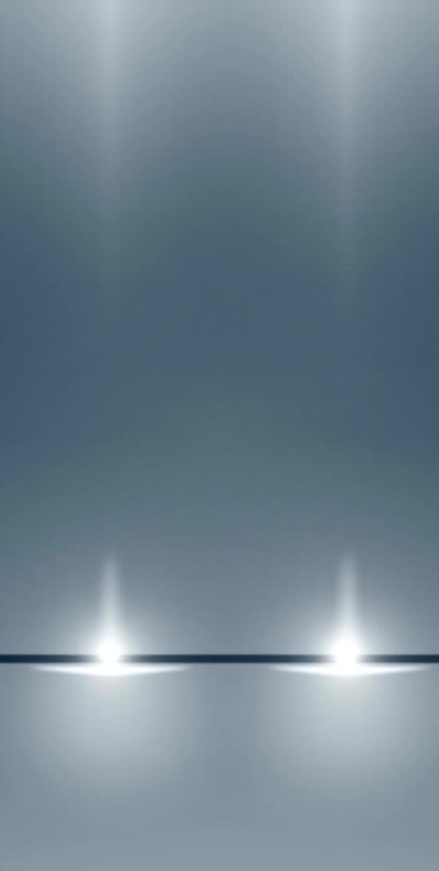
Measurement of daylight
Intensity of daylight illumination is liable to change from moment to moment, it is not measured in terms of foot candles.
Reliance is placed on a factor called the DAYLIGHT FACTOR (D.F.). It is the ratio of illumination at a given point to illumination at a point exposed simultaneously to the whole hemisphere of the sky (taken as 500 foot candles) excluding direct sunlight.
D.F = Instantaneous illumination INDOORS*100/Simultaneously occurring illumination OUTDOORS
The daylight factor in a building may be rapidly determined by a modified photo-electric meter known as a Daylight Factor Meter.
It is recommended that in living rooms, the daylight factor should be at least 8 percent and in kitchens about 10 per cent

Slide 6
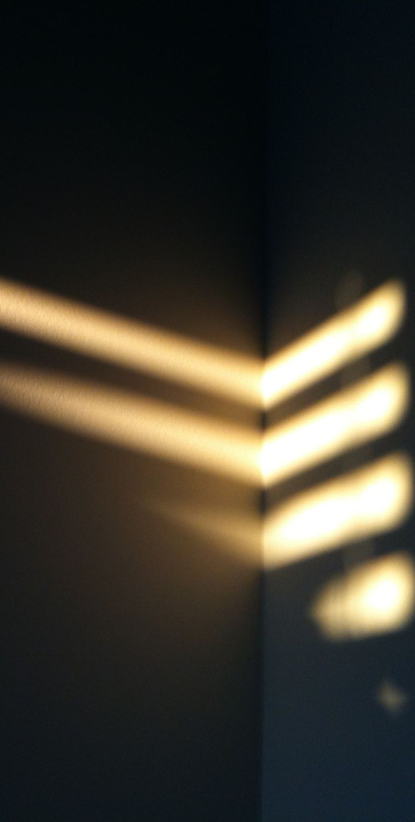
Artificial lighting
Artificial lighting should be as close as possible to daylight in composition.
DIRECT LIGHTING - In direct lighting, 99 to 100 per cent of the light is projected directly towards the working area. Direct lighting is efficient economical but tends to cast sharp shadows. It should not fall into the eyes.
SEMI-DIRECT : 10 to 40 per cent of the light is projected upwards so that it is reflected back on the object by the ceiling.
INDIRECT : light does not strike a surface directly, because 90 to 100 per cent of the light is projected towards the ceiling and walls. This gives a general illumination of the whole room but not of any object.
SEMI-INDIRECT : 60 to 90 per cent of the light is directed upwards, and the rest downwards.
DIRECT-INDIRECT : light is distributed equally.

Slide 7
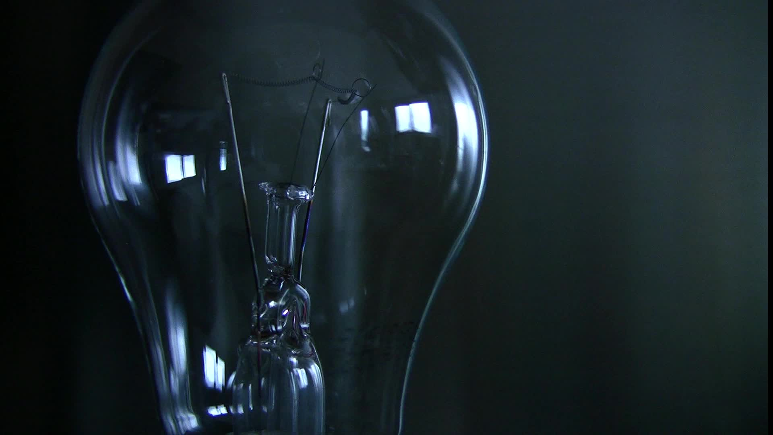
Methods of artificial illumination
FILAMENT LAMPS : These are widely used. The electric current heats up the tungsten filament and the light emitted depends upon the temperature.
The hotter filaments produce the bluer light.
Accumulation of dust on the bulbs reduces illumination by 30 to 40 per cent. The bulbs and shades therefore should be cleaned frequently.
FLUORESCENT LAMPS : Fluorescent lamps are economical in the use of electric current; they are cool and efficient; the light emitted simulates natural light.
The lamps consist of a glass tube filled with mercury vapour and an electrode fitted at each end.
The inside of the tube is coated with fluorescent chemicals, which absorb practically all the ultraviolet radiation and remit the radiation in the visible range.

Slide 8
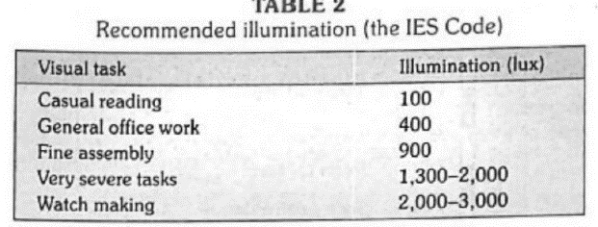
Lighting standards
The eye responds to a range of illumination ranging from 0-1 lux (full moonlight night) to 100,000 lux (bright sunshine).
The visual efficiency increases with the increase of illumination, but the curve flattens out at higher levels.
A useful rule of thumb is that the illumination level should be 30 times higher than the level at which the task can just be done.

Slide 9

Biological effect of light
The observation that daylight could cause the in vitro degradation of bilirubin is now being used as a therapeutic measure in premature infants with hyperbilirubinaemia.
Biologic rhythms of body temperature and physical activity
The stimulation of melanin synthesis,
The activation of precursors of vitamin D
Adrenocortical secretion and food consumption.

Slide 10
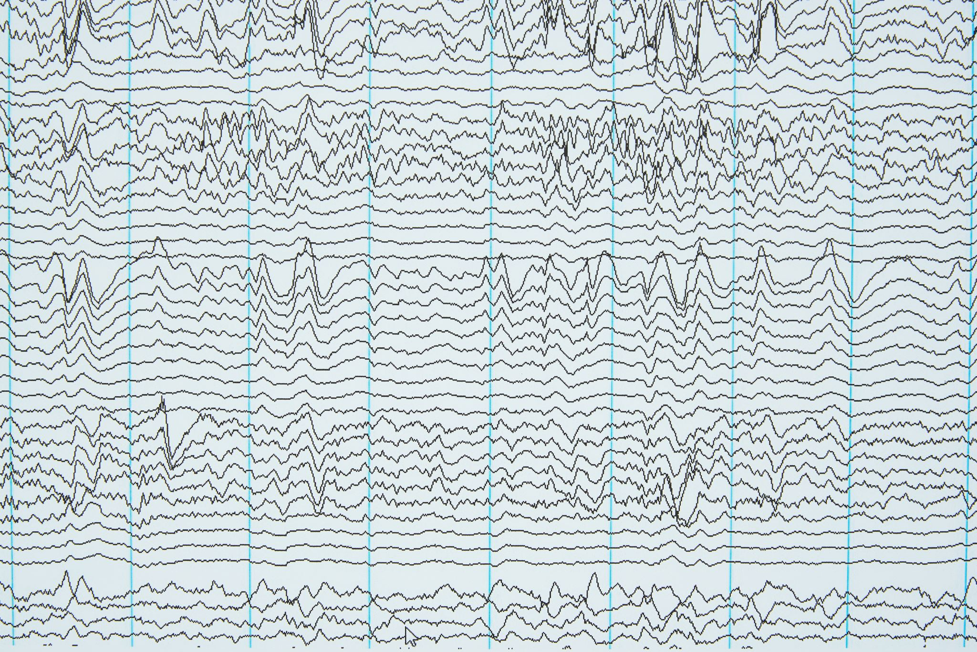
Noise

Slide 11
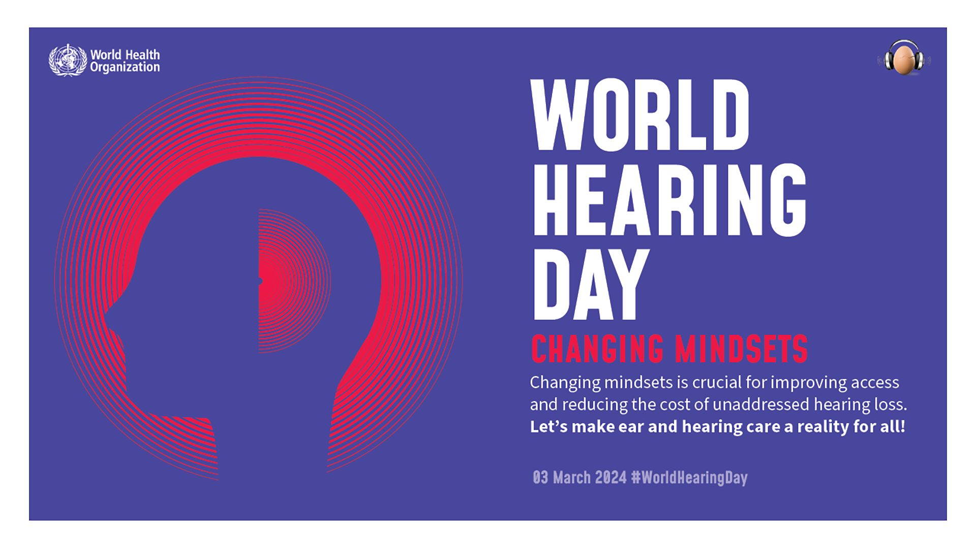

Slide 12

Noise
Noise is often defined as “unwanted sound”, but this definition is subjective because one man’s sound may be another man’s noise.
A better definition of noise is : “wrong sound, in the wrong place, at the wrong time”.
Man is living in an increasingly noisy environment. The 20th Century has been described as the “Century of Noise”.
The term “Noise Pollution” has been recently coined to signify the vast cacophony of sounds that are being produced in the modern life, leading to health hazards.
Sources : These are automobiles, factories, industries, air-crafts etc.
Noise levels are particularly acute near railway junctions, traffic round-abouts, bus terminuses and airports.
Use of pressure horns, recreational noise of loudspeakers with full volume during festivities particularly at night are other sources of noise production.
The domestic noises from the radios, transistors, T.V sets - all add to the quantum of noise in daily life.

Slide 13
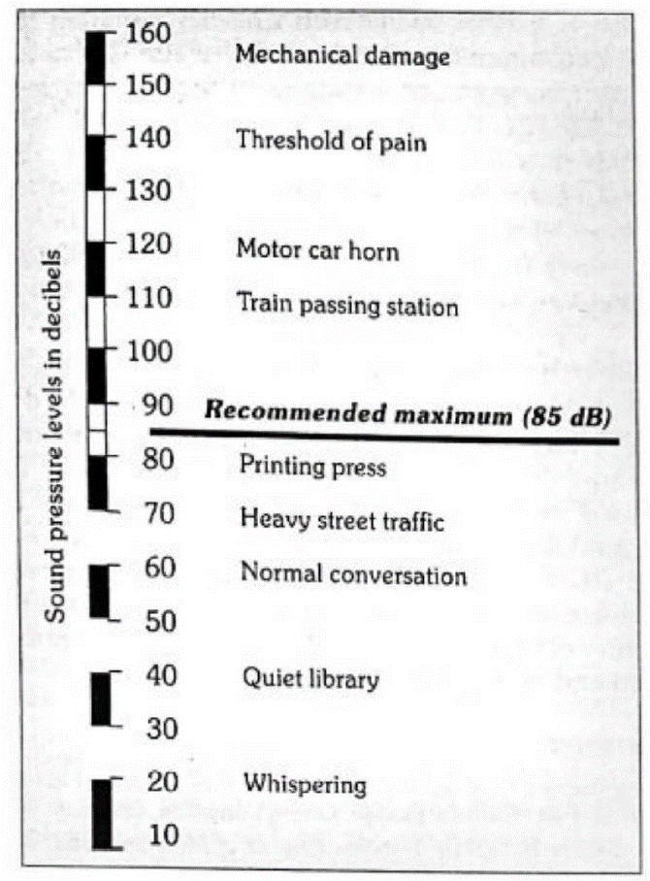
Properties - loudness
Loudness or intensity depends upon the amplitude of the vibrations which initiated the noise.
The loudness of noise is measured in decibels (dB).
When we say that sound is 60 dB, it means that it is 60 dB more intense than the smallest distinguishable noise or the “reference” sound pressure, which is understood to be 0.0002 microbar or dynes/cm2. A dyne is 1/1000,000th of atmospheric pressure.
Normal conversation produces a noise of 60-65 dB; whispering, 20-30 dB; heavy street traffic, 60-80 dB; and boiler factories, about 120 dB.
A daily exposure upto 85 dB is about the limit people can tolerate without substantial damage to their hearing.

Slide 14
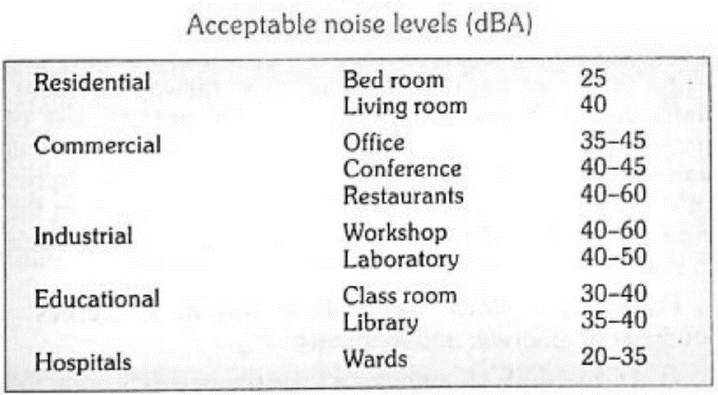
Properties - loudness
Human ear responds in a non-uniform way to different sound-pressure levels, that is, it responds not to the real loudness of a sound, but to the perceived intensity.
A weighting curve, called curve A has been constructed which takes into account the subjective effects of that sound.
Sound-pressure levels are therefore expressed in dB (A), that is in decibels conforming to the weighting curve A, because this reflects the perception of that sound emission by the normal human ear.

Slide 15
Properties - frequency
The frequency is denoted as Hertz (Hz.) One Hz is equal to one wave per second.
The human ear can hear frequencies from about 20 to 20,000 Hz, but this range is reduced with age and other subjective factors.
The range of vibrations below 20 Hz are infra-audible; and those above 20.000 Hz ultra-sonic.
Sometimes noise is expressed in psycho-acoustic terms – the phon. The phon is a psyho-acouslic index of loudness. It takes into consideration intensity and frequency.

Slide 16
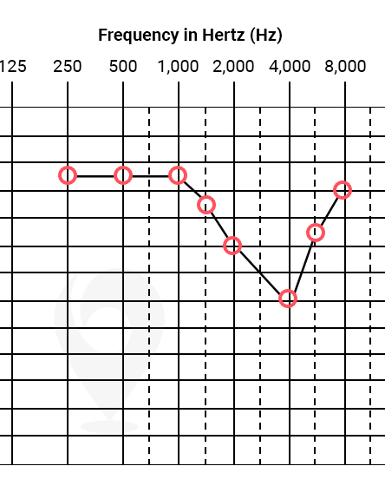
Instrument used for noise studies
The “Sound Level Meter” which measures the intensity of sound in dB or dB (A).
The “Octave Band Frequency Analyzer” which measures the noise in octave bands. The resulting plot shows the “sound spectrum and indicates the characteristics of the noise, whether it is mainly high pitched, low-pitched or of variable pitch,
The “Audiometer” which measures the hearing ability.
The zero line at the top in the audiogram represents normal hearing.
Noise-induced hearing loss shows a characteristic dip in the curve at the 4000 Hz frequency.

Slide 17
Noise exposure – auditory effect
Auditory fatigue : It appears in the 90 dB region and greatest at 4000 Hz.
It may be associated with side effects such as whistling and buzzing in the ears,
Deafness : The most serious pathological effect is deafness or hearing loss. The victim is generally unaware of it in early stages.
Temporary hearing loss results from a specific exposure to noise; the disability disappears after a period of time up to 24 hours following the noise exposure.
Most temporary hearing loss occurs in frequency range between 4,000 to 6,000 Hz.
Repeated or continuous exposure to noise around 100 decibels may result in a permanent hearing loss; in this, the inner ear damage may vary from minor changes in the hair cell endings to complete destruction of the organs of Corti.
When this occurs because of occupation in industries, it is called ‘occupational hearing loss’.
Exposure to noise above 160 dB may rupture the tympanic membrane and cause permanent loss of hearing.

Slide 18
Noise exposure – Non auditory effects
Interference with speech : Noise interferes with speech communication.
In everyday life, the frequencies causing most disturbance to speech communication lie in the 300-500 Hz range. Such frequencies are commonly present in noise produced by road and air traffic.
For good speech intelligibility, it is considered that the speech sound level must exceed the SIL (Speech Interference Level) by approximately 12 dB.
Annoyance : This is primarily a psychological response.
Neurotic people are more sensitive to noise than balanced people.
Workmen exposed to higher intensity of noise in occupational capacities, were often irritated, short temped and impatient and more likely to resort to agitation and disrupt production.
Efficiency : Where men a concentration is to be undertaken, a low level of noise is always desired.
Reduction in noise has been found to increase work output.

Slide 19
Noise exposure – Non auditory effects
Several temporary physiological changes occur in the human body as a direct result of noise exposure.
Rise in blood pressure,
Rise in intracranial pressure,
An increase in heart rate and breathing
An increase in sweating.
General symptoms such as giddiness, nausea and fatigue may also occur.
Noise interferes with sleep.
Noise is also said to cause visual disturbance. It is said to cause a narrowing of pupil, affect colour perception and reduce night vision.
Besides affecting health, noise is also a significant factor in economic losses. The potential cost of noise induced hearing loss to industry is quite great.

Slide 20
Control of noise
CAREFUL PLANNING OF CITIES :
Division of the city into zones with separation of areas concerned with industry and transport;
The separation of residential areas from the main streets by means of wide green belts. House fronts should lie not less than 15 metres from the road and the intervening space should be thickly planted with trees and bushes.
Widening of main streets to reduce the level of noise penetration into dwellings.
CONTROL OF VEHICLES :
Heavy vehicles should not be routed into narrow streets. Vehicular traffic on residential streets should be reduced. Indiscriminate blowing of the horn and use of pressure horn should be prohibited.
TO IMPROVE ACOUSTIC INSULATION OF BUILDING :
From the acoustic standpoint, the best arrangement is construction of detached buildings rather than a single large building or one that is continuous.
Installations that produce noise or disturb the occupants within dwellings should be prohibited.
Buildings should be sound-proof where necessary.

Slide 21
Control of noise
INDUSTRIES AND RAILWAYS :
Control of noise at source is possible in industries.
Special areas must be earmarked, outside residential areas, for industries, for railways, marshalling yards and similar installations.
When these demands cannot be met, protective green belts must be laid down between the installations and residential areas.
PROTECTION OF EXPOSED PERSONS : Hearing protection is recommended for all workers who are consistently exposed to noise louder than 85 decibels in the frequency bands above 150 Hz.
Workers must be regularly rotated from noisy areas to comparatively quiet posts in factories.
Periodical audiogram check-ups and use of ear plugs, ear muffs are also essential as the situation demands.
LEGISLATION: Many states have adopted legislation providing for controls which are applicable to a wide variety of sources.
Workers have the right to claim compensation if they have suffered a loss of ability to understand speech.
EDUCATION : No noise abatement programme can succeed without people’s participation. Therefore, their education through all available media is needed to

Slide 22


Slide 23

Radiation

Slide 24

Radiation
Radiation is the emission of energy as electromagnetic waves or as moving subatomic particles.
Types: Ionizing and Non-ionizing radiation.
Ionizing Radiation:
Ability to penetrate tissues and deposit its energy within them.
EM radiations - X-rays, gamma rays
Corpuscular radiations - Alpha particles, beta particles.
Effects: Can remove tightly bound electrons from atoms, creating ions.

Slide 25
Non-ionizing Radiation:
Several forms of electromagnetic radiation of wavelengths longer than those of ionizing radiation.
All non-ionizing forms of radiation have less energy than cosmic, gamma, and X-radiation have.
In order of increasing wavelength, non-ionizing radiation includes
Ultraviolet (UV) radiation, visible light, infrared radiation, microwave radiation and radio frequency radiation. Effects: Generally less harmful, can cause heating effects.

Slide 26
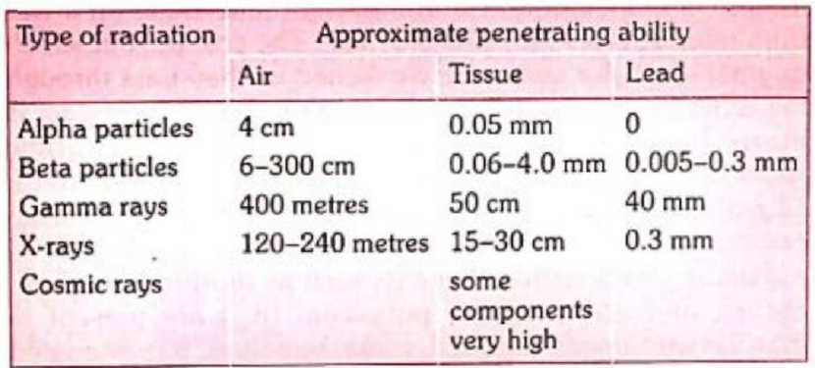
Alpha particles are 10 times as harmful as X-rays, beta particles or gamma rays.
Alpha particles, luckily, have little penetrating force. On the other hand, they are quite dangerous if radioactive substance has entered the body (by inhalation or through a wound).
Gamma rays and X-rays have short wave lengths; they are deep penetrating radiations.
X-rays are manmade, while gamma rays are emitted spontaneously by radioactive elements during their disintegration. Otherwise there is no material difference between gamma rays and X-rays.
Cosmic rays also contain ionizing radiations.

Slide 27
Sources - Natural
Cosmic rays : The cosmic rays which originate in outer space are weakened as they pass through the atmosphere.
At ordinary living altitudes, their impact is about 35 mrad a year. At altitudes above 20 km cosmic radiation becomes important. It has been calculated that a commercial jet pilot receives about 300 mrad per year from cosmic radiation.
Environmental :
Terrestrial radiation : Radioactive elements such as thorium, uranium, radium and an isotope of potassium (K40) are present in man’s environment, e.g., soil, rocks, buildings.
It is estimated that man derives about 50 mrad per year from terrestrial radiation.
Areas exist (e.g., Kerala in India) where there are rock formations containing uranium, it can be as high as 2,000 mrad a year.
Atmospheric radiation : The external radiation dose from the radioactive gases radon and thoron in the atmosphere is rather small : about 2 mrad per year.

Slide 28
Sources - Natural
Internal radiation : Man is also subjected to internal radiation, i.e., from radioactive matter stored in the body tissues.
These radioactive materials include minute quantities of uranium, thorium, and related substances, and isotopes of potassium (K40, strontium (Sr90), and carbon (C14).
Internal radiation is thought to inflict about 25 mrad a year on the body as a whole but may be as high as 70 or 80.
All in all, it is estimated that the total natural radiation to which the average person is subjected comes to approximately 0.1 rad a year.

Slide 29
Sources – Man Made
X-rays : The greatest man-made source of radiation exposure to the general population at the present time is medical and dental X-rays.
Two distinct groups are involved : (i) patients and (ii) radiologists and medical technicians.
When optimum radiographic techniques are employed, the skin dose to the patient from a single X-ray film varies roughly from 0.02 to 3.0 rad.
Radioactive fallout: Nuclear explosions release a tremendous amount of energy in the form of heat, light, ionizing radiation and many radioactive substances, the important being the isotopes of carbon (C14), iodine (l131), cesium (Cs137) and strontium (Sr90).
Csl37 and Sr90 are considered most important because they are liberated in large amounts and remain radioactive for many years. The “half-life” of Sr is about 28 years and that of Cs137 is 30 years.
These radioactive particles released into the atmosphere float down to earth for some years afterwards. Because of air currents, the particles are distributed evenly over the whole human race. Measurements made in 1963 in Germany (F.R.), a country where there had been no explosions, showed that a dose of 33 mrems per person was received from this source.
Miscellaneous : Some everyday appliances (e.g., TV sets, luminous wrist watches) are radioactive. But radiation from these sources at present is too small to be important.

Slide 30
Radiation units
The activity of a radioactive material is the number of nuclear disintegration per unit of time.
The unit of activity is a becquerel (Bq); 1 Bq is equal to 1 disintegration per second.
Formerly, the unit of activity was curie (Ci) and 1 Bq corresponds approximately to 27 picocuries.

Slide 31
Potency of radiation
Roentgen: Roentgen is the unit of exposure. It is the amount of radiation absorbed in air at a given point, i.e. number of ions produced in 1 ml of air.
Coulomb per kilogram (C/Kg) replacing the roentgen. 1 roentgen is equal to 2.58 x 10"4 C kg”1.
Rad is the unit of absorbed dose. It is the amount of radioactive energy absorbed per gram of tissue or any material, 1mrad = 0.001 Rad.
Gray (Gy) replacing the rad. Dose of ionizing radiation that impart 1 joule of energy to 1 kg of absorbing material. 1 rad is equal to 0.01 Gy.
Rem is the product of the absorbed dose and the modifying factors. The rem indicates the degree of potential danger to health.
Sievert (Sv) replacing the rem. It is the SI unit of dose equivalent. The dose equivalent of 1 sievert is equal to 100 rems.
The radiation to which the average citizen is exposed is made up almost of the fast moving, highly penetrating X-rays and gamma rays, where rem and rad are equal.

Slide 32
Dose equivalent
Dose equivalent (H) : As all types of radiation do not produce the same biological effect per unit of energy absorbed, the concept of dose equivalent has been introduced.
The dose equivalent, M (Sieverts) is equal to the absorbed dose, D (grays), multiplied by a quality factor Q which depends upon the density of ionization produced in the tissue by the radiation.
H = DQ
The factor Q for X-rays and Y-rays and electrons is equal to 1, whereas for a particle it is 20

Slide 33
Biological effects
Exposure to high doses of radiation over a short period of time producing acute or short term effects.
Exposure to low doses of radiation over an extended period of time producing chronic or long-term effect.
The effects of ionizing radiation can be somatic or genetic as shown below :
SOMATIC
Immediate
Radiation sickness
Acute radiation syndrome
Delayed:
Leukaemia
Carcinogenesis
Foetal developmental abnormalities
Shortening of life
GENETIC
Chromosome mutations
Point mutations

Slide 34
Biological response
< 5 rad : No immediate observable effects
~ 5 rad to 50 rad : Slight blood changes may be detected by medical evaluations
~ 50 rad to 150 rad : Slight blood changes will be noted and symptoms of nausea, fatigue, vomiting etc. likely.
~ 150 rad to 1,100 rad : Severe blood changes will be noted and symptoms appear immediately. Approximately 2 weeks later, some of those exposed may die.
At about 300-500 rad, upto one half of the people exposed will die within 60 days without intensive medical attention. Death is due to destruction of the blood forming organs. Without white blood cells, infection is likely.
At the lower end of the dose range, isolation, antibiotics, and transfusions may provide the bone marrow time to generate new blood cells and full recovery is possible.
At the upper end of the dose range, a borne marrow transplant may be required to produce new blood cells.

Slide 35
Biological response
~ 1,100 rad to 2,000 rad : The probability of death increases to 100% within one to two weeks. The initial symptoms appear immediately.
A few days later, things get very bad, very quickly since the gastrointestinal system is destroyed.
Once the GI system ceases to function, nothing can be done, and medical care is for comfort only.
>2,000 rad : Death is a certainity. At doses above 5,000 rad, the central nervous system (brain and muscles) can no longer control the body functions, including breathing and blood circulation.

Slide 36
Genetic effects
Somatic effects are recognizable within the life span of the irradiated person,
Genetic effects would be manifest in the more or less remote offspring.
Genetic effects result from injury to chromosomes. Chromosome mutations and point mutations.
Chromosome mutation is associated with sterility. Point mutation affects the genes.

Slide 37
Radiation protection
The amount of radiation received from outer space and background radiation has been estimated to be 0.1 rad a year. Apparently, this does not at present constitute a hazard. The additional permissible dose from man-made sources should not exceed 5 rad a year.
Of the man-made sources, the X-rays constitute the greatest hazard. In routine fluoroscopy, a dose of 4 rad is delivered to a part of the body in about one minute.
It also implies adequate control and surveillance of X-ray installations, protection of workers, improvement in techniques and improvements leading to dose reduction.
Effective protective measures include proper use of lead shields and lead rubber aprons. Lead aprons (0.5 mm of lead) will reduce the intensity of scattered X-rays over 90 per cent and should be worn by all workers regularly associated with X-ray procedures.
Workers must wear a film badge or dosimeter which shows accumulated exposure to radiation since last time the instrument was charged. Besides, periodic medical examinations, regular working hours, recreation, and holidays must be ensured to workers to maintain their state of health.

Slide 38
Radiation protection
Radiation protection is the youngest branch of hygiene, and is called radiation-hygiene.
The International Commission on Radiological Protection (ICRP), the International Atomic Energy Agency (IAEA) and the World Health Organization (WHO) have been active in this field. The ICRP’s recommendations on radiation dose levels for occupational workers and for the general population have been adopted by many countries.
It has been recommended that the genetic dose to the whole population from all sources additional to the natural background radiation, should not exceed 5 rems over a period of 30 years.
The WHO has published permissible radiation levels in drinking water.
The IAEA has sponsored many symposia on radioactive waste disposal and associated subjects.
Its main concern has been to promote peaceful uses of atomic energy and to assure that these uses do not imperil peace or health.

Slide 39

Thank you

